Slide 1
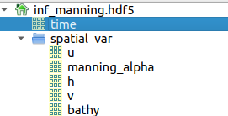
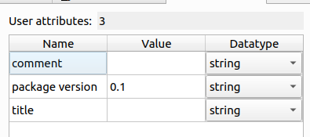
HDF5 structure
hdf5_file["time"]
hdf5_file["spatial_var/u"]
hdf5_file["spatial_var/v"]
hdf5_file["spatial_var/h"]
hdf5_file["spatial_var/manning_alpha"]
hdf5_file["spatial_var/bathy"]
hdf5_file.attrs['title']

Slide 2

Source HDF5

Slide 3
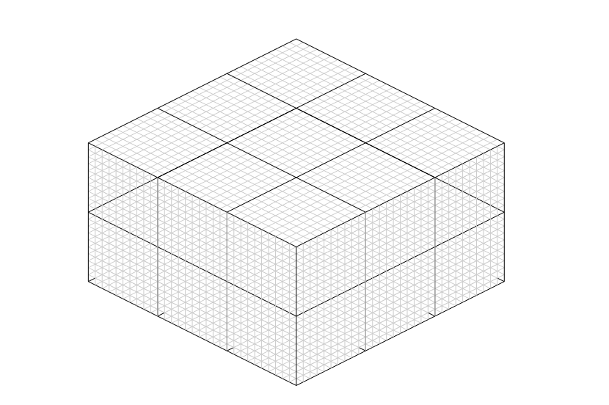
Access spatial variables
hdf5_file["spatial_var"][nb_cell, nb_timestep][ :,:]
time_index
Id of the timestep where the
Results have be written
["spatial_var"]["h"][ : , time_index]
Cell index
Cell index correspondance
["spatial_var/h"][ cell_index, : ]

Slide 4
Examples
All initiall values :
  manning_true = hdf5_file["spatial_var/manning_alpha"][:,0]
Values at first timestep
  manning_true = hdf5_file["spatial_var/manning_alpha"][:,1]
Values at nth timestep
  manning_true = hdf5_file["spatial_var/manning_alpha"][:,n]
n must be less than the number of writting time steps
  n <= nb_timestep = len( hdf5_file["time"]-1)

