Slide 1

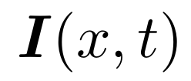

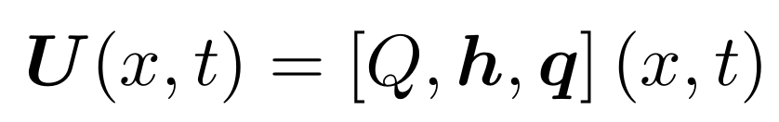
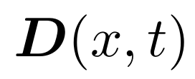
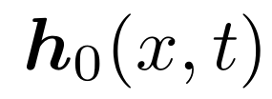
Input data
Atmospheric forcings
Physical descriptors
Hydrological Model
Parameters
Initial states
Simulated states and fluxes

Slide 2
Graphe simple learnable mapping
Input data
Atmospheric forcings
Physical descriptors
Hydrological Model
Parameters
Initial states
Simulated states and fluxes

Slide 3
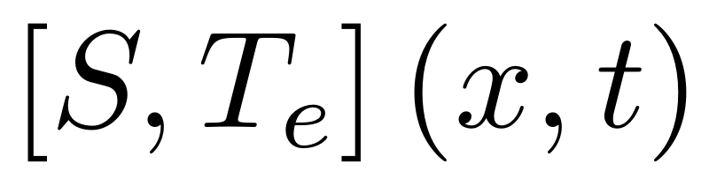
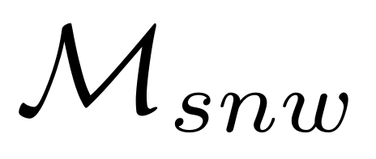
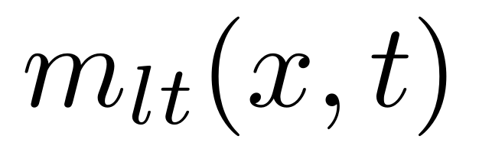
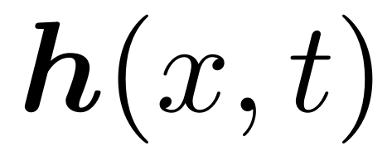
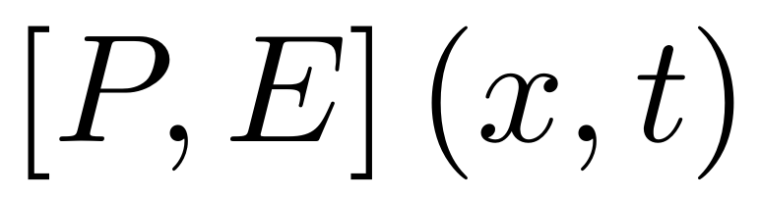
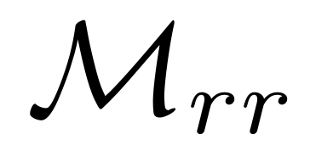
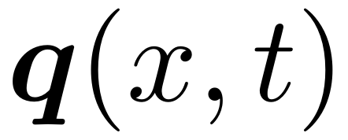
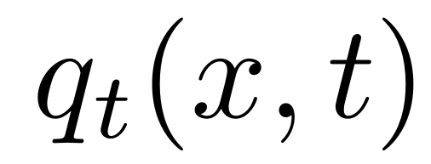
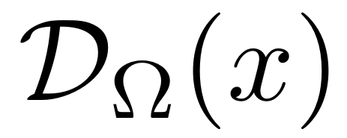
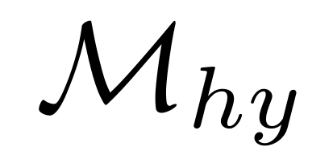
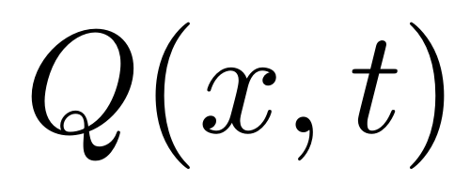
Input data
Hydrological Model
Snow, Temperature
Snow operator
Melt flux
Rain, Evapotranspiration
Hydrological operator
Moisture states
Internal fluxes
Elemental Runoff
Drainage Plan
Routing operator
Discharge

Slide 4
Input data
Atmospheric forcings
Physical descriptors
Hydrological Model
Parameters
Initial states
Simulated states and fluxes
State-fluxes observations
Descriptors-to-parameters mapping

Slide 5
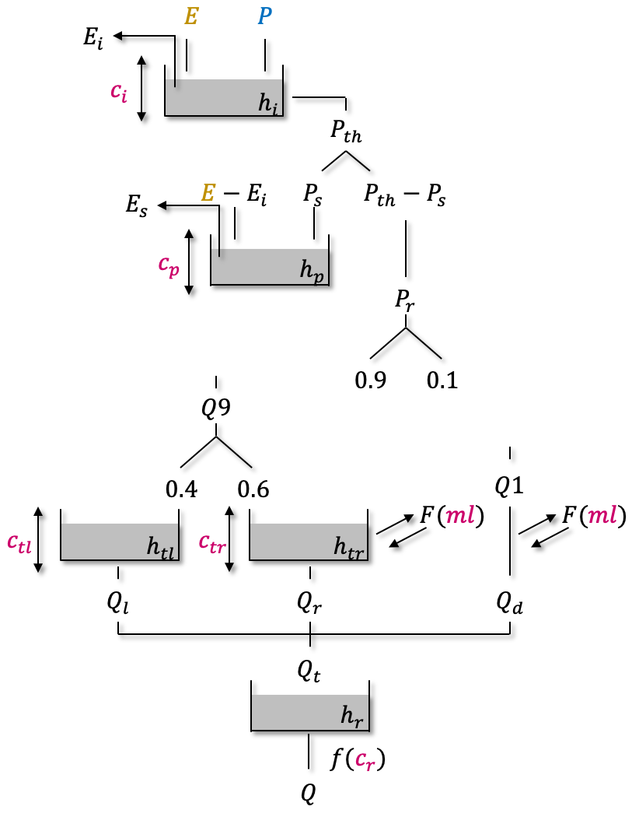
@FC, Ressortir schemas source, faire schemas de chaque model struct...
…

