Slide 1
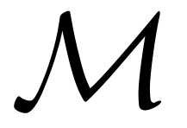
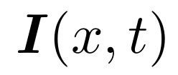

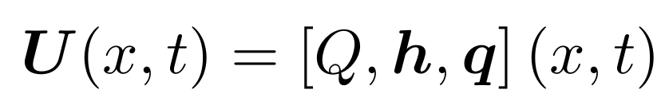
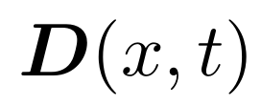
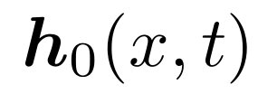
Flowchart graph: Forward problem statement
Input data
Atmospheric forcings
Physical descriptors
Hydrological Model
Parameters
Initial states
Simulated states and fluxes

Slide 2
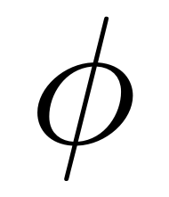
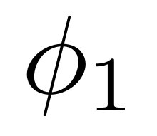
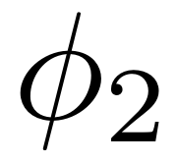
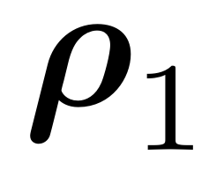
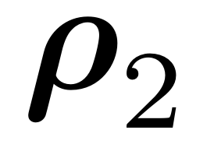
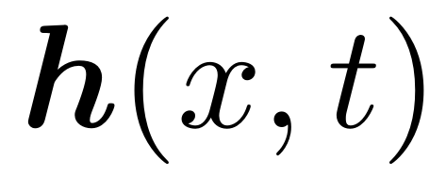
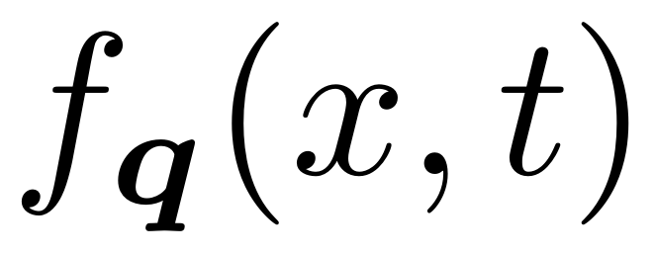
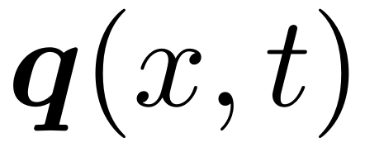
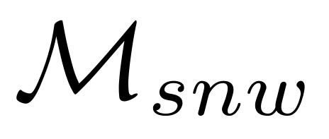
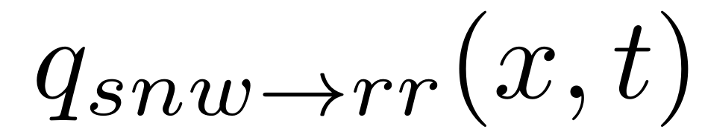
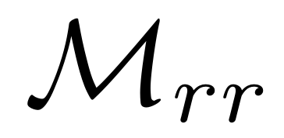
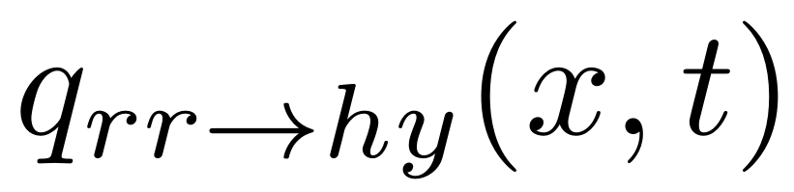
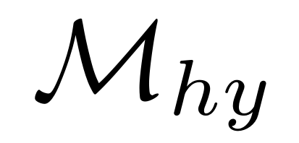
Flowchart graph: operators composition
Forward Model
Learnable Mapping
Descriptor-to-parameters operator
Parameters
Process correction operator
Parameters
Input data
Atmospheric forcings
Physical descriptors
Hydrological Model
Simulated Quantities
Moisture states
Internal fluxes
Input parameters
Conceptual parameters
Initial states
Corrections
Internal fluxes corrections
Snow operator
Hydrological operator
Routing operator
Melt flux
Runoff flux

Slide 3
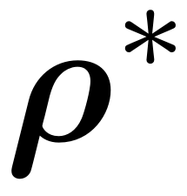


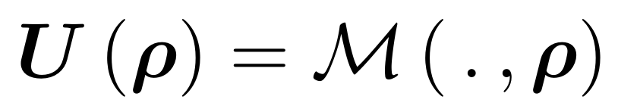
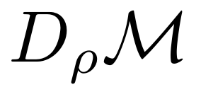
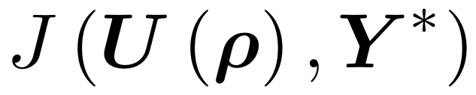
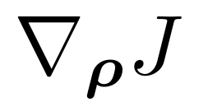
First guess
Control variables
Optimal values of control variables
Simulator
Forward Model
Simulated states and fluxes
If converged
Optimization algorithm
Adjoint Model
Cost function
and its gradients

Slide 4
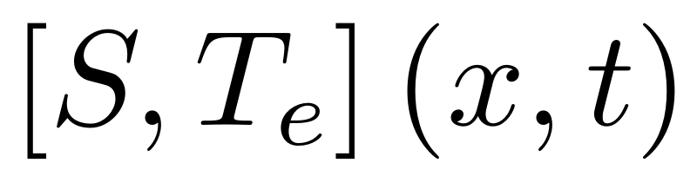
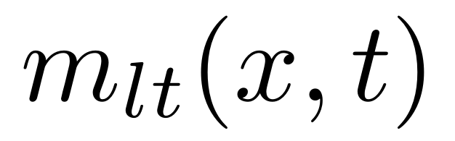
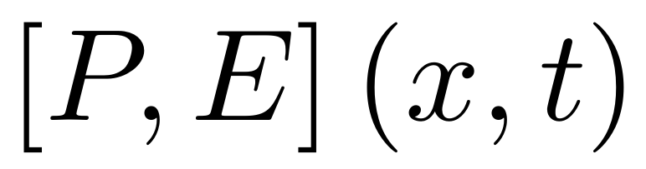
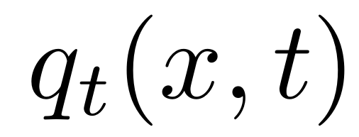
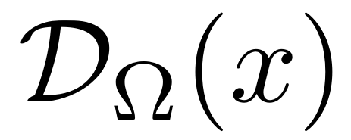
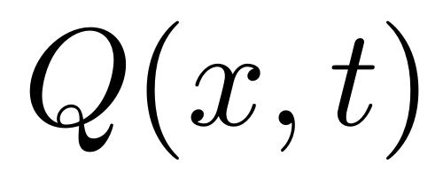
Flowchart graph: Forward model operators detail
Input data
Forward Model
Snow, Temperature
Snow operator
Melt flux
Rain, Evapotranspiration
Hydrological operator
Moisture states
Internal fluxes
Runoff flux
Drainage Plan
Routing operator
Discharge

Slide 5

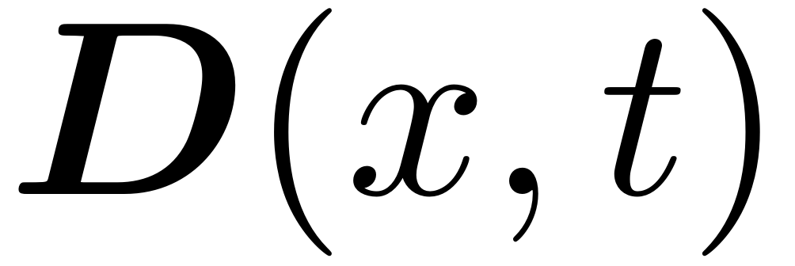

GMD smash V1.0
Input data
Forward Model
Physical Descriptors
Regionalization operator
Tunable parameter
Conceptual parameters
Initial states
Snow, Temperature
Snow operator
Melt flux
Rain, Evapotranspiration
Hydrological operator
Moisture states
Internal fluxes
Runoff flux
Drainage Plan
Routing operator
Discharge

Slide 6
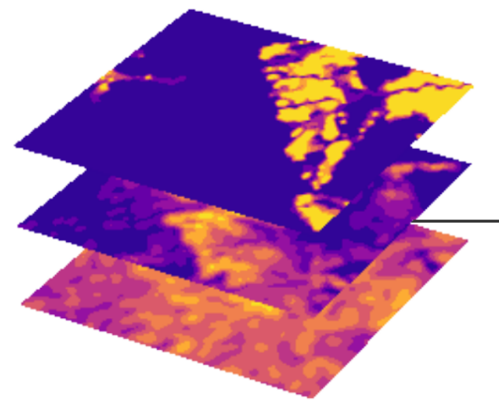
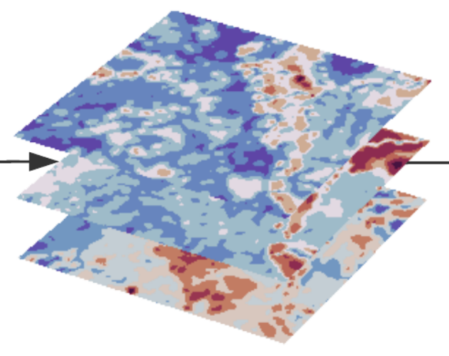
Forward Model
Regionalization operator
Tunable parameter
Nouveau flowchart regio style Truyen – incluant obs data… NN schematisé et nuage point regression multivarié R3
Conceptual parameters
Initial states
Snow operator
Melt flux
Hydrological operator
Moisture states
Internal fluxes
Runoff flux
Routing operator
Discharge

Slide 7
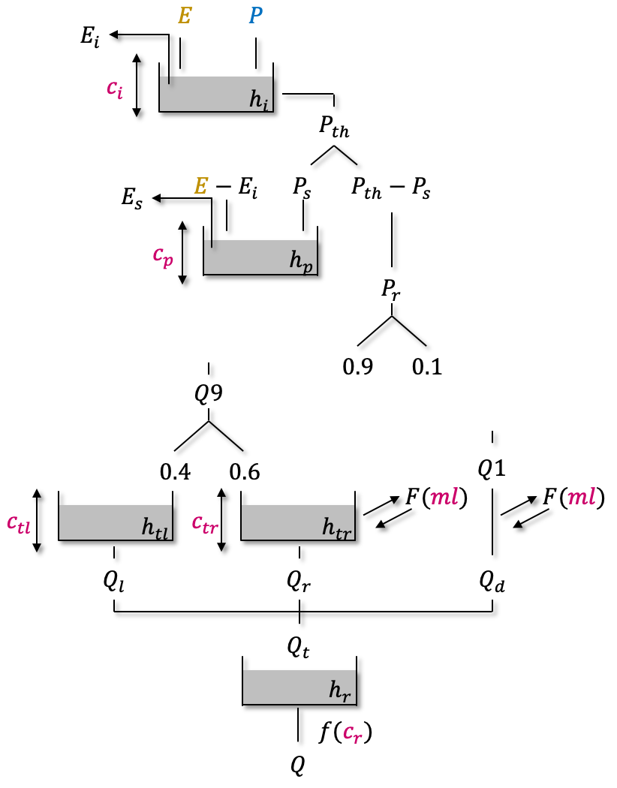
TODO : @FC, Ressortir schemas source, faire schemas de chaque model struct...
…
$$\sum_{k_{up=1}}^{N_{up}}{Q\left(k_{up}\right)}$$
Notes:
<number>

Slide 8
$$E$$
$$P$$
$$E$$
$$P$$
$$e_{i}$$
$$e_{i}$$
$$c_{i}$$
$$h_{i}$$
$$c_{i}$$
$$h_{i}$$
$$e_{n}=E-e_{i}$$
$$p_{n}$$
$$e_{n}=E-e_{i}$$
$$p_{n}$$
$$e_{s}$$
$$p_{s}$$
$$p_{n }$$- $$p_{s }$$
$$e_{s}$$
$$p_{s}$$
$$p_{n }$$- $$p_{s }$$
$$c_{p}$$
$$h_{p}$$
$$c_{p}$$
$$h_{p}$$
$$p_{erc }$$
$$p_{erc }$$
$$p_{r}+p_{erc }$$
$$0.9$$
$$0.1$$
$$0.9$$
$$0.1$$
$$l\left(k_{exc}\right)$$
$$l\left(k_{exc}\right)$$
$$l\left(k_{exc}\right)$$
$$l\left(k_{exc}\right)$$
$$c_{t}$$
$$h_{t}$$
$$c_{t}$$
$$h_{t}$$
$$q_{ft}$$
$$q_{d}$$
$$q_{ft}$$
$$q_{d}$$
$$q_{t}$$
$$q_{t}$$

