Slide 1
Telecom_Churn_Assignment
Saurav Kumar
Anish P
Drishant Dey

Slide 2
Introduction
To reduce customer churn, telecom companies need to predict which customers are at high risk of churn.
In this project, we will analyze customer-level data of a leading telecom firm, build predictive models to identify customers at high risk of churn and identify the main indicators of churn.

Slide 3
Steps:-
Reading, understanding and visualizing the data.
Preparing the data for modelling.
Building the model.
Evaluate the model.

Slide 4
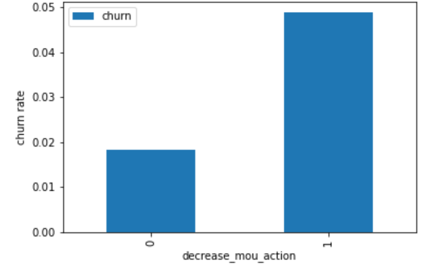
Churn rate on the basis whether the customer decreased her/his MOU in action month.
We can see that the churn rate is more for the customers, whose minutes of usage(mou) decreased in the action phase than the good phase.

Slide 5
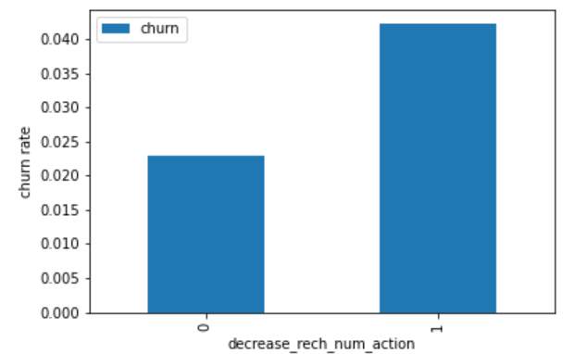
Churn rate on the basis whether the customer decreased her/his number of recharge in action month.
As expected, the churn rate is more for the customers, whose number of recharge in the action phase is lesser than the number in good phase.

Slide 6
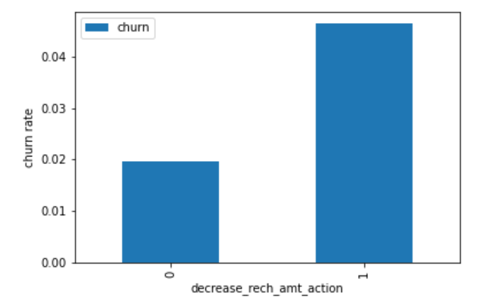
Churn rate on the basis whether the customer decreased her/his amount of recharge in action month.
Here also we see the same behavior. The churn rate is more for the customers, whose amount of recharge in the action phase is lesser than the amount in good phase.

Slide 7
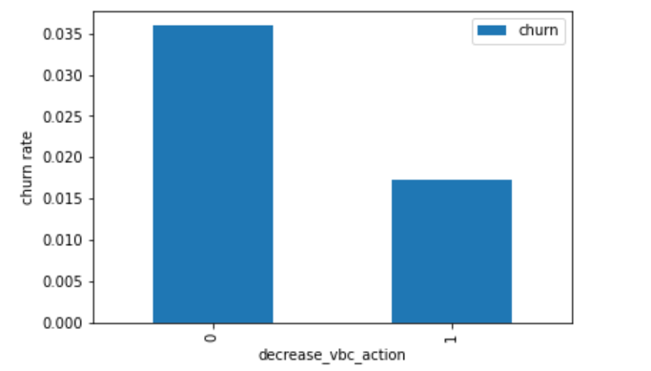
Churn rate on the basis whether the customer decreased her/his volume based cost in action month.
Here we see the expected result. The churn rate is more for the customers, whose volume based cost in action month is increased. That means the customers do not do the monthly recharge more when they are in the action phase.

Slide 8
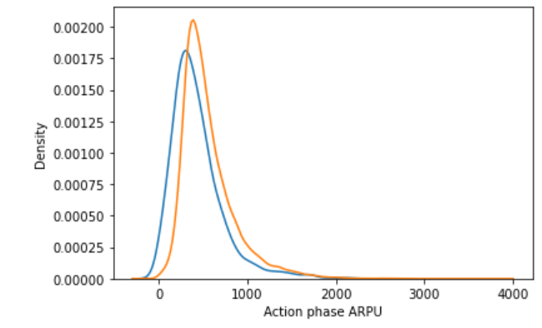
Analysis of the average revenue per customer (churn and not churn) in the action phase.
Average revenue per user (ARPU) for the churned customers is mostly densed on the 0 to 900. The higher ARPU customers are less likely to be churned.
ARPU for the not churned customers is mostly densed on the 0 to 1000.

Slide 9
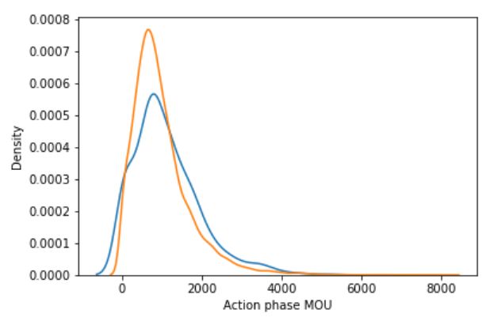
Analysis of the minutes of usage MOU (churn and not churn) in the action phase.
Minutes of usage(MOU) of the churn customers is mostly populated on the 0 to 2500 range. Higher the MOU, lesser the churn probability.

Slide 10
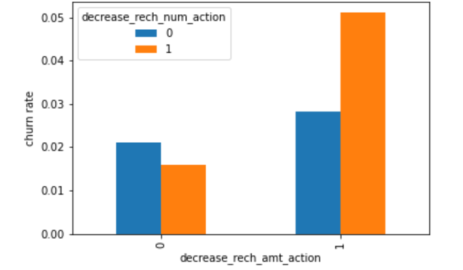
Analysis of churn rate by the decreasing recharge amount and number of recharge in the action phase
We can see from the above plot, that the churn rate is more for the customers, whose recharge amount as well as number of recharge have decreased in the action phase than the good phase.

Slide 11
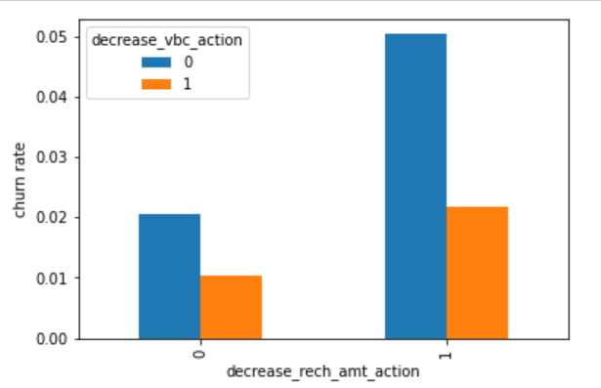
Analysis of churn rate by the decreasing recharge amount and volume based cost in the action phase.
Here, also we can see that the churn rate is more for the customers, whose recharge amount is decreased along with the volume based cost is increased in the action month.

Slide 12
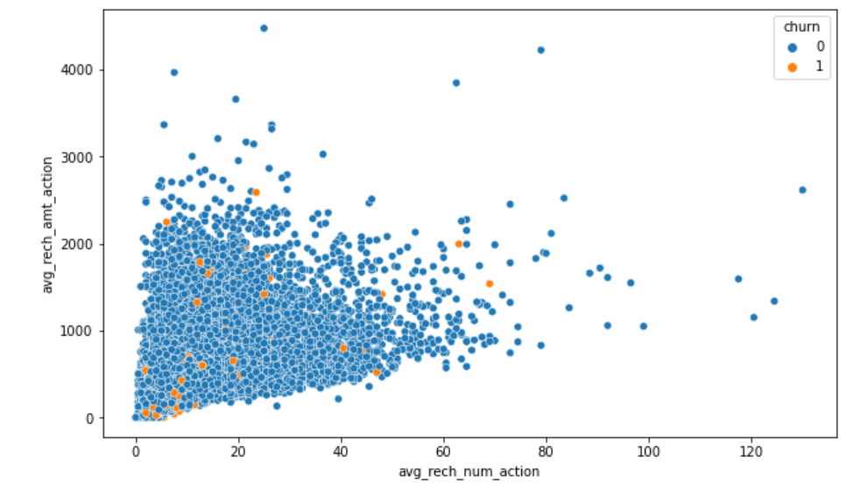
Analysis of recharge amount and number of recharge in action month.
We can see from the above pattern that the recharge number and the recharge amount are mostly propotional. More the number of recharge, more the amount of the recharge.

Slide 13
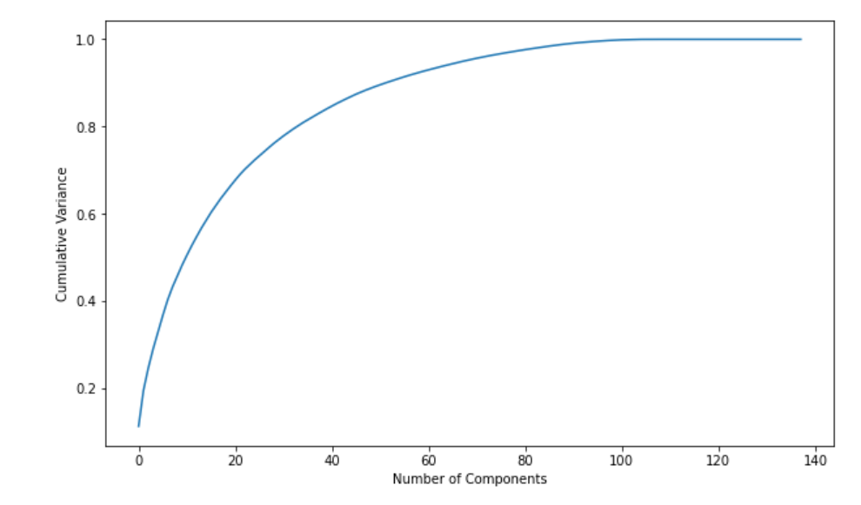
We can see that 60 components explain almost more than 90% variance of the data. So, we will perform PCA with 60 components

Slide 14
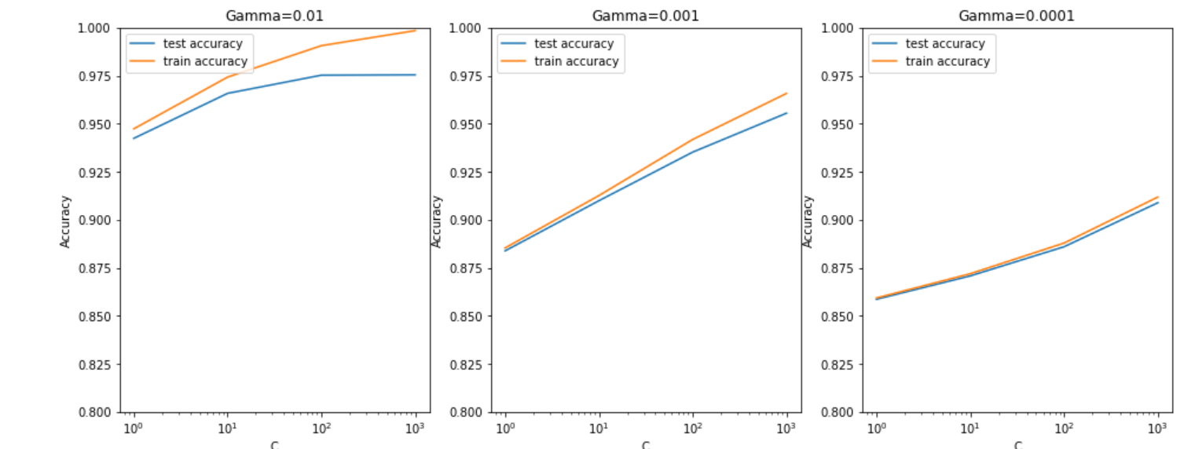
Plotting the accuracy with various C and gamma values
From the above plot, we can see that higher value of gamma leads to overfitting the model. With the lowest value of gamma (0.0001) we have train and test accuracy almost same.
Also, at C=100 we have a good accuracy and the train and test scores are comparable.

