Slide 1
Supply Chain management
- By Ankit Arnav

Slide 2
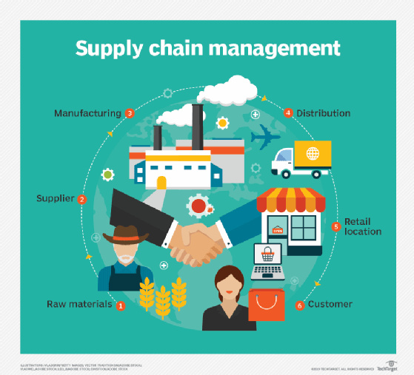
Problem statement:
An FMCG company entered into the instant noodles business two years back. Their higher management has noticed that there is a miss match in the demand and supply. Where the demand is high, supply is pretty low and where the demand is low, supply is pretty high. In both ways, it is an inventory cost loss to the company; hence, the higher management wants to optimize the supply quantity in every warehouse in the entire country.

Slide 3
Data Structure:
S_no | Field's Name | Description
1 | Warehouse_id | Product warehouse_id
2 | WH_Manager_ID | Employee ID of warehouse manager
3 | Location_type | Location of warehouse-like in city or village
4 | WH_capacity_size | Storage capacity size of the warehouse
5 | Zone | Zone of the warehouse
6 | WH_regional_zone | Regional zone of the warehouse under each zone
7 | num_refill_req_l3m | Number of times refilling has been done in last 3 months
8 | transport_issue_l1y | Any transport issue like accident or goods stolen reported in last one

Slide 4
S_no | Field’s Name | Description
9 | Competitor_in_mkt | Number of instant noodles competitors in the market
10 | retail_shop_num | Number of the retail shop that sell the product under the warehouse area
11 | wh_owner_type | Company is owning the warehouse or they have got the warehouse on rent
12 | distributor_num | The number of distributer works in between warehouse and retail shops.
13 | flood_impacted | Warehouse is in the Flood impacted area indicator.
14 | Flood_proof | Warehouse is a flood-proof indicator. Like storage is at some height not flood_proof
15 | electric_supply | Warehouse have electric back up like generator, so they can run the warehouse in load shedding
16 | dist_from_hub | Distance between warehouse to the production hub in Kms

Slide 5
S_no | Field's Name | Description
17 | workers_num | Number of workers working in the warehouse
18 | wh_est_year | Warehouse established year
19 | storage_issue_reported_l3m | Warehouse reported storage issue to corporate office in last 3 months. Like rat, fungus because of moisture etc.
20 | temp_reg_mach | Warehouse have temperature regulating machine indicator
21 | approved_wh_govt_certificate | What kind of standard certificate has been issued to the warehouse from government regulatory body
22 | wh_breakdown_l3m | Number of time warehouse face a breakdown in last 3 months. Like strike from worker, flood, or electrical failure
23 | govt_check_l3m | Number of time government Officers have been visited the warehouse to check the quality and expire of stored food in last 3 months
24 | product_wg_ton(Target_column) | Product has been shipped in last 3 months. Weight is in tons

Slide 6
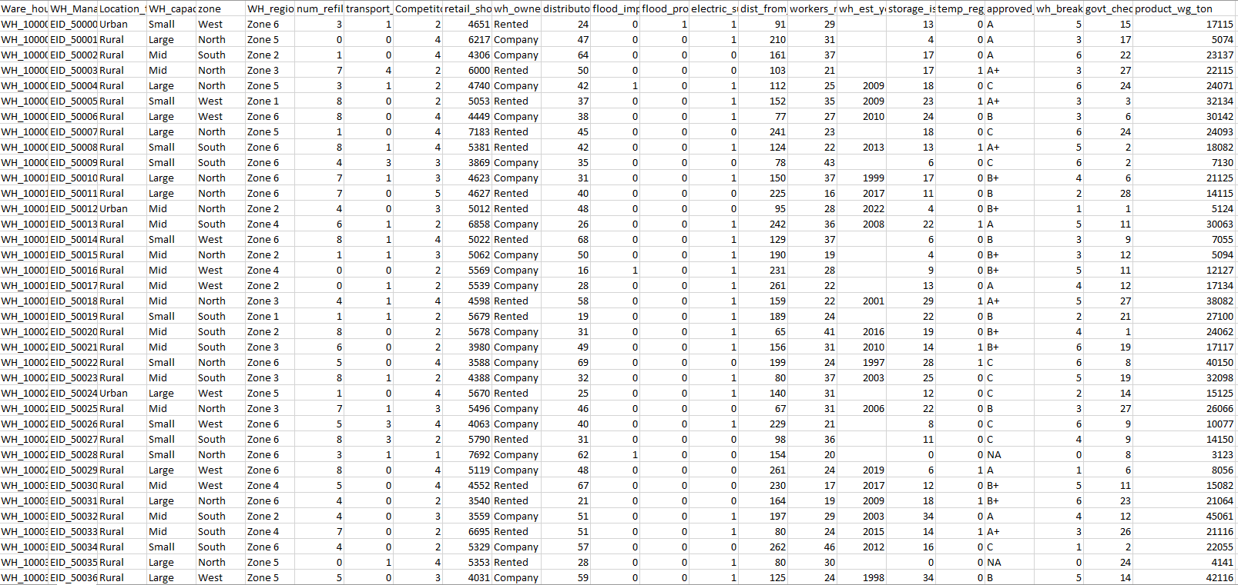
Task:
Regression
Dataset Shape:
25000 entries , 24 columns
Points about Dataset:
3 variables have NAs
Mix of numerical and categorical data
Outlier on some variables but treatment not required
ML technique used:
Random Forest

Slide 7
Data Preprocessing:
Checking for null values.
Removing duplicates.
Checking the skewness and significance of the variables.
Splitting the dataset into features and target variables.
Outlier Treatment if necessary
Checking whether dataset is imbalanced or not.
Feature Scaling the dataset using standardization as there are outliers.
Using One Hot encoder and dummy variables to get numeric data from labelled data.
Splitting the data into train set and test set.

Slide 8
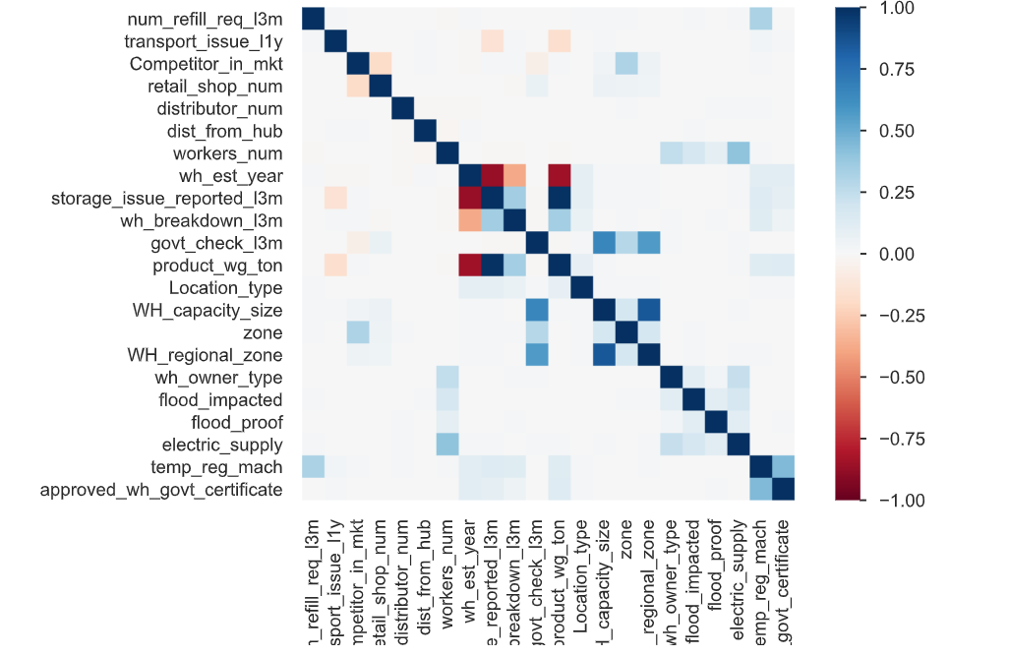
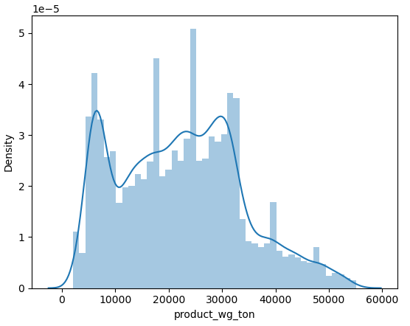
Exploratory Data Analysis
EDA.html The given link will give a keen visualization of the dataset whether the variables are correlated , imbalances, Multi collinearity , outliers , missing values and also QQ plots against all independent and dependent variables.

Slide 9
Model Building:
Since the problem statement is a regression problem we used Random Forest as the data was not linear due to some of the categorical variables.
We observed that Random forest gave the tremendous result in terms of r2 score with 99% training accuracy and 98% testing accuracy.
We also tried to prune the forest with significant variables . Although it reduces the accuracy (83% training and testing accuracy both) both it gave the forest more robustness

Slide 10
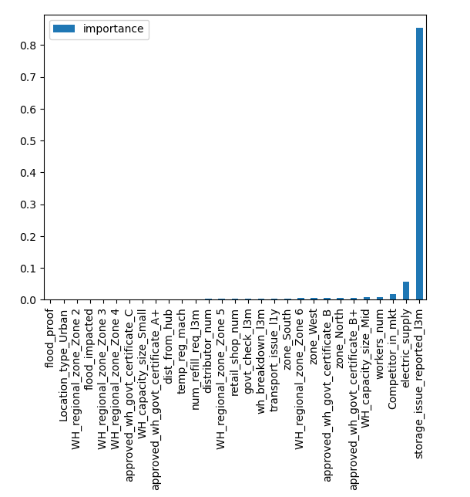
Summary:
Now our model can find the optimum weight with acuuracy of 98%. Also it came into account that more optimum weight is found on the basis of history of storage issues
We can say that more clean or well maintained storage facilities gave greater returns as there was no spoil of products

Slide 11
QnA
Thank You

