Slide 1


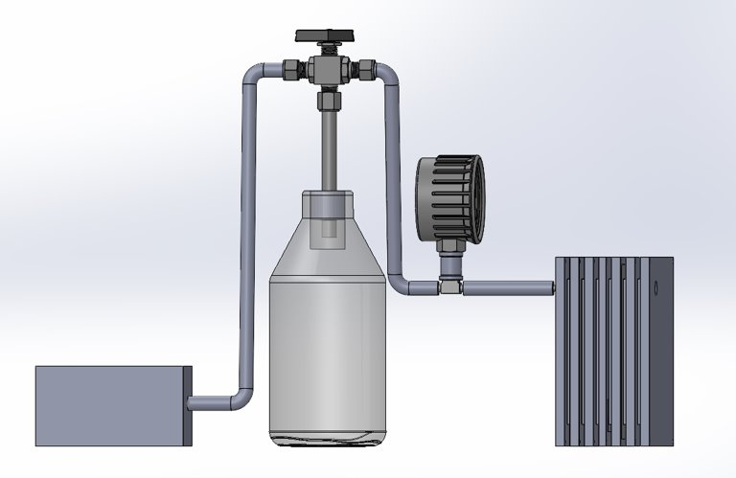
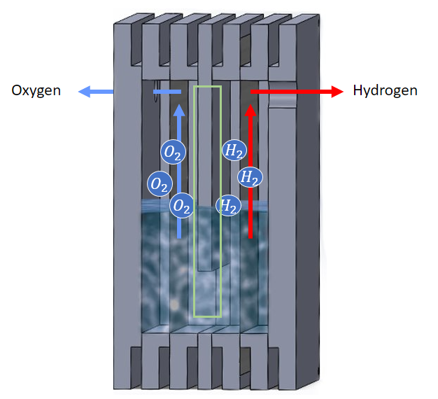
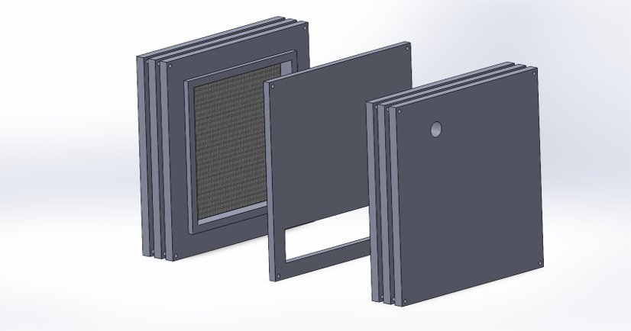
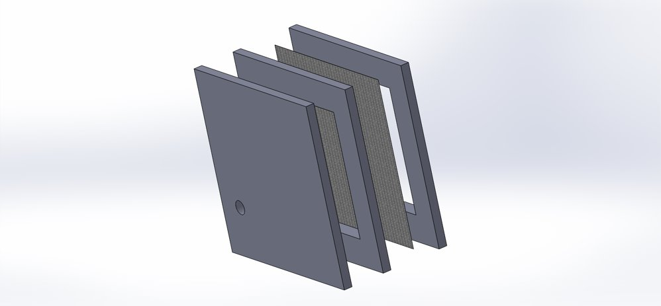

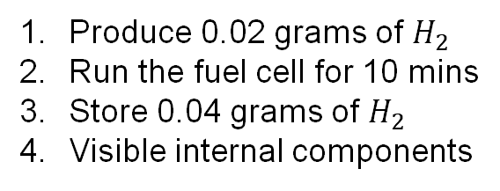
Embry-Riddle Hydrogen
Objective
Generate and store hydrogen gas to run Embry-Riddle’s fuel cell as an educational demonstrator.
T-Valve
Alkaline Electrolysis
Internal View
Pressure Gauge
Key Requirements
v
Produce 0.02 grams of $H_{2}$
Run the fuel cell for 10 mins
Store 0.04 grams of $H_{2}$
Visible internal components
Fuel Cell
Divider
Team
Material Storage
Lithium-Doped Graphitic Carbon Nitride holds 10wt% hydrogen gas and releases hydrogen gas at 300°C [1]. The material will be heated via electrical resistance in a Nichrome wire.
References
A. Murali, M. Sakar, S. Priya, R. J. Bensingh, and M. A. Kader, “Graphitic-Carbon Nitride for Hydrogen Storage,” in Nanoscale Graphitic Carbon Nitride, Elsevier, 2022, pp. 487–514. doi: 10.1016/B978-0-12-823034-3.00017-0.
Nickel Mesh
Plexiglass

