Slide 1

Dale Stubbs – 14024149
Supervisor: Dr Anthony Kleerekoper
Project (6G6Z1001_1617_9Z6)

Slide 2
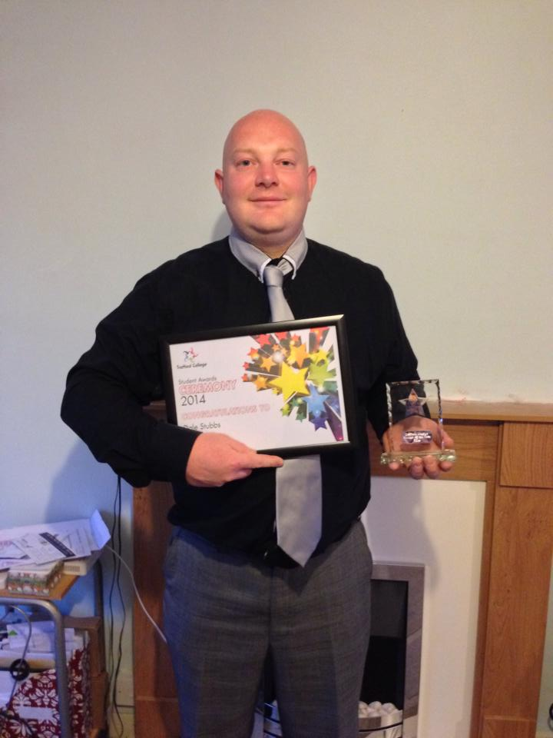

Introduction
The Author: Dale Stubbs
Course: BSc(hons) Computer Forensics & Security
Background: Student of the Year – Trafford College 2014
Warehouse Operative from 2001 – 2013
2012 – Decision made to change career into Computing

Slide 3
Project Outline
The aim of this project is to create a new type of password manager that has no single point of failure.
Passwords are generated from a sentence chosen by the user.
Requires the user to only remember this passwords as opposed to lots of individual passwords.
Address the balance between Usability and Password Security.
Mobile Phone Application or Browser Extension.

Slide 4
Literature
Password Managers
Single point of failure – Master Password
Users not happy with no control over password creation
Password Replacement Methodologies
Biometrics – Fingerprints can be copied
Retinal scanners can be ‘dazzling’

Slide 5
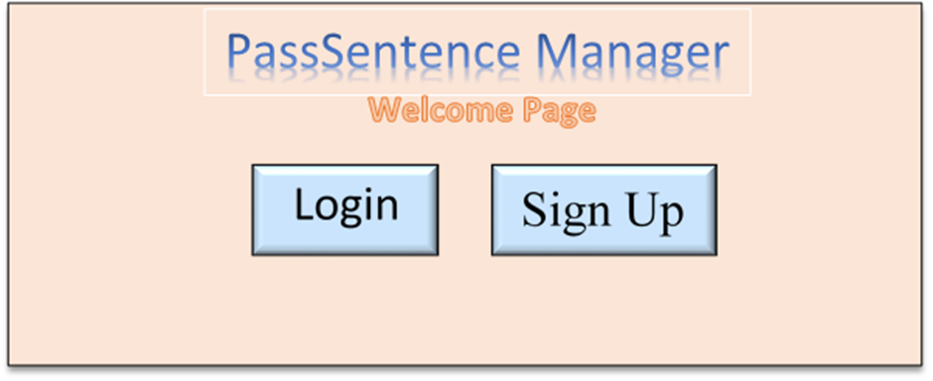
Design Phase
Overall look of the product
Not important for the prototype.
How many pages would my program require?
How should these look?
Desired algorithm
What did it need to do and how would it do it?

Slide 6
Algorithm
for (var x = 0; x <= charPlaceNumbers.length - 1; x ++) {
var a = charPlaceNumbers[x];
var char = sentence[a];
password += char;
}
Simply put:
Take a list of random numbers
Pick letters from the sentence at those numbers
Add them all together to create the password

Slide 7
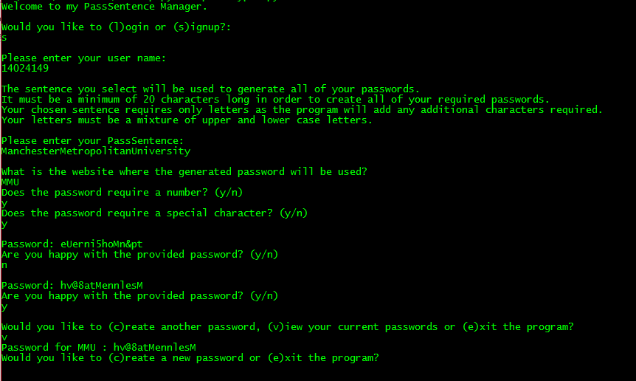
Prototype
Simple Command Line Interface
Outputs Passwords to a file.
Offers the user all of the required aspects mentioned in the Design Phase except Password Length

Slide 8
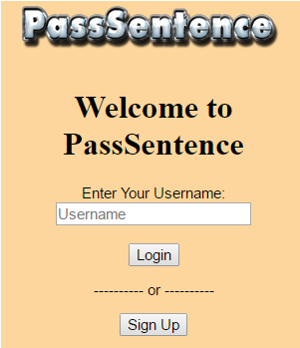
Product
Completed on eight pages:
Welcome
Sign Up
Existing User
New User
Create Password
Display Password
Saved Password
View Passwords
Combines JavaScript, HTML and CSS
Uses Google Chrome Messaging API for communication between back-end pages
Uses Google Chrome Storage API for storing the passwords.
Has no single point of failure.

Slide 9
Testing
Continuous Testing of code after each function created
This ensured each section of the code worked as intended
Product Testing with Test Cases
No bugs found in either the prototype or final product during these tests.
Usability Testing with Subjects
10 Subjects were given a copy of the program and asked to complete a short questionnaire.

Slide 10
Limitations
Single Browser Compatibility
No Ability to Change PassSentence
Limited Usability Testing
No browser Independent Storage
Password Length

Slide 11
Conclusion
PassSentence has no single point of failure.
Limitations can easily be overcome with more programming and background knowledge
Something I believe I will continue to use after University.

Slide 12
Questions???
Thanks for listening

