Slide 2
AJAX

Slide 3
Appreciate Ajax

Slide 4
Table of Content
AJAX | XMLHttpRequest methods
Components | creating XMLHttpRequest object
XMLHttpRequest | Adding AJAX code to the index.jsp
Creating XMLHttpRequest object | Result
XMLHttpRequest attributes | AJAX architecture
readyState

Slide 5
AJAX
Asynchronous JavaScript and XML
AJAX script is usually written in javascript using calls on an XML object called XMLHttpRequest (part of XML DOM)
Data is requested from the server and loaded in the background without interfering with the display and behavior of the existing page.
AJAX can selectively modify a part of a page displayed by the browser update page without the need to reload the whole document .
This Improves response time, exchange of only necessary data between client and server.

Slide 6
Components
AJAX uses
HTML, XHTML or CSS for markup and style
XMLHttpRequest object in the java script code for exchange of data between client and server.

Slide 7
Working
XMLHttpRequest
open()
send()
response
responseText
create
HTML page event
Result
get

Slide 8
XMLHttpRequest
The XMLHttpRequest object can be used in javascript program
to communicate with a server after a web page has loaded (either request data from the server or send data to the server in the background)
Update parts of the web page with new data without reloading the page

Slide 9
Creating XMLHttpRequest object
All new browsers including IE7
xmlhttp=new XMLHttpRequest()
IE6 and IE5
xmlhttp=new ActiveXObject("Microsoft.XMLHTTP")

Slide 10
XMLHttpRequest attributes
readyState:
the code successively changes value from 0 to 4 indicating that the status is “ready”.
status
Http Status code(200 for OK)
responseText
contains response string
responseXml
holds an XML loaded file, DOM's method allows to extract data.
onreadystatechange
Change property that takes a function as value that is invoked when the onreadystatechange event is dispatched.
Notes:
readyState

Slide 11
readyState
0: The request is not initialized
1: The request has been set up
2: The request has been sent
3: The request is in process
4: The request is complete

Slide 12
XMLHttpRequest methods
open(mode, url, boolean)
mode: type of request, GET or POST url: the location of the file, with a path. boolean: true (asynchronous) / false (synchronous).
send("string")
null for a GET command.

Slide 13
creating XMLHttpRequest object
xmlHttp=null;
try{
xmlHttp=new XMLHttpRequest(); }
catch(e){
try {
xmlHttp=new
ActiveXObject("Microsoft.XMLHTTP");
} catch(e)
{
alert ("Your browser does not support XMLHTTP!");
}
}
Old IE

Slide 14
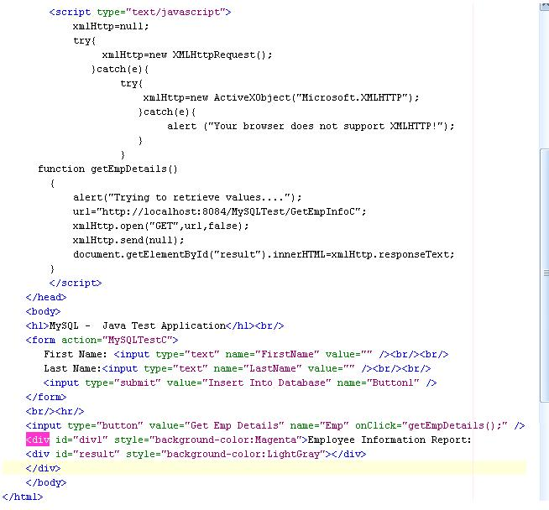
Adding AJAX code to the index.jsp
Creating xmlHttp object for Asynchronous request & response
Function to request the resource(servlet) on the server and get the response .
<div> to fill the response

Slide 15
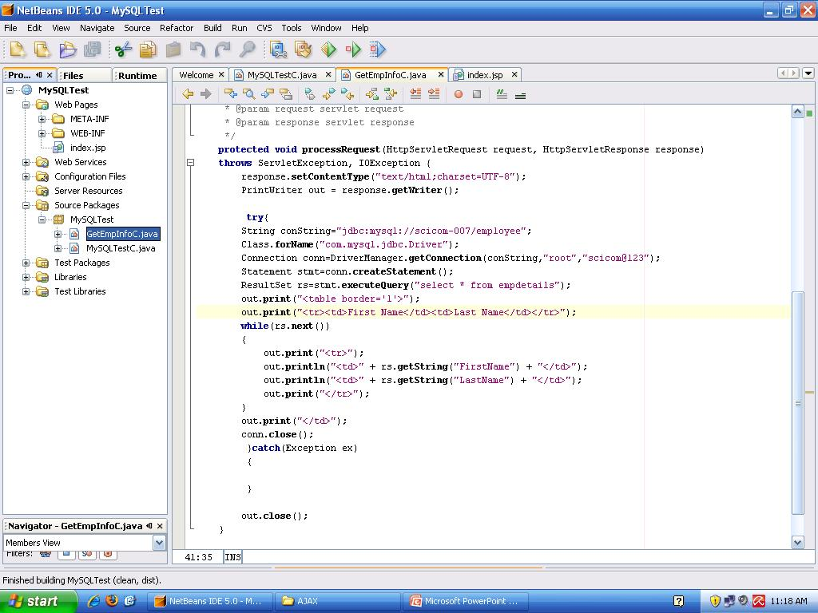
Add a Servlet(GetEmpInfoC) which will read values from the database and return to the calling page(index.jsp)

Slide 16
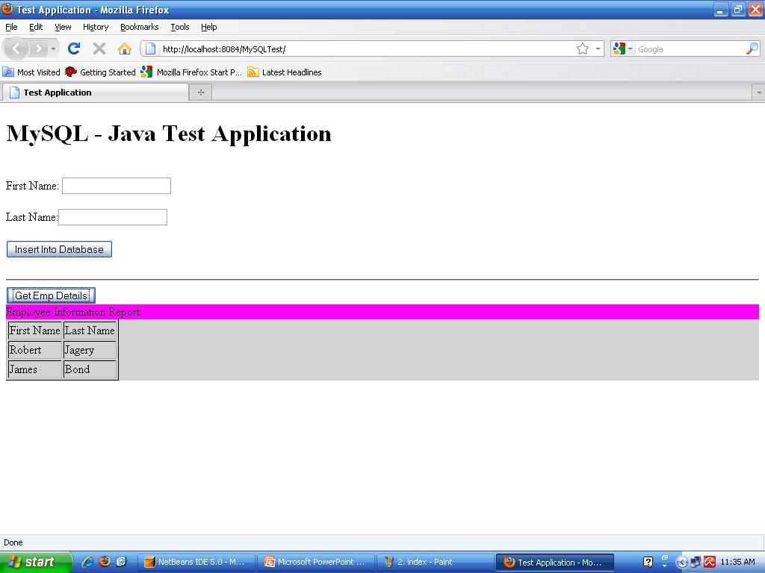
Result

Slide 17
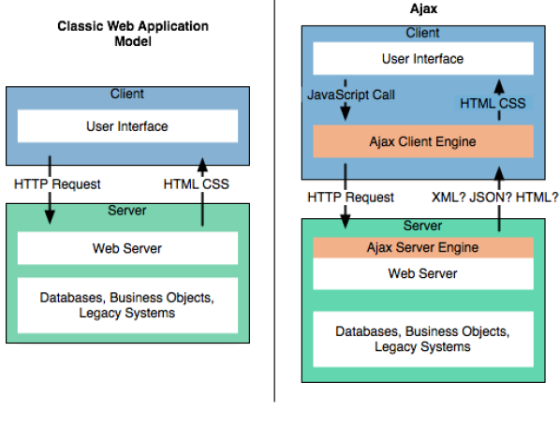
AJAX architecture
Notes:
Image from site: http://www.nejug.org/2006/include/ajax_ajax_architecture.pdf

Slide 18
Summary
AJAX script is usually written in javascript using calls on an XML object called XMLHttpRequest.
AJAX can selectively modify a part of a page displayed by the browser update page without the need to reload the whole document .
AJAX uses HTML, XHTML or CSS for markup and style.
AJAX also uses XMLHttpRequest object in the java script code for exchange of data between client and server.

