Slide 1
Hotel Booking Analysis
CAPSTONE PROJECT
Presented By:
1.Routhu Daswanta Kumar - Centurion University of Technology and Management - CSE

Slide 2
OUTLINE
Problem Statement (Should not include solution)
Proposed System/Solution
System Development Approach (Technology Used)
Algorithm & Deployment
Result (Output Image)
Conclusion
Future Scope
References

Slide 3
Problem Statement
Have you ever wondered when the best time of year to book a hotel room is? Or the optimal length of stay in order to get the best daily rate? What if you wanted to predict whether or not a hotel was likely to receive a disproportionately high number of special requests? This hotel booking dataset can help you explore those questions! This data set contains booking information for a city hotel and a resort hotel, and includes information such as when the booking was made, length of stay, the number of adults, children, and/or babies, and the number of available parking spaces, among other things. All personally identifying information has been removed from the data. Explore and analyse the data to discover important factors that govern the bookings.

Slide 4
Proposed Solution
Seasonal Pricing Strategies:
Implement dynamic pricing strategies based on seasonal booking trends to optimize revenue during peak seasons and attract guests during off-peak periods.
Cancellation Management:
Develop proactive cancellation management strategies, such as offering flexible cancellation policies or incentivizing non-cancellable bookings, to minimize revenue loss due to cancellations.
Targeted Marketing:
Tailor marketing campaigns and promotional offers to target specific guest segments identified through demographic analysis, such as families with children or guests making special requests.
Service Customization:
Personalize guest experiences by offering customized services and amenities based on guest preferences, special requests, and booking patterns.
Data-Driven Insights:
Continuously analyze booking data and guest feedback to identify emerging trends, preferences, and areas for improvement, allowing for data-driven decision-making and strategic planning.
By implementing these solutions, hotels can enhance guest satisfaction, optimize revenue streams, and stay competitive in the dynamic hospitality industry landscape. Additionally, leveraging data analytics and insights can empower hotels to adapt to changing market conditions and guest expectations effectively.

Slide 5
System Approach
1. Data Collection and Integration:
Data Sources: Collect data from various sources, including booking platforms, hotel management systems, and customer databases.
Data Integration: Integrate diverse datasets, including booking details, guest demographics, cancellation records, and hotel amenities, into a centralized data repository.
2. Data Preprocessing and Cleaning:
Data Cleaning: Identify and address missing values, outliers, and inconsistencies in the dataset to ensure data quality and reliability.
Feature Engineering: Create new features, such as total night stays, average daily rate per person, and price paid for stay, to enrich the dataset and facilitate analysis.
3. Exploratory Data Analysis (EDA):
Temporal Analysis: Explore booking trends over time, including yearly, monthly, and daily variations in booking volumes.
Hotel Comparison: Compare booking patterns, cancellation rates, and guest demographics between different types of hotels (e.g., Resort Hotel vs. City Hotel).
Guest Behavior Analysis: Analyze guest demographics, stay durations, special requests, and booking preferences to understand guest behavior and preferences.

Slide 6
4. Statistical Modeling and Predictive Analytics:
Cancellation Prediction: Develop predictive models to forecast cancellation probabilities based on historical booking data, guest characteristics, and external factors.
Demand Forecasting: Utilize time series forecasting techniques to predict future booking volumes and optimize resource allocation and capacity planning.
Segmentation Analysis: Segment guests based on demographic attributes, booking behavior, and preferences to personalize marketing strategies and service offerings.
5. Decision Support and Optimization:
Dynamic Pricing Strategies: Implement dynamic pricing algorithms that adjust room rates based on demand fluctuations, seasonal trends, and competitor pricing.
Crisis Management: Develop contingency plans and response strategies to mitigate the impact of unexpected events, such as natural disasters or pandemics, on hotel operations and bookings.
Resource Allocation: Optimize resource allocation, including staffing levels, room inventory management, and marketing budgets, to maximize revenue and profitability.
6. Continuous Monitoring and Feedback Loop:
Performance Monitoring: Monitor key performance indicators (KPIs), such as occupancy rates, revenue per available room (RevPAR), and customer satisfaction scores, to assess the effectiveness of strategies and initiatives.
Feedback Collection: Solicit feedback from guests through surveys, reviews, and social media channels to identify areas for improvement and address customer concerns promptly.
Iterative Improvement: Continuously iterate and refine strategies based on data-driven insights, market dynamics, and evolving guest preferences to stay competitive and adapt to changing circumstances.
7. Technology Integration and Automation:
Data Analytics Platforms: Implement data analytics platforms and business intelligence tools to streamline data analysis, visualization, and reporting processes.
Automation Solutions: Leverage automation technologies, such as machine learning algorithms and robotic process automation (RPA), to automate repetitive tasks, optimize operations, and enhance efficiency.

Slide 7
Algorithm & Deployment
Based on the analysis requirements and objectives outlined in the previous sections, we can select the following algorithms:
Decision Trees or Random Forest:
For cancellation prediction and demand forecasting, decision tree-based algorithms like Random Forest can be effective. They can handle non-linear relationships, capture interactions between variables, and provide interpretable results.
Time Series Forecasting (e.g., ARIMA):
For forecasting future booking volumes and demand trends, time series forecasting methods like ARIMA (AutoRegressive Integrated Moving Average) can be suitable. These models are adept at capturing temporal patterns and seasonality in the data.
Clustering (e.g., K-Means):
For segmentation analysis and customer profiling, clustering algorithms like K-Means can be utilized. They can group guests based on similarities in booking behavior, demographics, and preferences, enabling personalized marketing strategies and service offerings.
Data Input:
The input data for training the algorithms will include various features such as booking details (e.g., lead time, stay duration), guest demographics (e.g., adults, children), hotel attributes (e.g., hotel type), and historical booking records (e.g., cancellation status, special requests).

Slide 8
Training Process:
Data Preprocessing:
Clean the dataset by handling missing values, encoding categorical variables, and scaling numerical features if necessary.
Perform feature engineering to create new relevant features (e.g., total night stays, average daily rate per person).
Feature Selection:
Select relevant features based on their importance and contribution to the predictive models. Features like lead time, previous cancellations, and special requests may be particularly informative.
Model Training:
Train the selected algorithms (e.g., Decision Trees/Random Forest, ARIMA, K-Means) on the preprocessed dataset using appropriate training techniques.
Tune hyperparameters using techniques like cross-validation to optimize model performance.

Slide 9
Prediction Process:
Cancellation Prediction:
Use the trained decision tree-based models (e.g., Random Forest) to predict the probability of booking cancellations based on input features such as lead time, previous cancellations, and booking changes.
Deploy the model to generate real-time predictions for incoming bookings, enabling proactive management of cancellation risks.
Demand Forecasting:
Utilize the trained time series forecasting models (e.g., ARIMA) to forecast future booking volumes and demand trends based on historical booking data.
Generate forecasts for different time horizons (e.g., monthly, quarterly) to support strategic planning and resource allocation decisions.
Segmentation Analysis:
Apply the trained clustering algorithms (e.g., K-Means) to segment guests based on their booking behavior, demographics, and preferences.
Use the resulting clusters to personalize marketing campaigns, tailor service offerings, and optimize guest experiences.

Slide 10
Deployment:
Model Deployment:
Deploy the trained prediction models (e.g., Random Forest for cancellation prediction, ARIMA for demand forecasting) in a production environment using appropriate deployment platforms (e.g., cloud services, containerized applications).
Implement APIs or web services to facilitate real-time predictions and integrate the models with existing hotel management systems.
Dashboard and Visualization:
Develop interactive dashboards and visualization tools to monitor model performance, visualize prediction results, and track key performance indicators (KPIs) such as occupancy rates and revenue metrics.
Enable stakeholders to interactively explore and analyze the predictions, gaining actionable insights for decision-making.
Continuous Monitoring and Maintenance:
Establish monitoring mechanisms to track model performance and detect anomalies or drifts in prediction accuracy over time.
Implement regular model retraining and updates to incorporate new data, adapt to changing trends, and maintain model relevance and accuracy.

Slide 11
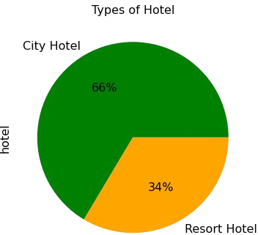
Result
the data we will be dealing with has 66 percent share of City Hotel and the rest is of the Resort Hotel.

Slide 12
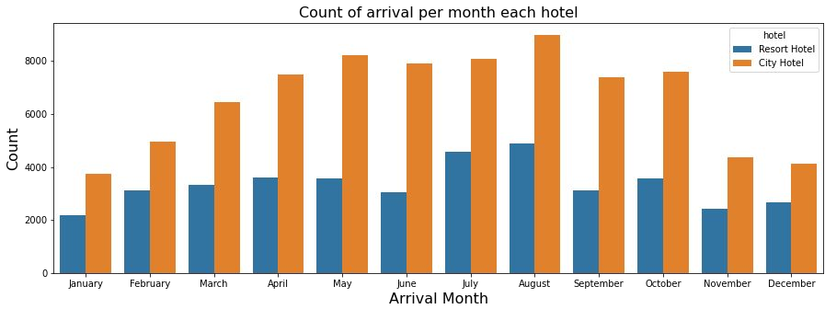
FABRICATING INSIGHTS
Analyzing Top Arrival Month

Slide 13
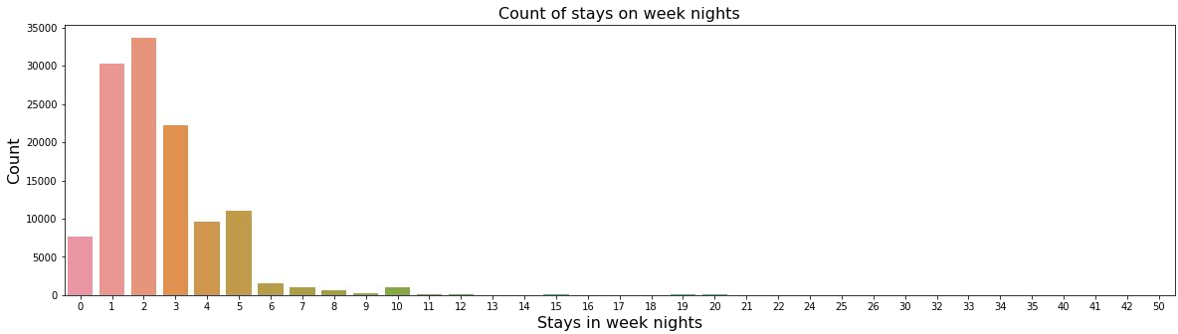
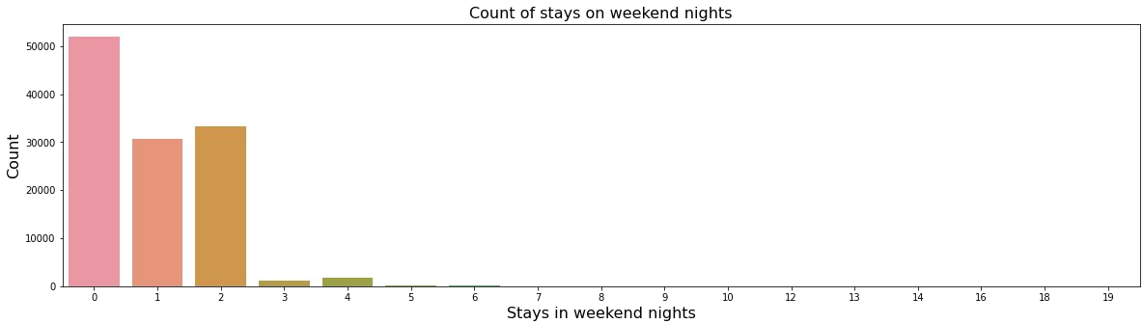
Analyzing Arrival Weekend Nights/Week Nights

Slide 14
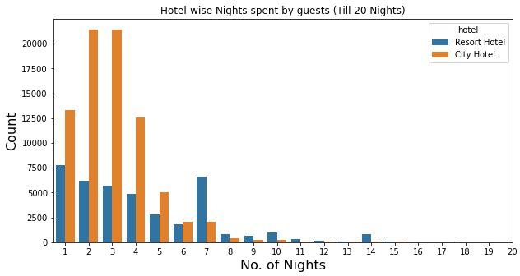
Analyzing Hotel-wise Nights Spent by guests

Slide 15
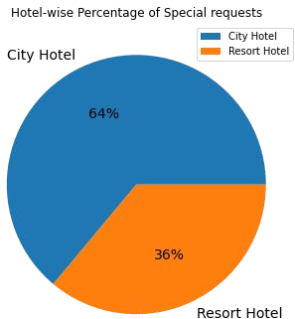
Analyzing Hotel-wise Special Request made by Guests

Slide 16
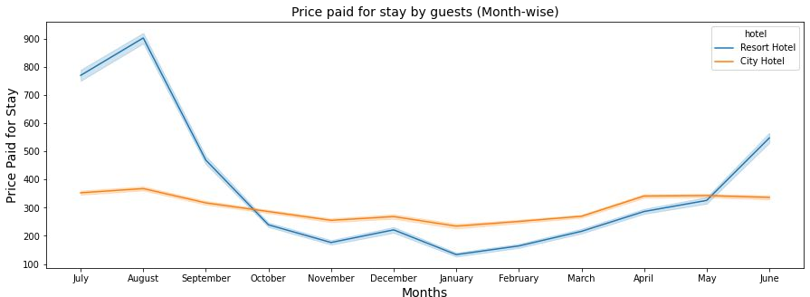
Analyzing Price Paid (Month-wise) by the Guest Entity

Slide 17
Conclusion
The analysis of the hotel booking dataset unveils pivotal insights for strategic decision-making in the hospitality sector. Noteworthy findings encompass fluctuations in booking trends across yearly, monthly, and daily intervals, indicating seasonal variations and dynamic demand patterns. Diverse hotel preferences are observed, with City Hotels encountering higher cancellation rates compared to Resort Hotels, underscoring the importance of tailored management strategies. Understanding the varied guest demographics and behaviors, including families, groups, and individual bookings, offers opportunities for personalized marketing initiatives and service enhancements. Proposed solutions include implementing dynamic pricing strategies, proactive cancellation management, targeted marketing campaigns, and service customization to optimize revenue and elevate guest satisfaction. This comprehensive approach involves systematic data collection, preprocessing, exploratory analysis, modeling employing algorithms like Decision Trees and Time Series Forecasting, and deployment of trained models for continuous monitoring and maintenance, culminating in empowered revenue management and elevated guest experiences in the competitive hospitality landscape.

Slide 18
Future scope
The insights garnered from the analysis of the hotel booking dataset lay a solid foundation for future advancements and innovations in the hospitality industry. With the continued integration of advanced analytics and machine learning techniques, there is immense potential to further refine revenue management strategies, enhance predictive modeling accuracy, and personalize guest experiences. Future endeavors could include the development of more sophisticated recommendation systems for personalized offerings, real-time dynamic pricing algorithms leveraging AI, and predictive analytics models tailored to emerging market trends and guest preferences. Moreover, the integration of IoT (Internet of Things) technologies and Big Data analytics could revolutionize operational efficiency, enabling predictive maintenance of hotel facilities, real-time guest feedback analysis, and seamless automation of guest services. As the hospitality landscape evolves, leveraging data-driven insights and cutting-edge technologies will be pivotal in driving sustainable growth, fostering innovation, and delivering unparalleled value to guests in the digital era.

Slide 19
References
Predicting Hotel Booking Demand with Deep Learning by Jan van der Linden et al. (2018)
Hotel Booking Cancellation Prediction: A Machine Learning Approach by Yu-Shan Chang et al. (2018)
Customer Segmentation and Price Optimization for Hotel Revenue Management by Natalia Krynets et al. (2013)
Analyzing the Determinants of Hotel Booking Decisions: A Multi-Criteria Approach by Irene del Río-Rama et al. (2019)
The Impact of Online Reviews on Hotel Booking Decisions by Xiangyu Xu et al. (2014)
Understanding the Sharing Economy: The Case of Airbnb by Marco Candela et al. (2018)
Seasonality in Hotel Booking Behavior by Dimitrios Bardopoulos et al. (2018)
The Influence of Hotel Distribution Channels on Guest Acquisition Costs by Robert Patterson et al. (2017)
Guest Loyalty in the Hotel Industry: A Review and Research Agenda by Vanessa Riethmüller Babakus (2009)
Travelers' Adoption of Mobile Hotel Booking Apps: A Conceptual Model by MinJeong Baek et al. (2018) (Note: This might be relevant if your analysis includes mobile booking trends)

Slide 20
THANK YOU

