Slide 1
RAD Sem01_2627 · PART 1 PROJECT PROPOSAL
SaigonBite: one platform to spread lunch-hour orders across hubs
Online Food Delivery Hub Platform (OFDH)
Nguyen Thanh Dat · 722I0004
UC-01 Place an order, UC-03 Manage hubs
Le Minh Quan · 523K0049
UC-02 Deliver an order, UC-04 Reports
Nguyen Minh Quan · 523K0050
UC-05 Confirm or reject, UC-06 Menus
Team02 · Part 1 proposal, 26 October 2026
Notes:
Speaker: Dat · Dat 1 of 6 (with slide 2) · Time: 0:00-0:19 (41 words)
Good morning. We are Team 02. I am Dat, and with me are Quan L. and Quan N.. Our project is SaigonBite, a delivery platform for cloud kitchens. Let me start with one lunch order, because that order explains the whole project.
Cue: Click: slide 2.

Slide 2
Paper tickets hide the queue: one hub overloads, another idles
Five pains from the case, and what the platform does about each.
Pain (from the case) | What the platform does
One hub overloaded, another idle | Busy-hub block, quieter-hub suggestion
Cash handed over late, with mistakes | Shipper records cash per order
Ingredient runs out; staff phone customers | Kitchen rejects, or replaces with consent
Tourists cannot register or pay | Local and tourist types; COD for all
No reliable reports | Reports from shared records
Vision One order record that customer, kitchen, shipper and manager all read.
Notes:
Speaker: Dat · Dat 1 of 6 · Time: 0:19-1:03 (96 words)
Imagine it is a quarter to twelve. Linh works in District 1 and orders pho. The District 1 hub has a board full of paper tickets, while another hub nearby is half empty. Nobody can see that, so Linh waits an hour. Then the beef runs out, and someone has to phone her. Her cash reaches the hub at the end of the day, sometimes short. Each pain needs its own rule, but every rule needs the same thing first: one shared order record that the customer, the kitchen, the shipper and the manager all read.
Cue: Click: slide 3.

Slide 3
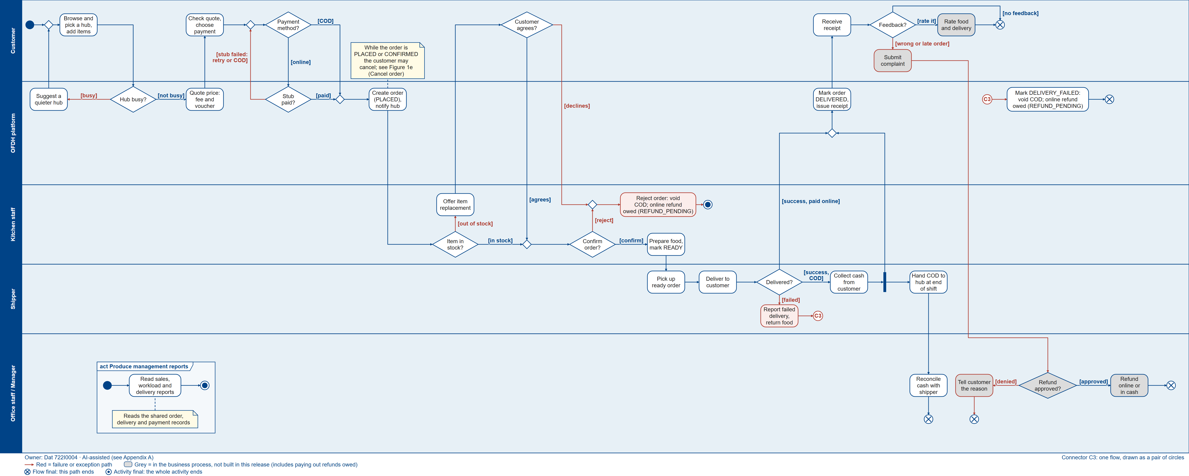
One lunch order crosses five roles
A
Order and pay
B
Kitchen
C
Delivery, cash
D
Receipt, refund
Figure 1 (proposal Section 3)
Notes:
Speaker: Dat · Dat 2 of 6 (with slide 4) · Time: 1:03-1:24 (44 words)
This is the map of Linh's order, not a slide to read: five lanes, customer, platform, kitchen, shipper and office. Blue is the normal path, red is where something goes wrong, grey is not in this release. The next slides zoom into four parts.
Cue: Point at the five lanes, then click: slide 4.

Slide 4
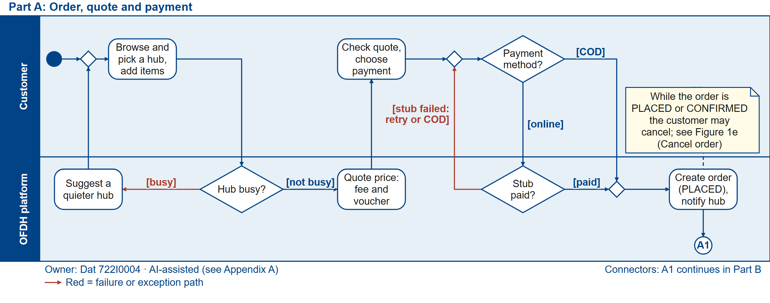
A busy hub redirects the customer before any order exists
Figure 1a (proposal Section 3.1)
A
B
C
D
Notes:
Speaker: Dat · Dat 2 of 6 · Time: 1:25-1:57 (69 words)
Part A. Linh picks the District 1 hub, and the platform checks its workload first. If the hub is busy, she is offered a quieter hub before any order exists. Then she sees the full price: food, delivery fee and voucher. She pays cash on delivery, or online through our payment stub; if that fails, she retries or switches to cash. Only then is the order created, as PLACED.
Cue: Point at "Hub busy?", then at "Create order". Click: slide 5.

Slide 5
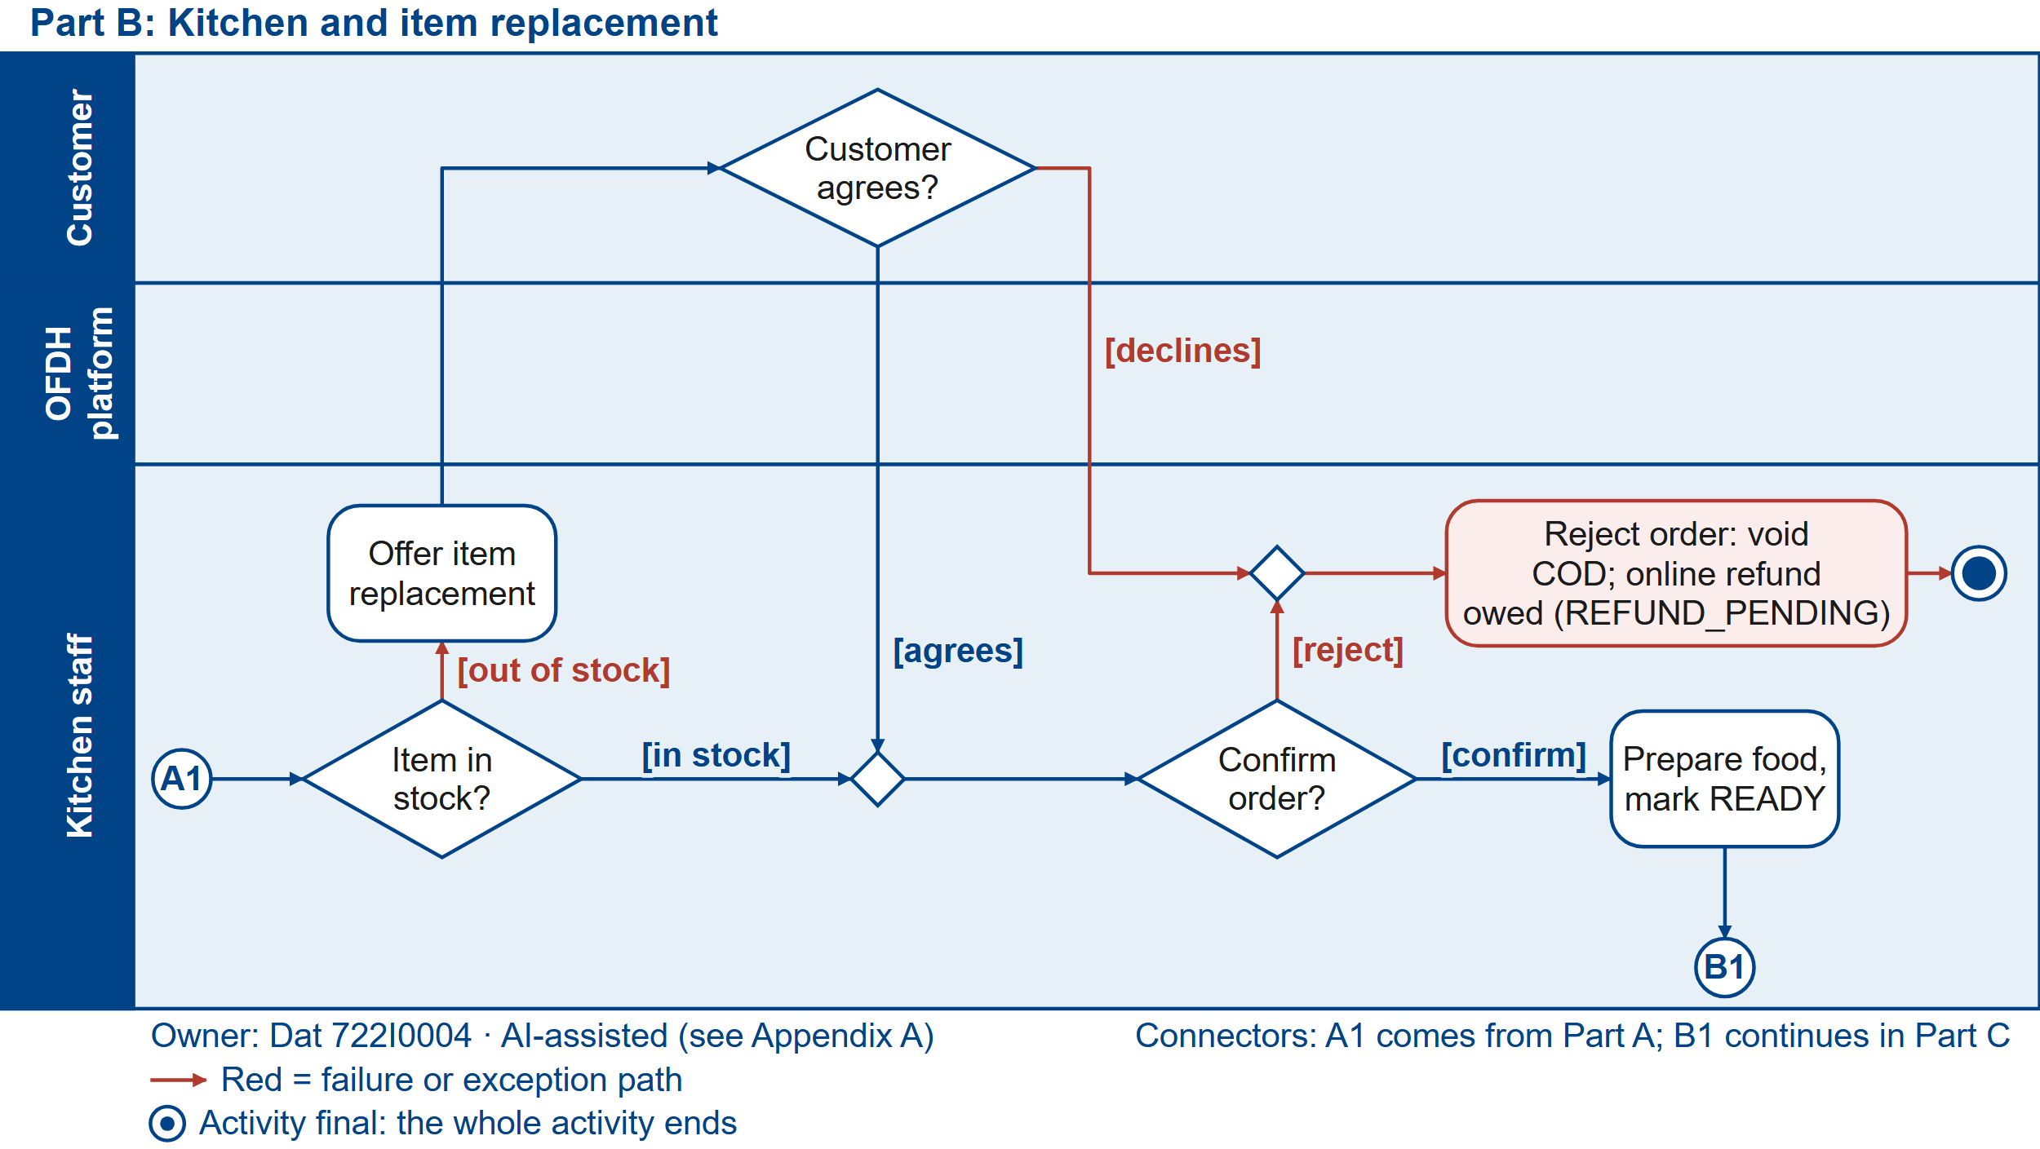
The kitchen confirms, offers a replacement, or rejects
Part E The customer may cancel until cooking starts: a separate activity (proposal Figure 1e).
Figure 1b (proposal Section 3.1)
A
B
C
D
Notes:
Speaker: Dat · Dat 3 of 6 · Time: 1:57-2:32 (75 words)
Part B, the kitchen. The kitchen confirms or rejects. If the beef has run out, the kitchen offers a replacement and Linh decides. If she says no, the order is rejected: cash is voided, and an online payment is owed back in full, with no approval. In this release we record that refund; paying it out comes later. Linh can also cancel herself, but only until cooking starts. That is Part E in the proposal.
Cue: Point at "Offer item replacement", then at the Part E strip. Click: slide 6.

Slide 6
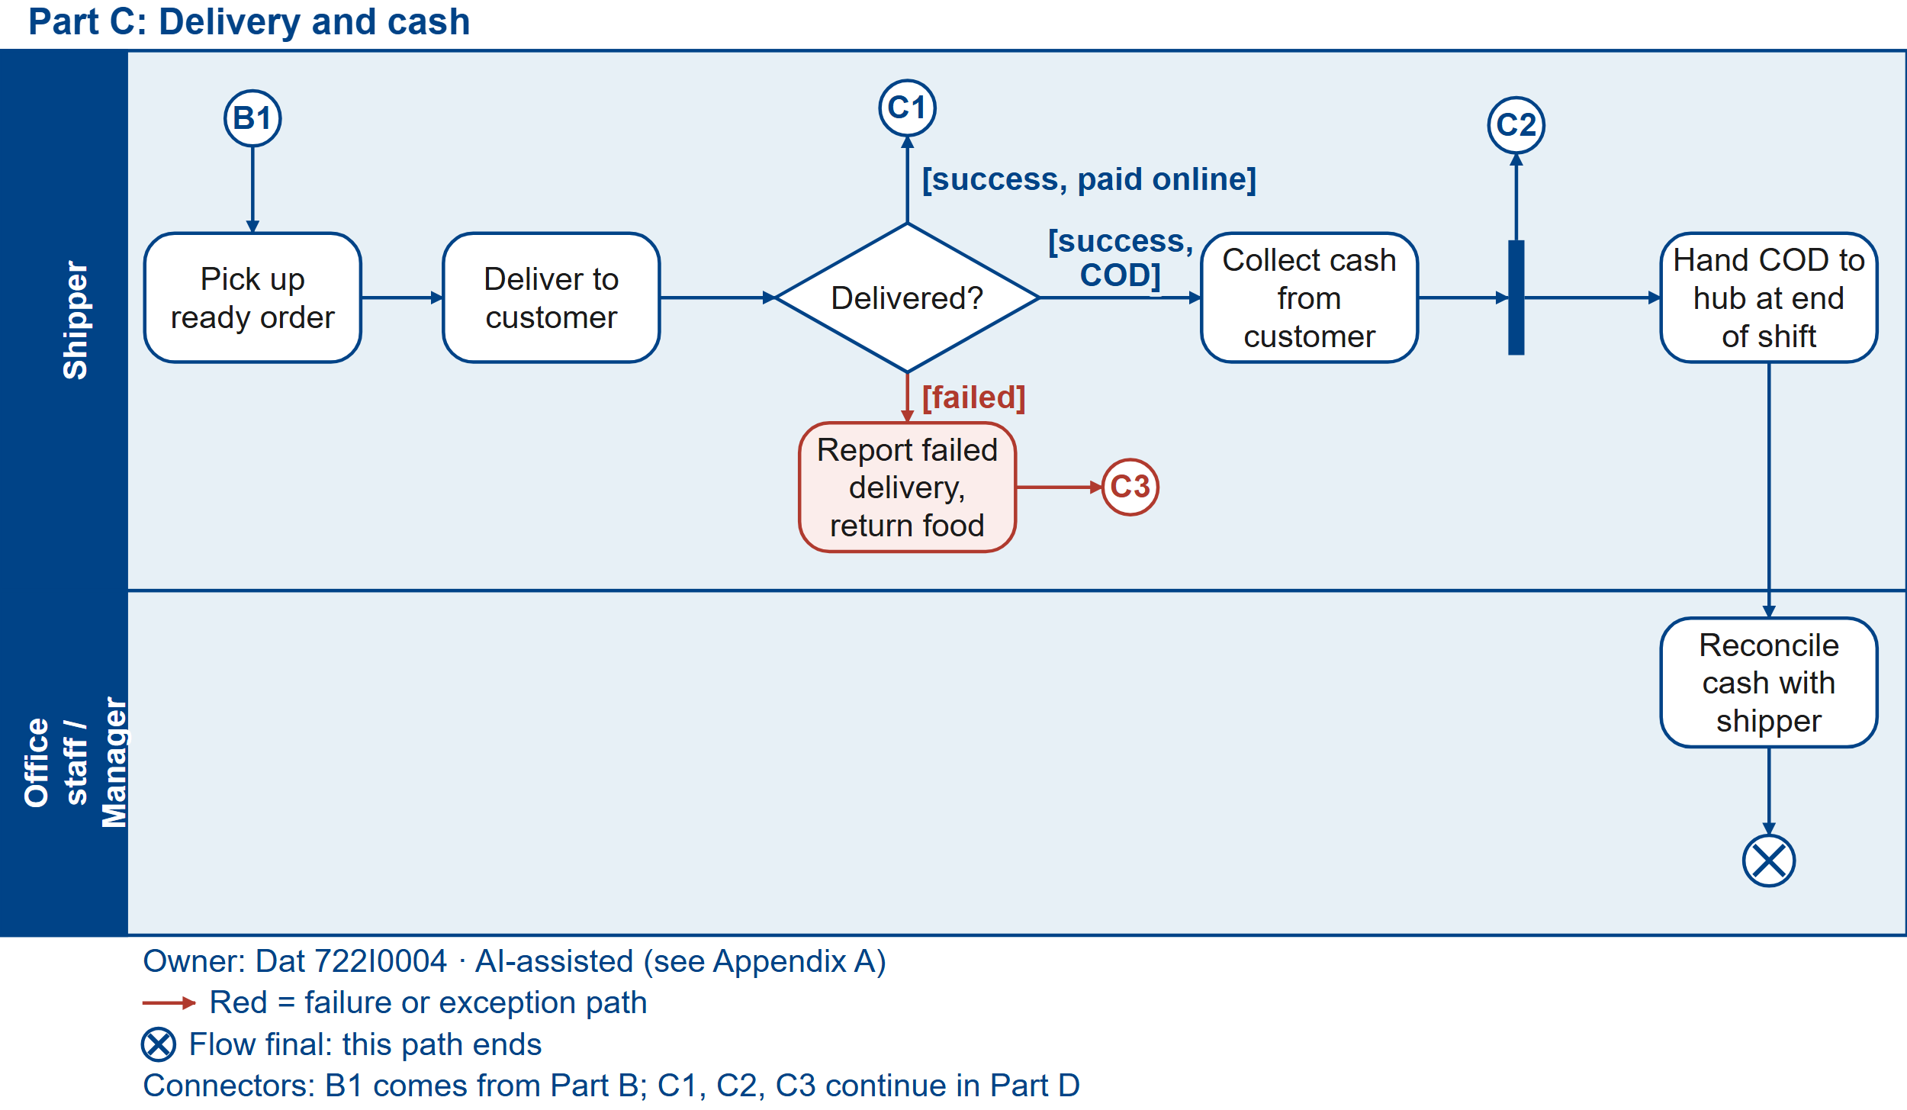
Delivered is not paid: cash is collected, then reconciled
Figure 1c (proposal Section 3.1)
A
B
C
D
Notes:
Speaker: Dat · Dat 4 of 6 (with slide 7) · Time: 2:32-3:02 (65 words)
Part C, delivery. The shipper picks up and delivers. The point we care about most: delivered is not the same as paid. For a cash order, the shipper records the cash at the door, for that one order. At the end of the shift, office staff check the cash against those records. If the delivery fails, the shipper reports it and brings the food back.
Cue: Point at "Collect cash", then at "Reconcile". Click: slide 7.

Slide 7
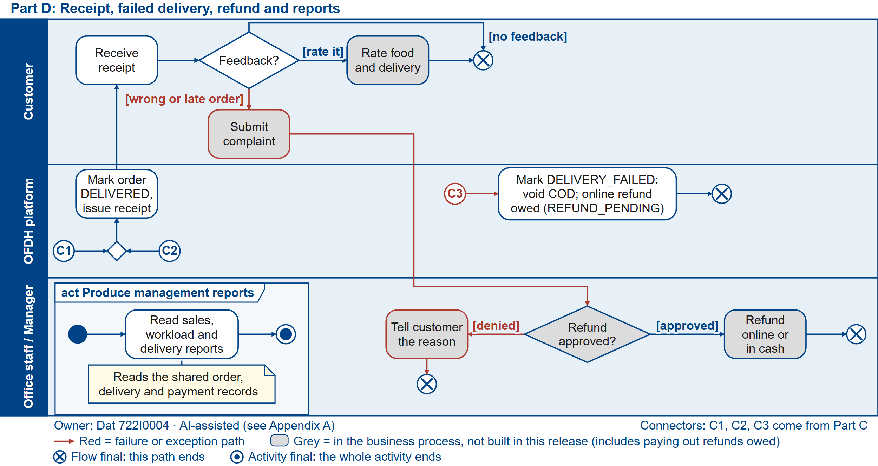
A failure means a full refund owed; only a complaint needs a decision
Figure 1d (proposal Section 3.1)
A
B
C
D
Notes:
Speaker: Dat · Dat 4 of 6 · Time: 3:02-3:35 (72 words)
Part D. Linh gets a receipt, and she can rate the order or complain. A failed delivery works like a rejection: cash is voided, and online money is owed back in full. A complaint is the only case where a person decides. Office staff approve a refund, or deny it and tell Linh why. Reports sit on the side and read the same records. Quan L. will show who owns which part.
Cue: Point at "Refund approved?". Hand-over: "Quan L. will show who owns which part."

Slide 8
Actors and responsibilities
Six roles in the business and one outside system.
Actor | Responsibility | Main use case
Customer | Orders, pays, may cancel or complain | UC-01
Kitchen staff | Confirms, rejects or replaces; cooks | UC-05
Shipper | Delivers, records cash per order | UC-02
Office staff | Reconciles cash, decides complaints | in process
Admin | Keeps hubs, capacity and menus | UC-03, UC-06
Manager | Reads sales, workload, delivery | UC-04
Payment provider | Online result (our stub) | UC-01
Notes:
Speaker: Quan L. · Quan L. 1 of 2 · Time: 3:35-4:05 (66 words)
Thank you, Dat. Six roles and one outside system touch Linh's order. The customer orders and pays. Kitchen staff confirm, reject or replace, then cook. The shipper delivers and records the cash. Office staff reconcile that cash and handle complaints. The admin keeps hubs, capacity and menus correct, and the manager reads the reports. The outside system is the payment provider, which our own stub simulates.
Cue: Click: slide 9.

Slide 9
Six main use cases, two per student, cover all four groups
ID | Use case | Actor | Group | Owner | State machine
UC-01 | Place an order (#3) | Customer | (a) ordering | Dat | Order
UC-02 | Deliver an order (#10) | Shipper | (b) fulfilment | Quan L. | Delivery
UC-03 | Manage hubs, capacity (#13) | Admin | (c) full CRUD | Dat | Hub
UC-04 | Produce reports (#16) | Manager | (d) report | Quan L. | none (read-only)
UC-05 | Confirm or reject an order (#7) | Kitchen staff | (b) fulfilment | Quan N. | uses Order
UC-06 | Manage brands, menu items (#14) | Admin | (c) full CRUD | Quan N. | MenuItem
Built today (Iteration 1) UC-01 subset: one persisted COD order
Planned build for Part 2 UC-01 to UC-06 in one application
Analysed only (pending L1) Cancel, voucher admin, accounts, order tracking
Deferred (pending L3) Complaint, refund payout, rating
Notes:
Speaker: Quan L. · Quan L. 2 of 2 · Time: 4:05-4:42 (81 words)
From these actors we chose six main use cases, two per student, covering all four required groups. Dat owns placing an order and managing hubs. I own delivery and the reports. Quan N. owns the kitchen decision and the menu. To be clear about status: all six are planned for Part 2. Today one is partly built: placing a cash order. Cancelling and voucher administration are analysed only; complaints, refund payouts and ratings are deferred. Quan N. will explain how we build it.
Cue: Point at the status line. Hand-over: "Quan N. will explain how we build it."

Slide 10
Short iterations, because the client’s rules are still open
Six iterations; each one analyses, designs, builds, tests and ends with a team review.
Why iterative
Stack and three layers (team choice)
1 Answers pending
Client figures arrive later
View
Flask + Jinja2 templates
Controller
One per use case
2 One shared Order
Six use cases grow one record
Domain
Order, Hub, Payment, MenuItem
3 Fixed deadlines
Three presentations; team of three
DAO
sqlite3, hand-written SQL
Database
SQLite, one database
4 Riskiest first
Capacity in I2, payment in I3
Python 3.13 · pytest · Flask-Login
Team choice; pending lecturer confirmation (L4)
Notes:
Speaker: Quan N. · Quan N. 1 of 2 · Time: 4:42-5:15 (71 words)
Thank you. The case is incomplete on purpose: capacity limits, fees and payment rules come from the client later. So we work in short iterations. Each one analyses, designs, builds and tests a thin slice, and then we review it together. The riskiest rules come first: capacity in Iteration 2, payment in Iteration 3. The stack is plain on purpose: Python and Flask, three layers, hand-written SQL on SQLite, and pytest.
Cue: Click: slide 11.

Slide 11
Six iterations; Part 2 never depends on the last one
Weekly view; red marks are decision points.
Iteration or milestone
17/10
24/10
31/10
07/11
14/11
21/11
28/11
I1 Persisted COD order
Part 1 packaging
Part 1 live presentation
26/10
I2 Hubs, capacity, kitchen
Lecturer answers needed
31/10
I3 Ordering, delivery, menus
I4 Reports, demo, Figma
I5 Models, tests, Part 2 report
Feature freeze
12/11
I5 buffer day
13/11
Part 2 submission
15/11
Part 2 presentation
16/11
I6 Feedback, v1.0-final, Part 3
Part 3 submission
29/11
Part 3 presentation
30/11
Contingency decide scope by 31/10 · freeze 12/11 · buffer day 13/11 · I6 only for feedback
Notes:
Speaker: Quan N. · Quan N. 2 of 2 · Time: 5:15-5:52 (80 words)
Here is the roadmap. Iteration 2 builds hubs, capacity and the kitchen board, which starts my part: the kitchen's confirm or reject. Iteration 3 completes ordering and delivery, and I build the menu management. Iteration 4 adds reports and the full demo. Iteration 5 freezes features before the Part 2 deadline and keeps one buffer day. Iteration 6 is only for feedback and Part 3. The red marks are where we decide. Back to Dat for what we actually delivered.
Cue: Point at the red diamonds. Hand-over: "Back to Dat for what we actually delivered."

Slide 12
Iteration 1 runs the six core processes in six days
17–22/10, two people, about 4 focused hours each per day (48 person-hours).
Day | Core process | Dat (UC-01) | Quan L. (foundation) | Evidence
D1 | CP1–2 Identify, plan | Vision, backlog, UC-01 stories | Repo, skeleton, events, actors | Skeleton runs; backlog v1
D2 | CP3 Discover details | UC-01 description, process diagram | Domain model, CRUD inventory | Names fixed
D3 | CP3–4 Design components | Activity, SSD, Order states | Schema, seed, UC-02 draft | SSD and schema agree
D4 | CP4–5 Build, test | Controller, Order code | DAOs, OrderDAO insert | COD order saved
D5 | CP5 Integrate | Checkout page, pytest | Role checks, README | pytest run recorded
D6 | CP6 Test, deploy | Fix defects, acceptance run | Second-machine run | Result; I1 review
Notes:
Speaker: Dat · Dat 5 of 6 (with slide 13) · Time: 5:52-6:05 (29 words)
Thank you. Iteration 1 had six days and two people, one core process per day. The goal was narrow on purpose: one cash order, at one hub, saved correctly.
Cue: Click: slide 13.

Slide 13
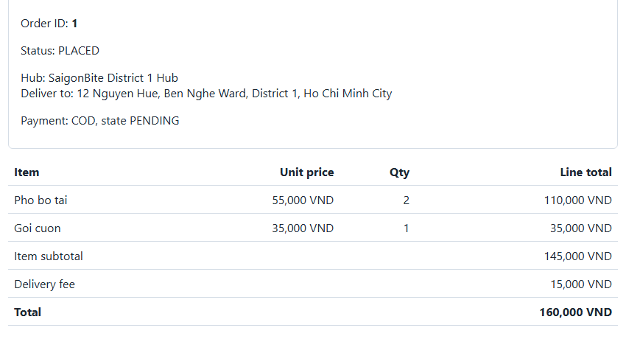
Iteration 1: a COD order saved end to end; 9 of 9 criteria met
As of 20/10, from the repository and the pytest output.
Measure | Plan | Actual
Criteria met | 9 of 9 | 9 of 9
Tests | AC-4 to AC-8 | 93 passed, 0 failed
Second machine | Passes | Mac (Docker): app and tests pass
Code review | On D6 | 20/10: 3 defects found, all fixed
Person-hours | 48 | Not logged per day
Roadmap change | None | Third member from I2
Saved order: ID 1, PLACED, COD, total 160,000 VND
Status Built: UC-01 subset only; the other five use cases are planned for Part 2. AI use: Appendix A.
Lesson Green tests are not proof: review found a bug 81 tests missed. Every finding now gets a test.
Notes:
Speaker: Dat · Dat 5 of 6 · Time: 6:05-6:49 (96 words)
Here is what happened. We built early, with AI assistance, and we say that openly. The order is saved in one transaction, and a double click still creates one order. All nine criteria are met; a teammate ran the app and the tests on a Mac with Docker. Then our review found a bug the tests had missed: a price that changed after the quote was charged without asking. All 81 tests were green. We fixed it, the suite grew from 81 to 93 tests by 20 October, and every review finding gets its own test.
Cue: Point at the saved order, then at the Lesson line. Click: slide 14.

Slide 14
Unconfirmed rules and the capacity race are the biggest risks
Each risk has a warning sign we watch and one owner.
ID | Risk | L / I | Owner | Mitigation
R-01 | CRUD coverage rejected | Med / High | Dat | Decide by 31/10; reuse UC-06 admin pattern
R-02 | Rules unconfirmed or changed | High / Med | Dat | Assumption Log; values in configuration
R-03 | Peak-hour capacity race | Med / High | Dat | One BEGIN IMMEDIATE transaction; boundary test
R-04 | Integration drift between use cases | Med / High | Dat | Shared schema, seed; demo at I3, I4
R-05 | Member absent; new member ramping up | Med / High | Dat | Pairing in I2; buffer day 13/11
Notes:
Speaker: Dat · Dat 6 of 6 (with slide 15) · Time: 6:49-7:20 (68 words)
Two risks matter most. First, the client may change a rule after we code it, so every rule lives in configuration and in the Assumption Log. Second, at the lunch peak two orders can race for the last slot, so in Iteration 2 the check and the insert will run in one transaction, with a boundary test. The other risks each have an owner and a warning sign.
Cue: Point at R-02 and R-03. Click: slide 15.

Slide 15
What we need from you
We keep building on our defaults until the answers arrive.
Client questions (with our default)
Questions for the lecturer
Q1 Workload Busy and quiet hub? Default: at capacity; quiet gets 5,000 VND off.
L1 Analysis plus seed data enough for CRUD?
Q2 Delivery Distance, fee? Default: base + per km.
L2 Team-built payment stub acceptable?
Q3 Cancel Until when? Default: before cooking; refund in full.
L3 Defer complaint, refund, rating?
Q4 Payment Online options? Default: wallet, card.
L4 Python with Flask acceptable?
Q5 Reports Which date? Default: delivered date.
L5 Third member, UC-05 and UC-06 accepted?
Close Please answer by 31/10. Iteration 2 starts on 27/10.
Notes:
Speaker: Dat · Dat 6 of 6 · Time: 7:20-7:52 (69 words)
To close, here is what we need. Five client questions, each with our default, so we can keep building while we wait. And five questions for you as our lecturer, mainly: is analysis plus seed data enough for the classes we do not build, and do you accept our third member and the two new use cases? With your answers by the thirty-first, Iteration 2 starts tomorrow. Thank you.
Cue: Stop on this slide for questions.

