Slide 1
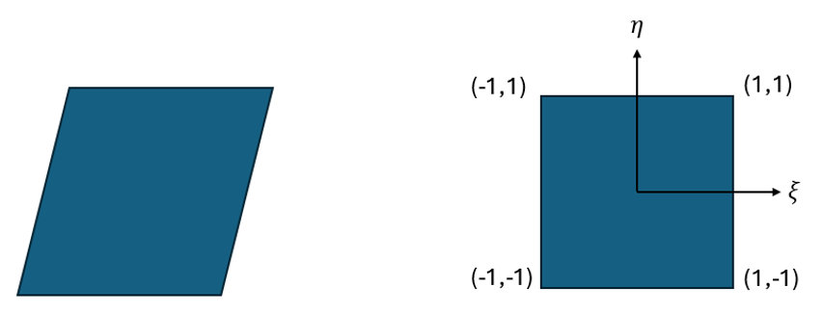
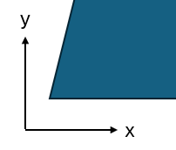
4
3
1
2

Slide 2
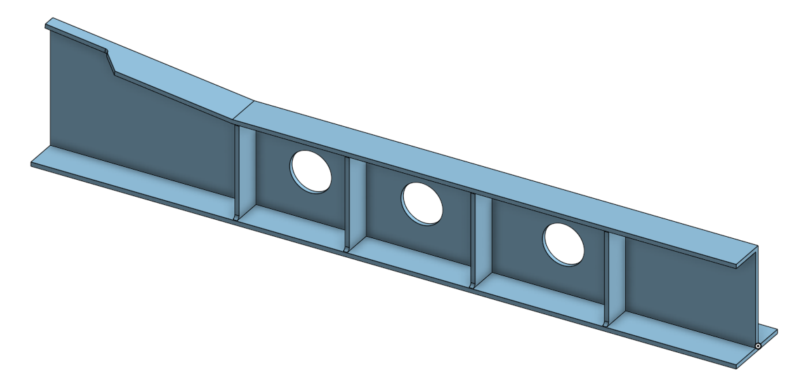
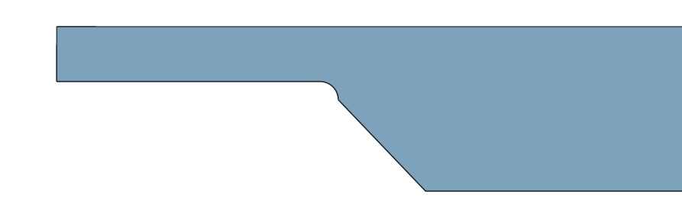

Slide 4
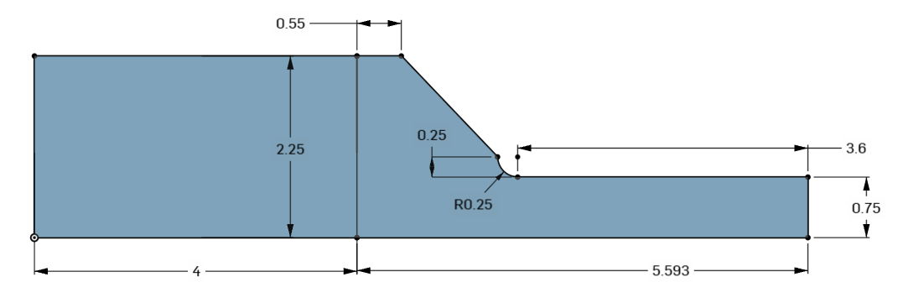
Under Conservative
H = 2*(0.75+0.25) = 2
d = 2*0.75 = 1.5
R = 0.25
H/d = 1.33
r/d = 0.17
Kt ~ 1.82
Over
Conservative
H = 2*2.25 = 4.5
d = 1.5
R = 0.25
H/d = 3
r/d = 0.17
Kt ~ 2.6

Slide 5










4
7
3
4
7
3
4
3
$$η$$
$$η$$
$$η$$
$$ξ$$
$$ξ$$
$$ξ$$
8
6
6
6
1
5
2
1
5
2
1
5
2
4
3
3
$$η$$
$$ξ$$
$$η$$
$$ξ$$
1
2
1
2

Slide 6
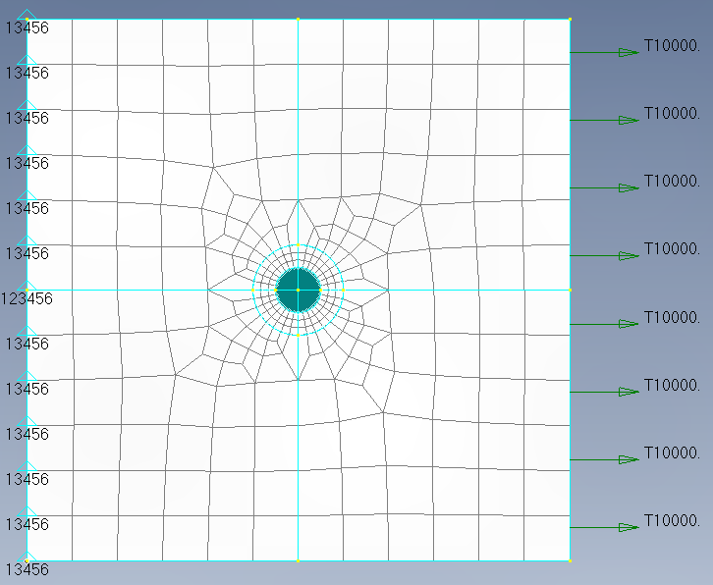
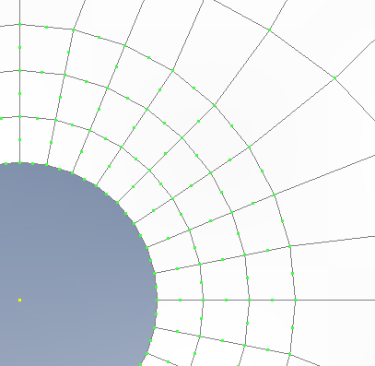
CQ4
CQ8
CQ7

Slide 7
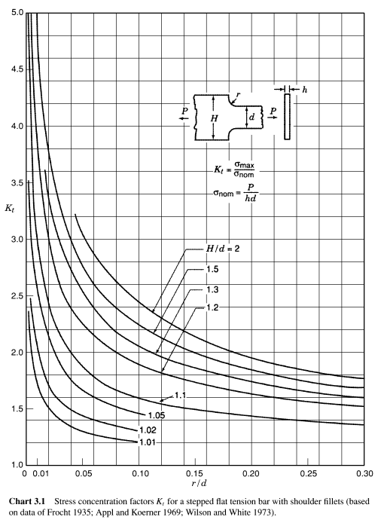

Slide 8
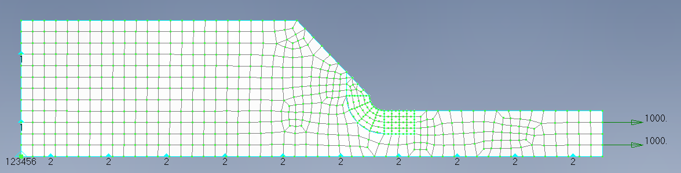
CQ8_4

Slide 9
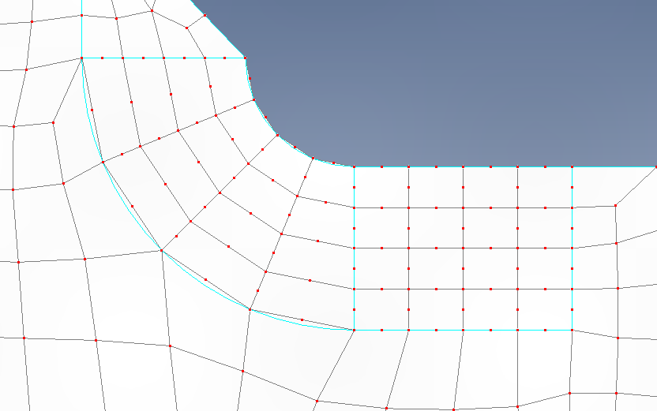
CQ8
CQ7
CQ7
CQ6

Slide 10
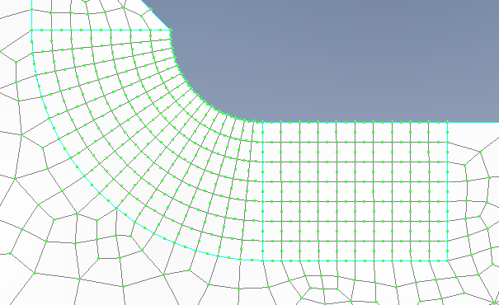
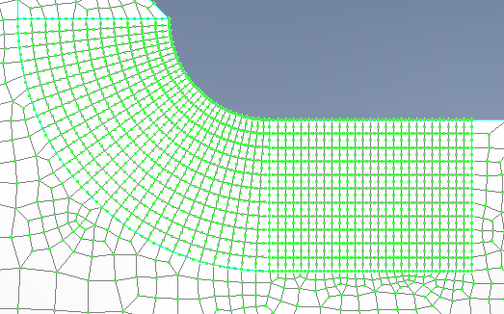
CQ8_4
CQ8_16
CQ8_28

Slide 11
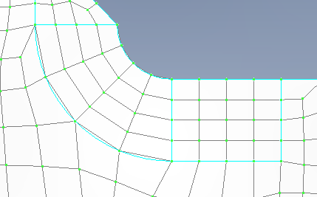
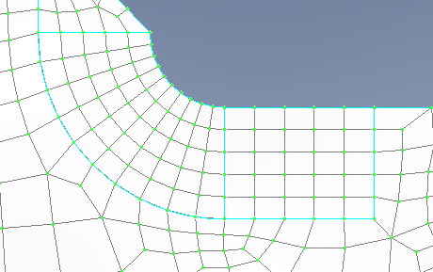
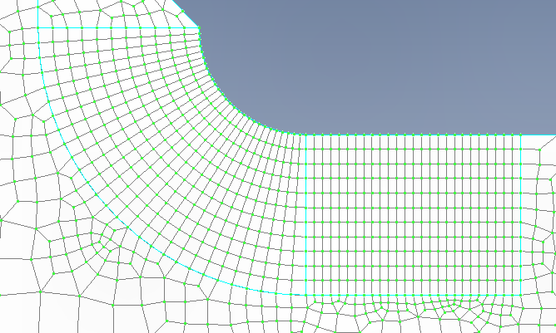
CQ4_4
CQ4_10
CQ4_28

