Slide 1

Side-channel power attack against a cryptographic software
Metehan Koç
Renaud Pacalet

Slide 2
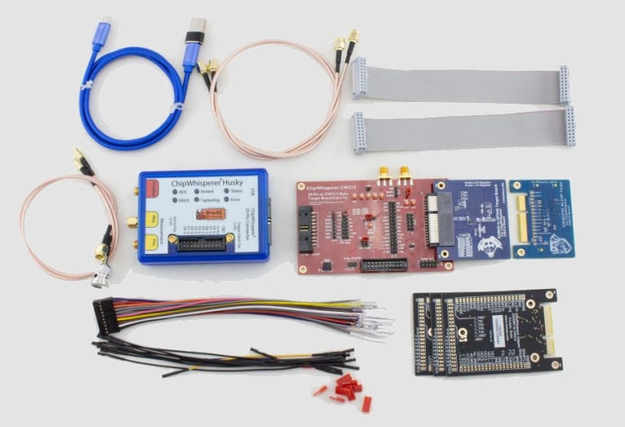
Project Overview
Objective: Capture power traces of ASCON algorithm to extract private key by side channel attacks.
Target Hardware: 32-bit ARM chip via CW-Husky.

Slide 3
What is ascon?
Purpose: Provides high security with low overhead, making it ideal for the Internet of Things (IoT), embedded sensors, and medical devices.
Functionality: It is primarily an Authenticated Encryption with Associated Data (AEAD) scheme, meaning it provides both confidentiality (encryption) and integrity (tamper protection) in a single process.
Design Philosophy: It is based on a sponge construction, similar to the SHA-3 (Keccak) hashing standard.

Slide 4
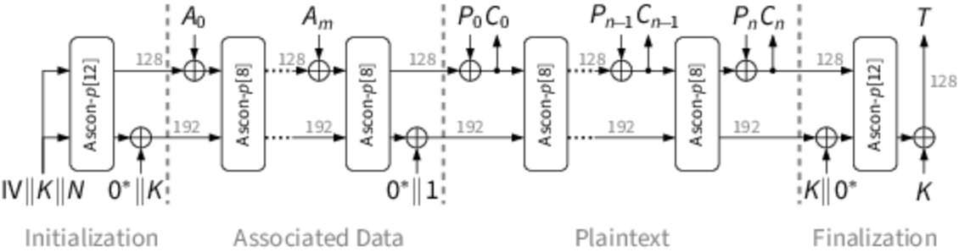
Phases of ascon
Initialization: Mixes Key, Nonce, and IV into the 320-bit state.
Associated Data: Absorbs non-encrypted data into the state.
Processing: XORs plaintext/ciphertext to encrypt or decrypt.
Finalization: Generates the 128-bit tag for verification.

Slide 5
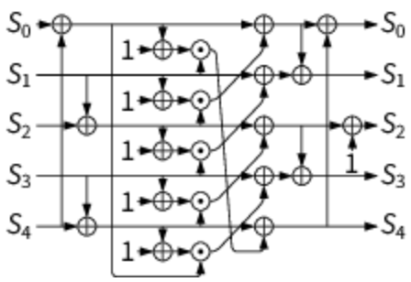
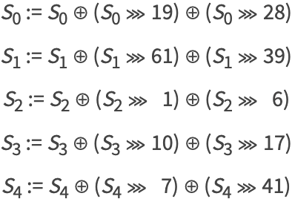
Ascon Permutations
Addition of Round Constants: XORs a unique 1-byte constant into the middle word (S₂).
Nonlinear Substitution Layer: Applies a 5-bit S-box "vertically" across all 5 words (64 times in parallel).
Linear Diffusion Layer: XORs each 64-bit word with two of its own rotated copies.
Ascon’s S-box
Ascon’s linear layer

Slide 6
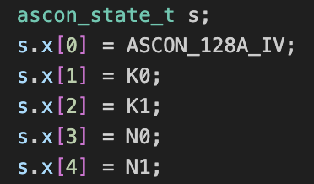
ASCON State Loading
S₀: 64-bit IV (contains algorithm-specific constants).
S₁, S₂: 128-bit Secret Key (K).
S₃, S₄: 128-bit Nonce (N).

Slide 7
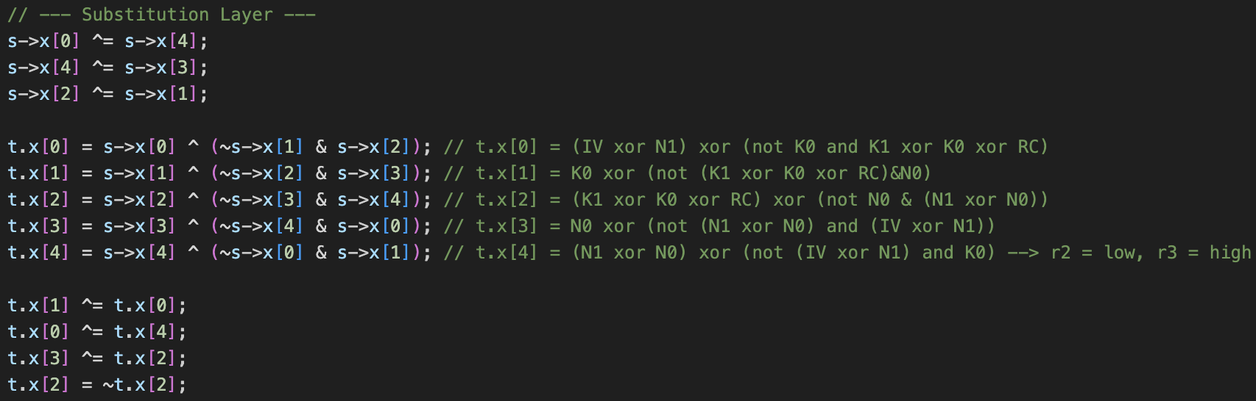
Substitution layer
Assembly presentation of C code

Slide 8
Implementation and KAT verification
Implementation: ASCON AEAD encryption and decryption algorithms implemented by using C (ascon.c, ascon.h).
Test Dataset: Utilized a comprehensive suite of 1,000 test cases derived from the official reference implementation.
Software Validation: Developed a C script (test_ascon.c) to verify encryption/decryption consistency across the entire dataset.
Result: ASCON implementation pass the all tests and it verified the correctness of the implementations.

Slide 9
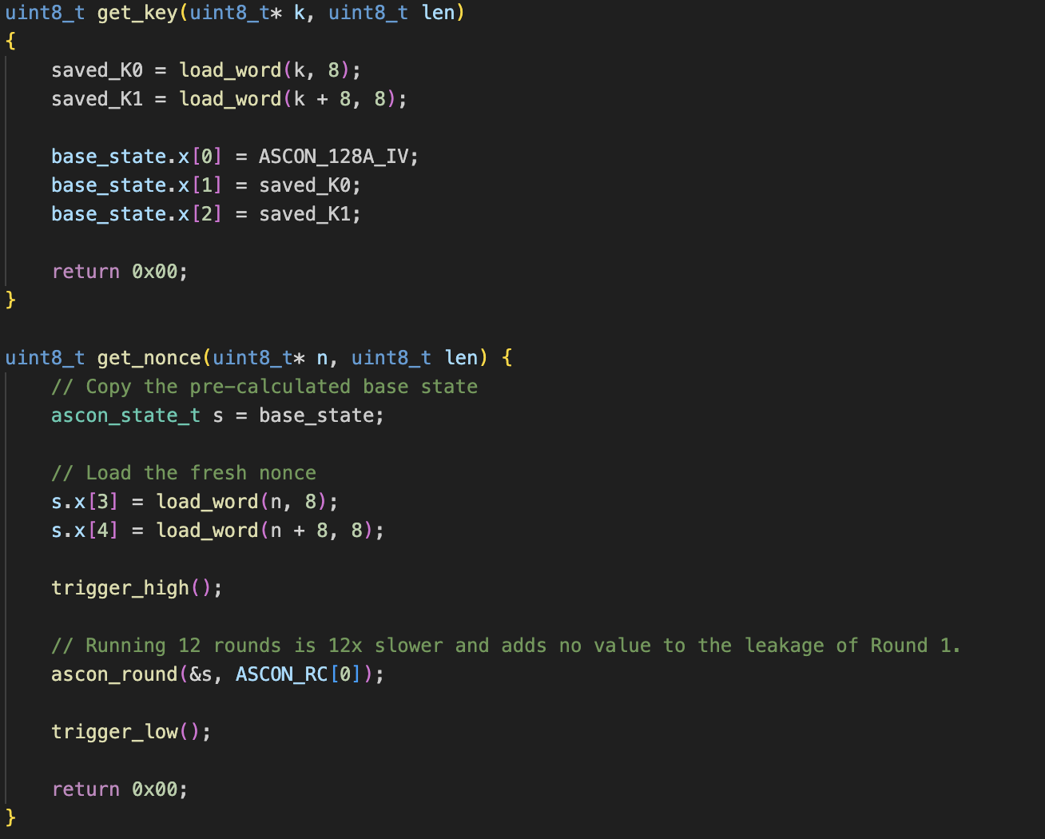
FIRMWARE
Target firmware is implemented in C.
Removed get_AD and get_PT to optimize firmware for collecting traces.
get_key: Sets the private key for ASCON.
get_nonce: Sets the nonce and starts the first permutation round.

Slide 10
Side channel attack to ASCON
To handle the complexity of the 32-bit K₀_low register, the attack uses a Divide-and-Conquer strategy combined with an iterative power model.
Target: K₀_low (Lower 32 bits of the first 64-bit key chunk).
Strategy: Two 16-bit sub-key guesses (65,536 hypotheses each) to reduce computational overhead.
Power Model: Hamming Weight (HW) of the intermediate state R₈, modeled as:
Dataset: 500,000 power traces processed using vectorized NumPy operations for high-speed correlation calculation.

Slide 11
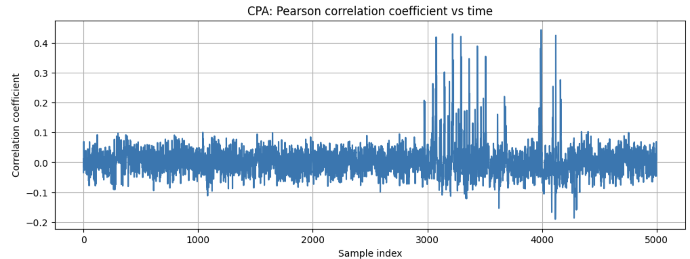
Synchronization of traces
Before running a full-scale attack on an unknown key, we use a Known Key to verify that the power traces are correctly synchronized with the ASCON cryptographic operations.
Hypothesis: If our model (R₈ register state) is correct and the traces are aligned, we should see a distinct correlation spike at the exact moment that register is manipulated in hardware.

Slide 12
Execution pipeline
Trace Centering: Pre-calculates mean traces and standard deviation to optimize the Pearson correlation loop.
Iterative Recovery:
Phase 1: Attacks Bytes 0-1 to find the first 16 bits.
Phase 2: Attacks Bytes 2-3 while maintaining the state of the previously recovered bits.
Statistical Selection: The candidate with the highest absolute Pearson correlation coefficient is selected as the winner for each segment.

Slide 13
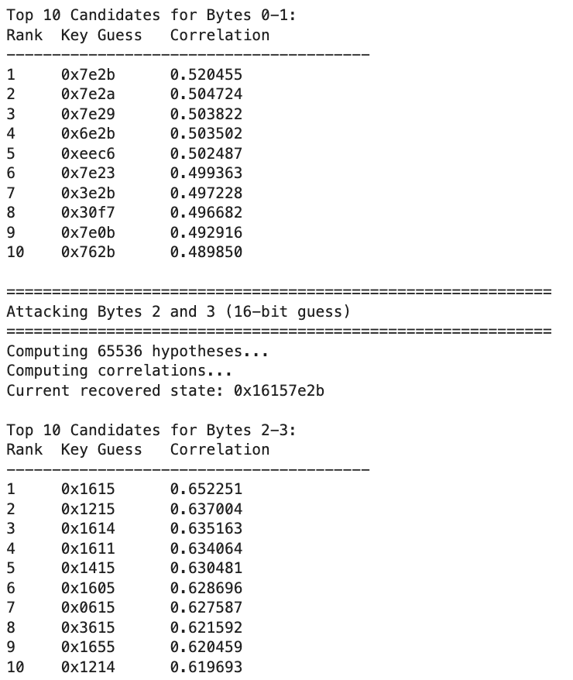
Results for ko_low
K0 recovered successfully (0x16157e2b)
Top results are all close to the actual key

Slide 14
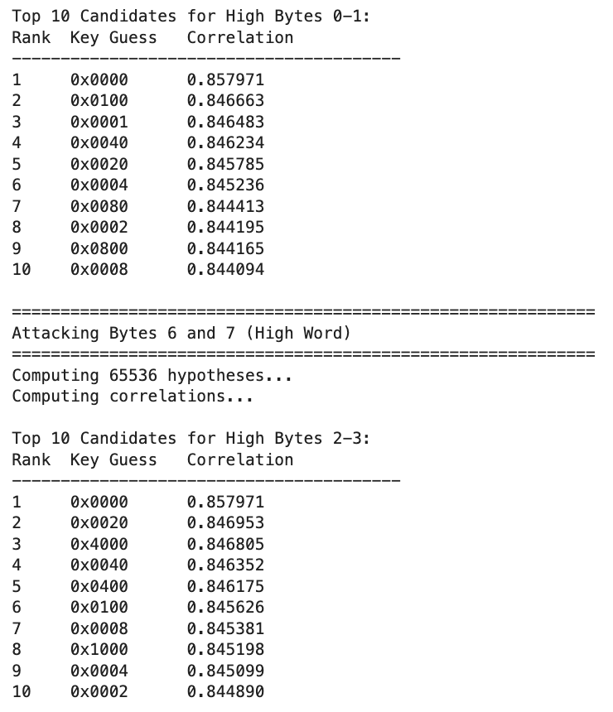
Results for k0_High
Results for all the bytes are wrong.
Correct bytes are not in top 10 guesses.
Possible reasons are false implementation, initial value of the register, noises.

Slide 15
summary
1. Implementation & Environment
Target: Successful implementation of Ascon authenticated encryption on firmware.
Data Acquisition: Power traces collected from the target hardware.
2. Testing & Synchronization
Testing: Ascon implementation tested both on local and target
Trace Alignment: Verified synchronization by comparing trace graphs across different cryptographic keys
3. Side-Channel Attack (SCA)
Side channel attack is performed by using Pearson Correlation
K₀_low: Successfully recovered with high confidence
K₀_high: Currently not recovered; further noise reduction or trace amplification required.

Slide 16
references
https://ascon.isec.tugraz.at/index.html
https://github.com/newaetech/chipwhisperer
https://chipwhisperer.readthedocs.io/en/latest/index.html
https://github.com/ascon/ascon-c/

Slide 17
Thank you for listening

