Slide 1
Recommendation Algorithm Results and Some Issues
Sun* ft Asian Frontier
Presenter & Author: Nguyen Van Dat – AI Engineer Sun*

Slide 2
Presentation content
Introduction
Recommendation Results
Result comparison
Some issues
The advantages
Conclusion

Slide 3
Introduction
This presentation is aim at showing off the results of my recommendation algorithm and listing some issues that need to be discussed to handle

Slide 4

Recommendation results
Currently, through a check for a while, results returned from my algorithm I approximate a 60 - 65% similarity to the sakenowa website.
This evaluation is based on the sakenowa search
The rest of my results, I strongly believe that is better than the others from the sakenowa.
Here is some examples:

Slide 5
Result Comparison
To determine the results of my algolrithm with results from the sakenowa
I have build a statistic table as decribed below
- Left column is my result
- Right column is results from the sakenowa
Please take a look:

Slide 6
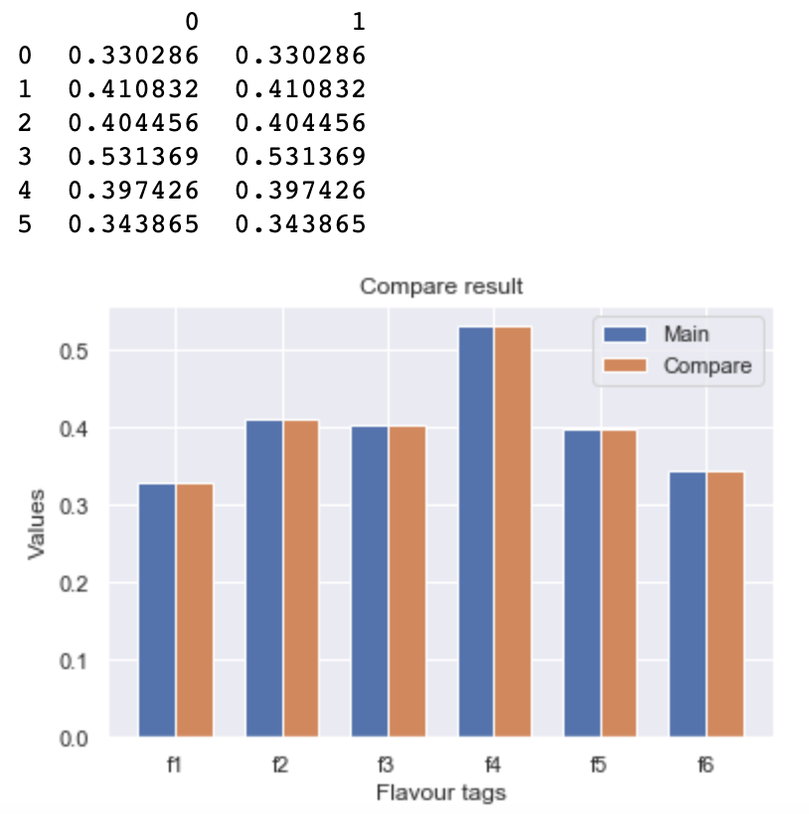

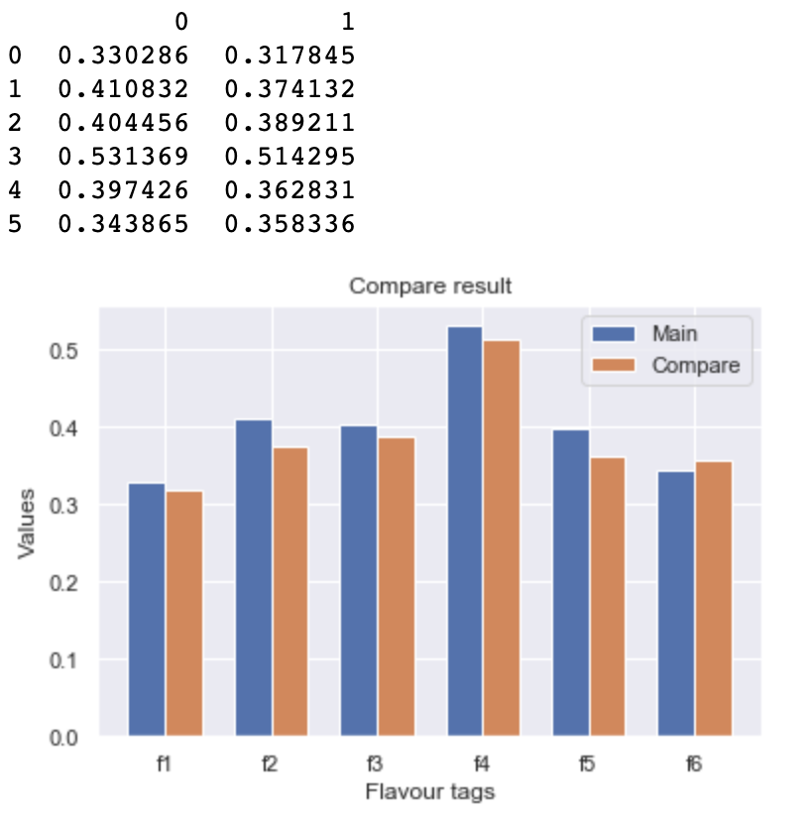
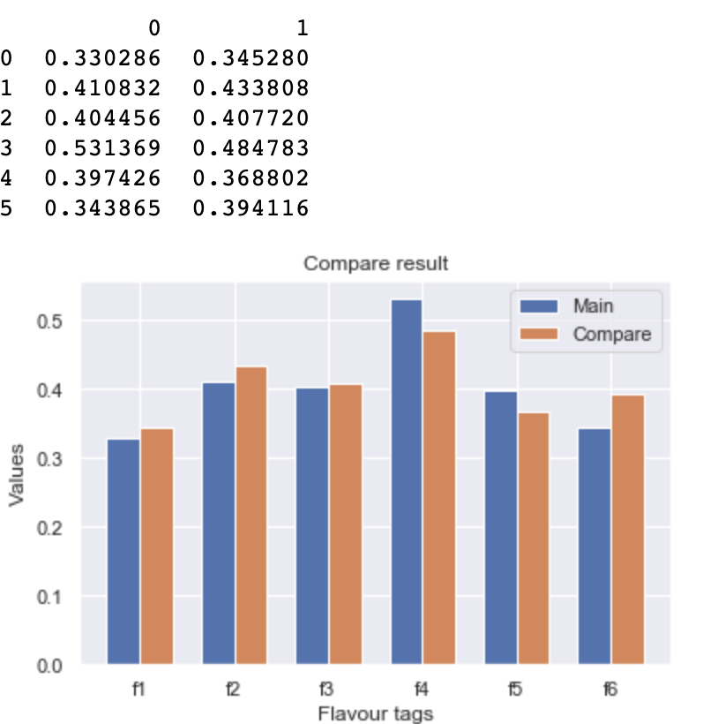
Result Comparison

Slide 7
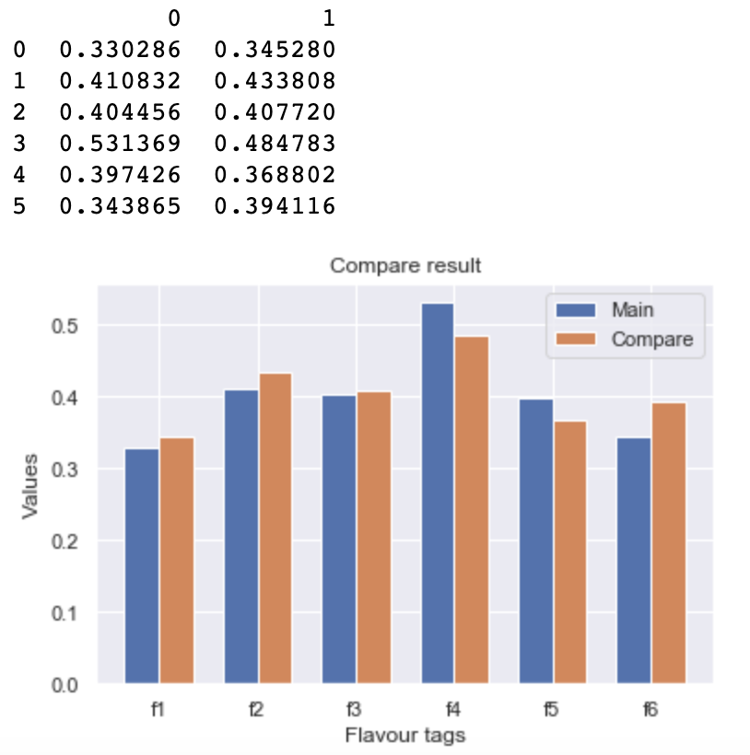
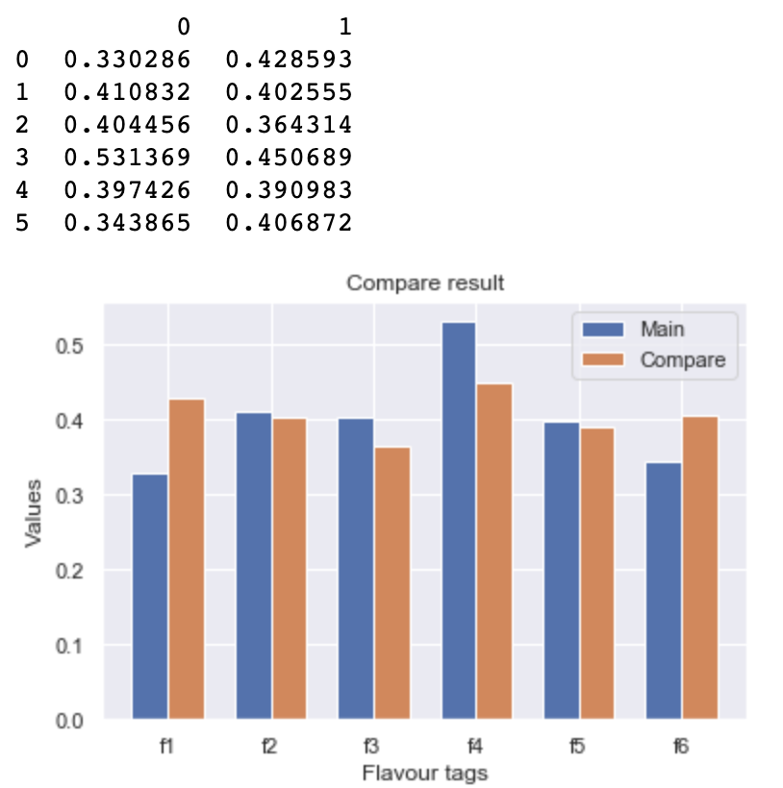
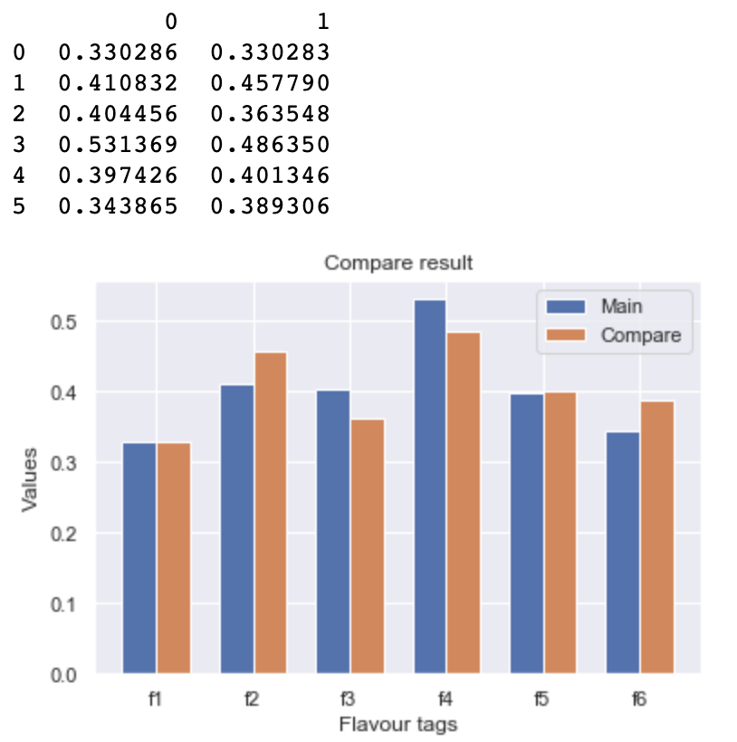
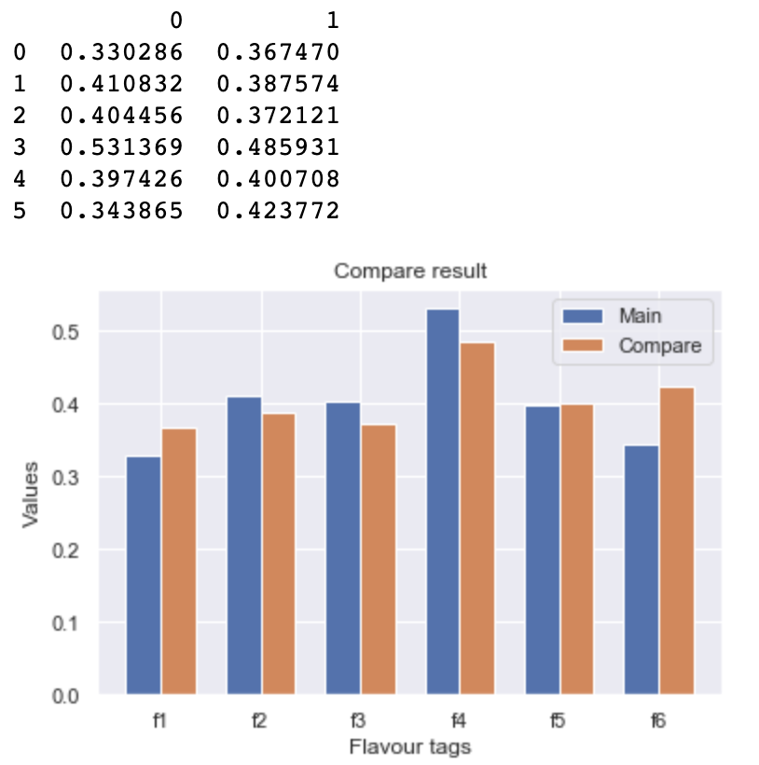
Result Comparison

Slide 8
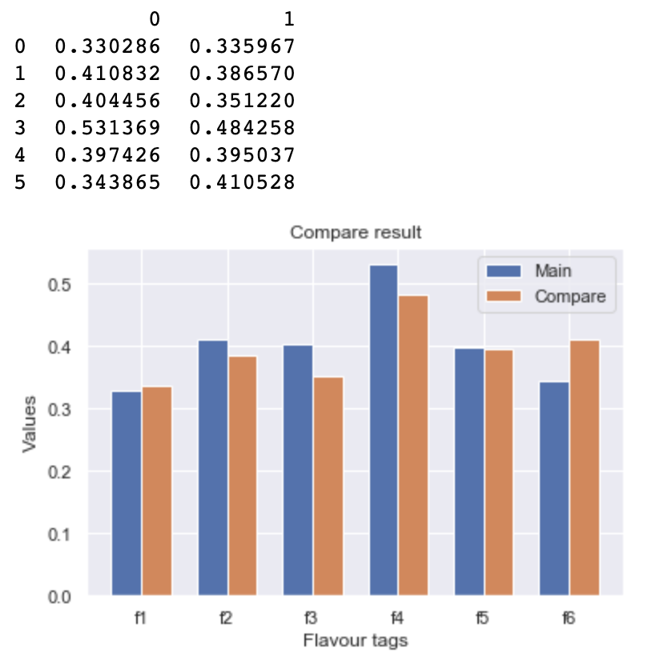
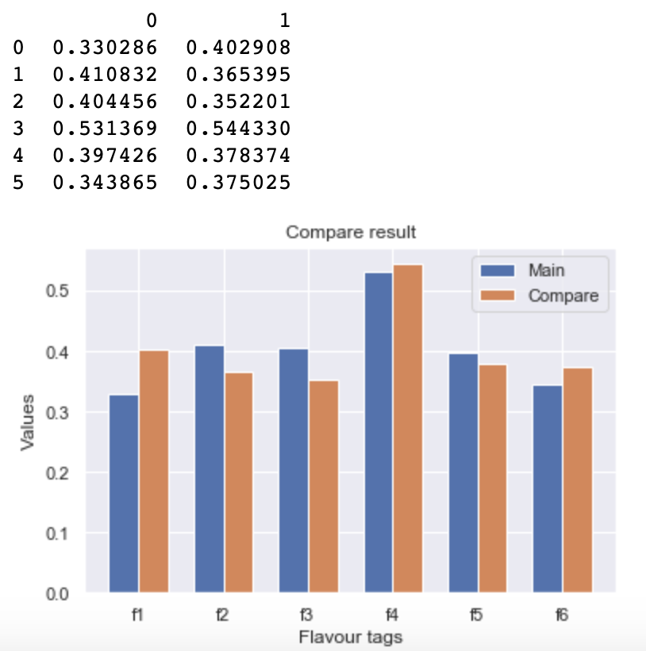
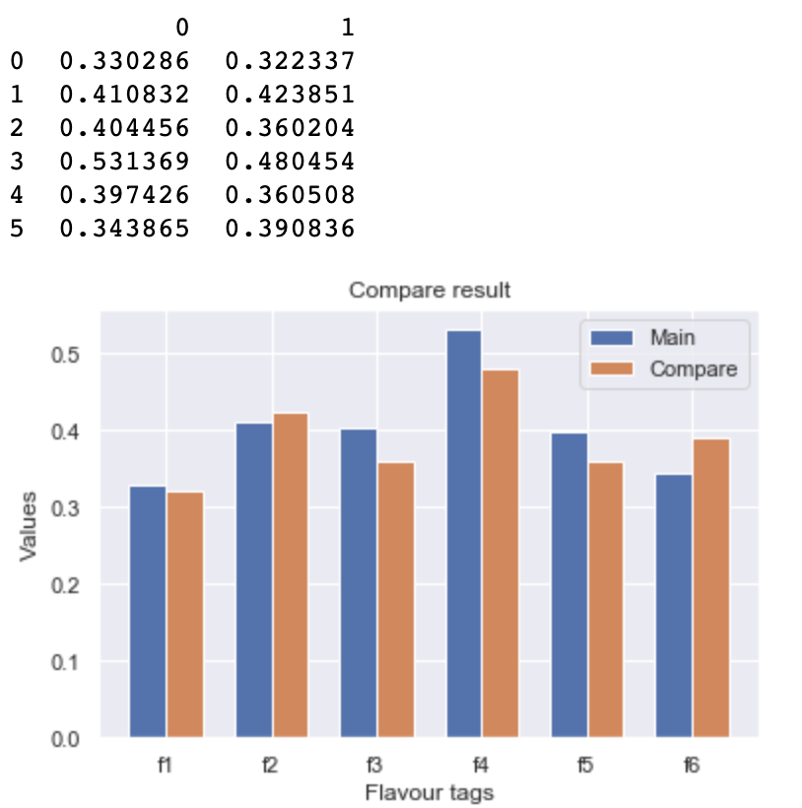
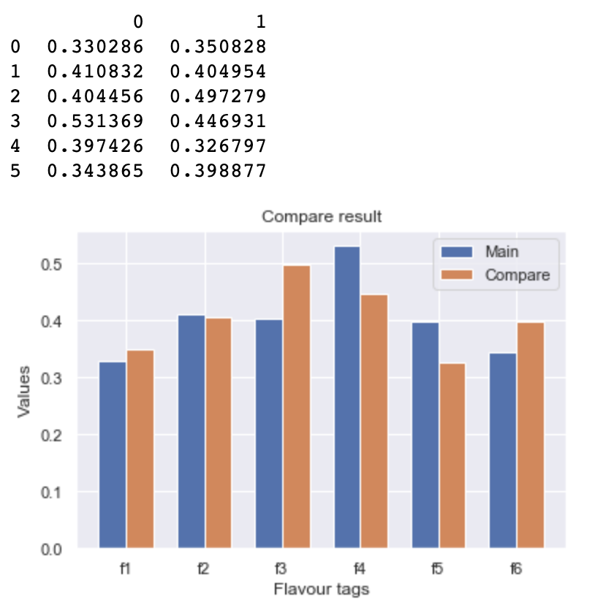
Result Comparison

Slide 9
Some issues
The similar products of one item in the sakenowa search is not the same with data crawled from sakenowa API
=> What source is better for evaluation
Many similar products crawled from sakenowa those does not exist
And many items returned from the sakenowa search does not exist
If the similar products returned from sakenowa search is more relizable; then, It will hit so much time all products can be tested hand-by-hands
Many items have blank flavour taste indices or flavour tags, that will be ignored or need to be handled by which method ?
Many items duplicate ?

Slide 10
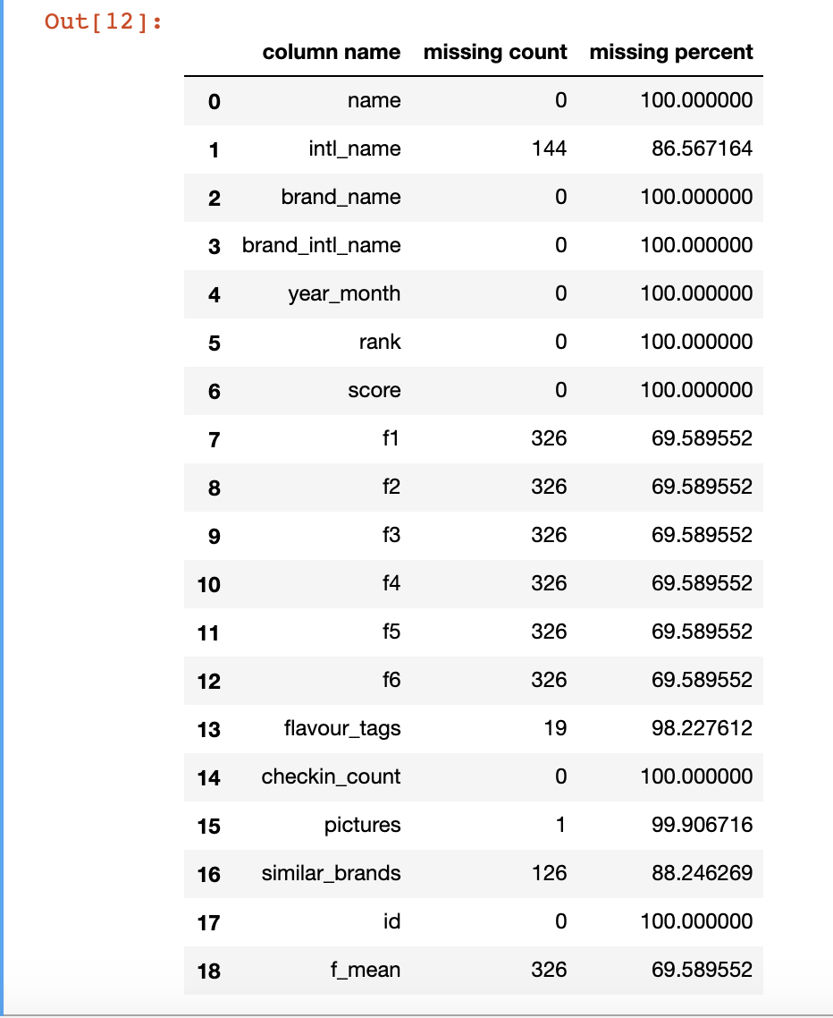
Some issues
Missing values statistic table

Slide 11
The Advantages of the algorithm
Time response is very very fast
Time spend for training model is also tiny
The recommend results is very prospect, potential
=> From my perspective, It is strong and robust for production environment.

Slide 12
Conclusion
As all arguments are mentioned above, In conclution I overwhelmingly believe the current algorithm is very prospective

Slide 13
Thank you for listening!

