Slide 1

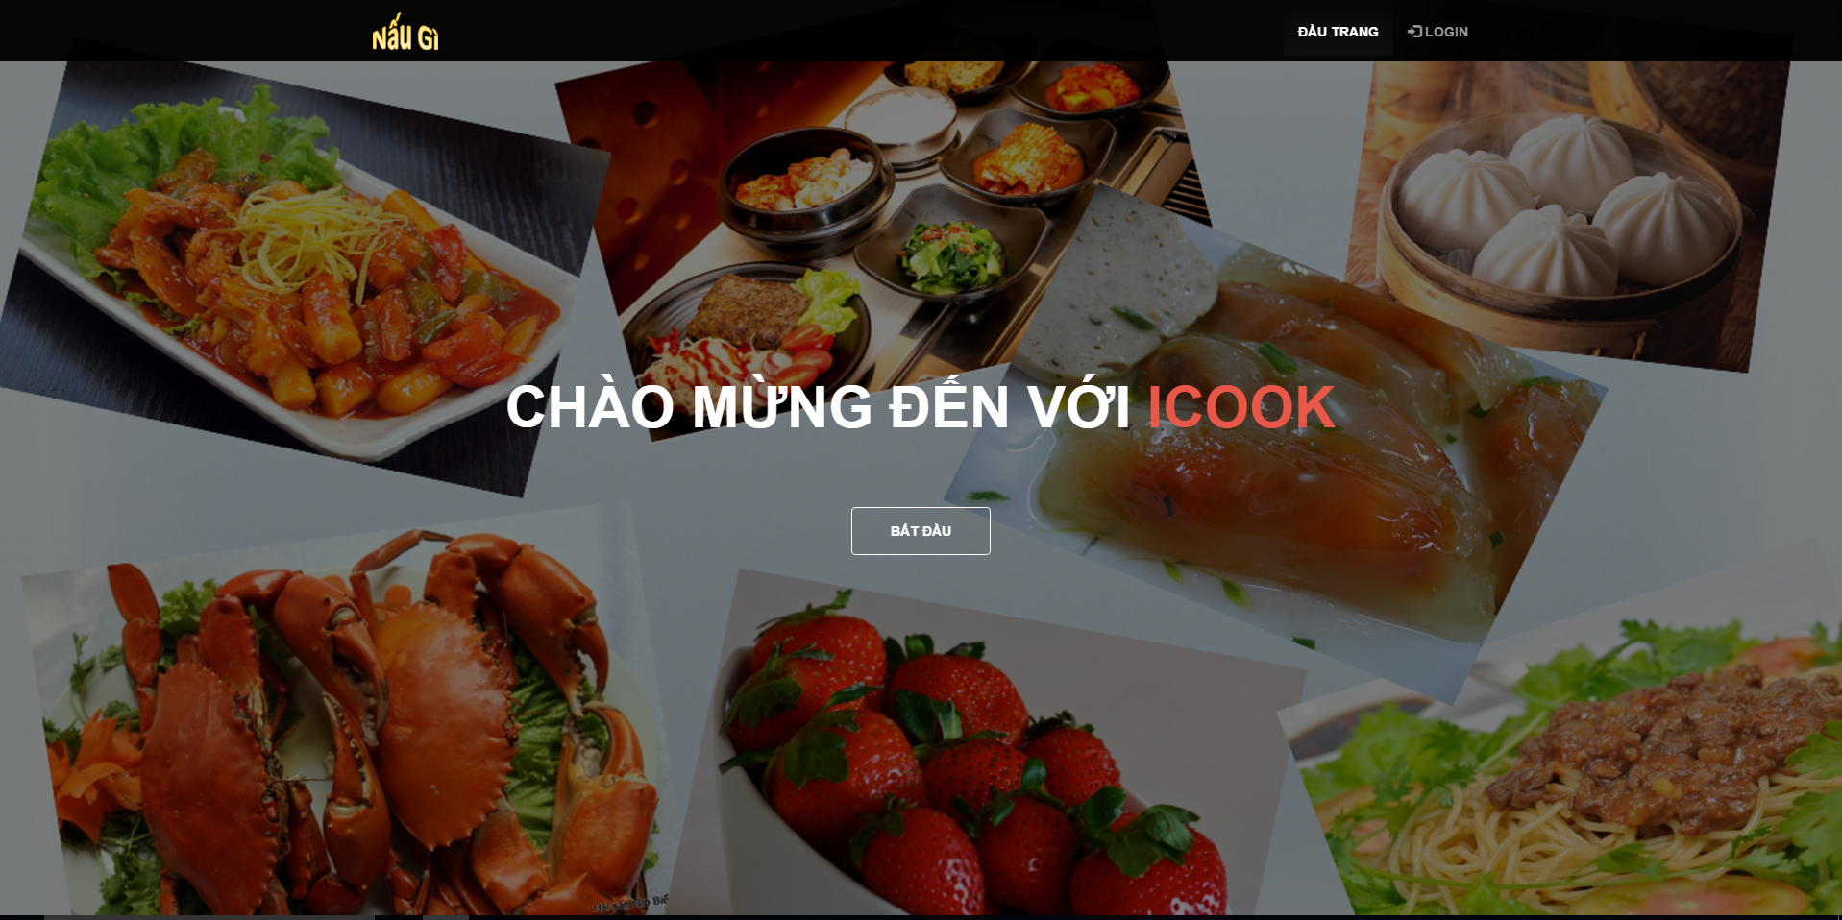
iCook Project
Team members:
Vo hong linh
Le ngoc hien
Tran quang tung
Luu tuan anh
Huynh thanh dat

Slide 2
Outline:
Requirement
Diagram
Demo

Slide 3
Requirement:
Design and develop a system to guide everybody to cook by some input material.
System can run on Web and mobile. (Android)

Slide 4
Diagrams:

Slide 5
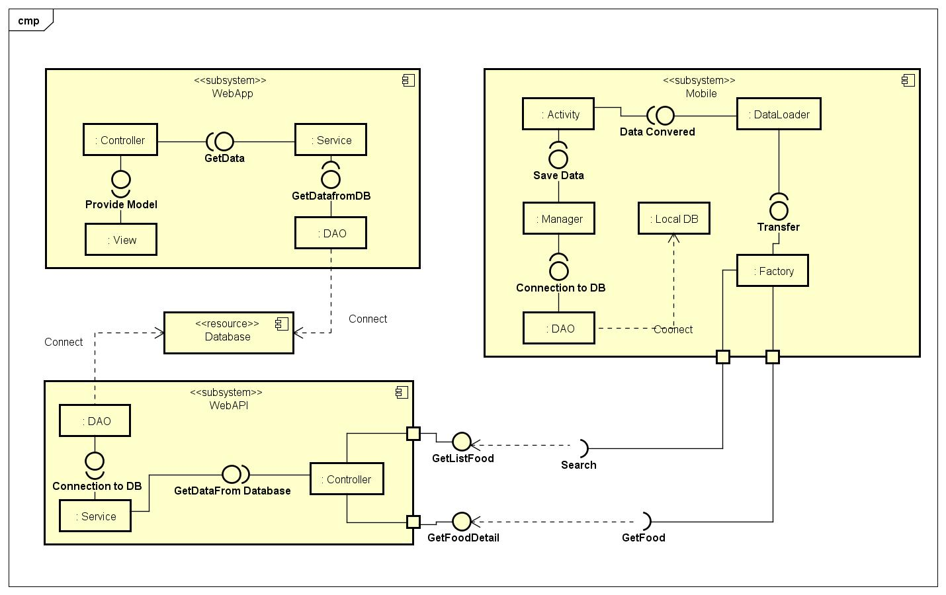
Component diagram:

Slide 6
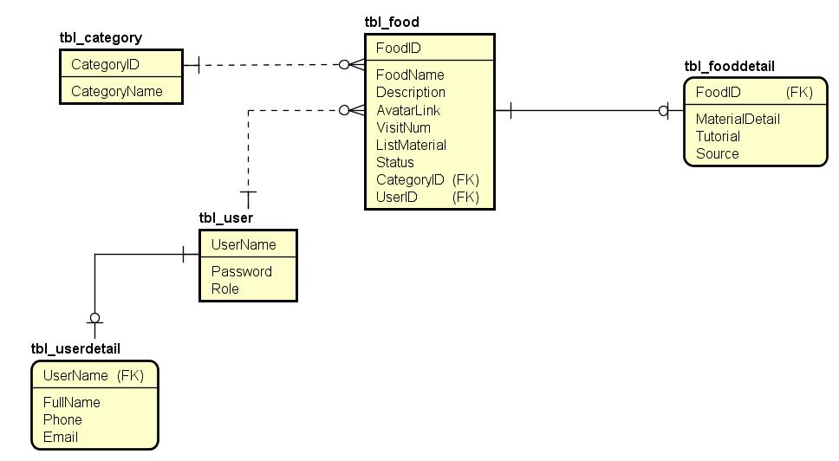
ERD

Slide 7
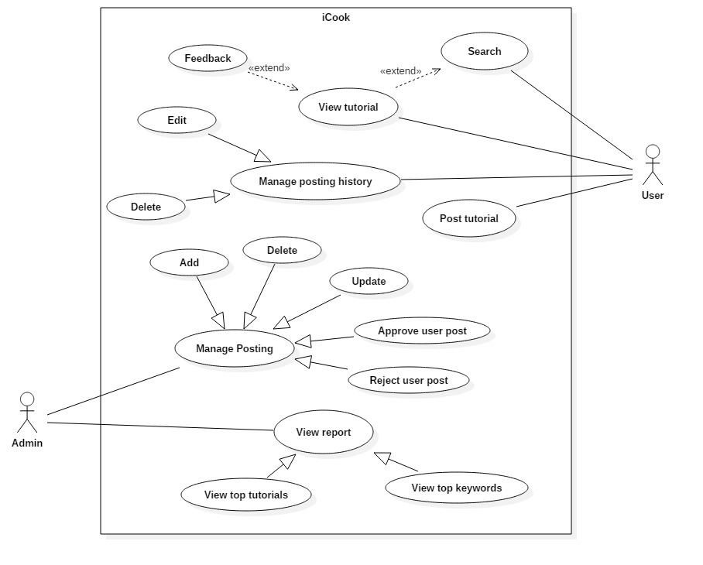
Usecase diagram:

Slide 8
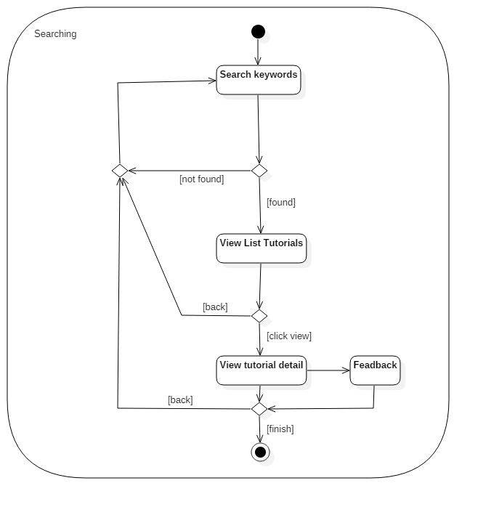

Slide 9
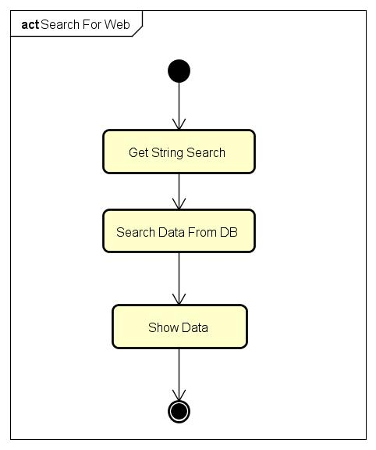

Slide 10
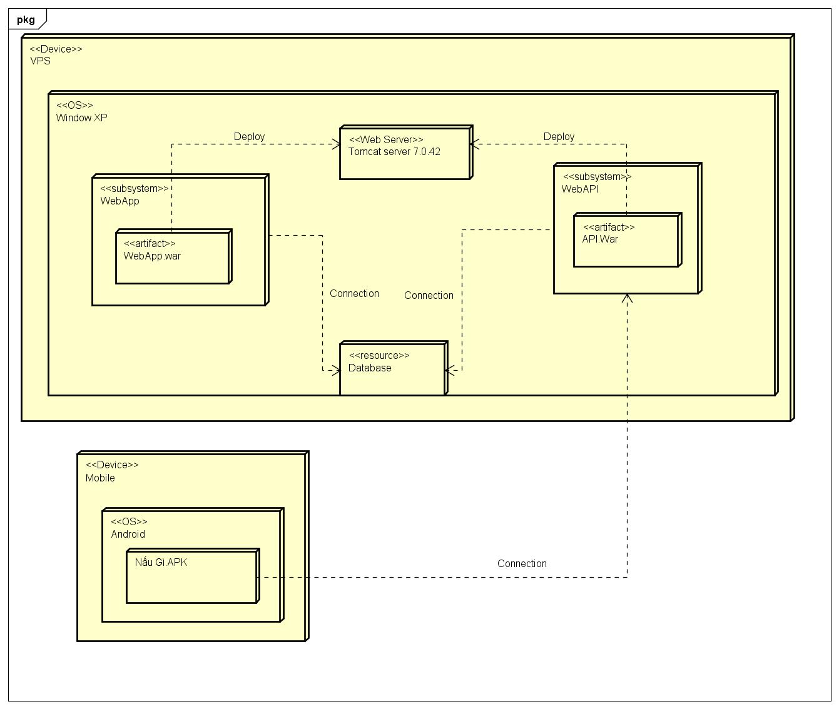
Deployment diagram:

Slide 11
Demo:

Slide 12
Thanks for listening ---The End---

