Slide 1
UNIT 22 / APPLICATION DEVELOPMENT
Ask anything
AI Study Mentor
Explain an equation
Step-by-step answer
Try a similar problem
Pearson (2025), Unit 22 Assignment Brief Part 1
Notes:
[Sources]
- Pearson (2025), Unit 22 Assignment Brief Part 1 (local brief).
This deck is intentionally limited to Part 1 Activity 1 (P1/P2) and Part 2 Activity 2 demo-slide.

Slide 2
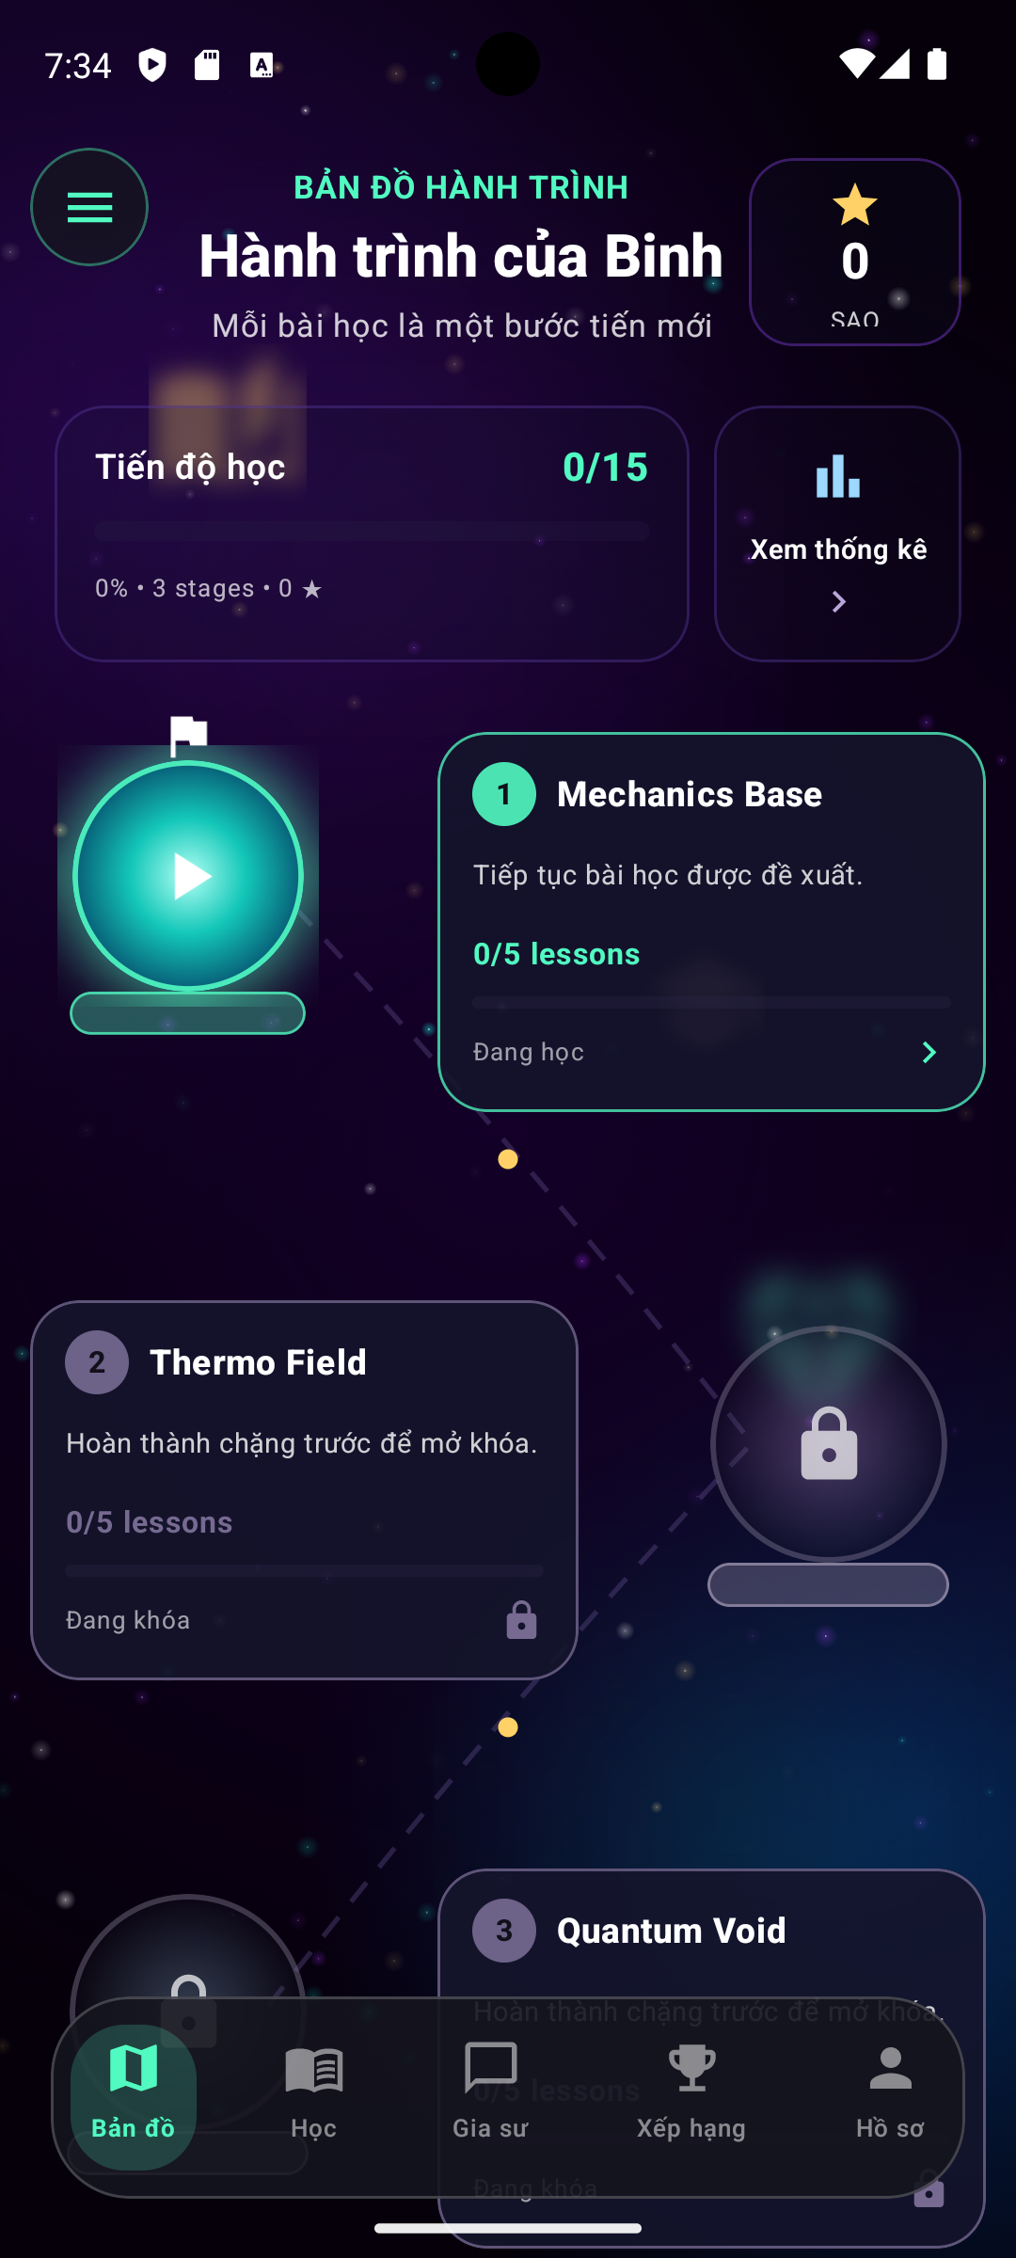
AI STUDY MENTOR
02
What BrightPath needs to solve
A clear business and user problem must be defined before selecting the solution.
User & Business problem
Students need immediate and understandable academic support
Learners may become stuck outside classroom hours.
Questions may come from different subjects and education levels.
Explanations must be simple, structured and appropriate for the learner.
Students need a clear next step after receiving help.
BrightPath must deliver a reliable MVP under strong constraints
Junior mobile development team
Limited development and AI budget
14-week MVP schedule
Student privacy and safety requirements
Need to control repeated AI API calls
Proposed response
Develop an Android-first AI Study Mentor that combines learning journeys, AI tutoring, progress tracking, daily missions and gamification in one student-focused application.
Notes:
[Sources]
- Pearson (2025), Unit 22 Assignment Brief Part 1 (local brief).

Slide 3
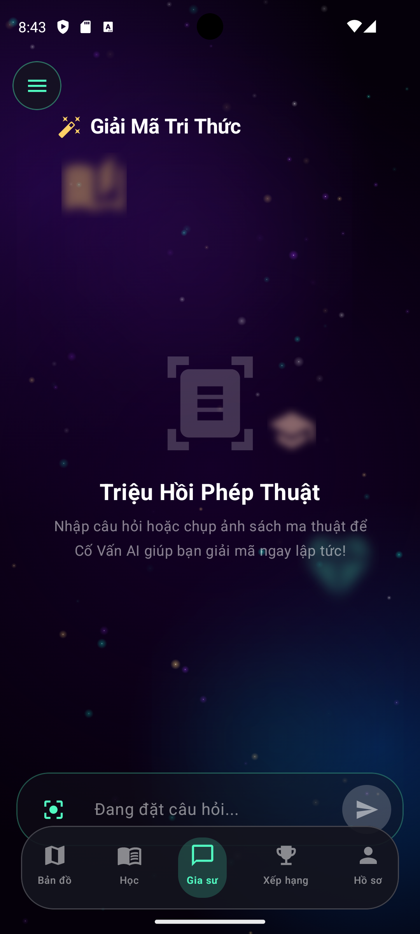
AI STUDY MENTOR
03
A Clearly Defined Problem Statement
Main problem statement
  BrightPath Learning needs to develop an Android-based AI Study Mentor for middle school, high school and university students who require immediate academic support outside classroom hours. The application must accept text and image questions, generate clear and level-appropriate explanations, protect student information and remain achievable within a 14-week MVP schedule and limited AI budget.
Current situation
Academic support may not be available when students become stuck.
Questions may involve text, equations, images or diagrams.
Answers that only provide final results do not support understanding.
BrightPath has a junior team and limited development resources.
Desired outcome
Students can submit a question in minimal steps.
AI explains the concept and logical solution process.
The student can save, review and practise related content.
BrightPath can control security, reliability and AI operating costs.
Success statement
  Success means that a student can ask, understand, practise and continue learning without requiring a teacher or lecturer to be available at that moment.
Notes:
[Sources]
- Pearson (2025), Unit 22 Assignment Brief Part 1 (local brief).

Slide 4
AI STUDY MENTOR
04
Students Face Delays, Input Barriers and Weak Explanations
The proposed application must remove friction at the moment a learner becomes stuck.
Delayed support
Multiple question formats
Answers may not support understanding
Issue: Students may need help outside classroom hours when a teacher or lecturer is unavailable.
Impact
Learning is interrupted.
Homework may remain incomplete.
Students may lose confidence or abandon the task.
System response: Provide immediate AI-supported question answering.
Issue. Academic questions may include:
typed text;
equations;
homework photographs;
diagrams;
programming code.
Impact: A text-only system would not support many real study situations.
System response: Support both text submission and image upload.
Issue: A final answer alone does not explain:
the reasoning;
the formula;
the concept;
common mistakes.
Impact: Students may copy the result without learning how to solve a similar problem.
System response: Provide structured, step-by-step and concept-based explanations.
Explanations may not fit the learner
Issue: Middle school, high school and university students require different levels of language and detail.
Impact: An answer may be too difficult, too basic or too long.
System response: Adapt the explanation to education level and preferred explanation style.
Notes:
[Sources]
- Pearson (2025), Unit 22 Assignment Brief Part 1 (local brief).

Slide 5
AI STUDY MENTOR
05
Project Constraints and Development Challenges
Project Challenges
Challenge | Business Impact
Junior development team | Longer implementation time
Limited AI budget | High API operating cost
Student privacy | Security and compliance requirements
14-week MVP | Limited feature scope
Design Responses
Android-first MVP
Secure REST API Backend
AI Cost Optimisation
MoSCoW Prioritisation
Team Training
Notes:
[Sources]
- Pearson (2025), Unit 22 Assignment Brief Part 1 (local brief).
Training time is included in the project plan rather than hidden as an assumption.

Slide 6
AI STUDY MENTOR
06
Stakeholders and Their Expectations
The solution must balance learning value, delivery constraints and student protection.
Stakeholder | Role | Main expectations
Students | Primary end users | Fast answers, clear explanations, simple navigation, learning progress and secure personal data
BrightPath Learning Team | Product owner and developer | Deliver the MVP within 14 weeks, control AI costs, maintain the system and support future growth
Parents or Guardians | Supporting stakeholders | Safe, age-appropriate use and protection of underage learners
Privacy Regulators | External stakeholders | GDPR/COPPA compliance, consent, secure storage and appropriate data handling
AI Service Provider | External dependency | Stable API access, predictable cost, acceptable response time and reliable integration
Notes:
[Sources]
- Pearson (2025), Unit 22 Assignment Brief Part 1 (local brief).
- https://eur-lex.europa.eu/eli/reg/2016/679/oj
- https://www.ftc.gov/legal-library/browse/rules/childrens-online-privacy-protection-rule-coppa
Pearson (2025), Unit 22 Assignment Brief Part 1: stakeholders, security and safety requirements.

Slide 7
AI STUDY MENTOR
07
The Student Learning Journey
The application supports both structured learning and immediate AI assistance.
1
Students select a subject, chapter or lesson from the learning journey.
Explore
2
Ask and understand
Students can study the lesson or ask the AI Tutor when they need additional help.
Practise
Students complete quizzes, review tasks and daily missions.
3
Progress
The application records XP, achievements, streaks and completed learning activities.
4
Review
Students return to previous topics and continue from their current position.
5
Every feature should help the student move from confusion to understanding and from understanding to measurable progress.
Notes:
[Sources]
- Pearson (2025), Unit 22 Assignment Brief Part 1 (local brief).

Slide 8
AI STUDY MENTOR
08
User Needs Translated into Testable Requirements
Each user need should be linked to a system behaviour and an observable result.
User need | System requirement | Observable result
Access the application securely | The system shall support registration and login using email and password | A valid user can sign in and access a personal profile
Find a clear learning path | The system shall display subjects, chapters and lesson progression | The student can open an available chapter and continue learning
Receive immediate help | The system shall provide an AI Tutor for academic questions | A submitted question produces a visible AI response or error state
Practise consistently | The system shall provide lessons, missions or quizzes | Completion updates mission or learning progress
Track achievement | The system shall record XP, level, streak and achievements | Updated values appear in the profile or progress interface
Stay motivated | The system shall provide daily missions and leaderboard features | Students can view rewards, mission progress and ranking
Revisit learning content | The system should store previous learning activity or saved content | The student can return to previously accessed learning content
Notes:
[Sources]
- Pearson (2025), Unit 22 Assignment Brief Part 1 (local brief).

Slide 9
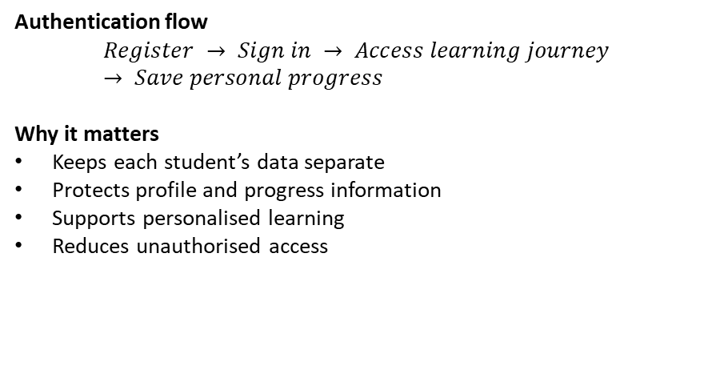
AI STUDY MENTOR
09
Authentication Protects the Personal Learning Space
Secure access separates each student’s profile, progress and learning activity.
Implemented in the current application
User registration with email and password
User login with validated credentials
Personal access to profile and progress information
Authenticated navigation to learning features
Logout from the personal account
Required or planned security enhancements
Stronger password validation
Password recovery
Optional two-factor authentication
First-use education-level and subject preferences
Preferred explanation-style settings
Authentication flow
$$Register → Sign in → Access learning journey → Save personal progress$$
Why it matters
Keeps each student’s data separate
Protects profile and progress information
Supports personalised learning
Reduces unauthorised access
Notes:
[Sources]
- Pearson (2025), Unit 22 Assignment Brief Part 1 (local brief).
- https://www.ftc.gov/legal-library/browse/rules/childrens-online-privacy-protection-rule-coppa
Pearson (2025), Unit 22 Assignment Brief Part 1: authentication and first-use preferences.

Slide 10
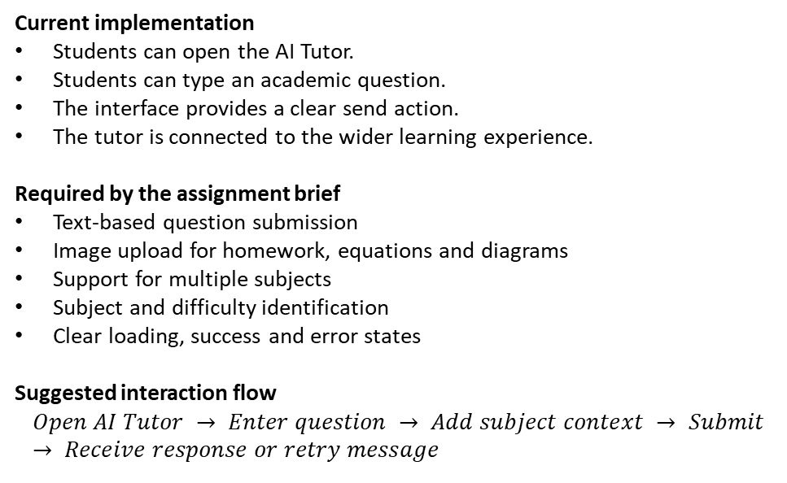
AI STUDY MENTOR
10
Question Submission Should Be Fast and Flexible
Students should be able to ask for help with minimal steps and clear system feedback.
Current implementation
Students can open the AI Tutor.
Students can type an academic question.
The interface provides a clear send action.
The tutor is connected to the wider learning experience.
Required by the assignment brief
Text-based question submission
Image upload for homework, equations and diagrams
Support for multiple subjects
Subject and difficulty identification
Clear loading, success and error states
Suggested interaction flow
$$Open AI Tutor → Enter question → Add subject context → Submit → Receive response or retry message$$
Notes:
[Sources]
- Pearson (2025), Unit 22 Assignment Brief Part 1 (local brief).

Slide 11
AI STUDY MENTOR
11
AI answers must teach, not only calculate
The answer format is part of the user requirement.
Additional learning support
Simplified explanation
Alternative approach
Key concept summary
Common mistakes to avoid
Suggested follow-up question
Reliability and safety
Show loading while the answer is generated
Display a clear retry option if the request fails
Avoid presenting uncertain output as guaranteed fact
Keep explanations appropriate for the learner’s level
Expected answer structure:
Identify the subject and difficulty
Explain the relevant concept or formula
Show the logical solution steps
Present the final answer clearly
Suggest a next learning action
Notes:
[Sources]
- Pearson (2025), Unit 22 Assignment Brief Part 1 (local brief).

Slide 12
AI STUDY MENTOR
12
Multi-Subject Learning Support
The application must adapt its explanation style to the subject and the student’s education level.
STEM
COMPUTING
HUMANITIES
Mathematics + Physic + Chemistry + Biology
Programming
languages
Formulas, diagrams, working and concept explanations.
Code, debugging, syntax and step-by-step reasoning.
Clear context, vocabulary and appropriately simple explanations.
Notes:
[Sources]
- Pearson (2025), Unit 22 Assignment Brief Part 1 (local brief).

Slide 13
AI STUDY MENTOR
13
Question History and Personal Learning Library
Saved learning content allows students to return, review and continue learning over time.
Required system capabilities
Automatically save each question and AI answer
Search previous questions
Bookmark important answers
Filter or organise content by subject
Reopen previously answered questions
Suggest review for frequently repeated topics
Allow selected saved content to be viewed offline
Notes:
[Sources]
- Pearson (2025), Unit 22 Assignment Brief Part 1 (local brief).

Slide 14
AI STUDY MENTOR
14
Practice Reinforces Learning
Students should apply newly learned knowledge after completing a lesson or receiving support from the AI Tutor.
Practice
Lesson
Students study a topic through the learning journey.
↓
AI Tutor
Students ask for additional explanation when they are unsure.
↓
Practice
Students complete a short learning activity.
↓
Feedback
The system shows the result and explains mistakes.
↓
Progress
XP, mission progress and learning statistics are updated.
Supported Practice Types
Multiple-choice questions
Short-answer questions
Fill-in-the-blank activities
Lesson review exercises
Daily learning missions
Learning Response
Immediate correctness feedback
Explanation for incorrect answers
XP reward after completion
Daily mission progress updated
Recommendation for the next lesson
Suggested follow-up practice
Algebra / medium
Choose a step
Instant feedback
Try a similar problem
Notes:
[Sources]
- Pearson (2025), Unit 22 Assignment Brief Part 1 (local brief).

Slide 15
AI STUDY MENTOR
15
Progress tracking shows whether the product helps
Activity becomes useful when it creates a visible learning signal.
Dashboard requirements
72
64
- Total questions asked
- Most studied subjects
- Quiz accuracy rate
- Time spent reviewing
- AI-generated insights
48
36
Questions
Accuracy
Review
Practice
Notes:
[Sources]
- Pearson (2025), Unit 22 Assignment Brief Part 1 (local brief).

Slide 16
AI STUDY MENTOR
16
Engagement should reinforce useful study behaviour
XP and badges are secondary to learning value.
EARN
UNLOCK
OPTIONAL
XP
Themes + avatars
Leaderboard
For asking, reviewing and completing practice quizzes.
Lightweight continuity and a sense of progress.
Friends or global activity without exposing sensitive data.
Notes:
[Sources]
- Pearson (2025), Unit 22 Assignment Brief Part 1 (local brief).

Slide 17
AI STUDY MENTOR
17
Notifications should bring students back to useful work
Reminders are valuable only when they have a clear learning reason.
Notification requirements
Safety controls
- Review bookmarked answers
- Alert repeated mistakes
- Motivate consistent activity
- Send daily or weekly summaries
- User-controlled preferences
- Quiet hours
- No sensitive content in previews
- Age-appropriate defaults
Notes:
[Sources]
- Pearson (2025), Unit 22 Assignment Brief Part 1 (local brief).
- https://www.ftc.gov/legal-library/browse/rules/childrens-online-privacy-protection-rule-coppa
Pearson (2025), Unit 22 Assignment Brief Part 1: notifications and security.

Slide 18
AI STUDY MENTOR
18
Offline access protects the review experience
Previously answered questions can remain useful without a network connection.
1
2
3
4
Download
Read
Review
Sync
Offline scope
When online returns
Read history, view bookmarks and continue downloaded practice.
Sync queued questions, refresh progress and show status clearly.
Notes:
[Sources]
- Pearson (2025), Unit 22 Assignment Brief Part 1 (local brief).

Slide 19
AI STUDY MENTOR
19
Security and safety are functional requirements
Student questions, images and profile data must be treated as protected content.
Requirement
Expected behaviour
Why it matters
Password strength
Weak passwords are blocked
Reduces account compromise
2FA option
Second factor can be enabled
Adds protection for personal history
Encrypted storage
User data and images protected
Limits exposure of student content
Abuse detection
Spam and inappropriate content flagged
Protects the learning environment
Notes:
[Sources]
- Pearson (2025), Unit 22 Assignment Brief Part 1 (local brief).
- https://eur-lex.europa.eu/eli/reg/2016/679/oj
- https://www.ftc.gov/legal-library/browse/rules/childrens-online-privacy-protection-rule-coppa
Pearson (2025), Unit 22 Assignment Brief Part 1: security and safety requirements.

Slide 20
AI STUDY MENTOR
20
Performance and usability make the promise credible
Non-functional requirements shape the experience students actually feel.
PERFORMANCE
USABILITY
PLATFORM
Fast and resilient
Simple and readable
Android first
Handle concurrent questions, optimise response time and show useful loading states.
Minimal submission steps, clear answer structure and intuitive navigation.
Support Android for the MVP; keep iOS as an optional future channel.
Notes:
[Sources]
- Pearson (2025), Unit 22 Assignment Brief Part 1 (local brief).

Slide 21
AI STUDY MENTOR
21
Privacy and compatibility constrain the design
The application must be usable across learners without collecting unnecessary data.
Privacy
Compatibility
- Securely encrypt user data
- Minimise collection
- Consider GDPR
- Consider COPPA for younger students
- Define retention and access rules
- Android is the MVP platform
- iOS is optional
- Previously answered content works offline
- New questions sync after reconnection
Notes:
[Sources]
- Pearson (2025), Unit 22 Assignment Brief Part 1 (local brief).
- https://eur-lex.europa.eu/eli/reg/2016/679/oj
- https://www.ftc.gov/legal-library/browse/rules/childrens-online-privacy-protection-rule-coppa
Pearson (2025), Unit 22 Assignment Brief Part 1: privacy and platform compatibility.

Slide 22
AI STUDY MENTOR
22
The MVP must fit a 14-week window
Scope is a requirement because delivery time is part of the business problem.
Constraint
Implication
MVP response
Timeline
No room for broad feature parity
Prioritise core learning loop
Budget
AI calls have operating cost
Cache, reuse and quota requests
Team skills
Mobile and AI learning is needed
Plan training and pairing
Quality
A fast answer can still be wrong or unsafe
Guardrails, testing and fallback
Notes:
[Sources]
- Pearson (2025), Unit 22 Assignment Brief Part 1 (local brief).

Slide 23
AI STUDY MENTOR
23
The mobile application is the strongest MVP option
Its camera access and always-available form factor directly fit the problem.
Option
Strength
Weakness
Decision
Desktop
Large screen and power
Not available at the moment of confusion
Reject for MVP
Web
Broad reach and easy updates
Less controlled camera / offline experience
Future channel
Mobile
Portable, camera-ready, familiar
Platform complexity
Select for MVP
Notes:
[Sources]
- Pearson (2025), Unit 22 Assignment Brief Part 1 (local brief).

Slide 24
AI STUDY MENTOR
24
MVP scope keeps the first release achievable
The first release protects the learning loop and postpones optional polish.
Priority
Included features
Release
MUST
Auth, text/image question, AI answer, history, basic progress
MVP
SHOULD
Bookmarks, practice, offline reading, reminders
If stable
COULD
Gamification, avatars, leaderboards, voice input
Phase 2
WON'T yet
Premium plans, advanced social features, iOS parity
Later
Notes:
[Sources]
- Pearson (2025), Unit 22 Assignment Brief Part 1 (local brief).

Slide 25
AI STUDY MENTOR
25
P1 conclusion: requirements describe one coherent product
The proposed solution is a focused mobile AI mentor, not a general-purpose education platform.
Ask
Understand
Practise
Review
1
2
3
4
Question
Explanation
Practice
Progress
Notes:
[Sources]
- Pearson (2025), Unit 22 Assignment Brief Part 1 (local brief).

Slide 26
01
PART 1 / ACTIVITY 1 / P2
Risk is managed before it becomes rework.
The risk plan focuses on the constraints named in the brief: skills, AI cost, schedule and student data.
Notes:
[Sources]
- Pearson (2025), Unit 22 Assignment Brief Part 1 (local brief).
P2 risk management: five slides follow.

Slide 27
AI STUDY MENTOR
27
Risk 1: junior skills can slow the first sprint
The mitigation is planned learning, not an optimistic assumption.
Risk
Mitigation
The team has limited mobile application, AI integration and secure data-handling experience.
- Include training in week 1
- Pair on the first vertical slice
- Use one focused Android stack
- Review architecture early
Notes:
[Sources]
- Pearson (2025), Unit 22 Assignment Brief Part 1 (local brief).

Slide 28
AI STUDY MENTOR
28
Risk 2: repeated AI calls can break the budget
Cost control must sit in the architecture from the beginning.
Risk
Mitigation
High requests, repeated questions or overly long responses can create an unaffordable API bill.
- Semantic or exact-match caching
- Prompt and response limits
- Weekly quotas
- Usage dashboard
- Safe fallback when limit is reached
Notes:
[Sources]
- Pearson (2025), Unit 22 Assignment Brief Part 1 (local brief).

Slide 29
AI STUDY MENTOR
29
Risk 3: schedule pressure can cause scope creep
The team needs a visible rule for what leaves the MVP.
Risk
Mitigation
A 14-week deadline can be lost when optional gamification, iOS parity or premium features enter too early.
- Freeze MUST items
- Demo every increment
- Review backlog every sprint
- Move COULD features to Phase 2
Notes:
[Sources]
- Pearson (2025), Unit 22 Assignment Brief Part 1 (local brief).

Slide 30
AI STUDY MENTOR
30
Risk 4: student data needs stronger-than-average care
A safe MVP treats privacy, consent and access control as release gates.
Risk
Mitigation
Questions, images and underage-user data could be exposed through weak authentication, storage rules or consent handling.
- Encrypt stored content
- Apply least-privilege access
- Add 2FA option
- Test consent and deletion
- Run security review before demo
Notes:
[Sources]
- Pearson (2025), Unit 22 Assignment Brief Part 1 (local brief).
- https://eur-lex.europa.eu/eli/reg/2016/679/oj
- https://www.ftc.gov/legal-library/browse/rules/childrens-online-privacy-protection-rule-coppa
P2 closes with an explicit release gate: security and privacy cannot be deferred.

Slide 31
02
PART 2 / ACTIVITY 2 / DEMO
Demo-slide: show the product learning loop.
The demo section introduces the developed application and walks through the student journey.
Notes:
[Sources]
- Pearson (2025), Unit 22 Assignment Brief Part 1 (local brief).
The screens below are presentation mockups because no APK, source project or screenshots were supplied in the workspace.

Slide 32
DEMO / 01 - START
32
Demo 1: open the app and choose a learning profile
Show the real login/onboarding screen here during the individual demo.
Welcome
Presenter focus
Requirement demonstrated
- How a new user registers
- How preferences are selected
- What is required vs optional
Email + password
User registration, secure login and first-use profile choices.
Choose education level
Choose subjects
Set explanation style
Replace with actual app screenshot
Notes:
[Sources]
- Pearson (2025), Unit 22 Assignment Brief Part 1 (local brief).
Replace mockup with a real screenshot from the developed application before submission.

Slide 33
DEMO / 02 - ASK
33
Demo 2: submit a text or image question
The strongest demo moment is the shortest path from confusion to a submitted question.
New question
Presenter focus
Requirement demonstrated
- Show text input
- Show camera / image selection
- Show loading and error state
Type a question
AI question submission using text and image formats across multiple subjects.
Take a homework photo
Select subject
Send to Mentor
Replace with actual app screenshot
Notes:
[Sources]
- Pearson (2025), Unit 22 Assignment Brief Part 1 (local brief).
Replace mockup with a real screenshot from the developed application before submission.

Slide 34
DEMO / 03 - ANSWER
34
Demo 3: read a structured AI explanation
The answer should visibly teach the reasoning and state the final answer clearly.
AI answer
Presenter focus
Requirement demonstrated
- Point to step-by-step structure
- Show explanation style
- Show any safety or retry state
Topic identified
AI identifies subject and difficulty, explains logically and adapts language.
Step 1: concept
Step 2: working
Final answer + next step
Replace with actual app screenshot
Notes:
[Sources]
- Pearson (2025), Unit 22 Assignment Brief Part 1 (local brief).
Replace mockup with a real screenshot from the developed application before submission.

Slide 35
DEMO / 04 - LIBRARY
35
Demo 4: save and revisit an answer
The application becomes more useful when the first answer remains available later.
My library
Presenter focus
Requirement demonstrated
- Save an answer
- Search history
- Bookmark and reopen
- Show offline behaviour if implemented
Search past questions
Question history, personal library, search and bookmarks.
Filter by subject
Bookmark answer
Read offline
Replace with actual app screenshot
Notes:
[Sources]
- Pearson (2025), Unit 22 Assignment Brief Part 1 (local brief).
Replace mockup with a real screenshot from the developed application before submission.

Slide 36
DEMO / 05 - PRACTICE
36
Demo 5: turn an answer into practice
The demo should end with a next learning action rather than a passive result.
Practice
Presenter focus
Requirement demonstrated
- Generate or open practice
- Submit an attempt
- Show feedback
- Link back to progress
Choose question type
AI-generated practice questions, instant feedback and progress tracking.
Submit attempt
Instant feedback
Review weak topic
Replace with actual app screenshot
Notes:
[Sources]
- Pearson (2025), Unit 22 Assignment Brief Part 1 (local brief).
Replace mockup with a real screenshot from the developed application before submission.

Slide 37
DEMO / 06 - END-TO-END
37
Demo 6: complete the learning loop
Use this sequence as the individual live-demo route.
1
2
3
4
5
6
Login
Ask
Answer
Save
Practise
Progress
Keep the live demo focused: one question, one answer, one saved item and one practice attempt.
Notes:
[Sources]
- Pearson (2025), Unit 22 Assignment Brief Part 1 (local brief).
This slide is a presenter route, not a claim that all features are implemented. Demonstrate only what the application supports.

Slide 38
DEMO / 07 - EVIDENCE
38
Demo evidence should connect each screen to a requirement
Screen / action
Requirement shown
Evidence to attach
A strong individual demo explains what the audience is seeing and why it matters.
Login + profile
Registration and first-use choices
Screenshot or live recording
Question capture
Text / image submission
Real app input + result
AI answer
Structured explanation
Response screen + fallback
Library
History + bookmarks
Saved item reopened
Practice
Feedback + progress
Attempt and updated state
Notes:
[Sources]
- Pearson (2025), Unit 22 Assignment Brief Part 1 (local brief).
Replace evidence column with actual screenshots or demo recording references.

Slide 39
DEMO / 08 - PERSONAL HANDOFF
39
Demo handoff: explain your own contribution clearly
The individual section should make ownership visible without narrating the entire team report.
Cover
Show
- Feature you implemented
- User problem it solves
- Tools or components used
- One challenge you resolved
- The working flow
- Before / after if relevant
- A known limitation
- The next improvement you recommend
Use the real names, screenshots and implementation details of your team member contribution here.
Notes:
[Sources]
- Pearson (2025), Unit 22 Assignment Brief Part 1 (local brief).
Personalise this slide with the individual student's real contribution and evidence.

Slide 40
DEMO / CLOSE
40
Close on the product value, not the feature list
AI Study Mentor helps a student move from a question to a next step in learning.
Ask. Understand. Practise. Review.
Finish by showing the working application and stating what is implemented today.
Notes:
[Sources]
- Pearson (2025), Unit 22 Assignment Brief Part 1 (local brief).
Final demo slide. Replace any remaining mockups with real evidence from the developed application.

