Slide 1
UNIT 22 / APPLICATION DEVELOPMENT
Ask anything
AI
Study Mentor
Explain an equation
Step-by-step answer
Try a similar problem
Part 1 Activity 1 + Part 2 Activity 2 Demo
Problem definition, risks and product walkthrough
Notes:
[Sources]
- Pearson (2025), Unit 22 Assignment Brief Part 1 (local brief).
This deck is intentionally limited to Part 1 Activity 1 (P1/P2) and Part 2 Activity 2 demo-slide.

Slide 2
AI STUDY MENTOR
02
What BrightPath needs to solve
A mobile AI mentor for students who need immediate, understandable help.
Business problem
Proposed response
Students need on-demand academic support, but BrightPath must deliver it with a junior team, limited budget and a 14-week MVP window.
A mobile application that accepts questions, generates structured explanations, stores learning history and suggests practice.
Notes:
[Sources]
- Pearson (2025), Unit 22 Assignment Brief Part 1 (local brief).

Slide 3
AI STUDY MENTOR
03
The problem statement is clear
BrightPath needs a safe, affordable and usable way for students to get help at the moment of confusion.
How might BrightPath give students instant, level-appropriate explanations from text or homework images while keeping data protected and AI usage affordable?
Success means the student can ask, understand and continue learning without a teacher being online.
Notes:
[Sources]
- Pearson (2025), Unit 22 Assignment Brief Part 1 (local brief).

Slide 4
AI STUDY MENTOR
04
Students face a time-and-friction problem
The need is not more content; it is better access to the right explanation.
MOMENT
INPUT
OUTCOME
Help is delayed
Work is messy
Answers may not teach
Students may be stuck outside class or without a teacher available.
Questions arrive as text, photos, equations and diagrams.
A final answer without reasoning does not build understanding.
Notes:
[Sources]
- Pearson (2025), Unit 22 Assignment Brief Part 1 (local brief).

Slide 5
AI STUDY MENTOR
05
BrightPath starts with real delivery constraints
The product scope must reflect the team's capability and the business case.
Difficulties
Design response
- Junior developers need mobile and AI training
- API calls can create unpredictable cost
- Student data needs strong protection
- A 14-week deadline limits experimentation
- Android-first MVP
- Managed backend services
- Central AI gateway with caching
- Explicit Must / Should / Could scope
Notes:
[Sources]
- Pearson (2025), Unit 22 Assignment Brief Part 1 (local brief).
Training time is included in the project plan rather than hidden as an assumption.

Slide 6
AI STUDY MENTOR
06
Stakeholders have different success criteria
The student is the end user, but BrightPath owns delivery and trust.
END USER
OWNER
TRUST
Students
BrightPath team
Parents / regulators
Fast help, clear reasoning, image input, history and practice.
Deliver, maintain and control cost within the MVP constraints.
Privacy, consent and age-appropriate handling of student data.
Notes:
[Sources]
- Pearson (2025), Unit 22 Assignment Brief Part 1 (local brief).
- https://eur-lex.europa.eu/eli/reg/2016/679/oj
- https://www.ftc.gov/legal-library/browse/rules/childrens-online-privacy-protection-rule-coppa
Pearson (2025), Unit 22 Assignment Brief Part 1: stakeholders, security and safety requirements.

Slide 7
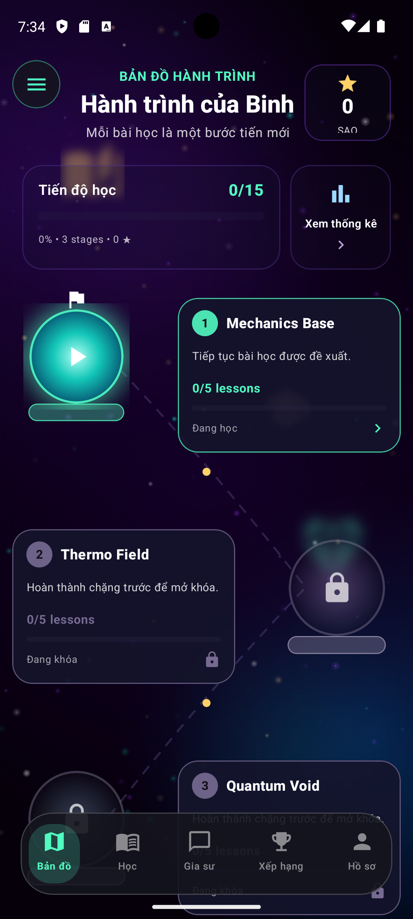
AI STUDY MENTOR
07
The primary user is a student with a question now
The first release should make the next useful action obvious.
1
2
3
4
Ask
Explain
Improve
Review
App — Learning Loop
The learning loop is the product: every feature should make one of these four steps easier.
Notes:
[Sources]
- Pearson (2025), Unit 22 Assignment Brief Part 1 (local brief).

Slide 8
AI STUDY MENTOR
08
User needs become observable requirements
P1 is strongest when each need can be seen in the product.
User need
Requirement
Observable outcome
Ask without friction
Text + image submission
Question accepted and routed
Understand the answer
Steps and simple language
Answer is readable and structured
Continue later
History + bookmarks
Saved answer is searchable
Improve weak topics
Practice + feedback
Attempt produces next step
Notes:
[Sources]
- Pearson (2025), Unit 22 Assignment Brief Part 1 (local brief).

Slide 9
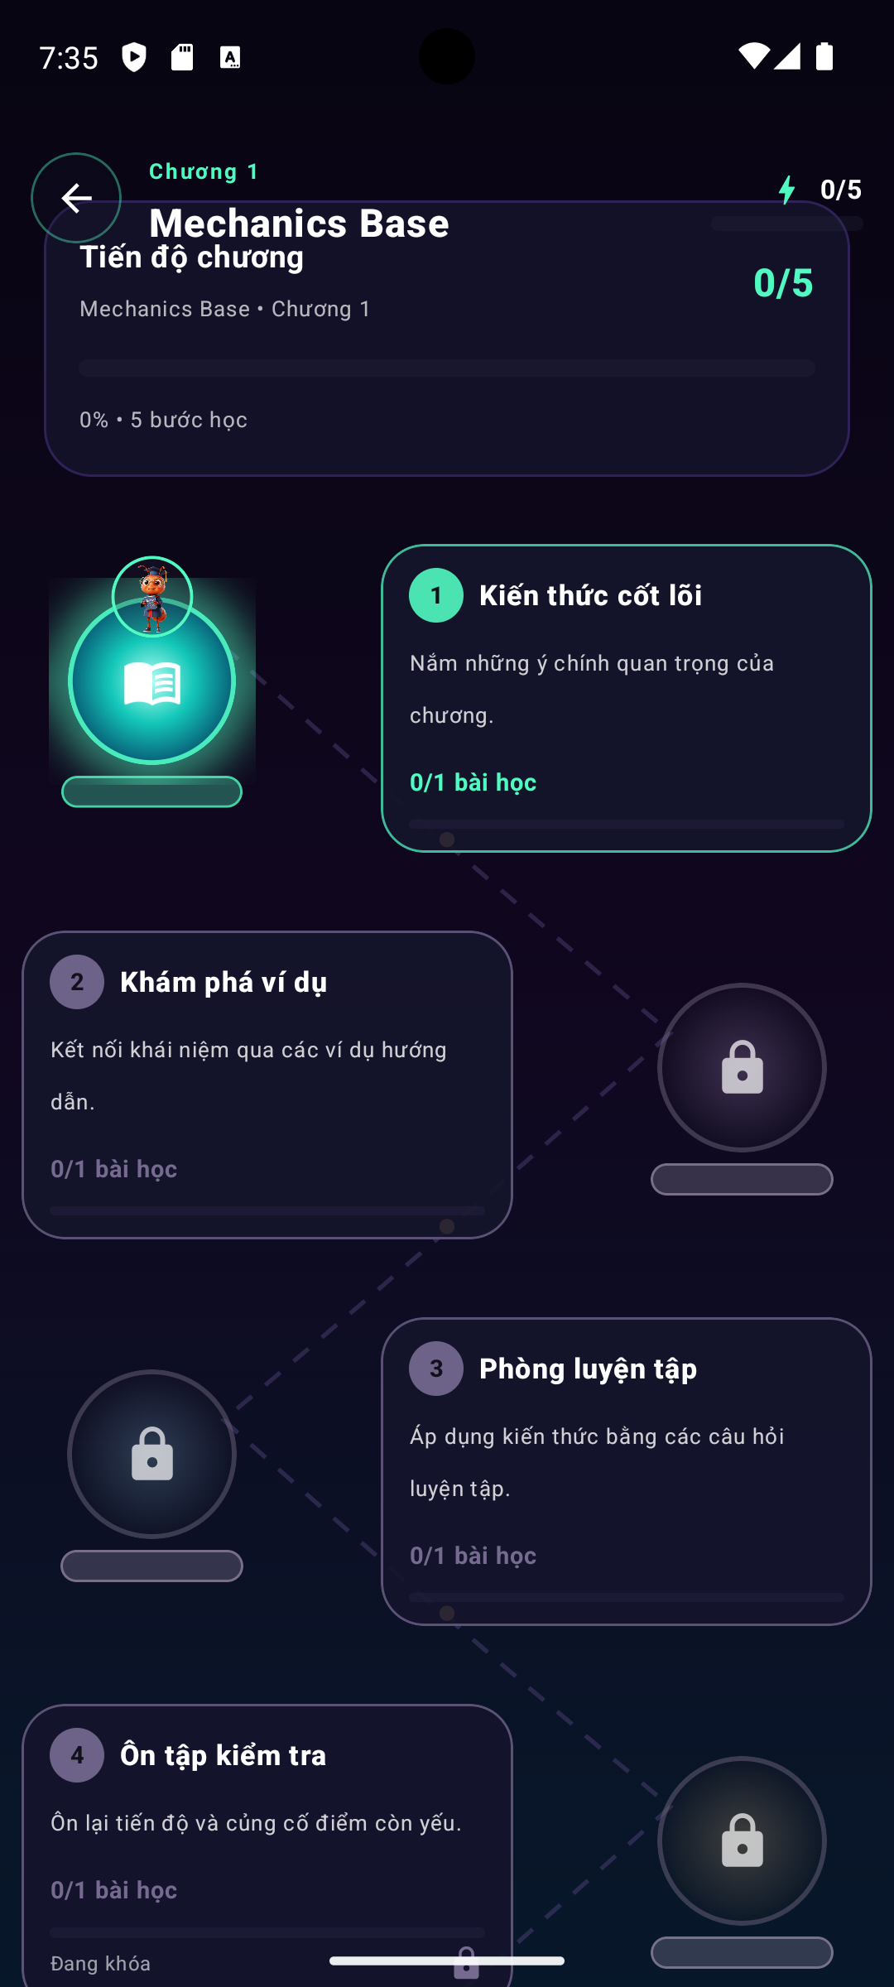
AI STUDY MENTOR
09
Authentication protects the personal learning space
Secure access is required for history, saved answers and statistics.
Functional requirements
Why it matters
- Register with email
- Secure login
- Password strength validation
- Optional 2FA
- First-use profile choices
- Personal history is private
- Preferences shape explanations
- Account controls support recovery
- Underage users need extra care
Login / Auth Screen
Notes:
[Sources]
- Pearson (2025), Unit 22 Assignment Brief Part 1 (local brief).
- https://www.ftc.gov/legal-library/browse/rules/childrens-online-privacy-protection-rule-coppa
Pearson (2025), Unit 22 Assignment Brief Part 1: authentication and first-use preferences.

Slide 10
AI STUDY MENTOR
10
Question submission must match real student behaviour
Text and image input are core requirements, not optional polish.
New question
Text input
Type a question
Concepts, languages and programming.
Take a photo
Image upload
Select subject
Homework, equations and diagrams.
Send to Mentor
Subject context
Text + Image Input
Supports routing and appropriate explanation depth.
Notes:
[Sources]
- Pearson (2025), Unit 22 Assignment Brief Part 1 (local brief).

Slide 11
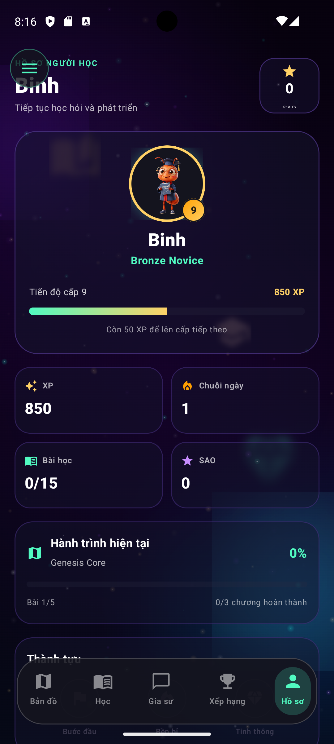
AI STUDY MENTOR
11
AI answers must teach, not only calculate
The answer format is part of the user requirement.
1 Identify topic and level
Optional learning support
2 Explain concept or formula
Simplified explanation
Alternative solution
Key concepts
Common mistakes
Follow-up practice
3 Show logical steps
4 State final answer clearly
AI Step-by-step Answer
Notes:
[Sources]
- Pearson (2025), Unit 22 Assignment Brief Part 1 (local brief).

Slide 12
AI STUDY MENTOR
12
The system should support multiple subjects
The brief names mathematics, science, programming, history and languages.
STEM
COMPUTING
HUMANITIES
Math + science
Programming
History + languages
Formulas, diagrams, working and concept explanations.
Code, debugging, syntax and step-by-step reasoning.
Clear context, vocabulary and appropriately simple explanations.
Notes:
[Sources]
- Pearson (2025), Unit 22 Assignment Brief Part 1 (local brief).

Slide 13
AI STUDY MENTOR
13
History and the personal library make help reusable
A one-off answer becomes a revision asset.
Student actions
System behaviour
- Search past questions
- Bookmark important answers
- Organise by subject
- View previously answered questions offline
- Save question + answer automatically
- Recognise repeated topics
- Suggest review
- Keep data linked to the right user
Question History
Notes:
[Sources]
- Pearson (2025), Unit 22 Assignment Brief Part 1 (local brief).

Slide 14
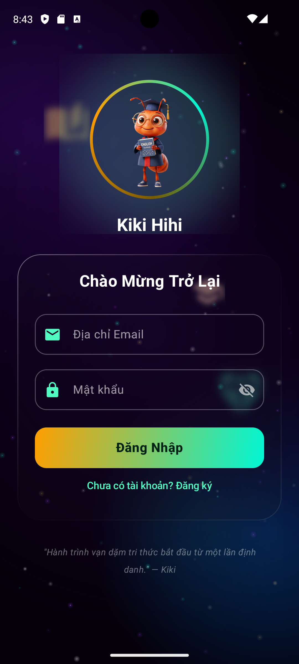
AI STUDY MENTOR
14
Practice questions turn help into learning
The app should create a next challenge from the previous question.
Practice
Supported types
Learning response
Algebra / medium
- Multiple choice
- Short answer
- Fill in the blank
Instant feedback, review exercises and suggested follow-up questions.
Choose a step
Instant feedback
Try a similar problem
MCQ Practice Quest
Notes:
[Sources]
- Pearson (2025), Unit 22 Assignment Brief Part 1 (local brief).

Slide 15
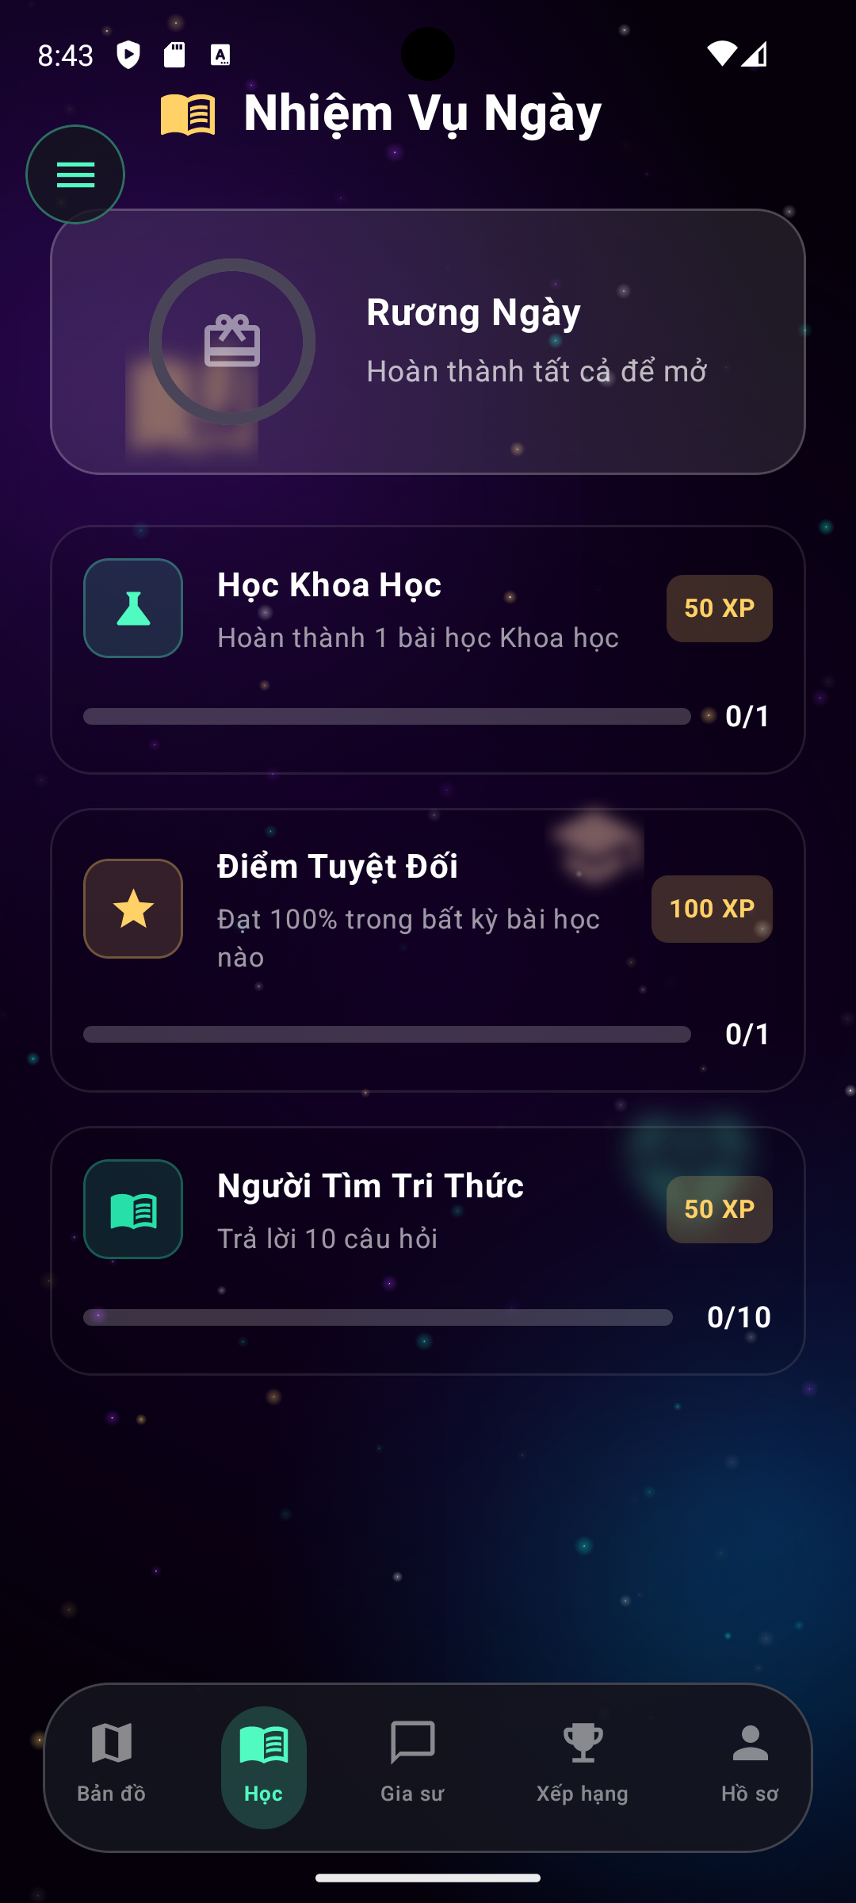
AI STUDY MENTOR
15
Progress tracking shows whether the product helps
Activity becomes useful when it creates a visible learning signal.
Dashboard requirements
72
64
- Total questions asked
- Most studied subjects
- Quiz accuracy rate
- Time spent reviewing
- AI-generated insights
48
36
Progress Dashboard
Questions
Accuracy
Review
Practice
Notes:
[Sources]
- Pearson (2025), Unit 22 Assignment Brief Part 1 (local brief).

Slide 16
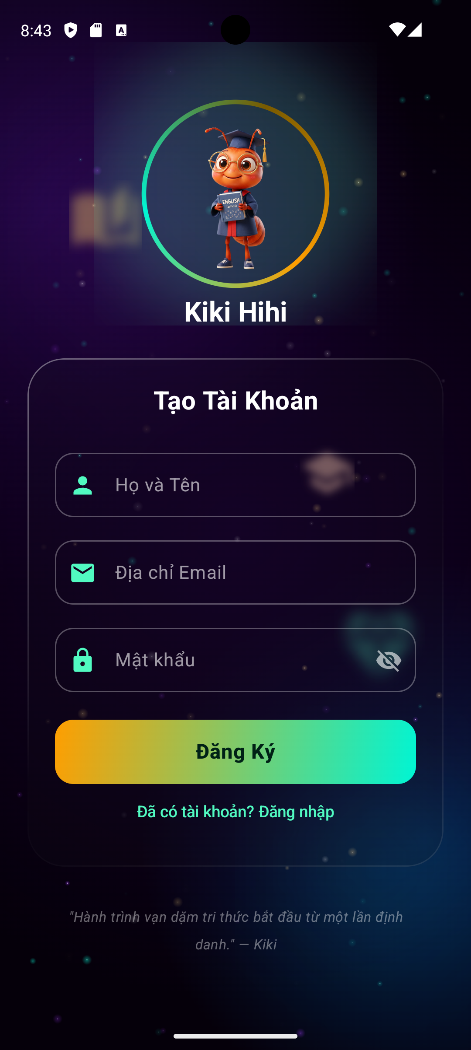
AI STUDY MENTOR
16
Engagement should reinforce useful study behaviour
XP and badges are secondary to learning value.
EARN
UNLOCK
OPTIONAL
XP
Themes + avatars
Leaderboard
For asking, reviewing and completing practice quizzes.
Lightweight continuity and a sense of progress.
Friends or global activity without exposing sensitive data.
Leaderboard / XP Rank
Notes:
[Sources]
- Pearson (2025), Unit 22 Assignment Brief Part 1 (local brief).

Slide 17
AI STUDY MENTOR
17
Notifications should bring students back to useful work
Reminders are valuable only when they have a clear learning reason.
Notification requirements
Safety controls
- Review bookmarked answers
- Alert repeated mistakes
- Motivate consistent activity
- Send daily or weekly summaries
- User-controlled preferences
- Quiet hours
- No sensitive content in previews
- Age-appropriate defaults
Notes:
[Sources]
- Pearson (2025), Unit 22 Assignment Brief Part 1 (local brief).
- https://www.ftc.gov/legal-library/browse/rules/childrens-online-privacy-protection-rule-coppa
Pearson (2025), Unit 22 Assignment Brief Part 1: notifications and security.

Slide 18
AI STUDY MENTOR
18
Offline access protects the review experience
Previously answered questions can remain useful without a network connection.
1
2
3
4
Download
Read
Review
Sync
Offline scope
When online returns
Read history, view bookmarks and continue downloaded practice.
Sync queued questions, refresh progress and show status clearly.
Notes:
[Sources]
- Pearson (2025), Unit 22 Assignment Brief Part 1 (local brief).

Slide 19
AI STUDY MENTOR
19
Security and safety are functional requirements
Student questions, images and profile data must be treated as protected content.
Requirement
Expected behaviour
Why it matters
Password strength
Weak passwords are blocked
Reduces account compromise
2FA option
Second factor can be enabled
Adds protection for personal history
Encrypted storage
User data and images protected
Limits exposure of student content
Abuse detection
Spam and inappropriate content flagged
Protects the learning environment
Notes:
[Sources]
- Pearson (2025), Unit 22 Assignment Brief Part 1 (local brief).
- https://eur-lex.europa.eu/eli/reg/2016/679/oj
- https://www.ftc.gov/legal-library/browse/rules/childrens-online-privacy-protection-rule-coppa
Pearson (2025), Unit 22 Assignment Brief Part 1: security and safety requirements.

Slide 20
AI STUDY MENTOR
20
Performance and usability make the promise credible
Non-functional requirements shape the experience students actually feel.
PERFORMANCE
USABILITY
PLATFORM
Fast and resilient
Simple and readable
Android first
Handle concurrent questions, optimise response time and show useful loading states.
Minimal submission steps, clear answer structure and intuitive navigation.
Support Android for the MVP; keep iOS as an optional future channel.
Notes:
[Sources]
- Pearson (2025), Unit 22 Assignment Brief Part 1 (local brief).

Slide 21
AI STUDY MENTOR
21
Privacy and compatibility constrain the design
The application must be usable across learners without collecting unnecessary data.
Privacy
Compatibility
- Securely encrypt user data
- Minimise collection
- Consider GDPR
- Consider COPPA for younger students
- Define retention and access rules
- Android is the MVP platform
- iOS is optional
- Previously answered content works offline
- New questions sync after reconnection
Notes:
[Sources]
- Pearson (2025), Unit 22 Assignment Brief Part 1 (local brief).
- https://eur-lex.europa.eu/eli/reg/2016/679/oj
- https://www.ftc.gov/legal-library/browse/rules/childrens-online-privacy-protection-rule-coppa
Pearson (2025), Unit 22 Assignment Brief Part 1: privacy and platform compatibility.

Slide 22
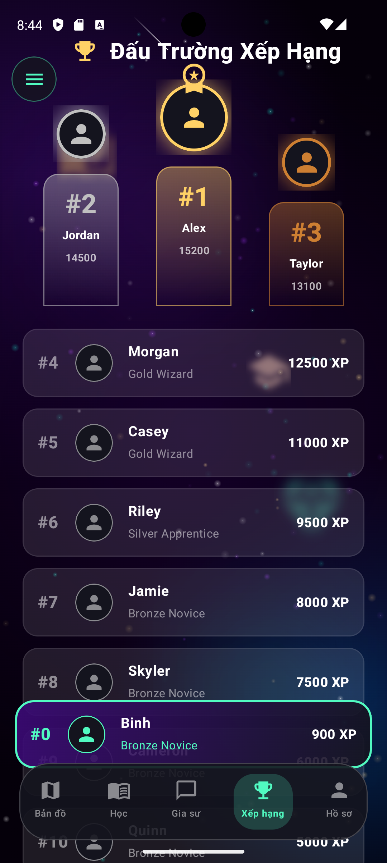
AI STUDY MENTOR
22
The MVP must fit a 14-week window
Scope is a requirement because delivery time is part of the business problem.
Constraint
Implication
MVP response
Timeline
No room for broad feature parity
Prioritise core learning loop
Budget
AI calls have operating cost
Cache, reuse and quota requests
Team skills
Mobile and AI learning is needed
Plan training and pairing
Quality
A fast answer can still be wrong or unsafe
Guardrails, testing and fallback
Working MVP on device
Notes:
[Sources]
- Pearson (2025), Unit 22 Assignment Brief Part 1 (local brief).

Slide 23
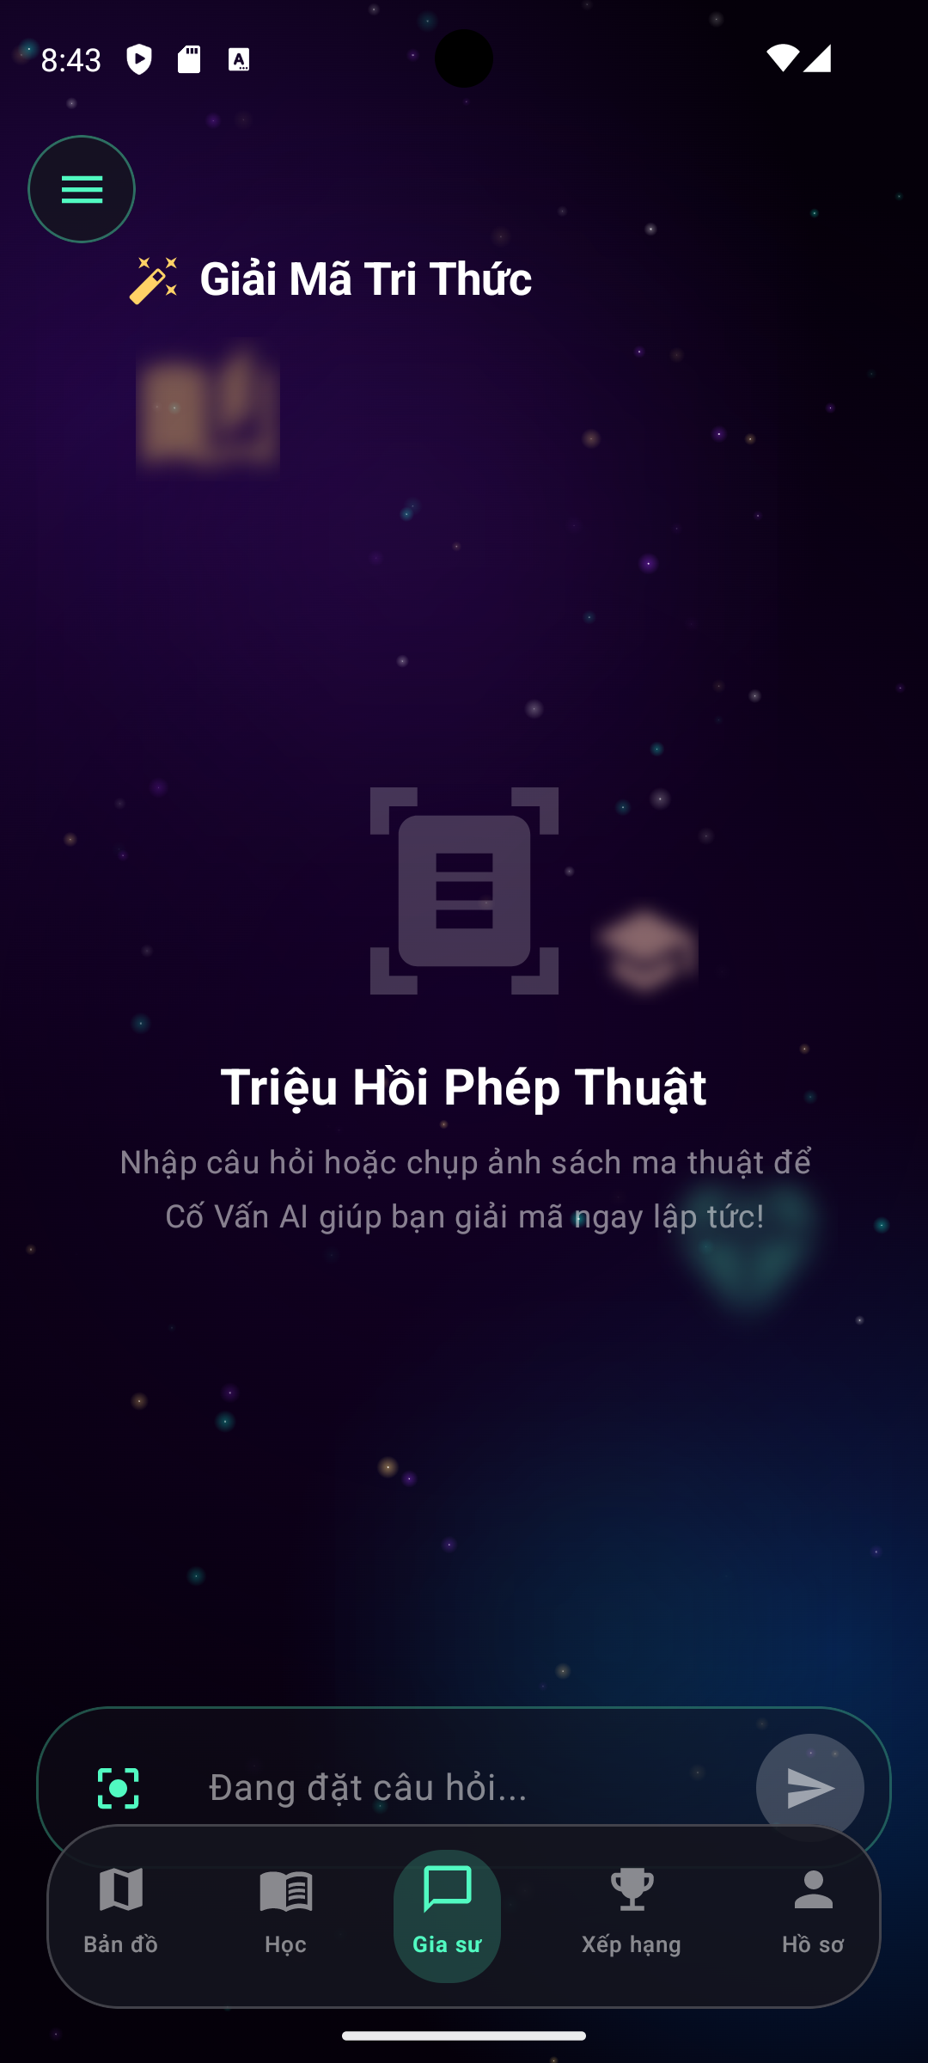
AI STUDY MENTOR
23
The mobile application is the strongest MVP option
Its camera access and always-available form factor directly fit the problem.
Option
Strength
Weakness
Decision
Desktop
Large screen and power
Not available at the moment of confusion
Reject for MVP
Web
Broad reach and easy updates
Less controlled camera / offline experience
Future channel
Mobile
Portable, camera-ready, familiar
Platform complexity
Select for MVP
Mobile — Journey Map
Notes:
[Sources]
- Pearson (2025), Unit 22 Assignment Brief Part 1 (local brief).

Slide 24
AI STUDY MENTOR
24
MVP scope keeps the first release achievable
The first release protects the learning loop and postpones optional polish.
Priority
Included features
Release
MUST
Auth, text/image question, AI answer, history, basic progress
MVP
SHOULD
Bookmarks, practice, offline reading, reminders
If stable
COULD
Gamification, avatars, leaderboards, voice input
Phase 2
WON'T yet
Implemented MVP features
Premium plans, advanced social features, iOS parity
Later
Notes:
[Sources]
- Pearson (2025), Unit 22 Assignment Brief Part 1 (local brief).

Slide 25
AI STUDY MENTOR
25
P1 conclusion: requirements describe one coherent product
The proposed solution is a focused mobile AI mentor, not a general-purpose education platform.
Ask
Understand
Practise
Review
1
2
3
4
Question
Explanation
Practice
Progress
Notes:
[Sources]
- Pearson (2025), Unit 22 Assignment Brief Part 1 (local brief).

Slide 26
01
PART 1 / ACTIVITY 1 / P2
Risk is managed before it becomes rework.
The risk plan focuses on the constraints named in the brief: skills, AI cost, schedule and student data.
Notes:
[Sources]
- Pearson (2025), Unit 22 Assignment Brief Part 1 (local brief).
P2 risk management: five slides follow.

Slide 27
AI STUDY MENTOR
27
Risk 1: junior skills can slow the first sprint
The mitigation is planned learning, not an optimistic assumption.
Risk
Mitigation
The team has limited mobile application, AI integration and secure data-handling experience.
- Include training in week 1
- Pair on the first vertical slice
- Use one focused Android stack
- Review architecture early
Team — Android Studio build
Notes:
[Sources]
- Pearson (2025), Unit 22 Assignment Brief Part 1 (local brief).

Slide 28
AI STUDY MENTOR
28
Risk 2: repeated AI calls can break the budget
Cost control must sit in the architecture from the beginning.
Risk
Mitigation
High requests, repeated questions or overly long responses can create an unaffordable API bill.
- Semantic or exact-match caching
- Prompt and response limits
- Weekly quotas
- Usage dashboard
- Safe fallback when limit is reached
Gemini AI response in app
Notes:
[Sources]
- Pearson (2025), Unit 22 Assignment Brief Part 1 (local brief).

Slide 29
AI STUDY MENTOR
29
Risk 3: schedule pressure can cause scope creep
The team needs a visible rule for what leaves the MVP.
Risk
Mitigation
A 14-week deadline can be lost when optional gamification, iOS parity or premium features enter too early.
- Freeze MUST items
- Demo every increment
- Review backlog every sprint
- Move COULD features to Phase 2
Notes:
[Sources]
- Pearson (2025), Unit 22 Assignment Brief Part 1 (local brief).

Slide 30
AI STUDY MENTOR
30
Risk 4: student data needs stronger-than-average care
A safe MVP treats privacy, consent and access control as release gates.
Risk
Mitigation
Questions, images and underage-user data could be exposed through weak authentication, storage rules or consent handling.
- Encrypt stored content
- Apply least-privilege access
- Add 2FA option
- Test consent and deletion
- Run security review before demo
Room DB — secure storage
Notes:
[Sources]
- Pearson (2025), Unit 22 Assignment Brief Part 1 (local brief).
- https://eur-lex.europa.eu/eli/reg/2016/679/oj
- https://www.ftc.gov/legal-library/browse/rules/childrens-online-privacy-protection-rule-coppa
P2 closes with an explicit release gate: security and privacy cannot be deferred.

Slide 31
02
PART 2 / ACTIVITY 2 / DEMO
Demo-slide: show the product learning loop.
The demo section introduces the developed application and walks through the student journey.
Notes:
[Sources]
- Pearson (2025), Unit 22 Assignment Brief Part 1 (local brief).
The screens below are presentation mockups because no APK, source project or screenshots were supplied in the workspace.

Slide 32
DEMO / 01 - START
32
Demo 1: open the app and choose a learning profile
Show the real login/onboarding screen here during the individual demo.
Welcome
Presenter focus
Requirement demonstrated
- How a new user registers
- How preferences are selected
- What is required vs optional
Email + password
User registration, secure login and first-use profile choices.
Choose education level
Choose subjects
Set explanation style
Screen 1
Screen 2
Screen 3
Screen 4
Notes:
[Sources]
- Pearson (2025), Unit 22 Assignment Brief Part 1 (local brief).
Replace mockup with a real screenshot from the developed application before submission.

Slide 33
DEMO / 02 - ASK
33
Demo 2: submit a text or image question
The strongest demo moment is the shortest path from confusion to a submitted question.
New question
Presenter focus
Requirement demonstrated
- Show text input
- Show camera / image selection
- Show loading and error state
Type a question
AI question submission using text and image formats across multiple subjects.
Take a homework photo
Select subject
Send to Mentor
Screen 5
Screen 6
Notes:
[Sources]
- Pearson (2025), Unit 22 Assignment Brief Part 1 (local brief).
Replace mockup with a real screenshot from the developed application before submission.

Slide 34
DEMO / 03 - ANSWER
34
Demo 3: read a structured AI explanation
The answer should visibly teach the reasoning and state the final answer clearly.
AI answer
Presenter focus
Requirement demonstrated
- Point to step-by-step structure
- Show explanation style
- Show any safety or retry state
Topic identified
AI identifies subject and difficulty, explains logically and adapts language.
Step 1: concept
Step 2: working
Final answer + next step
Screen 7
Screen 8
Notes:
[Sources]
- Pearson (2025), Unit 22 Assignment Brief Part 1 (local brief).
Replace mockup with a real screenshot from the developed application before submission.

Slide 35
DEMO / 04 - LIBRARY
35
Demo 4: save and revisit an answer
The application becomes more useful when the first answer remains available later.
My library
Presenter focus
Requirement demonstrated
- Save an answer
- Search history
- Bookmark and reopen
- Show offline behaviour if implemented
Search past questions
Question history, personal library, search and bookmarks.
Filter by subject
Bookmark answer
Read offline
History View
Saved Answers
Notes:
[Sources]
- Pearson (2025), Unit 22 Assignment Brief Part 1 (local brief).
Replace mockup with a real screenshot from the developed application before submission.

Slide 36
DEMO / 05 - PRACTICE
36
Demo 5: turn an answer into practice
The demo should end with a next learning action rather than a passive result.
Practice
Presenter focus
Requirement demonstrated
- Generate or open practice
- Submit an attempt
- Show feedback
- Link back to progress
Choose question type
AI-generated practice questions, instant feedback and progress tracking.
Submit attempt
Instant feedback
Review weak topic
Quest Screen
Answering
Daily Quests
Chapter Map
Notes:
[Sources]
- Pearson (2025), Unit 22 Assignment Brief Part 1 (local brief).
Replace mockup with a real screenshot from the developed application before submission.

Slide 37
DEMO / 06 - END-TO-END
37
Demo 6: complete the learning loop
Use this sequence as the individual live-demo route.
1
2
3
4
5
6
Login
Ask
Answer
Save
Practise
Progress
Keep the live demo focused: one question, one answer, one saved item and one practice attempt.
Login
Ask
Answer
Save
Practice
Progress
Notes:
[Sources]
- Pearson (2025), Unit 22 Assignment Brief Part 1 (local brief).
This slide is a presenter route, not a claim that all features are implemented. Demonstrate only what the application supports.

Slide 38
38
Screen / action
Requirement shown
A strong individual demo explains what the audience is seeing and why it matters.
Login + profile
Registration and first-use choices
Question capture
Text / image submission
Real app input + result
AI answer
Structured explanation
Response screen + fallback
Library
History + bookmarks
Saved item reopened
Practice
Feedback + progress
Attempt and updated state
Screen 1
Screen 5
Notes:
[Sources]
- Pearson (2025), Unit 22 Assignment Brief Part 1 (local brief).
Replace evidence column with actual screenshots or demo recording references.

Slide 39
DEMO / 08 - PERSONAL HANDOFF
39
Demo handoff: explain your own contribution clearly
The individual section should make ownership visible without narrating the entire team report.
Cover
Show
- Feature you implemented
- User problem it solves
- Tools or components used
- One challenge you resolved
- The working flow
- Before / after if relevant
- A known limitation
- The next improvement you recommend
Implemented screen
Implemented screen
Use the real names, screenshots and implementation details of your team member contribution here.
Notes:
[Sources]
- Pearson (2025), Unit 22 Assignment Brief Part 1 (local brief).
Personalise this slide with the individual student's real contribution and evidence.

Slide 40
DEMO / CLOSE
40
Close on the product value, not the feature list
AI Study Mentor helps a student move from a question to a next step in learning.
Ask. Understand. Practise. Review.
Finish by showing the working application and stating what is implemented today.
Notes:
[Sources]
- Pearson (2025), Unit 22 Assignment Brief Part 1 (local brief).
Final demo slide. Replace any remaining mockups with real evidence from the developed application.

