Slide 1

BANKING
SYSTEM
LECTURER: NGUYỄN THỊ THU THẢO
SUBJECT: DBI202
GROUP: 7
MEMBER:
HÀ NGUYỄN TIẾN ĐẠT - SE203334
TRẦN HỮU VIỆT - SE190596
MAI THÀNH ĐƯỢC - SE193659
LÊ NGUYÊN NGỌC - SS190849
DBI202
1

Slide 2
CONTENTS
I. INTRODUCTION
IV. NORMALIZATION
II. HIGH-LEVEL DESIGN
V. PHYSICAL DESIGN
III. LOGICAL DESIGN
VI. CONCLUSION
2

Slide 3
I. INTRODUCTION
3

Slide 4

I. INTRODUCTION
1. Introduction
The banking database system ensures secure, reliable data management and supports core banking operations, providing a solid foundation for future development.
4

Slide 5

I. INTRODUCTION
2. Project Objectives
  Manage customers, accounts, and transactions.
  Manage loans and generate reports.
  Ensure secure login, MFA, and audit logs.
5

Slide 6


I. INTRODUCTION
3. Overview of data models
  We analyzed four primary data models:
  Structured (RDBMS)
  Semi-Structured (NoSQL/JSON)
  Unstructured (Blob Storage)
  Graph (Graph DB)
6

Slide 7
I. INTRODUCTION
4. Proposed Data Model / Design
We analyzed four primary data models:
  Structured (RDBMS): Ideal for core financial data requiring high consistency and ACID compliance.
  Semi-Structured (NoSQL/JSON): Best for flexible data like varied customer profiles.
  Unstructured (Blob Storage): Suited for storing large files like scanned KYC documents.
  Graph (Graph DB): Excellent for analyzing complex relationships, such as in fraud detection.
7

Slide 8
II. HIGH-LEVEL DESIGN
8

Slide 9

II. HIGH-LEVEL DESIGN
1. Scenario
  The system manages branches, customers, accounts, loans, employees, and transactions.
  Branches serve customers with multiple accounts and loans.
  Employees handle branch tasks, while transactions link to accounts for accurate tracking.
9

Slide 10
II. HIGH-LEVEL DESIGN
2. Identify entities, relationships and their properties
The core entities identified for the RDBMS portion of the system are:
  Employee
  Branch
  Customer
  Account
  Loan
  Transactions
  Branch_Management
  Customer_Loan
10

Slide 11
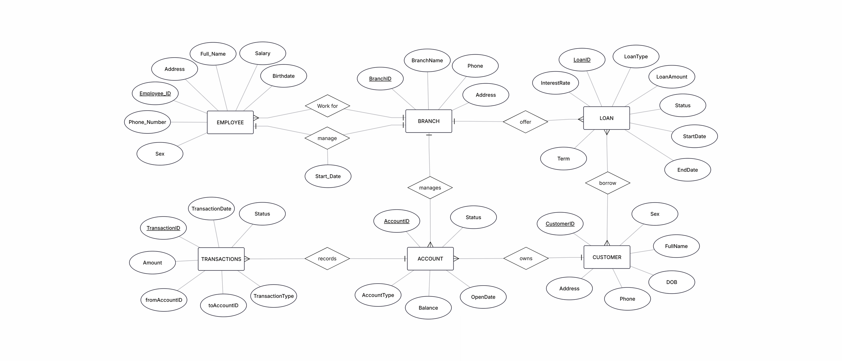
The conceptual model defines core banking entities, their attributes, and relationship cardinalities in the ERD.
11

Slide 12
II. HIGH-LEVEL DESIGN
3. Create the Conceptual Model (ERD)
Entities: EMPLOYEE, BRANCH, CUSTOMER, ACCOUNT, LOAN, TRANSACTIONS
Relationships:
  EMPLOYEE–BRANCH: works (N:1), manages (1:1) → BRANCH_MANAGEMENT
  BRANCH–ACCOUNT / LOAN: (1:N)
  CUSTOMER–ACCOUNT: (1:N)
  CUSTOMER–LOAN: (N:M) → CUSTOMER_LOAN
  ACCOUNT–TRANSACTIONS: (1:N) via fromAccountID & toAccountID
12

Slide 13
II. HIGH-LEVEL DESIGN
4. Develop the Logical Model (RD schems)
Core Entities: BRANCH, CUSTOMER, EMPLOYEE, ACCOUNT, LOAN, TRANSACTIONS.
Relationships:
  EMPLOYEE, ACCOUNT, and LOAN link to a BRANCH via BranchID (FK).
  ACCOUNT belongs to a CUSTOMER via CustomerID (FK).
  TRANSACTIONS involve two ACCOUNTs
Linking Tables:
  BRANCH_MANAGEMENT connects a BRANCH to its EMPLOYEE Manager
  CUSTOMER_LOAN links CUSTOMER to their LOANs.
13

Slide 14
III. LOGICAL DESIGN
14

Slide 15
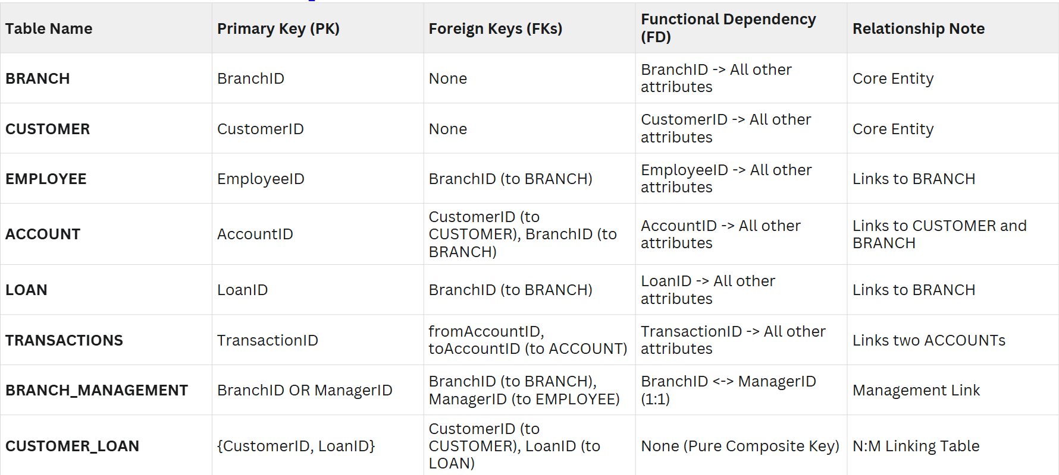
III. LOGICAL DESIGN
1. Functional Dependencies
15

Slide 16
III. LOGICAL DESIGN
1. Functional Dependencies
Pattern Recognition Process
  The team identified functional dependencies (FDs) by analyzing how each key uniquely determines other attributes.
  Examples include BranchID → Branch info, CustomerID → Customer info, AccountID → Account details, etc.
  Patterns such as 1:1 (manager–branch) and N:M (customer–loan) led to creating the linking tables BRANCH_MANAGEMENT and CUSTOMER_LOAN.
  This ensured the database accurately represents real-world relationships and constraints.
16

Slide 17
III. LOGICAL DESIGN
1. Functional Dependencies
Algorithmic Reasoning Steps
  Identify determinants (e.g., EmployeeID, BranchID, CustomerID).
  Find dependent attributes for each determinant.
  Check attribute closures to remove redundancy.
  Determine candidate keys based on full dependencies.
  Select primary keys for clarity and simplicity.
→ This ensured accurate functional dependencies and consistent normalization.
17

Slide 18
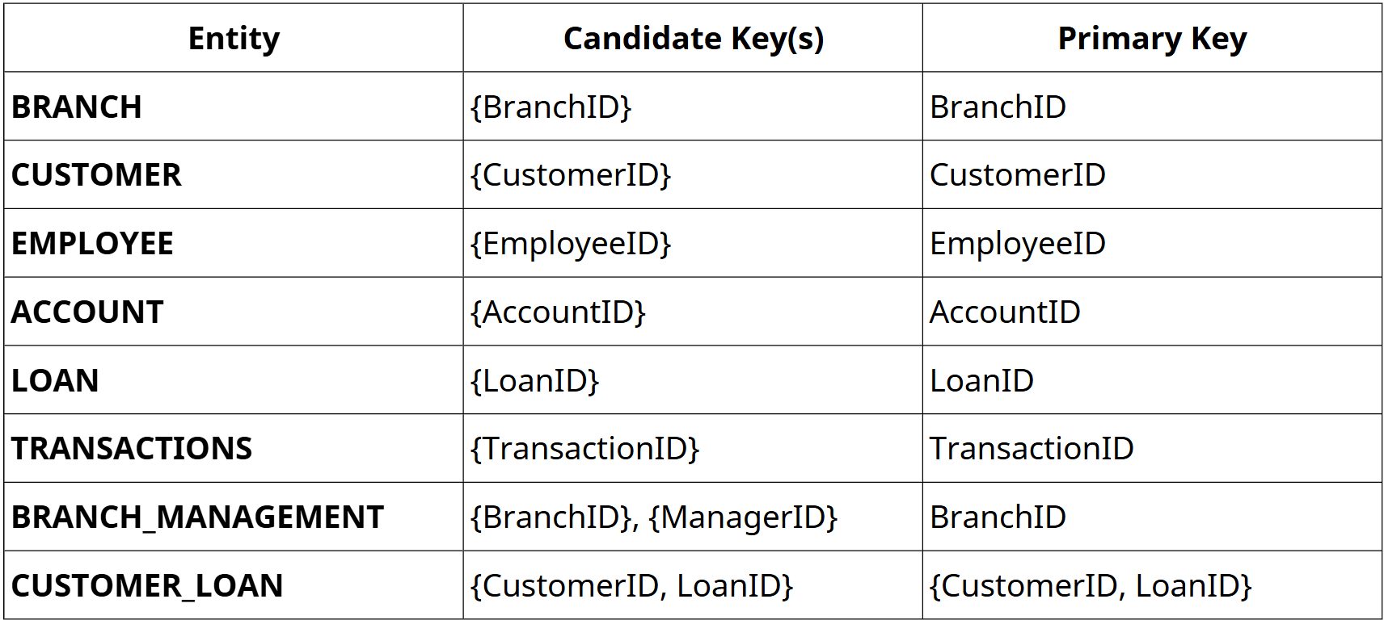
III. LOGICAL DESIGN
2. Find the keys
18

Slide 19
IV. NORMALIZATION
19

Slide 20
IV. NORMALIZATION
1. Anomaly Detection and Normalization
  Redundancy: Employee info may be duplicated across branches.
  Update: Changing a branch’s address requires multiple manual updates, risking inconsistency.
  Insertion: Cannot add a branch without assigning an employee due to foreign key constraints.
  Deletion: Removing a branch may inadvertently delete associated employee data.
20

Slide 21
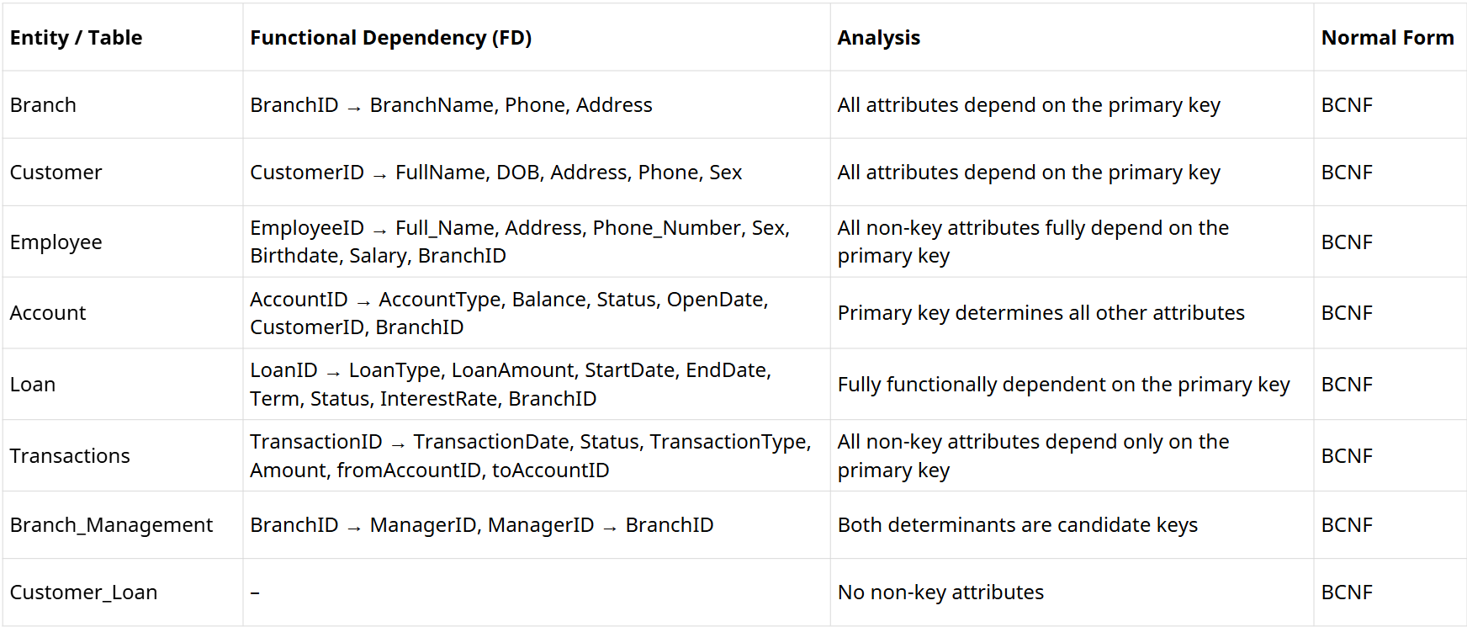
IV. NORMALIZATION
2. Identify Normal Forms
21

Slide 22
IV. NORMALIZATION
3. Perform Decomposition
  N:M Decomposition: Created CUSTOMER_LOAN to resolve the many-to-many “borrow” relationship.
  1:1 Decomposition: Created BRANCH_MANAGEMENT to enforce the unique manager–branch link.
  Logic Decomposition: Unified TRANSACTIONS and TRANSFER into one table using fromAccountID and toAccountID.
22

Slide 23
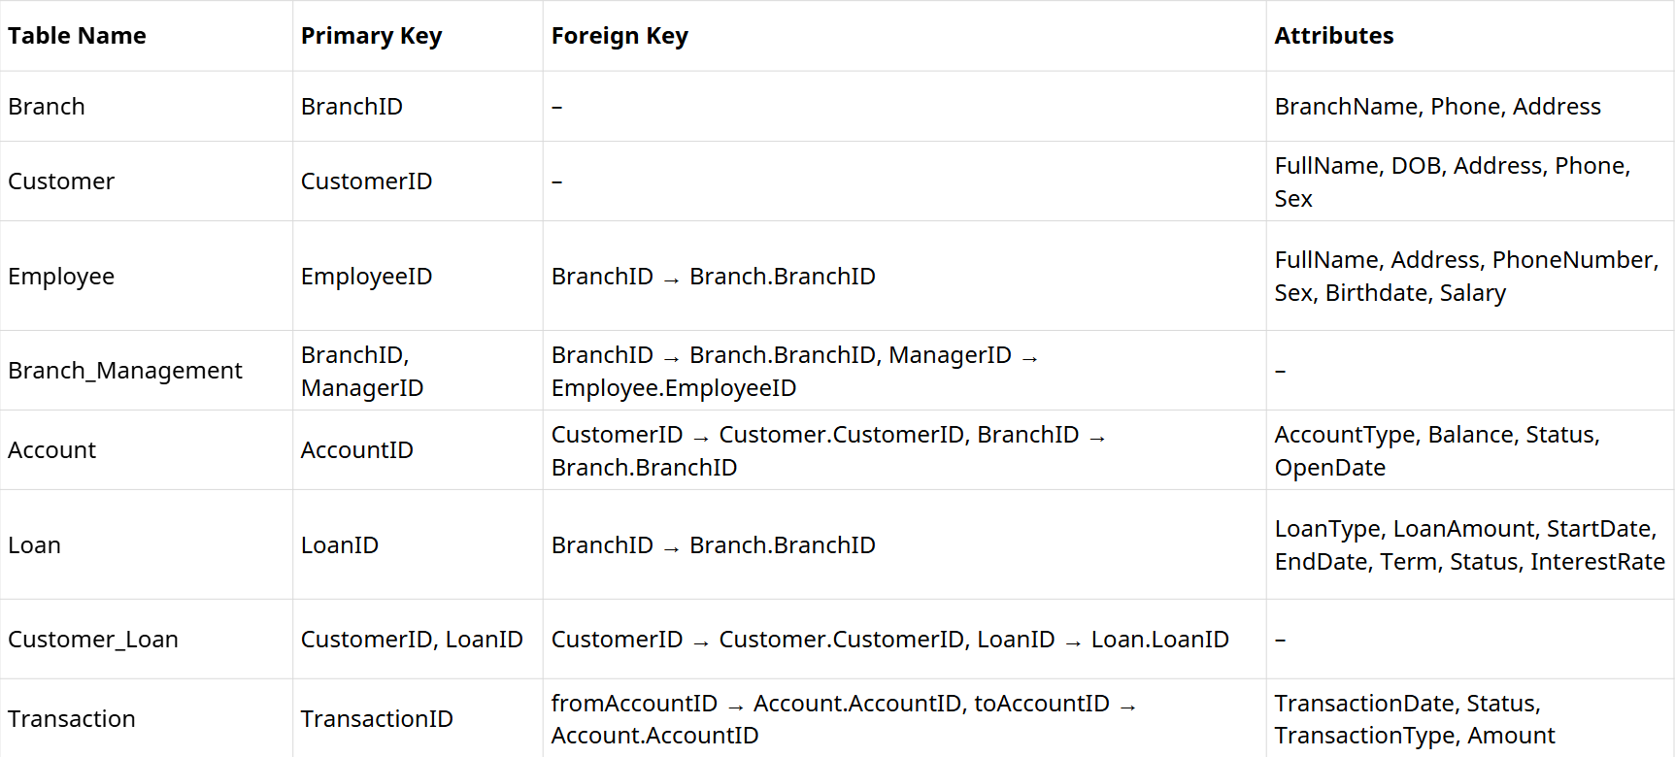
IV. NORMALIZATION
4. Final Normalized Schema
23

Slide 24
V. PHYSICAL DESIGN
24

Slide 25
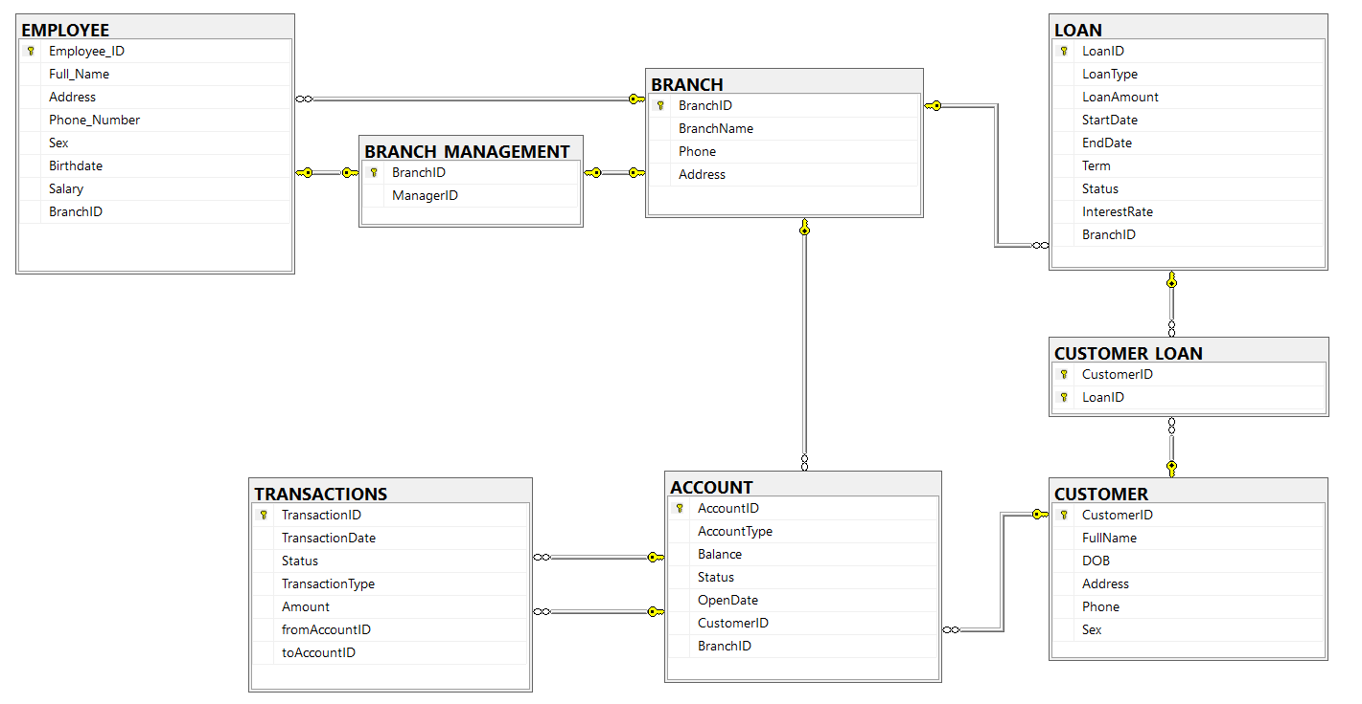
V. PHYSICAL DESIGN
1. Design the Physical Model
25

Slide 26

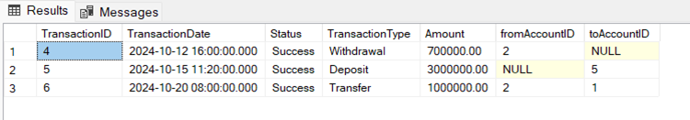
V. PHYSICAL DESIGN
2. Basic retrieval to advanced operations
SQL Queries (Basic)
Description: List transactions from October 12th to October 21st, 2024, sorted by date.
SELECT * FROM TRANSACTIONS
WHERE TransactionDate >= '2024-10-12' AND TransactionDate <= '2024-10-21'
ORDER BY TransactionDate
26

Slide 27
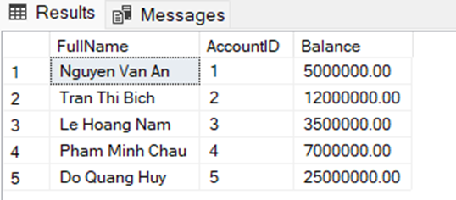
V. PHYSICAL DESIGN
2. Basic retrieval to advanced operations
SQL Queries (Intermediate)
Description: Retrieve the customer's FullName, AccountID and the Balance of all accounts they own.
SELECT c.FullName, a.AccountID, a.Balance
FROM CUSTOMER c
JOIN ACCOUNT a ON c.CustomerID = a.CustomerID
27

Slide 28
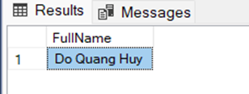
V. PHYSICAL DESIGN
2. Basic retrieval to advanced operations
SQL Queries (Advanced)
Description: Find the names of customers who have an 'Active' account that has received a deposit over 1,000,000.
SELECT FullName FROM CUSTOMER
WHERE CustomerID IN (
SELECT CustomerID FROM ACCOUNT
WHERE Status = 'Active' AND AccountID IN (
SELECT toAccountID FROM TRANSACTIONS
WHERE Amount > 1000000
)
)
28

Slide 29
V. PHYSICAL DESIGN
3. Functions
fn_CalculateCustomerAge
Description: Calculates a customer's current age based on their Date of Birth (DOB).
CREATE FUNCTION fn_CalculateCustomerAge(@DOB DATE)
RETURNS INT AS
BEGIN
RETURN DATEDIFF(YEAR, @DOB, GETDATE());
END
29

Slide 30
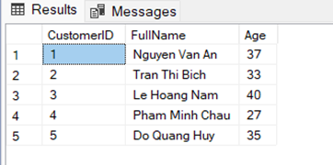
V. PHYSICAL DESIGN
3. Functions
fn_CalculateCustomerAge
Execution:
SELECT CustomerID, FullName, dbo.fn_CalculateCustomerAge(DOB) AS Age
FROM CUSTOMER
30

Slide 31
V. PHYSICAL DESIGN
4. Stored Procedures
sp_AddNewCustomer
Description: Inserts a new customer record into the CUSTOMER table.
CREATE PROCEDURE sp_AddNewCustomer
@CustomerID INT, @FullName NVARCHAR(100),
@DOB DATE, @Address NVARCHAR(255),
@Phone VARCHAR(20), @Sex VARCHAR(10)
AS
BEGIN
INSERT INTO CUSTOMER (CustomerID, FullName, DOB, Address, Phone, Sex)
VALUES (@CustomerID, @FullName, @DOB, @Address, @Phone, @Sex);
END
31

Slide 32
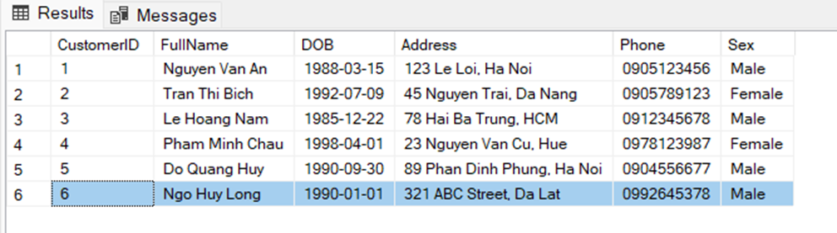
V. PHYSICAL DESIGN
4. Stored Procedures
sp_AddNewCustomer
Execution:
EXEC sp_AddNewCustomer 6, N'Ngo Huy Long', '1990-01-01', N'321 ABC Street, Da Lat', '0992645378', 'Male'
32

Slide 33
V. PHYSICAL DESIGN
5. Triggers
trg_PreventCloseAccountWithDebt
Description: Enforces a critical business rule. This trigger prevents changing an account's status to 'Closed' if the Customer who owns that account has any outstanding loans (any loan status other than 'Paid Off').
33

Slide 34
CREATE TRIGGER trg_PreventCloseAccountWithDebt
ON ACCOUNT
AFTER UPDATE
AS
BEGIN
IF EXISTS (SELECT 1 FROM inserted WHERE Status = 'Closed')
BEGIN
IF EXISTS (
SELECT 1 FROM inserted i
JOIN CUSTOMER_LOAN cl ON i.CustomerID = cl.CustomerID
JOIN LOAN l ON cl.LoanID = l.LoanID
WHERE i.Status = 'Closed' AND l.Status <> 'Paid Off'
)
BEGIN
RAISERROR ('Cannot close account. Customer still has outstanding loans.', 16, 1);
ROLLBACK TRANSACTION;
END
END
END
34

Slide 35
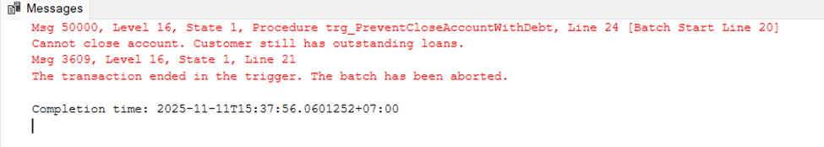
V. PHYSICAL DESIGN
5. Triggers
trg_EnforceLoanLimit
Execution: This will fail with error: Cannot close account. Customer still has outstanding loans.
UPDATE ACCOUNT SET Status = 'Closed' WHERE AccountID = 1
35

Slide 36
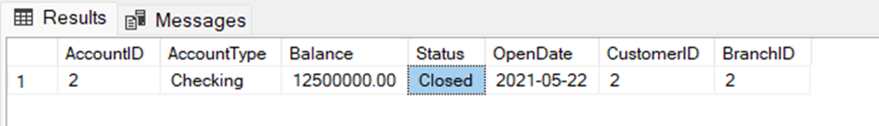
V. PHYSICAL DESIGN
5. Triggers
trg_EnforceLoanLimit
Execution: The command succeeds (test case for AccountID = 2, whose owner has a 'Paid Off' loan).
UPDATE ACCOUNT SET Status = 'Closed' WHERE AccountID = 2;
36

Slide 37
V. PHYSICAL DESIGN
6. View and Index
View
Description: Defines a view to simplify complex queries. This view provides a straightforward way to see customer account details without needing to write the JOINs manually.
CREATE VIEW vw_CustomerAccountDetails AS
SELECT
C.CustomerID, C.FullName, C.Phone,
A.AccountID, A.AccountType, A.Balance, A.Status AS AccountStatus,
B.BranchName
FROM CUSTOMER AS C
JOIN ACCOUNT AS A ON C.CustomerID = A.CustomerID
JOIN BRANCH AS B ON A.BranchID = B.BranchID;
37

Slide 38
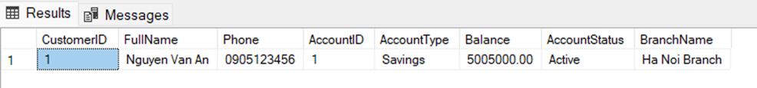
V. PHYSICAL DESIGN
6. View and Index
View
Execution:
SELECT * FROM vw_CustomerAccountDetails
WHERE FullName LIKE N'Nguyen Van A%'
38

Slide 39
V. PHYSICAL DESIGN
6. View and Index
Index
Description: Creates a composite index on the CustomerID and BranchID columns in the ACCOUNT table. This index is designed to improve the performance of queries that frequently filter or join on both the customer and their branch.
CREATE INDEX idx_Account_CustomerBranch
ON ACCOUNT(CustomerID, BranchID);
39

Slide 40
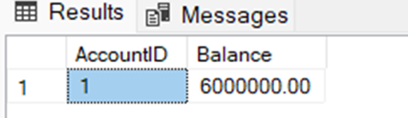
V. PHYSICAL DESIGN
6. View and Index
Index
Execution:
SELECT AccountID, Balance FROM ACCOUNT
WHERE CustomerID = 1 AND BranchID = 1;
40

Slide 41
VI.CONCLUSION
41

Slide 42
VI. CONCLUSION
Summary
  Successfully decomposed complex 1:1 ("manages") and N:M ("borrow") rules into a robust, 8-table schema .
  The final design is fully normalized to BCNF, ensuring data integrity .
  Implemented key business logic using updated Stored Procedures (sp_MakeDeposit) and Triggers (trg_PreventCloseAccountWithDebt).
AI Utilization
  AI was used to validate FDs, BCNF, and refine the logic for the unified TRANSACTIONS table and sp_MakeDeposit procedure.
42

Slide 43

THANK YOU
DBI202
End Slide
43

