Slide 1

Chapter 8
Database programming on SQL Server

Slide 2
Objectives
Understand what triggers are for and how to use
Understand what stored-procedure are for and how to use
Understand what cursors are for and how to use
Understand what functions are for and how to use
Understand the difference between T-SQL programming with other programming languages
Understand the useful of trigger, function, stored-procedure (compared with SQL statements)

Slide 3
Contents
T-SQL Programming
Stored-procedure
Functions
Triggers
Cursors

Slide 4
Physical Diagram - FUHCompany

Slide 5
Variables
There are 2 types of variables:
Global variables: are variables that are used anywhere in the system. In SQL, global variables are system variables provided by SQL Server.
SQL automatically updates the values ​​for global variables, users cannot assign values ​​directly to these variables.
Local variables: are variables that are only used within the program that declares them.
Local variables start with an @ symbol

Slide 6
Global variables
Global variables | Meaning
@@ERROR | T-SQL statement error number
@@FETCH | STATUS Cursor access status (0 if access status is successful; -1 if unsuccessful)
@@IDENTITY | The identity value added
@@ROWCOUNT | Number of rows in the SQL statement result
@@SERVERNAME | Name of the local server
@@TRANSCOUNT | Number of open transactions
@@VERSION | Information about the SQL Server version in use
@@CURSOR_ROWS | Number of Cursor data rows

Slide 7
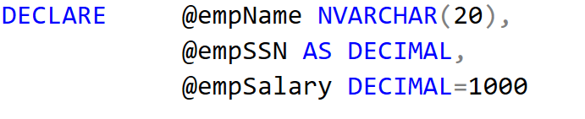
2. Local variables
2a) Declare a variable
DECLARE
@variable [AS] dataType [= value],...
2b) Assigning Values to Variables
SET @VariableName = Value;

Slide 8
Variables - Assign a value
Assign a value into a variable : using SET or SELECT
SET @empName = N’Mai Duy An’
SELECT @empSalary = 2000
Assign a value into a variable using SQL command:
SELECT or UPDATE
SELECT @empName = empName, @empSalary = empSalary
FROM tblEmployee
WHERE empName = N'Mai Duy An’
UPDATE tblEmployee
SET empName = @empName, empSalary = @empSalary
WHERE empName = N'Mai Duy An’

Slide 9
Variables - Display value
Display value of a variable using PRINT or SELECT
PRINT @empName
SELECT @empSalary
Converts an expression from one data type to a different data type: using CAST or CONVERT function
DECLARE @empName NVARCHAR(20), @empSalary DECIMAL
SET @empName = N'Mai Duy An'
SET @empSalary = 1000
PRINT @empName + '’’s salary is ' +
CAST(@empSalary AS VARCHAR)
PRINT @empName + '’’s salary is ' + CONVERT(VARCHAR, @empSalary)

Slide 10
2. Flow-control statement
2.1. Statement Blocks: Begin…End
2.2. Conditional Execution:
IF ... ELSE Statement
CASE ... WHEN
2.3. Looping: WHILE Statement
2.4. Error handling:
@@ERROR
TRY … CATCH

Slide 11
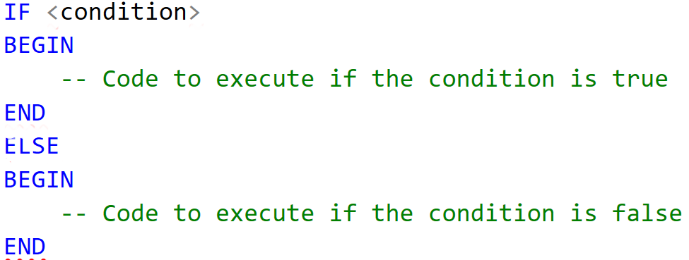
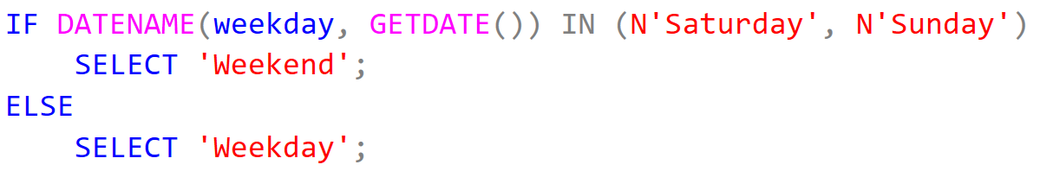
2.1. IF...ELSE (Transact-SQL)
Examples:

Slide 12
2.2. IF ... ELSE Statement
Evaluate a Boolean expression and branch execution based on the result
DECLARE @workHours DECIMAL, @bonus DECIMAL
SELECT @workHours=SUM(workHours)
FROM tblWorksOn
WHERE empSSN=30121050027
GROUP BY empSSN
IF (@workHours > 300)
SET @bonus=1000
ELSE
SET @bonus=500
PRINT @bonus

Slide 13
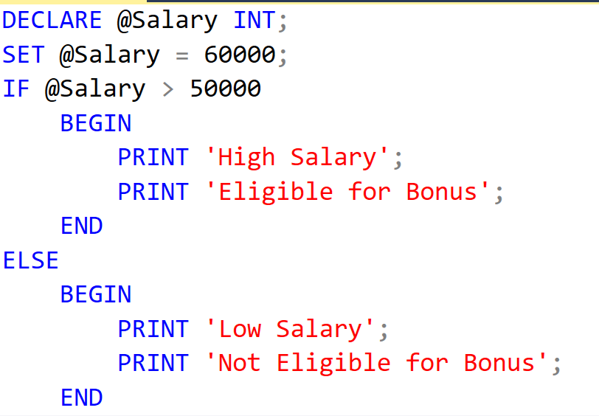

Slide 14
2.2. CASE ... WHEN Statement
Syntax:
CASE input_expression
WHEN when_expression THEN result_expression
[WHEN when_expression THEN result_expression…n]
[ELSE else_result_expression ]
END
Example
DECLARE @depNum DECIMAL, @str NVARCHAR(30)
SELECT @depNum = A.depNum
FROM tblEmployee A
WHERE A.empName LIKE N'Trần Thiện Bảo'
SET @str=
CASE @depNum
WHEN 1 THEN N'Nhóm A'
WHEN 2 THEN N'Nhóm A'
ELSE N'Nhóm B'
END
PRINT @str

Slide 15
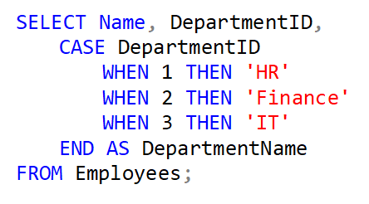
CASE ... WHEN

Slide 16
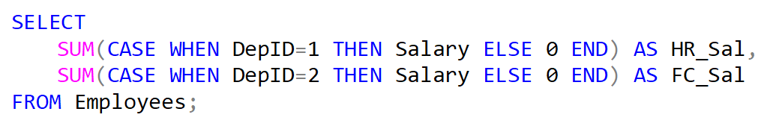
CASE ... WHEN ...with SUM
Key Points:
The CASE expression must always end with END.
If no condition matches and there is no ELSE clause, NULL will be returned.
CASE WHEN is evaluated sequentially, meaning the first condition that evaluates to TRUE will return its result

Slide 17
We use CASE in statements such as SELECT, UPDATE, DELETE and SET, and in clauses such as SELECT list, IN, WHERE, ORDER BY, and HAVING
DECLARE @womanDayBonus DECIMAL
SELECT @womanDayBonus =
CASE empSex
WHEN 'F' THEN 500
WHEN ‘M' THEN 0
END
FROM tblEmployee
WHERE empSSN=30121050004
PRINT @womanDayBonus

Slide 18
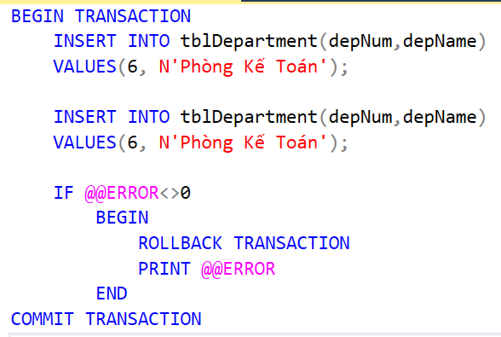
Handling error using @@ERROR function
The @@ERROR returns 0 if the last Transact-SQL statement executed successfully; if the statement generated an error, @@ERROR returns the error number

Slide 19
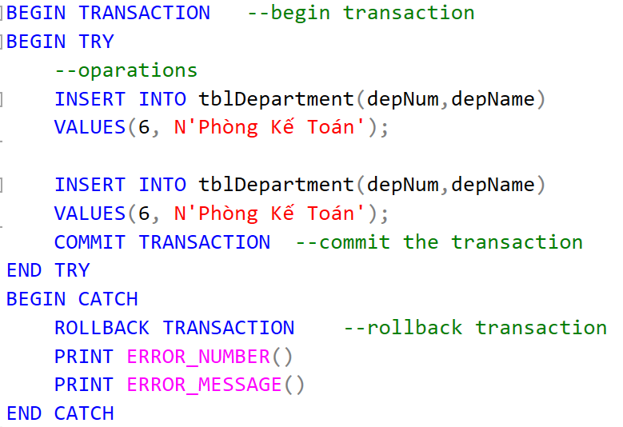
Handling error using TRY … CATCH
Statements to be tested for an error are enclosed in a BEGIN TRY…END TRY block.
A CATCH block immediately follows the TRY block, and error-handling logic is stored here

Slide 20
WHILE Statement
Repeats a statement or block of statements as long as a specified condition remains true
Syntax
WHILE boolean_expression
SQL_statement | block_of_statements
[BREAK]
SQL_statement | block_of_statements
[CONTINUE]

Slide 21
DECLARE
@factorial INT,
@n INT
SET @n=5
SET @factorial=1
WHILE (@n > 1)
BEGIN
SET @factorial = @factorial*@n
SET @n = @n - 1
END
PRINT @factorial

Slide 22
Exceptions in T-SQL programming
The form of a handler declaration is
The choices for where to go next
CONTINUE
EXIT
UNDO
DECLARE <where to go next> HANDLER FOR
<condition list> <statement list>;

Slide 23
II.
Stored Procedure

Slide 24
Advantages of using Stored Procedure
Using stored procedures offer numerous advantages over using SQL statements. These are:
Reuse of Code
Maintainability
Reduced Client/Server Traffic
Precompiled Execution
Improved Security

Slide 25
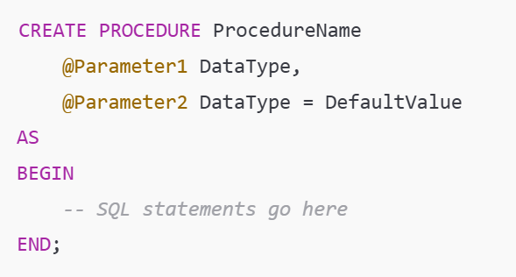
Stored Procedure

Slide 26
Key Components:
ProcedureName: The name of the stored procedure.
@Parameter1, @Parameter2: Input parameters (optional) for passing values into the procedure.
AS and BEGIN...END: Indicate the start and end of the procedure logic.
SQL statements: The actual SQL commands (e.g., SELECT, INSERT, UPDATE, etc.) that the procedure will execute.

Slide 27
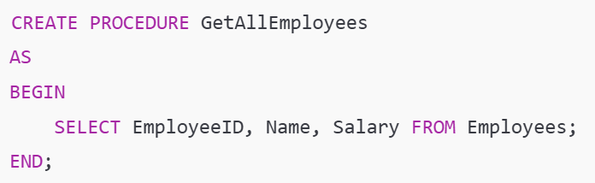
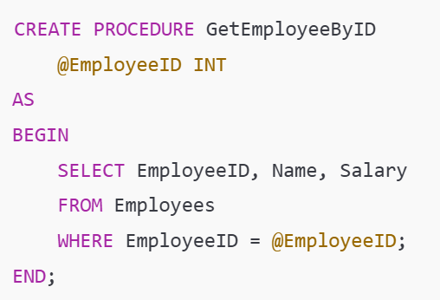
EXEC GetEmployeeByID @EmployeeID=1001;

Slide 28

Example 1:
A Simple Stored Procedure Without Parameters
This stored procedure, GetAllEmployees, when executed, returns all employees from the Employees table.
To Execute:

Slide 29
Example 1:
Create stored procedure to list all projects
Create stored procedure to change the project’s name
Create stored function to return the name of project

Slide 30
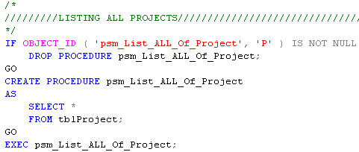
Example

Slide 31
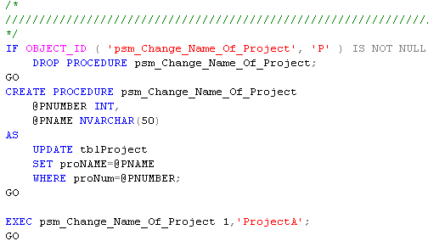
Example

Slide 32
3. Function

Slide 33
3. FUNCTION
In T-SQL, functions are blocks of code that can perform calculations or data manipulation and return results.
There are two main types of functions in T-SQL:
1) Scalar Functions: Return a single value.
2) Table-Valued Functions (TVF): Return a table of data

Slide 34
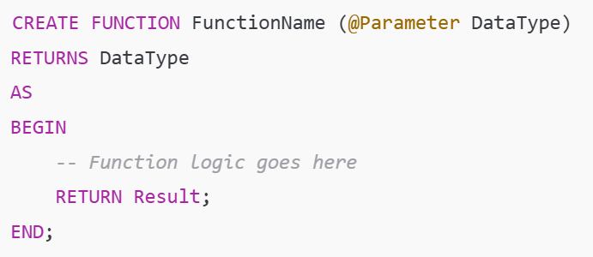
1. Scalar functions
Scalar functions perform an operation and return a single value like INT, VARCHAR, DATE, etc.

Slide 35
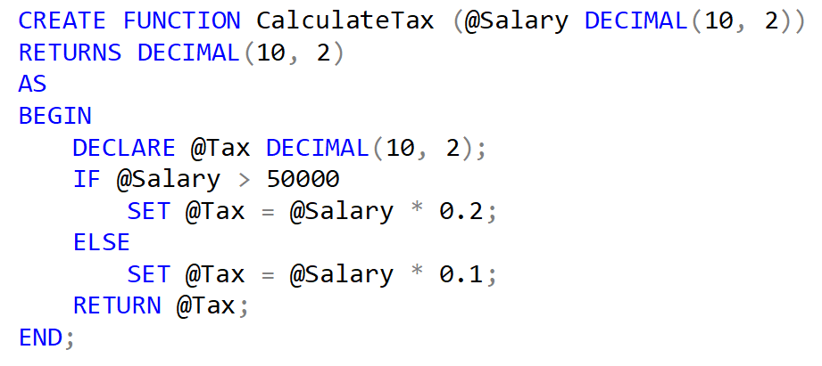
Creating a function to calculate tax based on salary:
Calling the function:

Slide 36
2. Table-Valued Functions (TVF)
Table-valued functions return a table of data.
There are two types:
1. Inline table-valued functions: Have a single RETURN statement.
2. Multi-statement table-valued functions: Can contain multiple statements and variables within the BEGIN...END block.

Slide 37
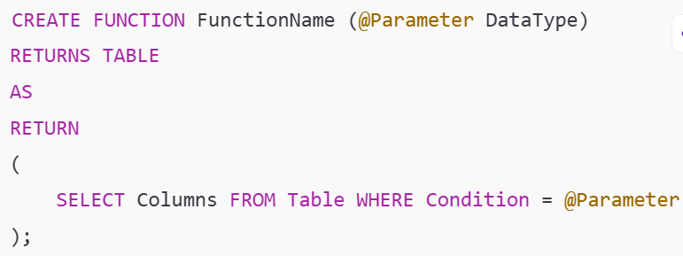
1. Inline table-valued functions

Slide 38
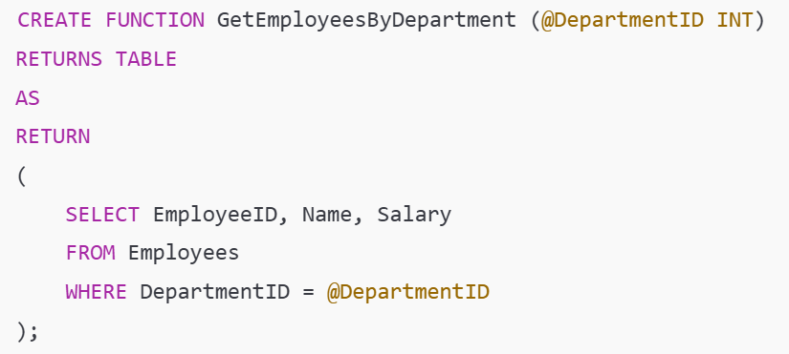

1. Inline table-valued functions
Creating a function that returns a list of employees by department:
Using the function:

Slide 39
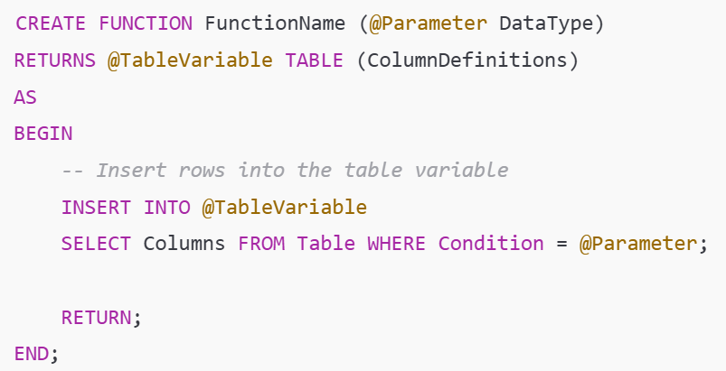
2. Multi-statement table-valued functions
Multi-statement TVFs are more complex and can contain multiple statements inside BEGIN...END.

Slide 40
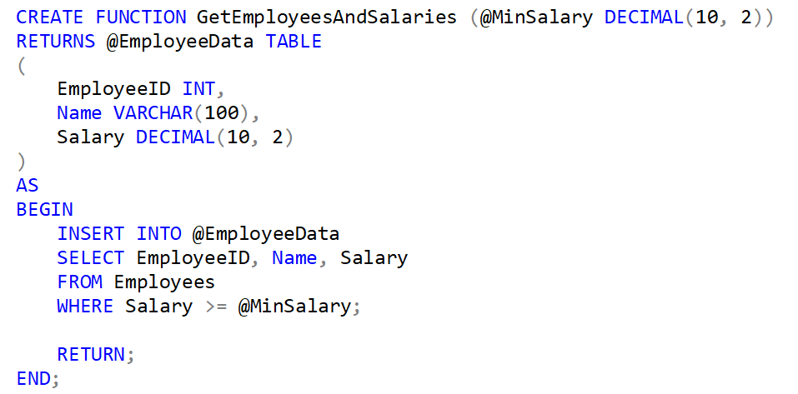
Creating a function that returns employees and their total salaries for departments:

