Slide 1

chapter 8 (Cont.)
Database programming on SQL Server

Slide 2
Contents
T-SQL Programming
Stored-procedure
Functions
Triggers
Cursors

Slide 3
SAMPLE 1 - default value
--1. Viết thủ tục hiển thị thông tin của nhân viên có tên được chỉ định (hoặc mặc định là Võ Việt Anh)
CREATE PROC usp_DSNV @fullname
nvarchar(20)= N'Võ Việt Anh'
AS
BEGIN
--YOUR CODE HERE
END
--TEST
EXEC usp_List01
EXEC usp_List01 N'Trần Thiện Bảo'

Slide 4
SAMPLE 1 (default value)
--02. Viết thủ tục hiển thị danh sách nhân viên theo phòng được chỉ định
CREATE PROC usp_DSNVTheoPhong
@empDep INT
AS
BEGIN
--YOUR CODE HERE
END
--TEST
EXEC usp_DSNVTheoPhong 1
EXEC usp_DSNVTheoPhong @empDep = 1

Slide 5
SAMPLE 3 -
--03. Viết thủ tục hiển thị danh sách nhân viên từ phòng i đến phòng j (thủ tục gọi thủ tục khác)
CREATE PROC usp_DSNV
@i int,
@j int
AS
BEGIN
--YOUR CODE HERE
END
--test
EXEC usp_DSNV

Slide 6
FUNCTION (cont.)
--04. Viết hàm trả về bảng DS nhân viên theo phòng được chỉ định
CREATE FUNCTION fn_DSNVTheoPhong (@empDep int)
RETURNS TABLE
AS
RETURN
( SELECT *
FROM tblEmployee A
WHERE A.depNum = @empDep);
--TEST
SELECT * FROM fn_DSNVTheoPhong(1)

Slide 7
FUNCTION (cont.)
--05 Viết hàm trả về danh sách nhân viên có thâm niên làm việc từ 10 năm trở lên gồm các thông tin: Mã nhân viên, họ tên, giới tính, năm vào làm, lương, thâm niên
CREATE FUNCTION Fn_DSNV_lamviectu10nam()
RETURNS TABLE
AS
RETURN (SELECT A.empSSN, A.empName, A.empSex, YEAR(A.empStartdate)AS YearStartDate, A.empSalary, YEAR(GETDATE())-YEAR(A.empStartdate) as Seniority
FROM tblEmployee A
WHERE (YEAR(GETDATE())- YEAR(A.empStartdate)>=10))
--test
SELECT * FROM Fn_DSNV_lamviectu10nam()

Slide 8
FUNCTION (cont.)
--06- Viết hàm lấy ra danh sách những nhân viên được tăng lương 15% so với lương cũ
--nếu làm việc từ 15 năm trờ lên
CREATE FUNCTION Fn_DSTangLuong_lamviectu15nam()
RETURNS TABLE
AS
RETURN (SELECT A.empSSN, A.empName, A.empSalary as OldSalary, YEAR(A.empStartdate)AS YearStartDate, NewSalary = ceiling(A.empSalary*0.15), YEAR(GETDATE())-YEAR(A.empStartdate) as Seniority
FROM tblEmployee A
WHERE (YEAR(GETDATE())-YEAR(A.empStartdate)>=15)
)
--test
SELECT * FROM Fn_DSTangLuong_lamviectu15nam()

Slide 9
Triggers
Triggers differ from the other constraints.
Triggers are only awakened when certain events occur (INSERT, UPDATE, DELETE).
One awakened, the trigger tests a condition.
If the condition does not hold, trigger do nothing to response to occurred event
If the condition is satisfied, the action associated with trigger is performed by the DBMS

Slide 10
Some principle features of triggers
The trigger's condition and action can be based on the database state before or after the triggering event (insert, update, delete).
The condition and action can refer to both old and/or new values of tuples that were updated in the triggering event.
Trigger executes either
Once for each modified tuple
Once for all the tuples that are changed in one SQL statement

Slide 11
The Options for Trigger Design
AFTER / BEFORE
UPDATE / INSERT/ DELETE
WHEN (<condition>)
OLD ROW / NEW ROW
BEGIN … END;
FOR EACH ROW/FOR EACH STATEMENT

Slide 12
CREATE TRIGGER
CREATE TRIGGER trigger_name ON TableName
{AFTER [DELETE]/[INSERT]/[UPDATE]
AS
BEGIN
sql_statement 1
sql_statement 2
END
Disable a TRIGGER
DISABLE TRIGGER <trigger_name> ON <table_name>
Enable a TRIGGER
ENABLE TRIGGER <trigger_name> ON <table_name>

Slide 13
Products (ProductID, ProductName, Price)
PriceHistory (HistoryID, ProductID,
OldPrice, NewPrice, ChangeDate)
EXAMPLE 1
CREATE TABLE Products
(
ProductID INT PRIMARY KEY,
ProductName VARCHAR(100),
Price DECIMAL(10, 2)
);
CREATE TABLE PriceHistory
(
HistoryID INT IDENTITY(1,1) PRIMARY KEY,
ProductID INT,
OldPrice DECIMAL(10, 2),
NewPrice DECIMAL(10, 2),
ChangeDate DATETIME DEFAULT GETDATE()
);

Slide 14
EXAMPLE 1
--insert values
INSERT INTO Products VALUES
(1, 'Laptop', 1000),
(2, 'TV', 550);
Create the Trigger
create a trigger to automatically log price change history whenever a record in the Products table is updated.

Slide 15
EXAMPLE 1
CREATE TRIGGER trigger_AfterPriceUpdate
ON Products
AFTER UPDATE
AS
BEGIN
INSERT INTO PriceHistory (ProductID, OldPrice, NewPrice)
SELECT d.ProductID, d.Price, i.Price
FROM deleted d, inserted i
WHERE d.ProductID = i.ProductID
and d.Price <> i.Price; -- Only log if the price has changed
END;
--test
update Products
set Price = Price + 50
where ProductID = '01'
SELECT * FROM PriceHistory;

Slide 16
Deleted and Inserted tables
When a trigger is executing, it has access to two memory-resident tables that allow access to the data that was modified: Inserted and Deleted.
These tables are available only within the body of a trigger for read-only access.
The structures of the inserted and deleted tables are the same as the structure of the table on which the trigger is defined
INSERT action
UPDATE action
DELETE action
new data
old data
inserted data
deteted data
Inserted Table
Deleted Table

Slide 17
Example: using Deleted and Inserted tables
IF OBJECT_ID('Tr_Employee_Insert', 'TR') is not null
drop trigger Tr_Employee_Insert;
--create a trigger
CREATE TRIGGER Tr_Employee_Insert ON tblEmployee
AFTER INSERT
AS
DECLARE @vEmpSSN DECIMAL, @vEmpName NVARCHAR(50)
SELECT @vEmpSSN=empSSN FROM inserted
SELECT @vEmpName=empName FROM inserted
PRINT 'new tuple:'
PRINT 'empSSN=' + CAST(@vEmpSSN AS nvarchar(11)) + ' empName=' + @vEmpName;
--test
INSERT INTO tblEmployee(empSSN, empName, empSalary, depNum, supervisorSSN)
VALUES (30121050345, N'Nguyễn Văn Tý',10000,1,30121050037);

Slide 18
Samples
Create the trigger that refuses all under-18-year-old employee’s insertion or update.
CREATE TRIGGER Tr_Employee_Under18 ON tblEmployee
AFTER INSERT, UPDATE
AS
DECLARE @empBirthdate DATETIME, @age INT
SELECT @empBirthdate=empBirthdate
FROM inserted;
SET @age=YEAR(GETDATE()) - YEAR(@empBirthdate)
IF (@age < 18)
BEGIN
RAISERROR(‘Employee is under 18 years old. We can not sign a contact with him/her.',16,1)
ROLLBACK TRANSACTION
END

Slide 19
Another method: using EXISTS
CREATE TRIGGER Tr_Employee_Under18 ON tblEmployee
AFTER INSERT, UPDATE
AS
IF EXISTS(SELECT *
FROM inserted
WHERE (YEAR(GETDATE())-YEAR(empBirthdate))<18 )
BEGIN
RAISERROR('Employee is under 18. We cannot sign a contact.',16,1)
ROLLBACK TRANSACTION
END

Slide 20
Using Cursor in MS SQL Server
Declare cursor
DECLARE cursor_name CURSOR FOR SELECT Statement
Open cursor
OPEN cursor_name
Loop and get values of each tuple in cursor with FETCH statement
FETCH NEXT | PRIOR | FIRST | LAST FROM cursor_name INTO @var1, @var2
Using @@FETCH_STATUS to check fetch status. The 0 value mean FETCH statement was successful.
CLOSE cursor_name
DEALLOCATE cursor_name

Slide 21
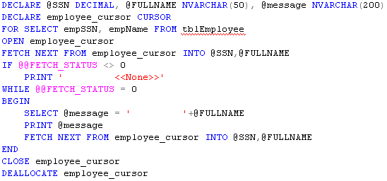
Example

Slide 22
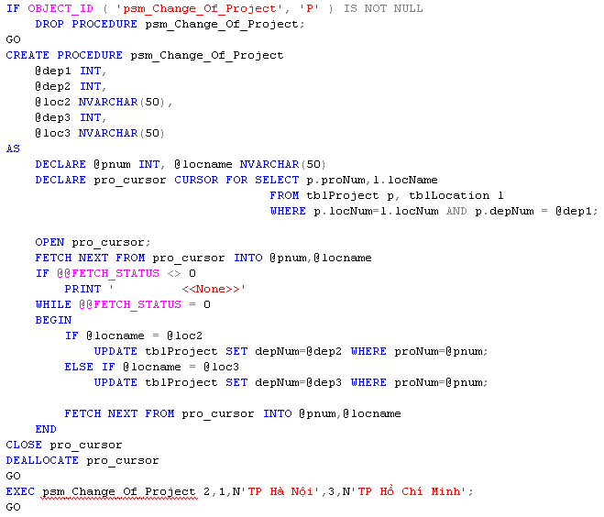
Example

Slide 23
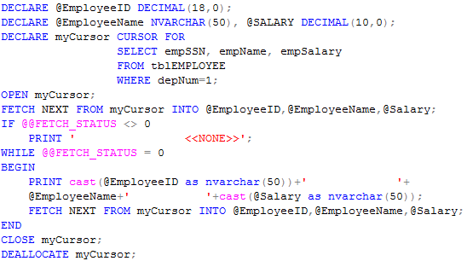
Example

Slide 24
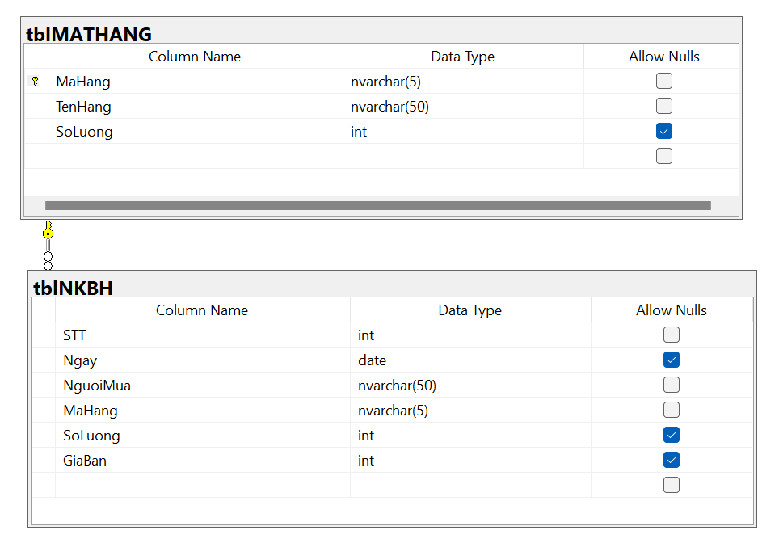
EX01

Slide 25
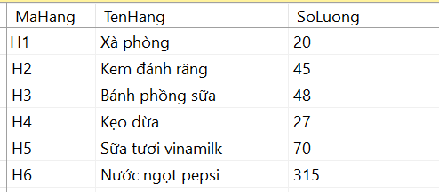
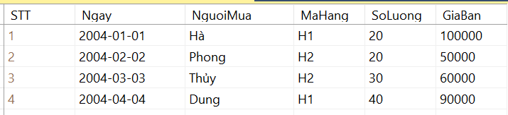
EX01

Slide 26
EX01
1. Tạo trigger cập nhật số lượng mặt hàng còn lại khi mặt hàng đó được bán (thêm mới vào bảng NKBH)
CREATE TRIGGER trg_AfterInsert_NKBH
ON NKBH
FOR INSERT
AS
BEGIN
update MATHANG set SoLuong = A.SoLuong - B.SoLuong
from MATHANG A, inserted B
where A.MaHang = B.MaHang
END

Slide 27
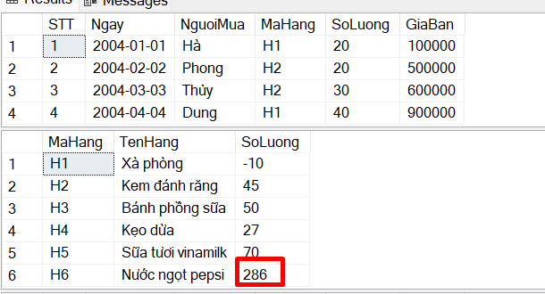
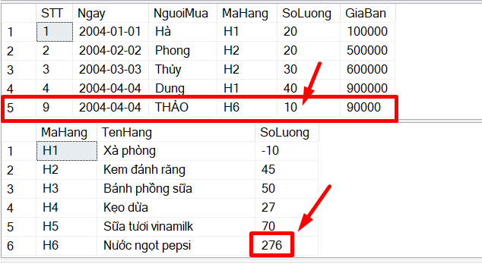
INSERT INTO NKBH values ('4/4/2004',N'THẢO','H6',10, 90000)
Trước khi thêm mới vào NKBH
Sau khi thêm mới vào NKBH

Slide 28
2. Tạo trigger cập nhật lại số lượng mặt hàng khi cập nhật NKBH
CREATE TRIGGER TRG_AfterUpdate_NKBH_SoLuong
ON NKBH
FOR UPDATE
AS
BEGIN
if UPDATE (SoLuong)
UPDATE MATHANG set SoLuong = A.SoLuong-(B.SoLuong - C.SoLuong)
from MATHANG A, inserted B, deleted C
where A.MaHang = B.MaHang and B.STT = C.STT
END

Slide 29
--TEST
SELECT * FROM NKBH
SELECT * FROM MATHANG
UPDATE NKBH
SET SoLuong = SoLuong - 1
WHERE STT = 9
SELECT * FROM NKBH
SELECT * FROM MATHANG

Slide 30
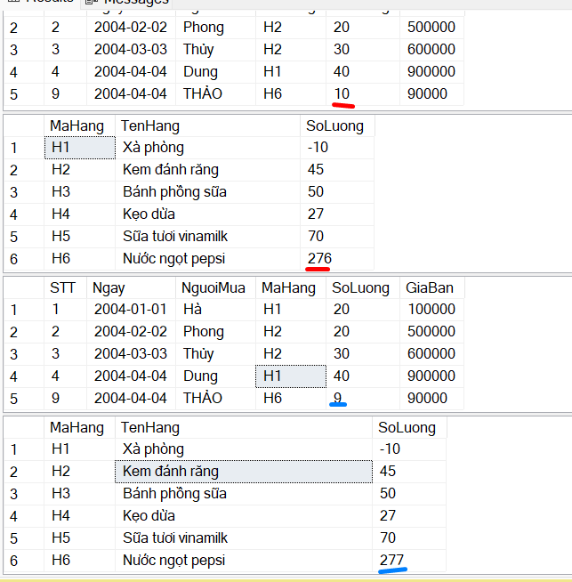

Slide 31
3. Tạo trigger ràng buộc số lượng mặt hàng bán phải ít hơn hoặc bằng số lượng còn lại trong kho
CREATE TRIGGER TRG_NKBH_INSERT_SLBAN_SLTON
on NKBH
for INSERT
AS
BEGIN
BEGIN TRANSACTION
DECLARE @SLTON INT, @SLBAN INT
SET @SLTON =(SELECT A.SoLuong FROM MATHANG
SET @SLBAN = (SELECT B.SoLuong FROM inserted B )
IF (@SLBAN>@SLTON)
ROLLBACK TRANSACTION
ELSE
COMMIT
END

