Slide 1
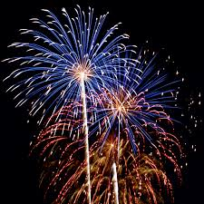
Firework Simulation
By Michael Lombardo

Slide 2

Firework Simulation Details
For my final project, I will create a simulation for a firework show.
Luckily for the viewers of the firework show, they are having their first opportunity to watch a new generation of fireworks. These fireworks have electronics mounted within the firework to avoid them from exploding below a particular height for safety purposes.
This simulation will include my demonstration of 2D-projectile motion, collision detection, and momentum conservation.

Slide 3
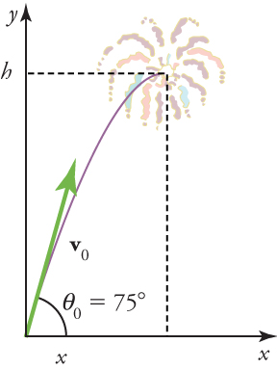
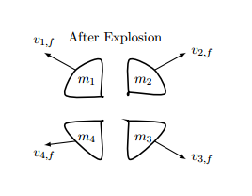
2D-projectile motion will be demonstrated through the motion of the launched firework, also considering the loss of mass from black powder (charcoal or thermite)
Momentum conservation will be demonstrated through the fireworks explosion. For the instance of this simulation, I will treat the tip of a firework as many small particles for the explosion.
Collision detection will be demonstrated through the firework’s low elevation electronics

Slide 4
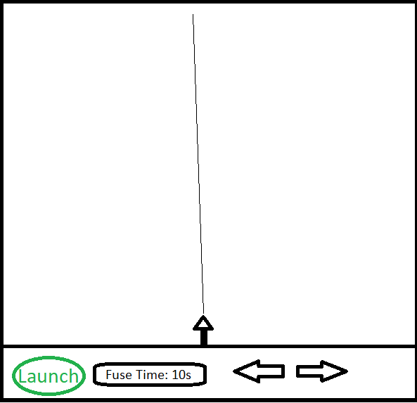
Firework Simulation Window Example
Launch button to execute the shooting of the firework.
Fuse time input field, allows user to select the length of fuse time.
Directional keys allow the user to aim the direction the firework is being shot, aim is depicted through a thin line from the firework.

