Slide 1

Predict the change and price house in real estate
Advisor : PhD Trinh Hung Cuong
Students :
- Nguyen Thanh Dat - 51600012
- Le Tran Nhat Viet - 51603376

Slide 2
1 . Introduce.
2 . Step.
2.1 . Crawl Data.
2.2 . Clean Data.
2.3 . Visualiztion Data.
2.4 . Data preprocessing.
2.4 . Modelling and predicting.
3 . Demo.
SUMMARY
1

Slide 3
1. Introduce.
Let’s start

Slide 4
- Housing Price and housing price projections are one of the top concerns of market participants from investors, real estate companies to commercial companies especially in the context of This market is very vibrant in recent years.
- In Vietnam, there still does not exist a real estate index as in developed countries. Not only that, there is no information about this market and if any, it cannot be verified.
INTRODUCE
1

Slide 5
- To overcome these obstacles, this project uses a simple approach: collecting and exploiting data from real estate listings posted on https://alonhadat.com.vn - a website specializing in real estate transactions
INTRODUCE
1

Slide 6
INTRODUCE
1

Slide 7
2. Step
1

Slide 8
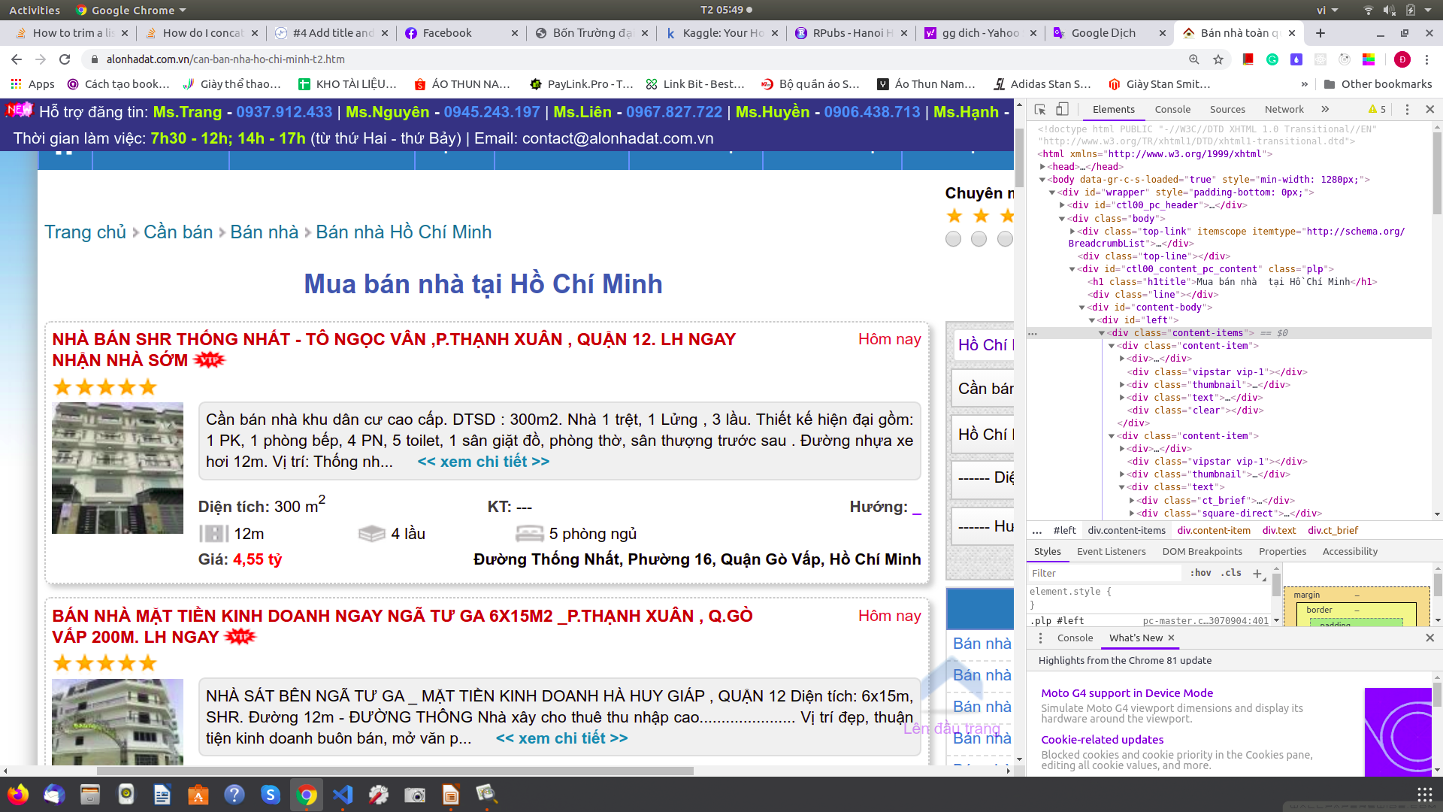
2.1 . Crawl Data :
Step
1

Slide 9
Librabries used.
.
MODULES OF OUR ASSIGNMENT
1

Slide 10
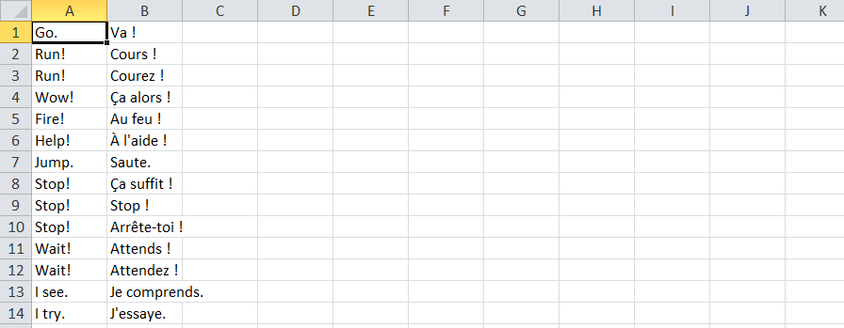
2.2 . Data .
eng-french.txt
Source : https://download.pytorch.org/tutorial/data.zip
MODULES OF OUR ASSIGNMENT
1

Slide 11
MODULES OF OUR ASSIGNMENT
2.2 . Data .
Preparing data.
The full process for preparing the data is:
Read text file and split into lines, split lines into pairs
Normalize text, filter by length and content
Make word lists from sentences in pairs
.
1

Slide 12
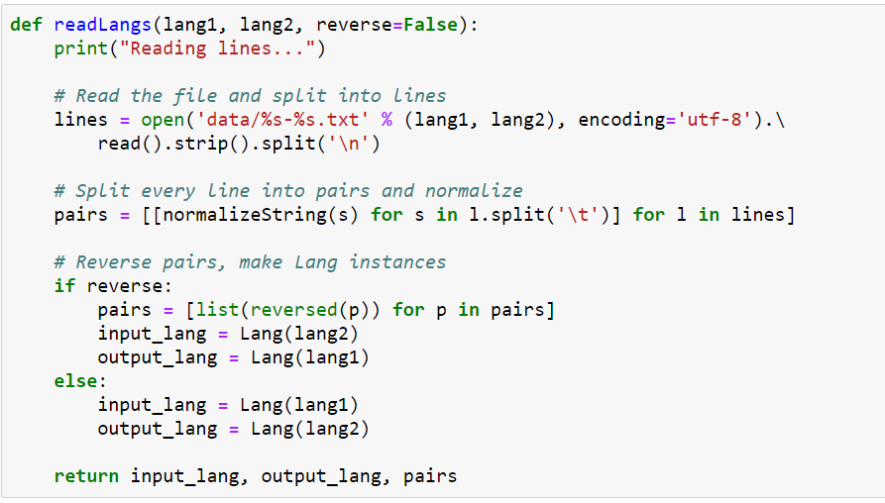
2.2 . Data .
To read the data file we will split the file into lines, and then split lines into pairs. The files are all English → Other Language, so if we want to translate from Other Language → English I added the reverse flag to reverse the pairs..
.
MODULES OF OUR ASSIGNMENT
1

Slide 13
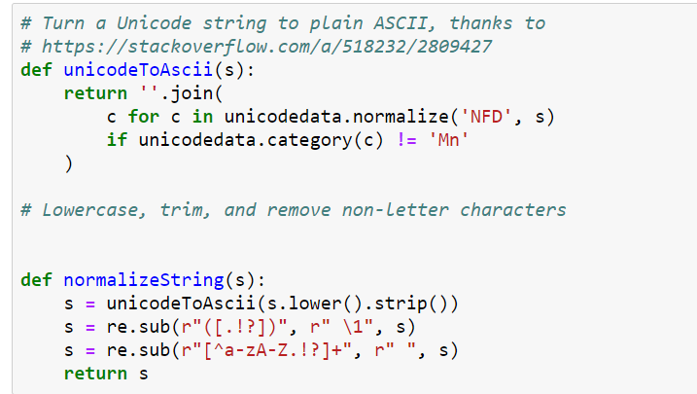
2.2 . Data .
The files are all in Unicode, to simplify we will turn Unicode characters to ASCII, make everything lowercase, and trim most punctuation.
.
MODULES OF OUR ASSIGNMENT
1

Slide 14
2.3 . Sequence to Sequence model.
A Recurrent Neural Network, or RNN, is a network that operates on a sequence and uses its own output as input for subsequent steps.
A Sequence to Sequence network, or seq2seq network, or Encoder Decoder network, is a model consisting of two RNNs called the encoder and decoder. The encoder reads an input sequence and outputs a single vector, and the decoder reads that vector to produce an output sequence.
.
MODULES OF OUR ASSIGNMENT
1

Slide 15
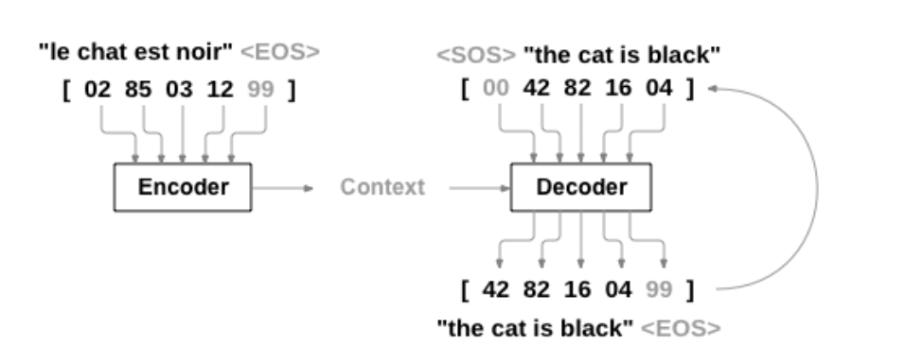
2.3 . Sequence to Sequence model.
Unlike sequence prediction with a single RNN, where every input corresponds to an output, the seq2seq model frees us from sequence length and order, which makes it ideal for translation between two languages.
.
MODULES OF OUR ASSIGNMENT
1

Slide 16
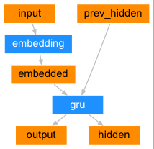
2.3 . Sequence to Sequence model.
The Encoder .
.
MODULES OF OUR ASSIGNMENT
1

Slide 17
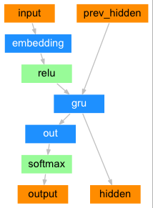
2.3 . Sequence to Sequence model.
The Decoder .
.
MODULES OF OUR ASSIGNMENT
1

Slide 18
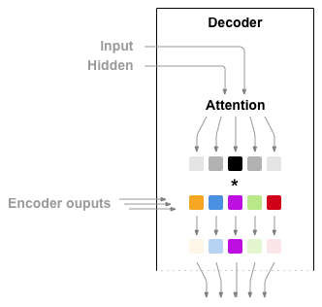
2.3 . Sequence to Sequence model.
Attention Decoder .
.
MODULES OF OUR ASSIGNMENT
1

Slide 19
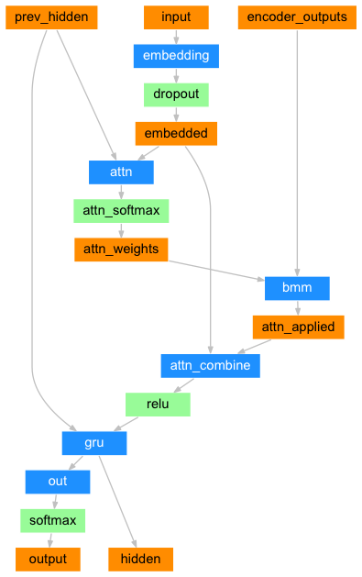
2.3 . Sequence to Sequence model.
.
MODULES OF OUR ASSIGNMENT
<number>

Slide 20
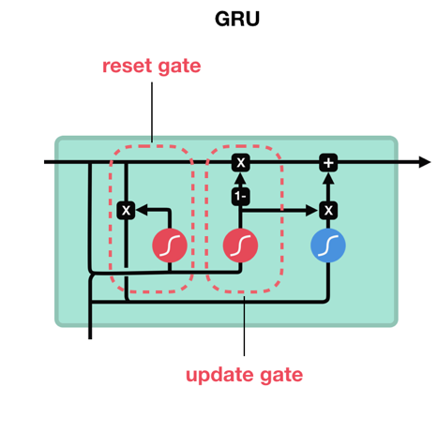
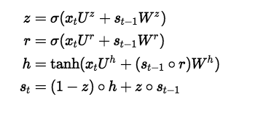
2.3 . Sequence to Sequence model.
.
<number>

Slide 21
MODULES OF OUR ASSIGNMENT
2.4 . Training and Evaluating data.
Training :
To train we run the input sentence through the encoder, and keep track of every output and the latest hidden state. Then the decoder is given the <SOS> token as its first input, and the last hidden state of the encoder as its first hidden state.
.
.
<number>

Slide 22
MODULES OF OUR ASSIGNMENT
2.4 . Training and Evaluating data.
Training :
The whole training process looks like this:
Start a timer
Initialize optimizers and criterion
Create set of training pairs
Start empty losses array for plotting.
.
<number>

Slide 23
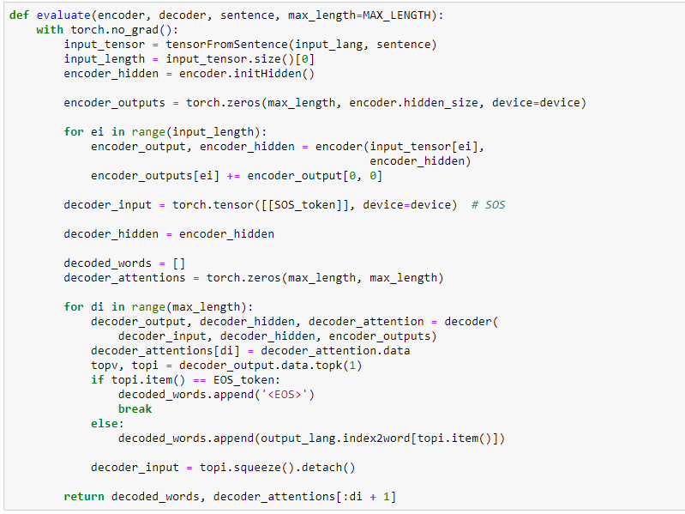
2.4 . Training and Evaluating data.
Evaluating :
.
MODULES OF OUR ASSIGNMENT
<number>

Slide 24
3. Demo.

Slide 25
THANKS FOR WATCHING !
<number>

