Slide 1

Group member Kay(Khin) Dat Sam

Slide 2
At first, my group intend to create a program that serve student during their college life because we are college students. Thus, we are developing a program that can help colleges student to access many helpful sources in their colleges.
In my opinions, student period is a beginning period, so it should be a basic and easy topic to get involved in. In addition, we, as college students, should figure out a way to help not only us but also other college students to get access quickly and easily to different sources around school, such as schedule, group, and job.

Slide 3
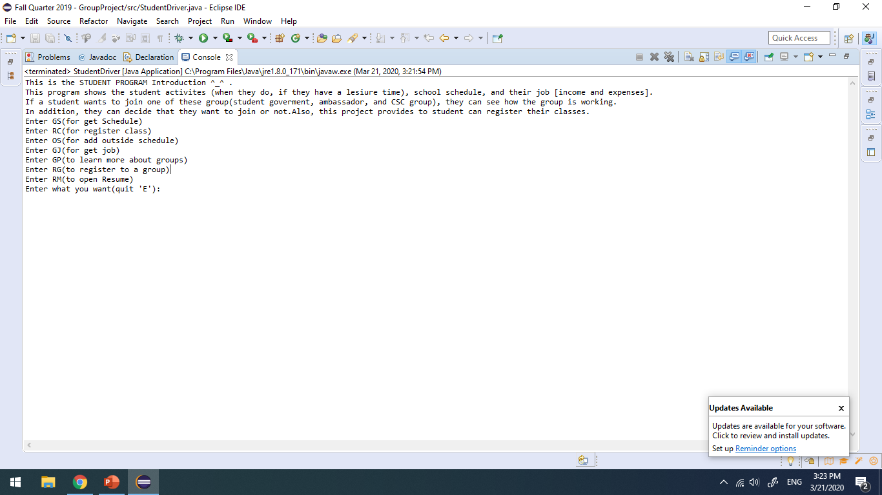
This program is an interactive tool, which helps college student to access to the information they want. For instance, Schedule (both schedule inside school and outside of school), register classes, the information of your job, the information about groups or register to those groups, and student resume.

Slide 4
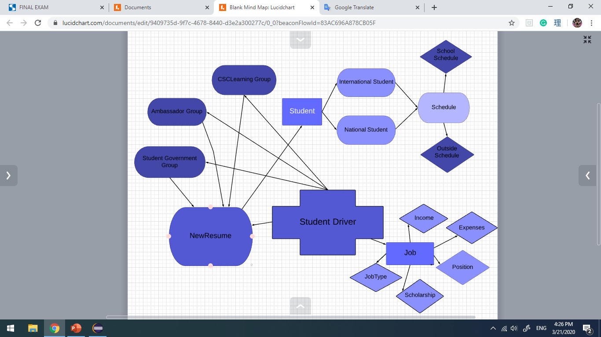

Slide 5
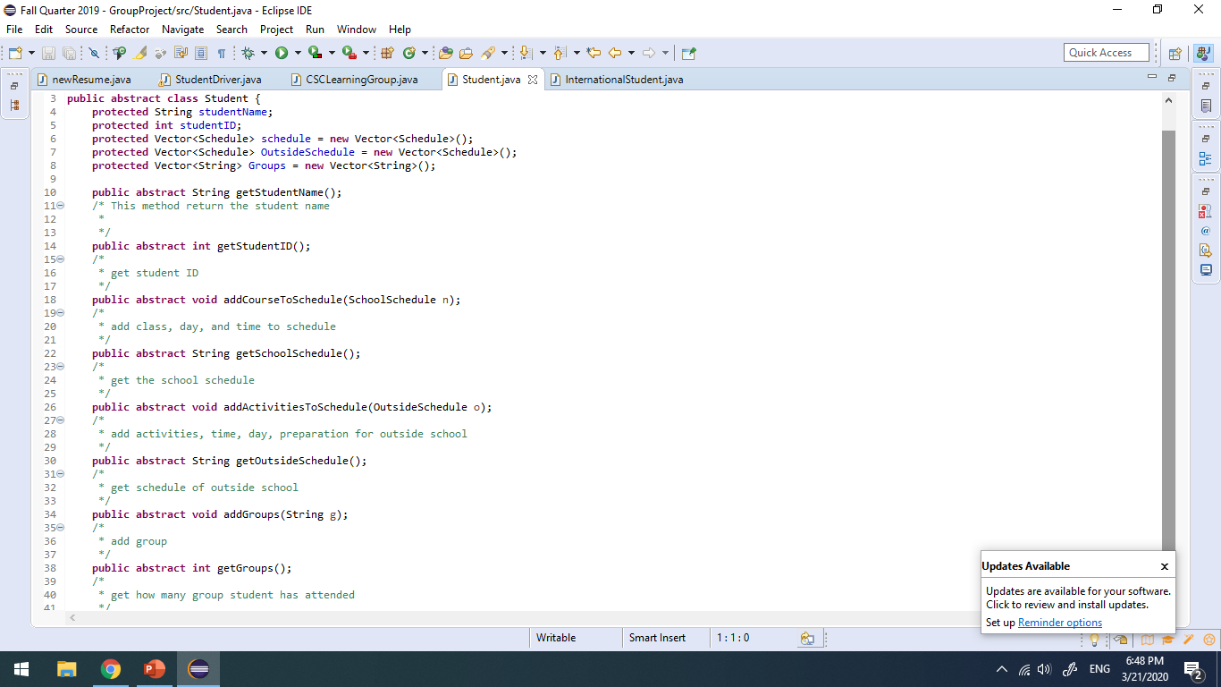
Field:
+ studentName is used to store the name of a student.
+ studentID is used to store the ID of a student and can be use to verify a student instead of their name.
+ schedule is used to store class schedule or any activities that take place at school, and OutsideSchedule is used to store outside school activities. Students can access their schedule by calling the method.
+Groups is used to store and show how many groups that a student has attended.
These 2 methods help identify the students by getting their name or studentID.
These two methods are used to set and get the school schedule
After adding schedule, students can see both schedules together by calling them in student driver.
These two methods are used to set and get the outside schedule
After attending a group by addGroups method, the Groups field will store the name of those group. Then, these data will be call and store at student newresume.

Slide 6
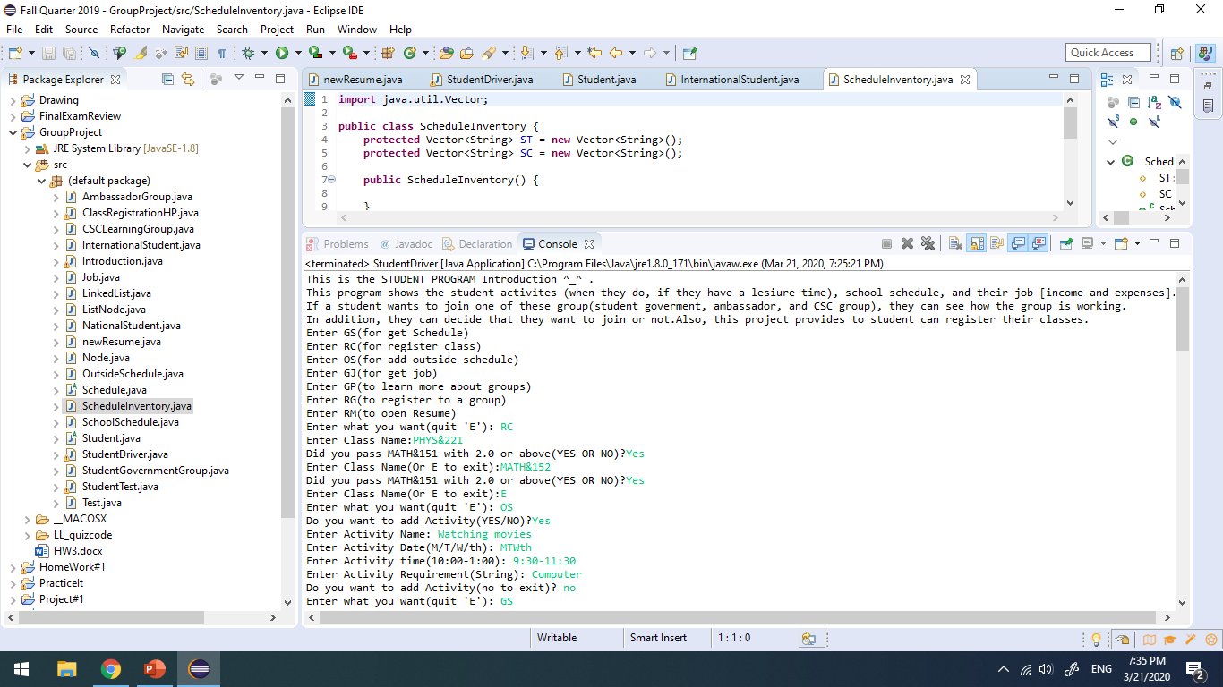
At first, student can register their class and add the outside school activities like this.

Slide 7
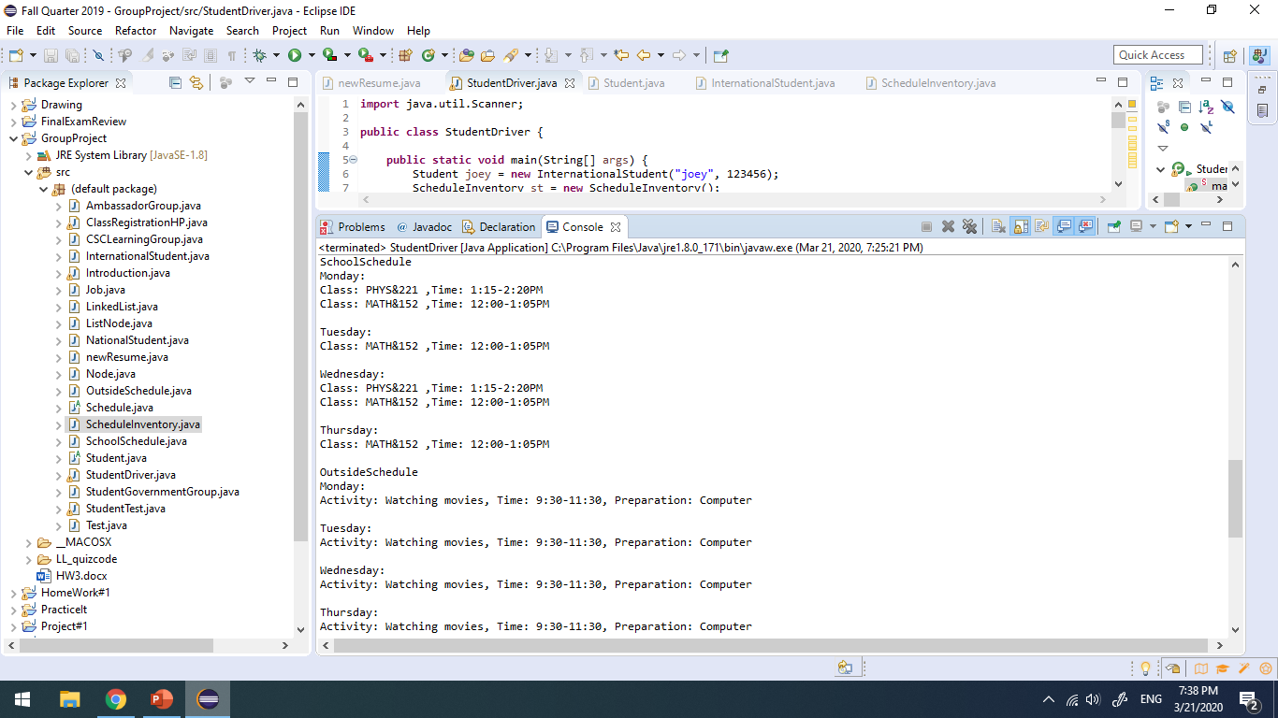
Then if they want to see their schedule, then can do that by calling GS(get schedule).

Slide 8
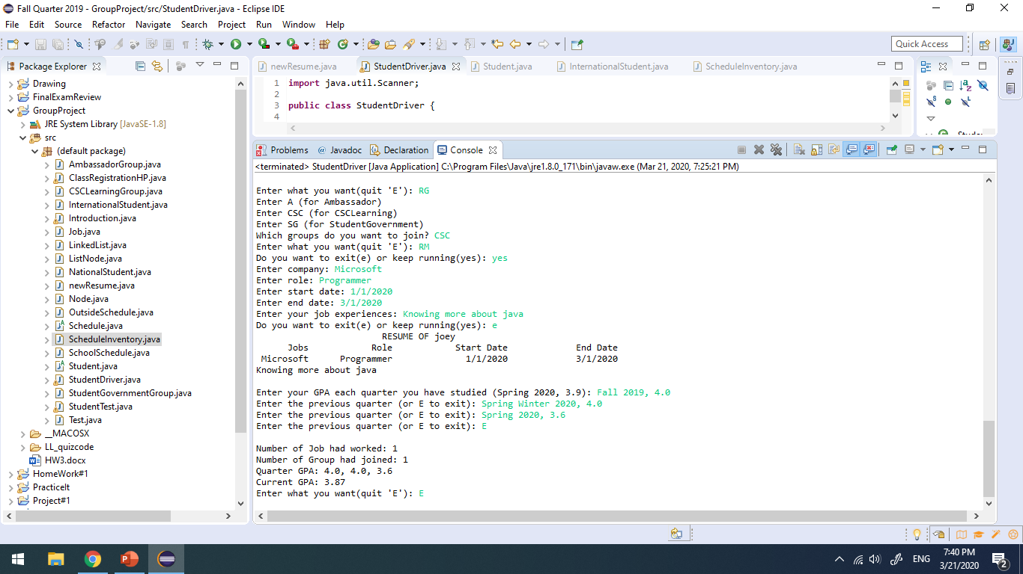
The last part is about resume, if a student has attended a group before, it will be mention in the resume. In addition, the resume also show company, role, and time of the job that student had worked. Finally, the GPA of a student, this part data is depended on what the user input is.
If student want to exit the program, press E

Slide 9
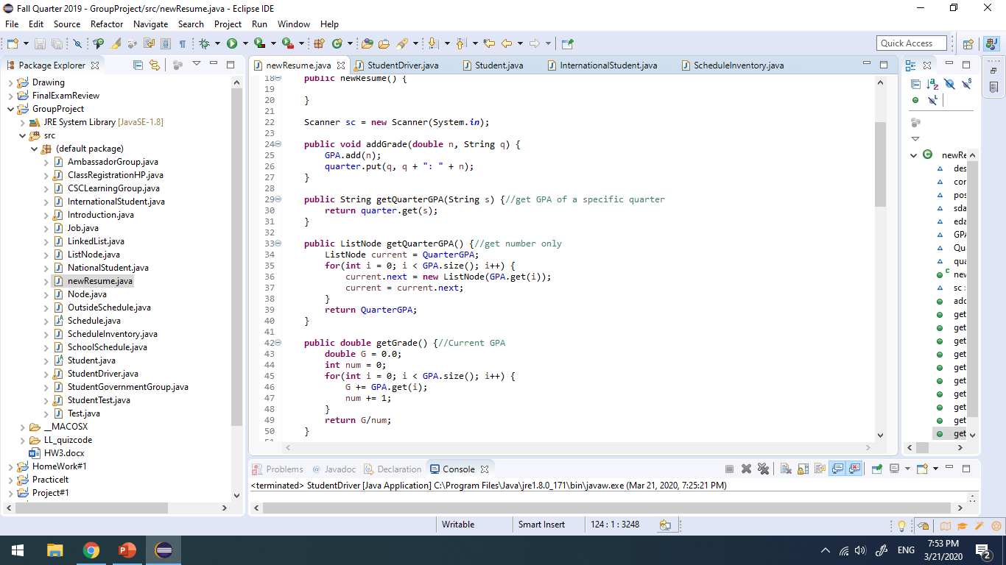
One of the challenged I encounter is ListNode. First, I intend to use it to store String of job, but I find it easier to deal with number. As a result, I use ListNode to keep track of a LinkedList of GPA in the resume class.

Slide 10
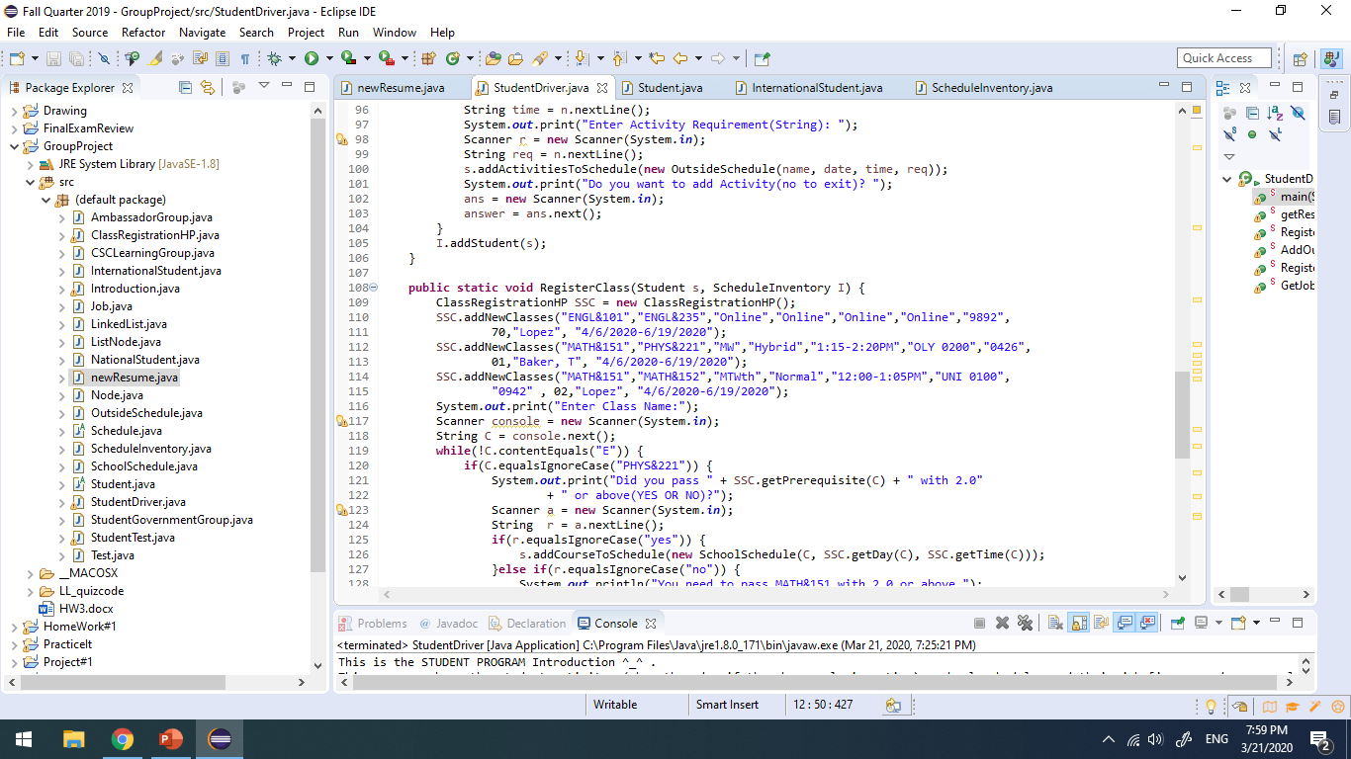
If I am going to work in this project more in the future, there are 3 thing I want to convert. First, the amount of classes that students can register. Now, there are only 3 classes, and I want to add more choices for student.

Slide 11
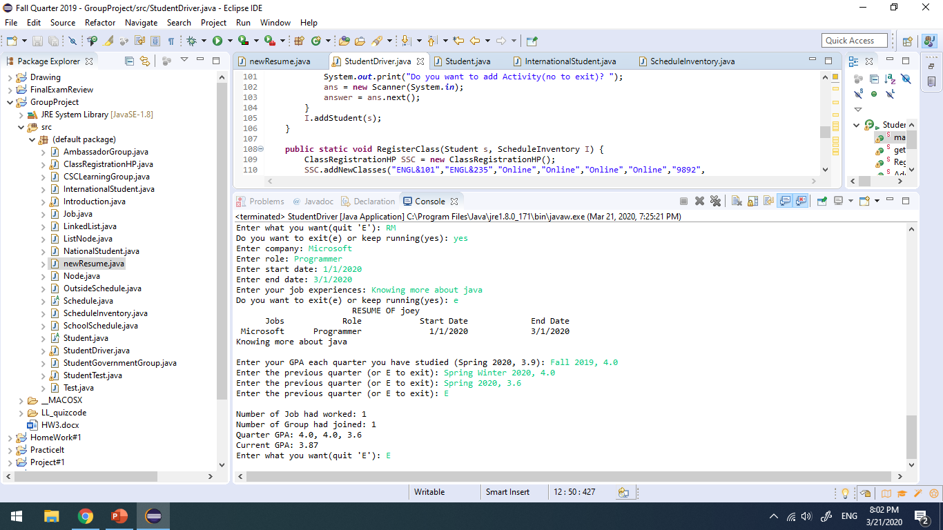
Secondly, I want to make the resume look better and more neatly.
Last thing I want to change is about how to get the grade and put it into the resume. I intend to get GPA from instructor.

Slide 12
After finishing this project, I learn that the power of group is better than individual in some way. For instance, I’m not going at using Iterator, but my teammate can figure out the useful of Iterator and use it in new resume. I am enjoyed most is the register class because the process of register a class is one of the inevitable act a student must do. While I’m working on how to connect all classes and call them out in the student driver, it gave me a hard time. In addition, I’m often very frustrated because I can’t completely connect those classes because I can’t understand completely how my partner classes work. Furthermore, I don’t want to mess with her class and create error. There were many new materials that Emilia taught in class, but she didn’t let student practice them right after she taught them. It is more helpful for me if instructors do so.

