Slide 1
Enhancing Financial Security: Implementation of a Credit Card Fraud Detection Model on Google Cloud Platform
%
TEAM: F
Varsada Anjali Rameshchandra
Kiran Kumar Reddy Guggilla
Nimmagadda Sadasiva Madhav

Slide 2
Introduction
Financial security is a paramount concern for individuals, businesses, and financial institutions alike. One of the most pervasive threats to financial security today is credit card fraud.
Leveraging the robust capabilities of Google Cloud AI Platform, we embark on a journey to harness the potential of artificial intelligence in detecting and mitigating credit card fraud.
Through this project, we intend to explore how machine learning algorithms, coupled with the vast computational resources of Google Cloud, can be employed to develop a robust, efficient, and adaptable credit card fraud detection system.

Slide 3
Literature Review
Machine learning algorithms, when trained on historical credit card transaction data, can successfully detect and prevent credit card fraud by identifying patterns, anomalies, and fraudulent behaviors. Additionally, incorporating feature engineering and advanced modeling techniques can enhance the accuracy and efficiency of fraud detection systems [1].
According to Statista, the global eCommerce losses to online payment fraud reached $41 billion in 2022 and are estimated to cross $48 billion by the end of 2023.Therefore, detecting incidents of payment fraud and preventing associated losses has become a prime concern for businesses.
In research, we have found that Autoencoder can be seen as one of the best technique for feature selection. Autoencoder is a neural network for unsupervised learning that minimizes deviation in input-output transformation [2].
In recent years, neural networks have played an important role in fraud detection. Neural Networks can actually calculate user profiles in an independent manner, thus adapting more elegantly to the behavior of the various users [3].To create a fraud detection system for credit card transactions, we must tackle the issue of class imbalance as fraudulent transactions are rare.

Slide 4
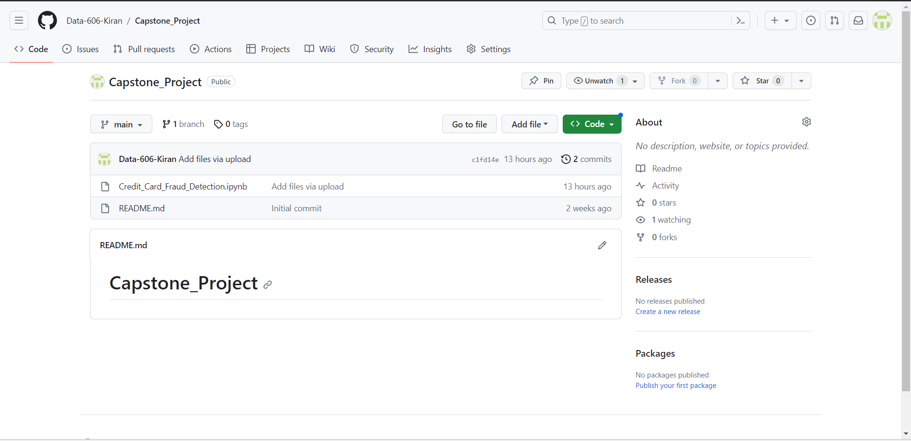
GitHub Repository
https://github.com/Data-606-Kiran/Capstone_Project

Slide 5
Overview on Data set
Data Overview:
The dataset contains transactions that occurred over two days in September 2013.
There are a total of 284,807 transactions.
The dataset has been collected and analysed during a research collaboration of Worldline and the Machine Learning Group on big data mining and fraud detection. (http://mlg.ulb.ac.be)
Source : Kaggle
https://www.kaggle.com/datasets/mlg-ulb/creditcardfraud
Features:
The features V1, V2, … V28 are the result of a Principal Component Analysis (PCA) transformation.
The 'Time' feature represents the seconds elapsed between each transaction and the first transaction in the dataset.
The 'Amount' feature represents the transaction amount.
Target Variable:
The response variable is 'Class,' which takes a binary value:
1: Indicates a fraudulent transaction.
0: Indicates a non-fraudulent (legitimate) transaction.

Slide 6
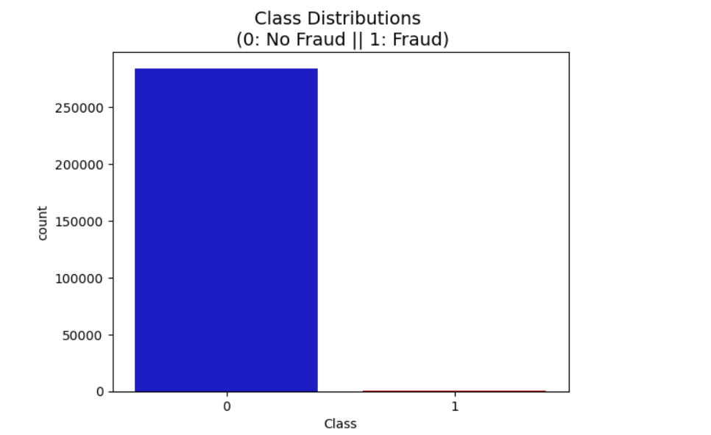
Exploratory Data Analysis
Class Distribution
OUT OF 284807 records of data 99.83% of the transactions are not fraud and 0.17% transaction are Fraud.
We can notice how imbalanced is our original dataset! Most of the transactions are non-fraud. If we use this dataframe as the base for our predictive models and analysis we might get a lot of errors and our algorithms will probably overfit since it will "assume" that most transactions are not fraud. But we don't want our model to assume, we want our model to detect patterns that give signs of fraud!

Slide 7
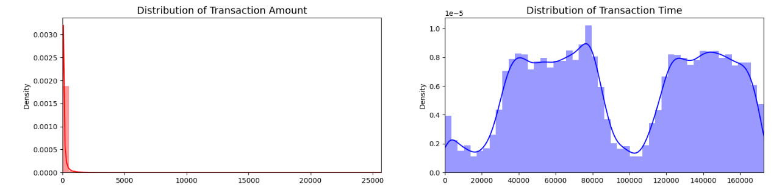
Visualizing the Imbalanced data
We can Observe how skewed the features are to avoid this situation and to bring the balance in the data we are gonna perform Oversampling using Synthetic Minority OverSampling Technique (SMOTE) or Undersampling using Ensemble Learning.

Slide 8
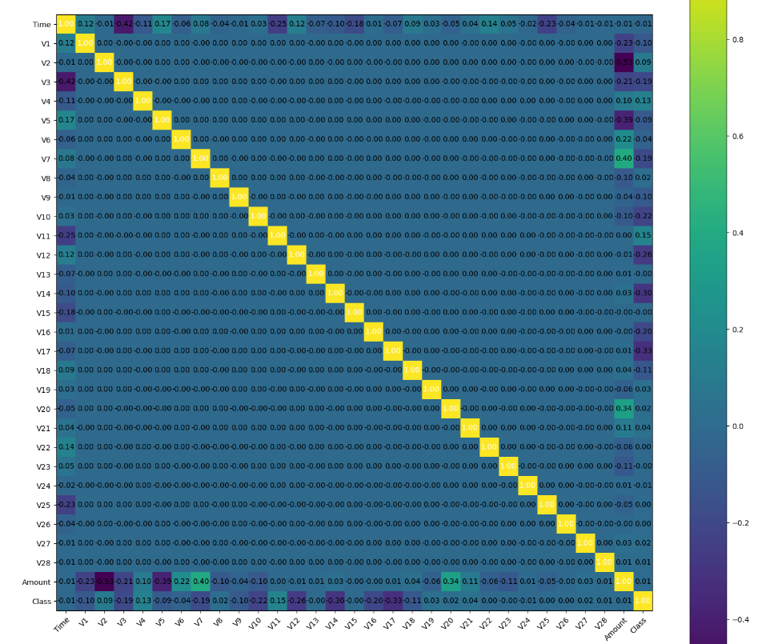
HeatMap

Slide 9
Spearman Correlation and Performance Metrics
In the initial EDA we used Spearman correlation to identify potential features . Features with strong positive or negative correlations with Target are potential features.
Features with Negative Correlation:
V3 with a correlation of -0.0593
V10 with a correlation of -0.0596
V12 with a correlation of -0.629
V14 with a correlation of -0.0646
Features with Strong Positive Correlation:
V2 with a correlation of 0.0511
V4 with a correlation of 0.063
V11 with a correlation of 0.0601
Precision Recall
F1-Score
AUPRC (Area Under Precision Recall Curve)
Confusion Matrix Accuracy is not reliable for highly Unbalanced Classification

Slide 10


Model Training
Auto ML
Custom Training
AutoML on Google Cloud Platform (GCP) streamlines machine learning by automating model creation. AutoML simplifies ML for diverse applications and Train the model without write code.
Gives complete control over training process.Need to write code for training and choose hyperparameters tuning option. GCP offers scalable and efficient training pipelines for diverse ML applications.

Slide 11
References
N. Boutaher, A. Elomri, N. Abghour, K. Moussaid and M. Rida, "A Review of Credit Card Fraud Detection Using Machine Learning Techniques," 2020 5th International Conference on Cloud Computing and Artificial Intelligence: Technologies and Applications (CloudTech), Marrakesh, Morocco, 2020, pp. 1-5, doi: 10.1109/CloudTech49835.2020.9365916.
I. Benchaji, S. Douzi and B. ElOuahidi, "Using Genetic Algorithm to Improve Classification of Imbalanced Datasets for Credit Card Fraud Detection," 2018 2nd Cyber Security in Networking Conference (CSNet), Paris, France, 2018, pp. 1-5, doi: 10.1109/CSNET.2018.8602972.
L. Nahar, I. Amir and S. Shabnam, "A Comprehensive Survey of Fraud Detection Techniques", Int. J. Appl. Inf. Syst, vol. 10, no. 2, pp. 26-32, Dec. 2015.
https://www.sciencedirect.com/science/article/pii/S187705092030065X
https://ieeexplore.ieee.org/document/9121114

Slide 12
Thank You !!

