Slide 1
✈
MACHINE LEARNING PROJECT • INDIA DOMESTIC FLIGHTS
Flight Price
Prediction
Analyzing 300,153 Indian domestic flight reservations
to predict ticket prices — Business Target: MAE < 15% of mean price
Simplon Maghreb × Jobintech | April 2026 | Dataset: Indian Flight Dataset

Slide 2
Project Context
🇮🇳
📊
🎯
Indian Domestic Market
The Dataset
Our Goal
Dataset covers 6 major Indian airlines (Vistara, Air India, Indigo, GO FIRST, AirAsia, SpiceJet) on routes between 6 key cities across India.
300,153 flight reservations — 0 missing values, 0 duplicates. 11 features covering airline, cities, timing, class, duration, and booking lead time.
Build a reliable regression model to predict flight prices (in ₹ Indian Rupees). Business target: MAE well below the mean price of ₹20,889.

Slide 3
Dataset & Variables
Variable Types
Dataset Stats
🔵 Continuous
300,153
Total Rows
duration (hrs), price (₹)
11
Features
🟠 Nominal Categorical
6
airline, source_city, destination_city, class
Indian Airlines
6
🟣 Ordinal
Indian Cities
arrival_time, departure_time, days_left, stops
0
Missing Values
🗑️ Dropped
0
flight (high cardinality — removed before modeling)
Duplicates

Slide 4
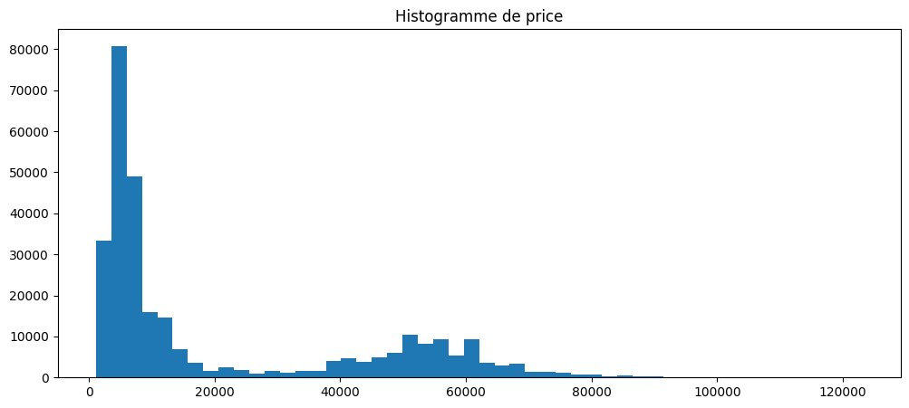
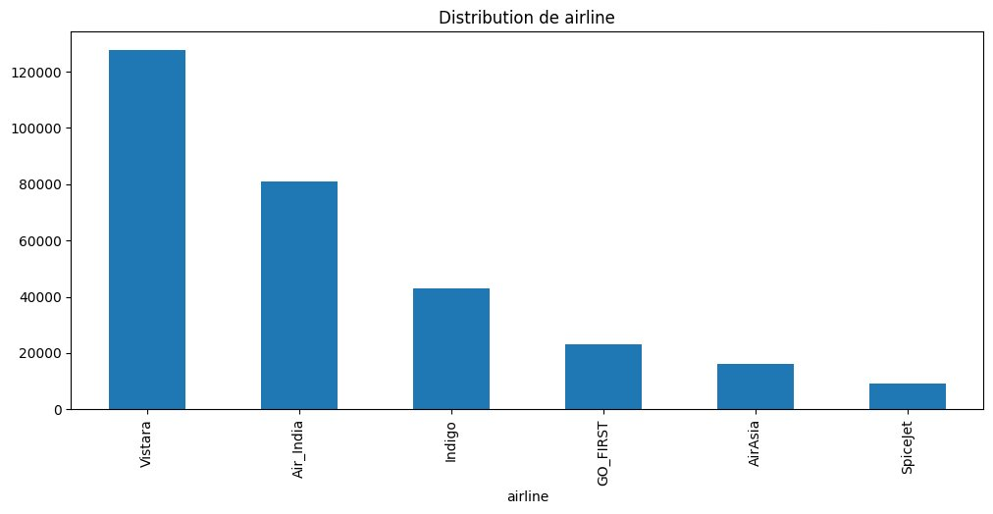
Univariate Analysis — Price & Categorical Variables
Price Distribution — right-skewed, median ₹7,425
Airline Distribution — Vistara dominates (127,859 flights)
Stops — 83% of flights have ONE stop (250,863 flights)
Class — 69% Economy (206,666) vs 31% Business (93,487)
zero: 36,004 • one: 250,863 • two_or_more: 13,286
Price gap: Economy avg ₹6,500 vs Business avg ₹52,000+

Slide 5
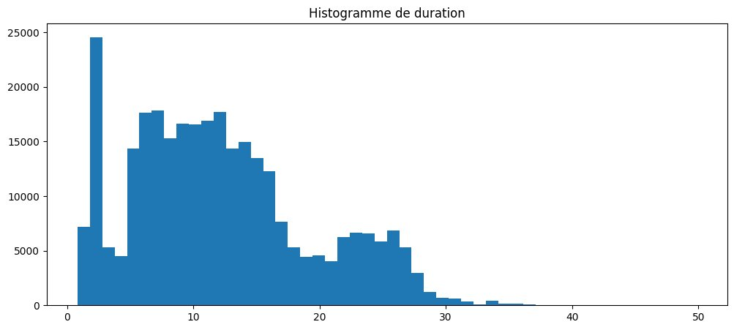
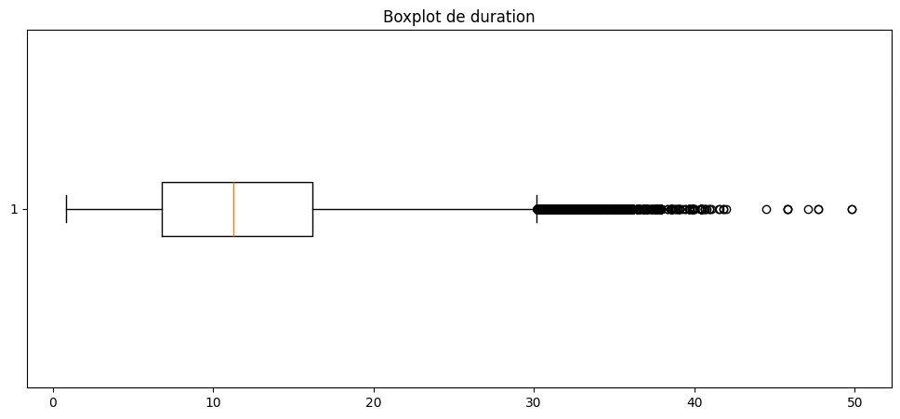
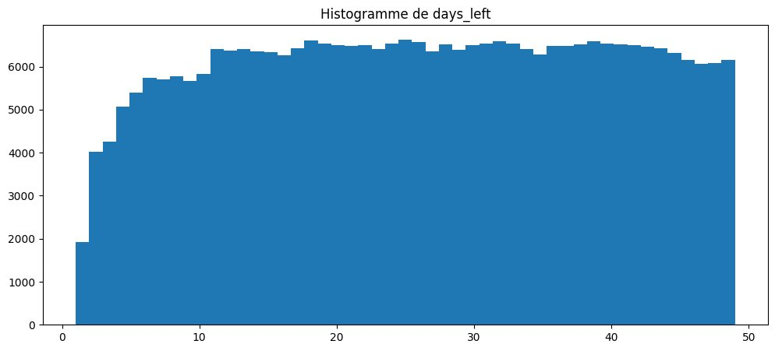
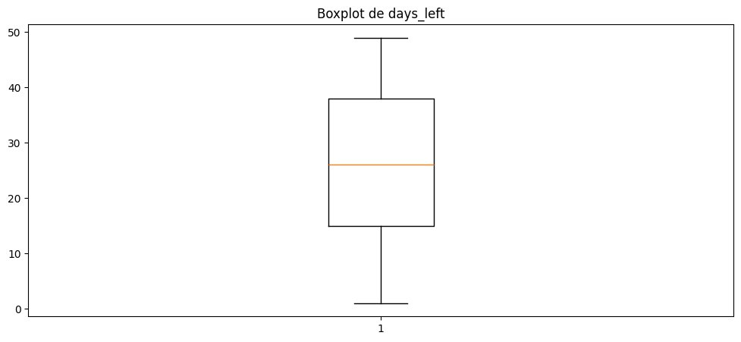
Univariate Analysis — Numeric Variables
Duration (hrs) — mean 12.2h, median 11.25h
Duration Boxplot — outliers above ~30h (long-haul)
Days Left — nearly uniform 1–49 days (mean 26 days)
Days Left Boxplot — IQR: 15–38 days, no outliers

Slide 6
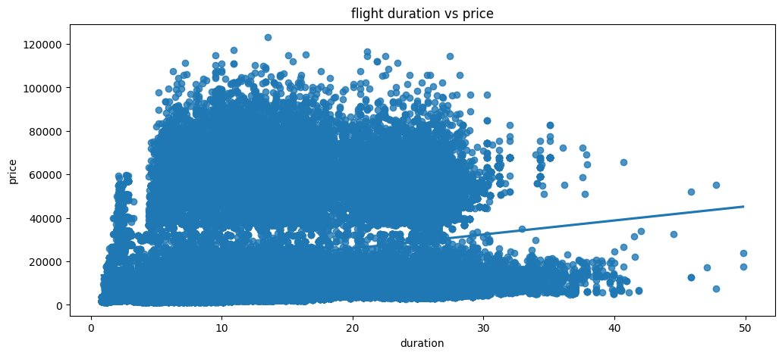
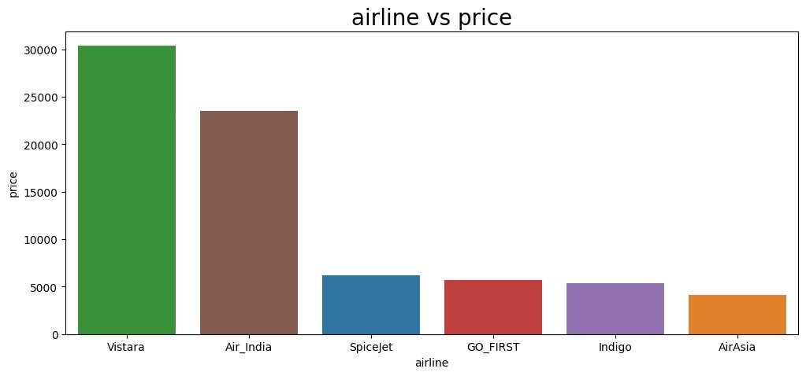
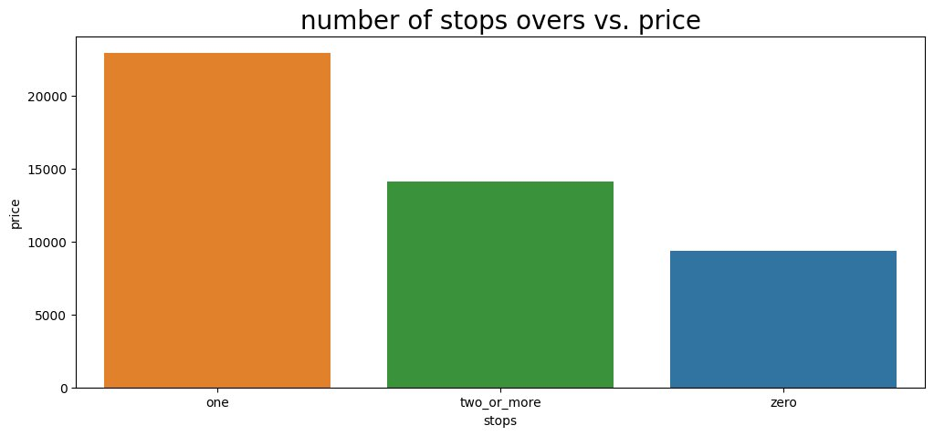
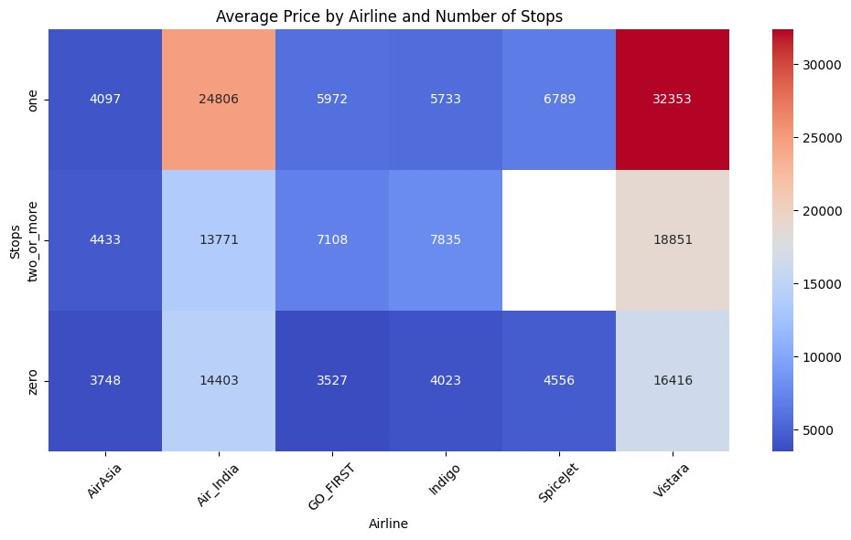
Multivariate Analysis — Price Relationships
Duration vs Price — weak positive trend (r=0.20)
Airline vs Price — Vistara ₹30,486 | AirAsia ₹4,239
Stops vs Price — one-stop most expensive (₹22,968)
Days Left vs Price — prices spike in final 7 days

Slide 7
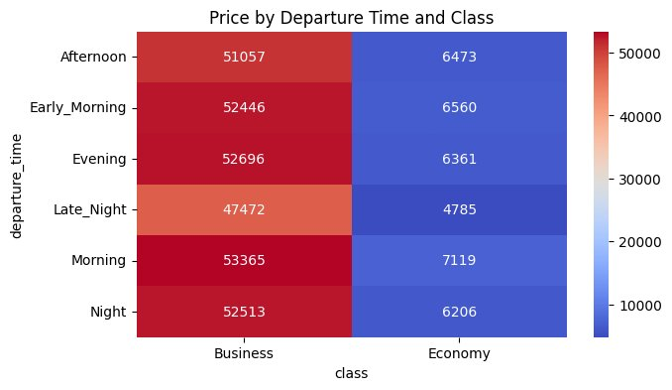
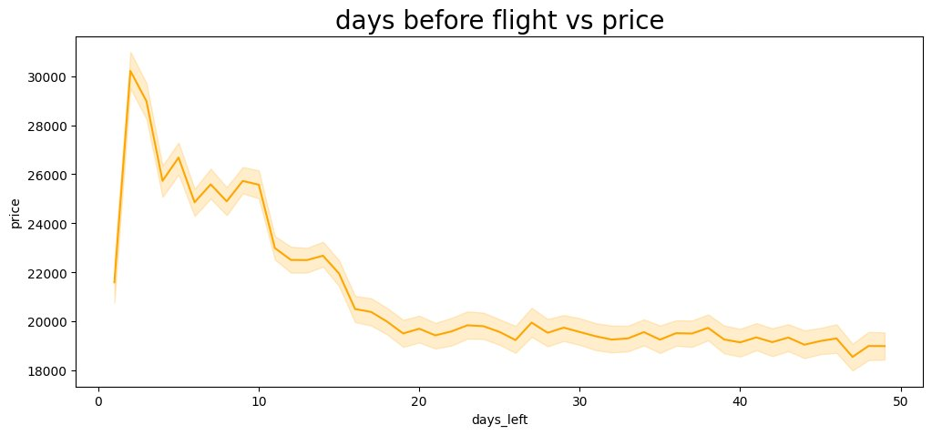
Multivariate Analysis — Heatmaps
Avg Price by Airline & Stops — Vistara one-stop: ₹32,353
Avg Price by Departure & Class
Business: ₹47K–53K regardless of time
Economy: ₹4,785–7,119 (Morning cheapest)

Slide 8
Hypothesis Testing
Test
Variables
Statistic
Conclusion
Pearson r
Duration vs Price
r=0.2042, p≈0
✅ H0 rejected — weak but significant correlation
ANOVA
Airline vs Price
F=17,194, p≈0
✅ H0 rejected — airlines differ significantly
Chi-square
Departure Time vs Stops
p≈0
✅ H0 rejected — departure time & stops are dependent
Chi-square
AirAsia market share ≠ 70%
χ²=597,148, p≈0
✅ H0 rejected — AirAsia ≠ 70% of market
Chi-square
AirAsia Delhi→Mumbai ≠ 60%
χ²=21,090, p≈0
✅ H0 rejected — route share ≠ 60%
ANOVA
Stops vs Price
F=6,477, p≈0
✅ H0 rejected — stop count strongly affects price
All tests run at α = 0.05 significance level

Slide 9
Preprocessing Pipeline
🗑️
🔢
📐
🔤
📏
Drop
`flight`
Ordinal
Encoding
Train /
Test Split
One-Hot
Encoding
Standard
Scaler
High cardinality — too many unique codes, would cause dimensionality explosion
▶
stops: zero→0, one→1, two_or_more→2
class: Economy→0, Business→1
▶
80% train / 20% test
random_state=42
Stratified shuffle
▶
airline, source_city, destination_city, arrival_time, departure_time
(fit on train only)
▶
duration & days_left normalized
(fit on train only — no leakage)
⚠️ No data leakage: encoder and scaler fitted ONLY on train set, then applied to test set

Slide 10
Model Comparison — Cross Validation (5 folds)
🏆 Winner: Random Forest — MAE ₹1,113 vs baseline ₹19,754. R² = 0.985. Best by a wide margin.

Slide 11
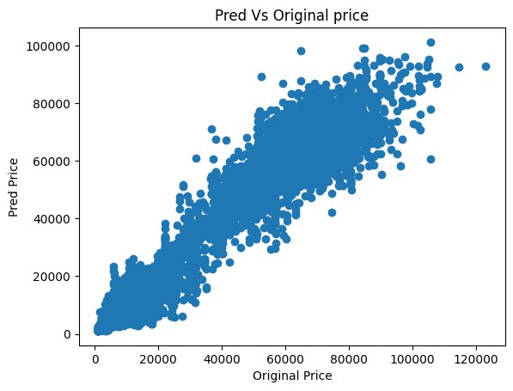
Final Model Evaluation — Random Forest on Test Set
0.985
₹1,070
₹2,744
✅
R² Score
MAE
RMSE
Target Met
98.5% variance explained
Mean Absolute Error on test set
Root Mean Squared Error
MAE well under mean price ₹20,889
Predicted vs Actual Prices — nearly perfect diagonal alignment
Key Takeaways
Top predictors: class, days_left, airline
Business class inflates price by ~8×
Last 7 days: prices spike sharply (+50%)
Model pipeline exported as .joblib (no leakage at inference)
MSE: 7,527,027 — confirms tight predictions

Slide 12
Tools & Deliverables
🛠 Tech Stack
📦 Deliverables
Python
Core language
📓
Jupyter Notebook
Structured, step-by-step, readable
Pandas / NumPy
Data manipulation
📊
Visualizations
Seaborn / Matplotlib
Visualization
EDA plots, model comparisons
Scikit-learn
Modelling & pipeline
💾
model.joblib
Full sklearn pipeline exported
SciPy
Statistical tests (Pearson, ANOVA, χ²)
🗂️
GitHub Repository
Joblib
Model export
Clean repo with README
📽️
This Presentation
Jupyter Notebook
Development environment
Summary of analysis & results

Slide 13
NOTRE ÉQUIPE
Meet the Team
H
O
S
O
Hamza KHIAR
Oumaima BEJJA
Safa NYA
Oussama Akhrraz
Simplon Maghreb × Jobintech | Formation Data Analyst | Promotion 2026

Slide 14
THANK YOU
Questions?
✈
We're happy to walk through any step:
statistical tests · preprocessing · model selection · confidence intervals
Random Forest | R² = 0.985 | MAE ₹1,070 | RMSE ₹2,744 | Pipeline exported .joblib

