Slide 1

Booking Data Analysis
OF JULY 2024

Slide 2
ABOUT US
Ola is India’s largest mobility platform and one of the world’s largest ride-hailing companies, serving 250+ cities across India, Australia, New Zealand, and the UK. The Ola app offers mobility solutions by connecting customers to drivers and a wide range of vehicles across bikes, auto-rickshaws, metered taxis, and cabs, enabling convenience and transparency for hundreds of millions of consumers and over 1.5 million driver-partners.

Slide 3
WORKFLOW DIAGRAM
Data Cleaning with Python and Export the Cleaned Data for Future Use
Analysis the Data with SQL Query to find the Answer
Database Creation
EDA : Data Visualization
Create Database using PostgreSQL and dump the Cleaned Data
Using Python, applied Exploratory Data Analysis to create Visualization
Data
Cleaning
SQL Analysis

Slide 4
SQL ANALYSIS

Slide 5
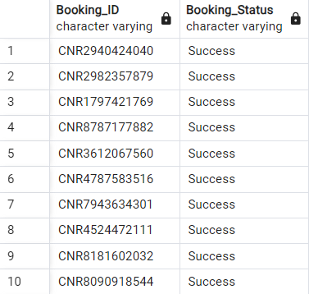
SQL Analysis Result
Retrieve all successful bookings : Here, we have shown successful bookings by Booking ID. [ ** Due to limited space, we have shown 10 data only ** ]

Slide 6
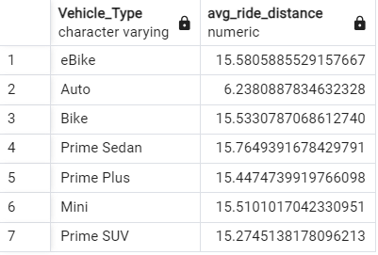
SQL Analysis Result
Find the average ride distance for each vehicle type : Here, we have shown average ride distance by Vehicle Types. Average ride distance measured in Km. “Prime Sedan” covered the most average distance, i.e. 15.76 KM.

Slide 7

SQL Analysis Result
Get the total number of cancelled rides by customers : Here, we have shown total number of cancelled rides by customers, i.e. 10499.

Slide 8
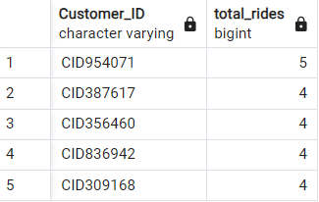
SQL Analysis Result
List the top 5 customers who booked the highest number of rides : Here, we have shown top 5 customers who booked the highest number of rides . Customer ID – CID954071 booked the greatest number of rides, i.e. 5.

Slide 9

SQL Analysis Result
Get the number of rides cancelled by drivers due to personal and car-related issues : Here, we have shown the number of rides cancelled by drivers due to personal and car-related issues, i.e. 6542.

Slide 10

SQL Analysis Result
Find the maximum and minimum driver ratings for Prime Sedan bookings : Here, we have shown the maximum and minimum driver ratings for Prime Sedan bookings. The minimum rating was : 3.0 & maximum rating was : 4.9

Slide 11
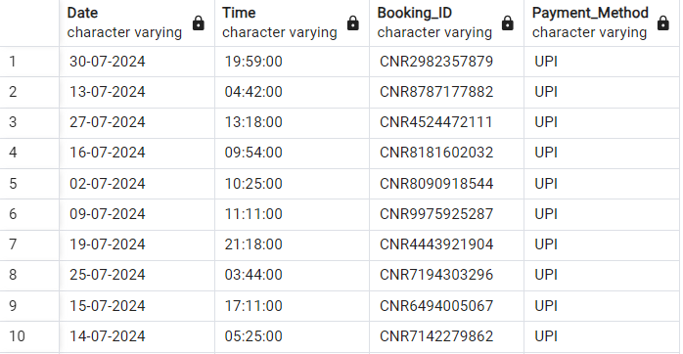
SQL Analysis Result
Retrieve all rides where payment was made using UPI : Here, we have shown the all rides where payment was made using UPI. [ ** Due to limited space, here we have shown 10 results. ]

Slide 12
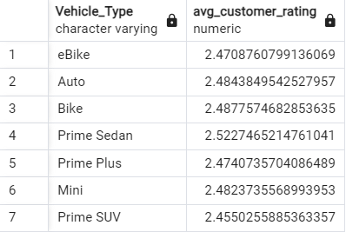
SQL Analysis Result
Find the average customer rating per vehicle type : Here, we have shown the average customer ratings per vehicle type. “Prime Sedan” had the highest average customer ratings : 2.52

Slide 13

SQL Analysis Result
Calculate the total booking value of rides completed successfully : Here, we have shown the total booking value of rides completed successfully.
Total booking was - 32829985

Slide 14
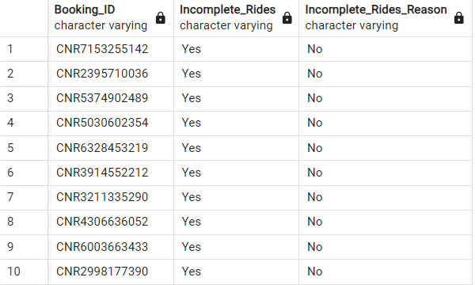
SQL Analysis Result
List all incomplete rides along with the reason : Here, we have shown the list of all incomplete rides along with the reason. [ ** Due to limited space, here we have shown 10 results. ]

Slide 15
EDA - Visualization

Slide 16
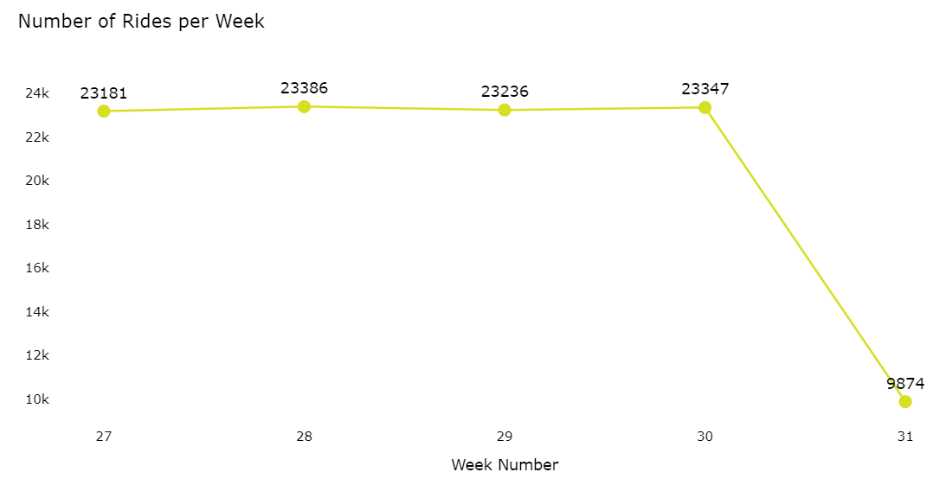
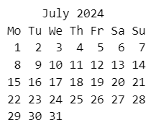
Python EDA - Visualization
Ride Volume Over Time : A time-series chart showing the number of rides per week >>>
** Note : Week No. 31 had only three days. So, the number of rides naturally lower than other weeks.

Slide 17
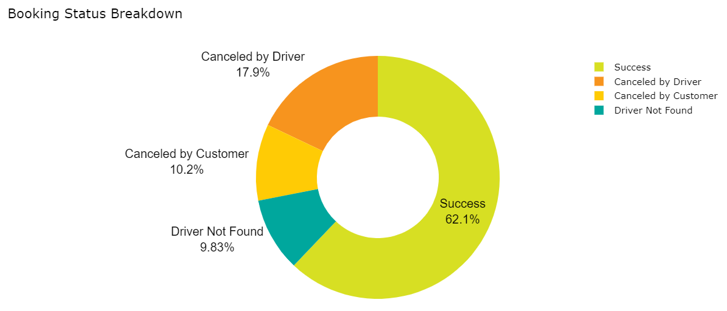
Python EDA - Visualization
Booking Status Breakdown : A pie or doughnut chart displaying the proportion of different booking statuses (success, cancelled by the customer, cancelled by the driver, etc.).
** Note : Booking status – “Success” had most percentage, i.e. 62.1 %
The next one was “Cancelled by Driver”, i.e. 17.9 %, which mean, in some cases might be driver did not want to go to the destination or some problems occurred due to booking issue with customers.

Slide 18
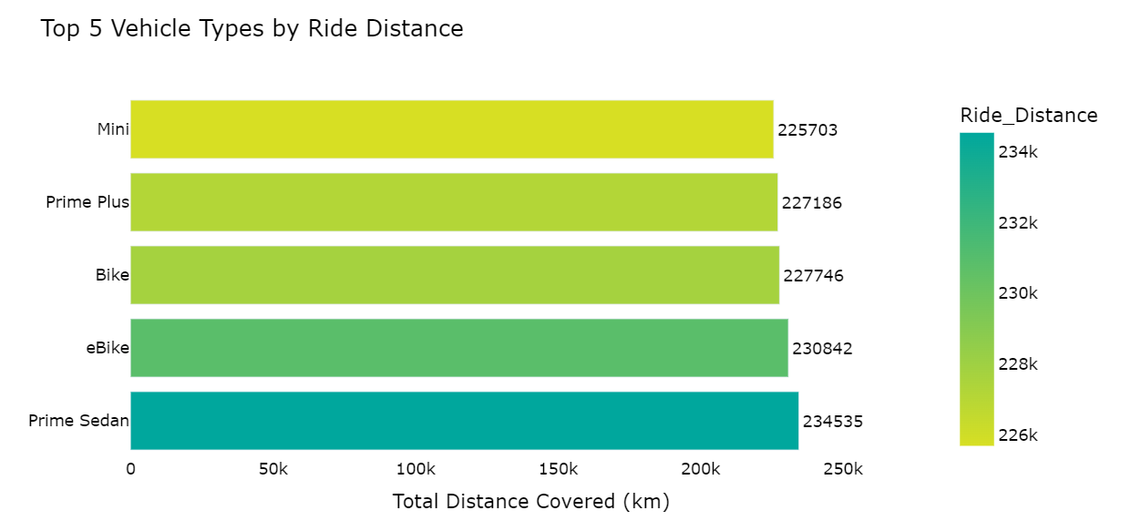
Python EDA - Visualization
Top 5 Vehicle Types by Ride Distance : A bar chart ranking vehicle types based on the total distance covered.
** Note : “Prime Sedan” covered more distance than other vehicle types. It covered 234535 KM

Slide 19
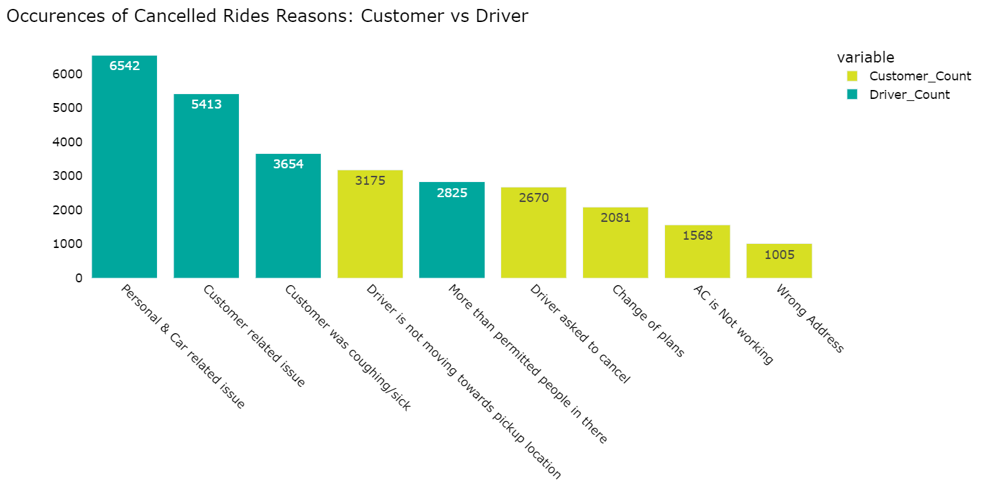
Python EDA - Visualization
Cancelled Rides Reasons : A bar chart that highlights the common reasons for ride
cancellations by customers and drivers.
** Note : “Personal & Car related issue” was the most frequent reason for cancellation by Driver, which happened 6542 times.
“Driver is not moving towards pickup location” was the most frequent reason for cancellation by Customer, which happened 3175 times.

Slide 20
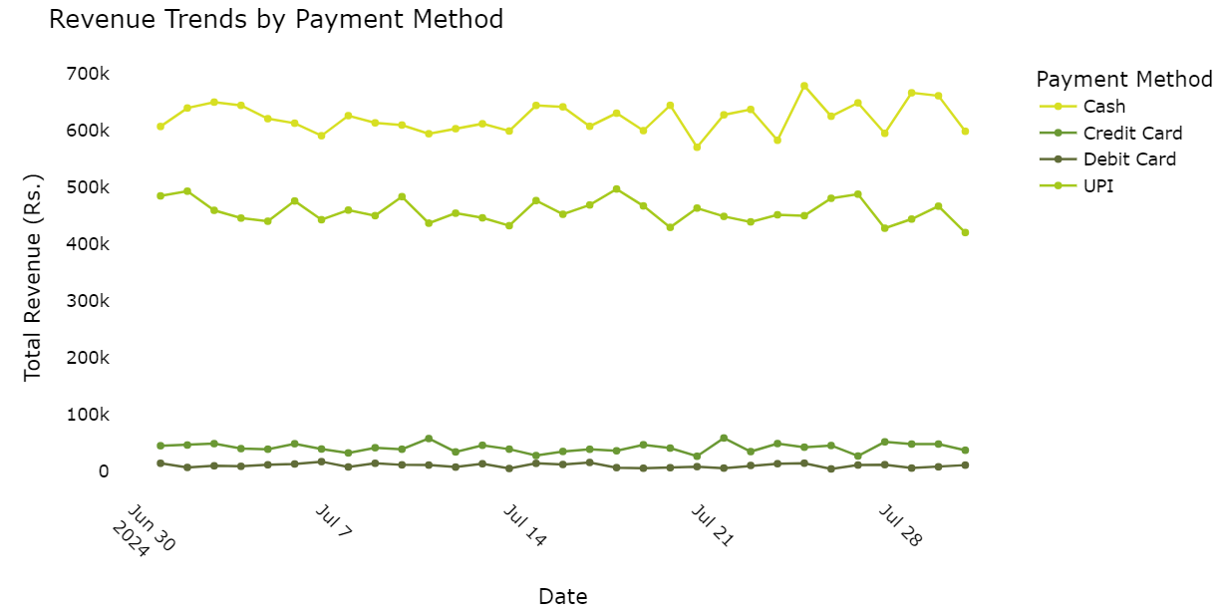
Python EDA - Visualization
Revenue by Payment Method : A multi-line chart displaying total revenue based on
payment methods (Cash, UPI, Credit Card, etc.)
** Note : “Cash” was the mostly trending revenue generator and the next one was “UPI”.
Where as “Debit & Credit Card” was least responsible for revenue generator.

Slide 21
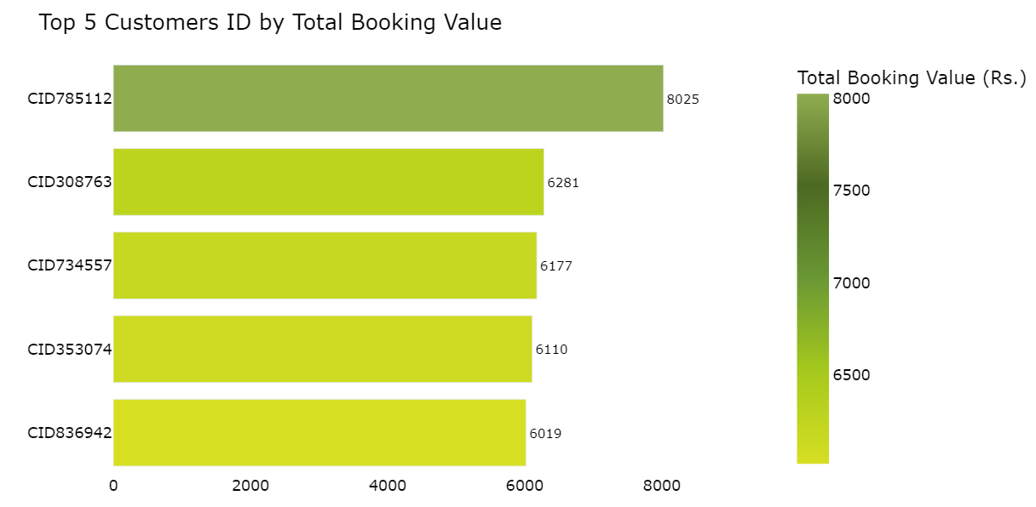
Python EDA - Visualization
Top 5 Customers by Total Booking Value : A leaderboard visual listing customers who have spent the most on bookings.
** Note : “CID785112” was the top customer with highest booking values, i.e. Rs. 8025.

Slide 22
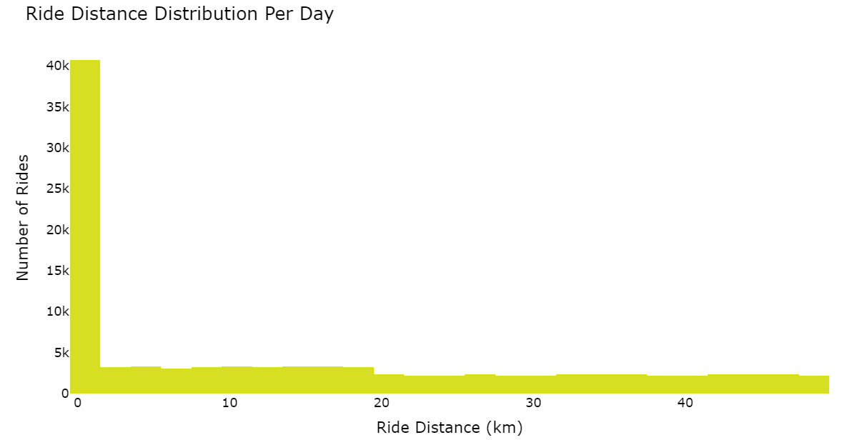
Python EDA - Visualization
Ride Distance Distribution Per Day : A histogram showing the distribution of ride distances for different Dates.
** Note : Between “0 to 1 KM”, more than 40K rides booked. So, we assume that, up to 1 KM, most passengers travelled by OLA in July.

Slide 23
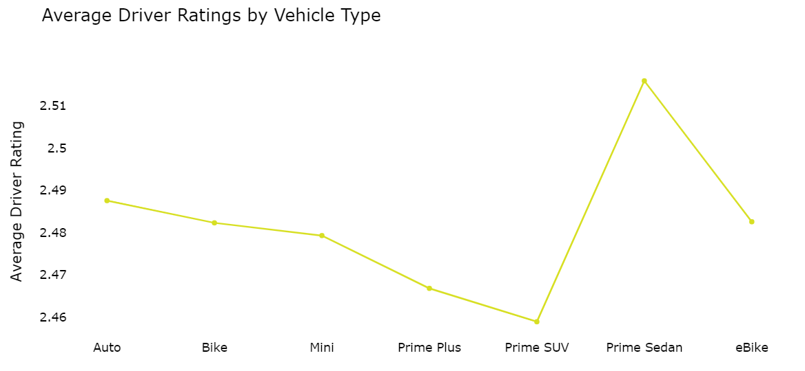
Python EDA - Visualization
Driver Rating Distribution : A line chart visualizing the spread of driver ratings for different vehicle types.
** Note : “Prime Sedan” got highest average Driver’s rating among all vehicle types.
Where as, “Prime SUV” got average lowest rating by Drivers.

Slide 24
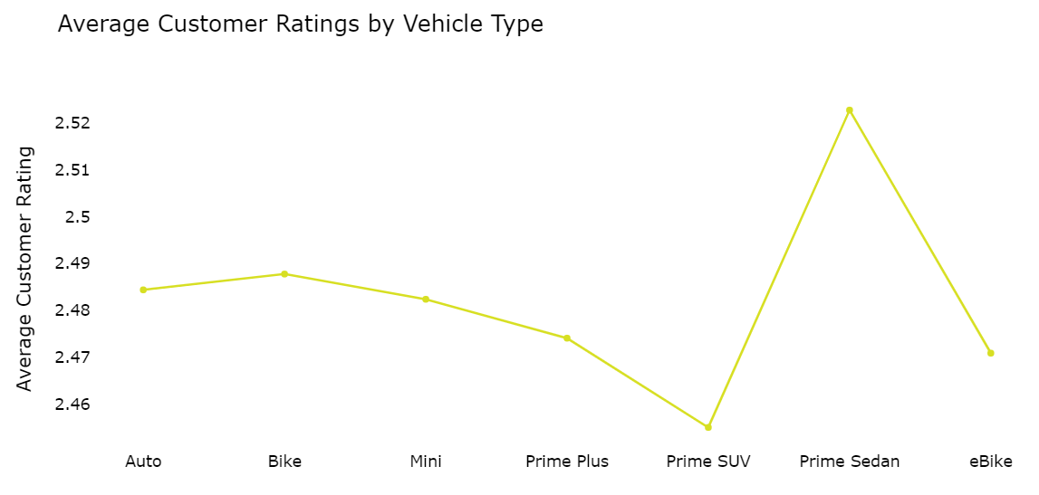
Python EDA - Visualization
Customer Rating Distribution : A line chart visualizing the spread of customer ratings for different vehicle types.
** Note : “Prime Sedan” got highest average Customer’s rating among all vehicle types.
Where as, “Prime SUV” got average lowest rating by Customers.

Slide 25
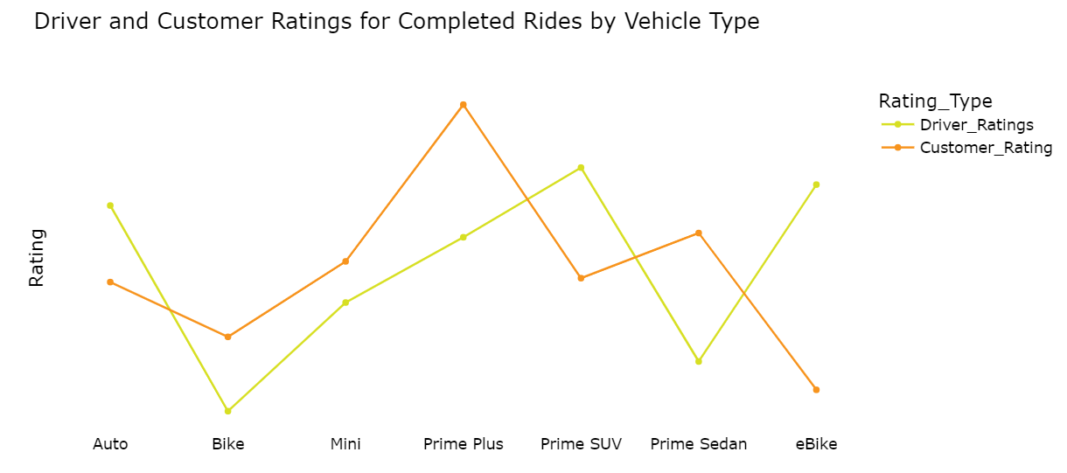
Python EDA - Visualization
Customer vs. Driver Ratings : A line plot comparing customer and driver ratings for completed rides
** Note : For ‘Completed’ Rides, Driver’s highest rating was for “Auto”, “Prime SUV” & “e-Bike”.
Where as, Customer’s highest rating was for “Prime Plus” & “Prime Sedan”.

Slide 26
SUMMARY
Here, with OLA booking dataset of July 2024, we have analyzed various section of business problems. We have gone through total rides in KM for each vehicle types, revenues by vehicle types, revenues by each customer, ratings of rides by drivers and customers, count of each type of booking status etc. Also, we have shown various graphs to easily understand the scenario of OLA cab rides in July 2024.

Slide 27

THANK YOU!
Presented By : Akashdeep Dam
Email : akashdeepdam@gmail.com

