Slide 1


Day 1: ETL Processes & Python for Data Engineering
Introduction to ETL Concepts and Python Fundamentals
by DataBishop

Slide 2
Agenda for Today
1
ETL Processes
2
Python
Introduction to ETL Processes
Python Fundamentals for Data Engineering
3
Hands-on
4
Assessment
Building a Simple ETL Pipeline
Assessment Overview

Slide 3
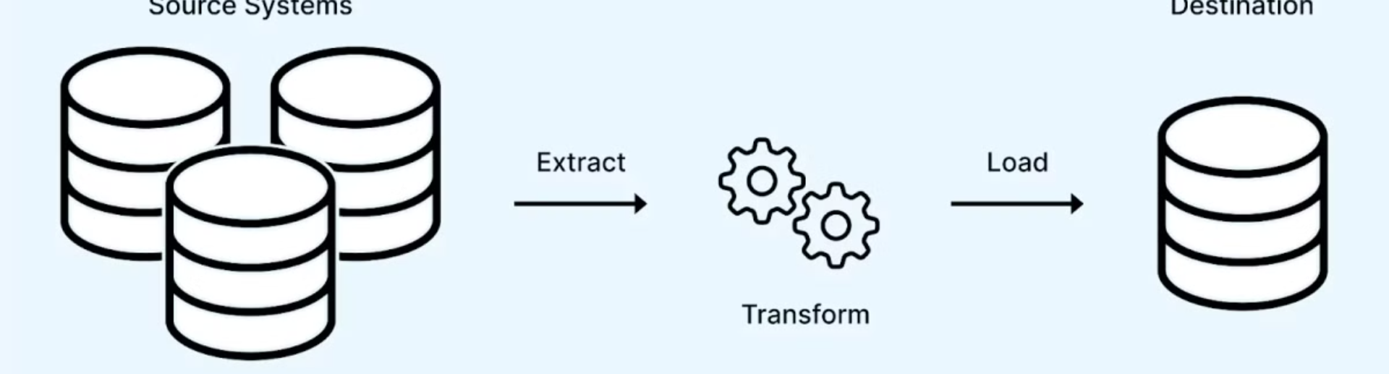



What is ETL?
Extract
Transform
Load
Pulling data from various sources
Cleaning, structuring, and enriching data
Storing data in a target system

Slide 4




Real-World ETL Examples
E-commerce
Healthcare
Social Media
Aggregating sales data
Consolidating patient records
Analyzing user engagement data

Slide 5
Why Python for Data Engineering?
Popularity
Key Libraries
Advantages
Python’s popularity in data engineering
pandas, NumPy, SQLAlchemy, psycopg2
Easy to learn, extensive libraries

Slide 6

Introduction to Pandas
What is pandas?
Key Data Structures
Library for data manipulation and analysis
Series and DataFrame
Common Operations
Reading/writing data, filtering, sorting

Slide 7

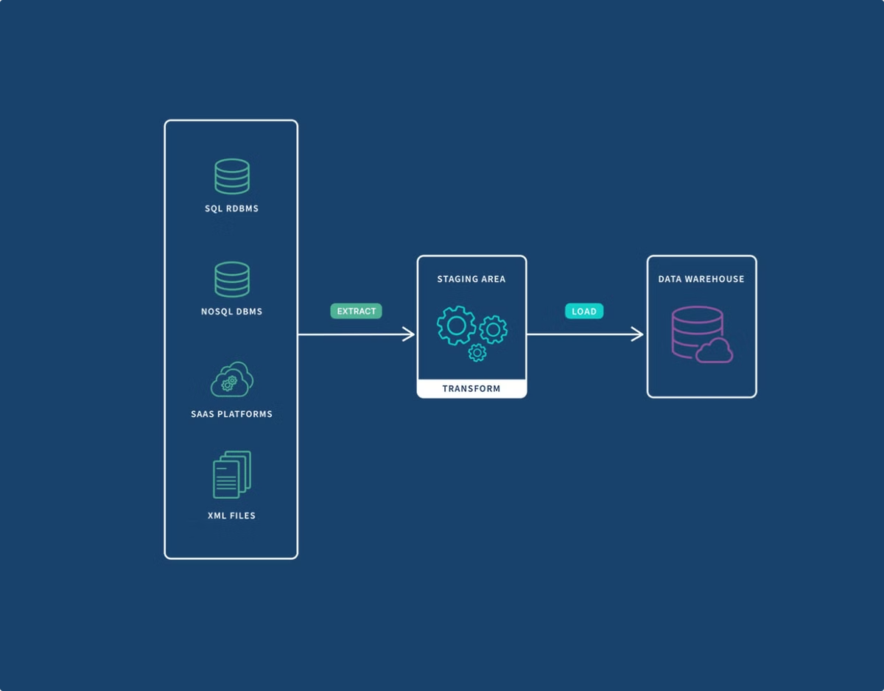
Hands-on Workshop: ETL Pipeline
1
Objective
Build a pipeline to extract, transform, and load data
2
Steps
Extract, Transform, Load
3
Tools
Python, pandas, psycopg2/SQLAlchemy

Slide 8
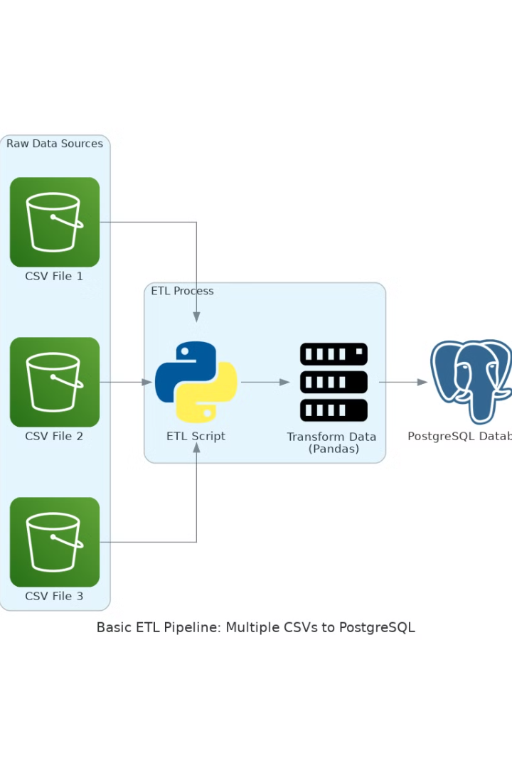
Workshop Step-by-Step
Extract
Load a CSV file using pandas
Transform
Clean the data: Handle missing values
Load
Connect to PostgreSQL and save the data

Slide 9



Assessment: Build an ETL Pipeline
Requirements
2
Extract data from a provided CSV file
Clean and structure the data using pandas
Task
1
Load the data into any SQL database
Transform a messy dataset into a clean format and load it into PostgreSQL
Deliverables
3
Python script and a screenshot of the loaded data in the SQL Database

Slide 10


Q&A and Up Next
1
Q&A Session
2
Day 2 Preview
3
Further Learning
Data Quality and Pipeline Orchestration.
Python tutorials, pandas documentation, etc.
4
Recommended Links
PostgreSQL download: https://www.postgresql.org/download/
ELT vs ETL: https://www.geeksforgeeks.org/difference-between-elt-and-etl/
Pandas documentation: https://pandas.pydata.org/docs/
Psycopg2 tutorial: https://earthly.dev/blog/psycopg2-postgres-python/​
SQLAlchemy tutorial: https://www.tutorialspoint.com/sqlalchemy/sqlalchemy_introduction.htm
My Socials
https://linkedin.com/in/abasifreke-nkanang
https://github.com/Data-Bishop

