Slide 1
Data Challenges – Group A: Task 1
Team Presentation: Xheni, Philipp Wörner 6375519, Tobias, Jakob Vanek 5879817

Slide 2
Overview
Access to the data set
Manual data exploration
Dimensionality reduction techniques
Web app development framework
Overview

Slide 3
1. Access to the data set
We decided to use panda-dataframes in combination with object oriented classes for each patient
1. Access to the data set

Slide 4
2. Manual data exploration
Main Task
2. Manual data exploration

Slide 5
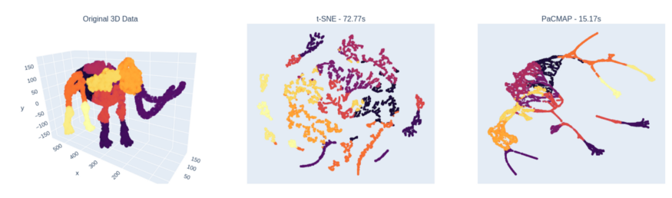
3. Dimensionality reduction techniques
From blog post: https://towardsdatascience.com/why-you-should-not-rely-on-t-sne-umap-or-trimap-f8f5dc333e59
3. Dimensionality reduction techniques

Slide 6
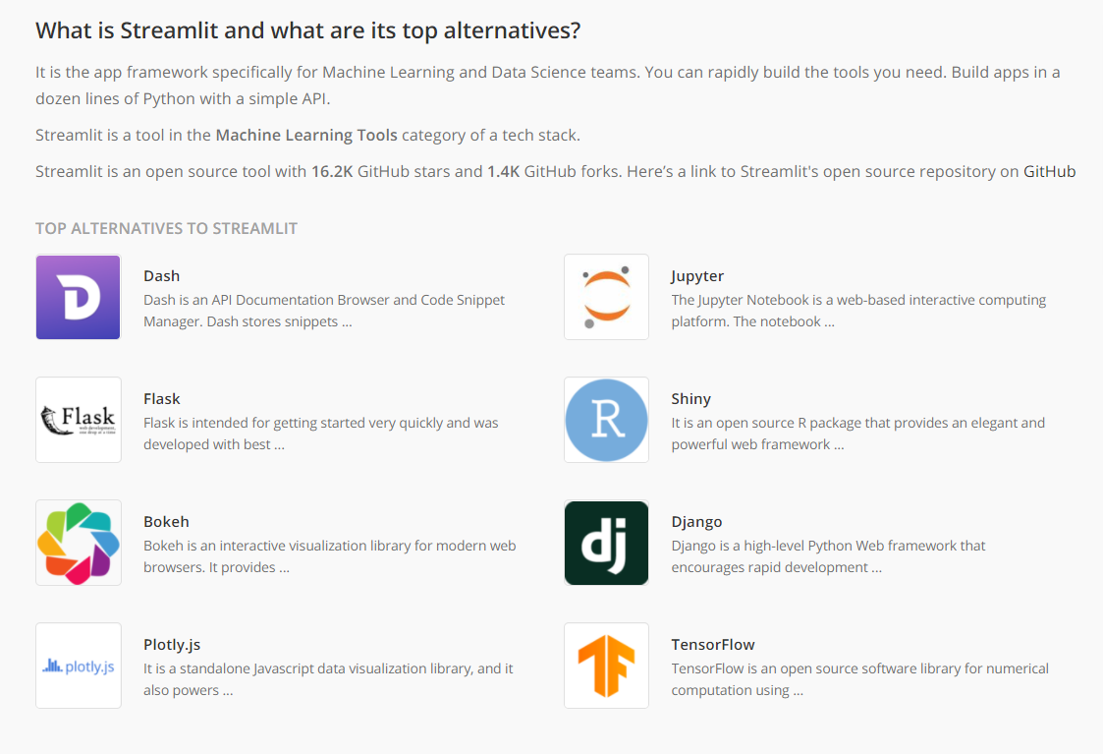
4. Web app development framework
We chose streamlit after comparing it to popular alternatives
4. Web app development framework

Slide 7
Outlook
This dataset can now be analysed with different machine learning tools in python
Dimensionality reduction will be a helpful step to visualize the data
The final presentation of results will be enabled within a streamlit web app
Outlook

Slide 8
Data Challenges – Group A: Task 1
Team Presentation: Xheni, Philipp, Tobias, Jakob Vanek 5879817

