Slide 1

Data Challenges Task 4: Subspace Clustering and Imputation Group 8
Jakob Vanek 5879817 Philipp Wörner 6375519 Tobias Ettling 6753746

Slide 2
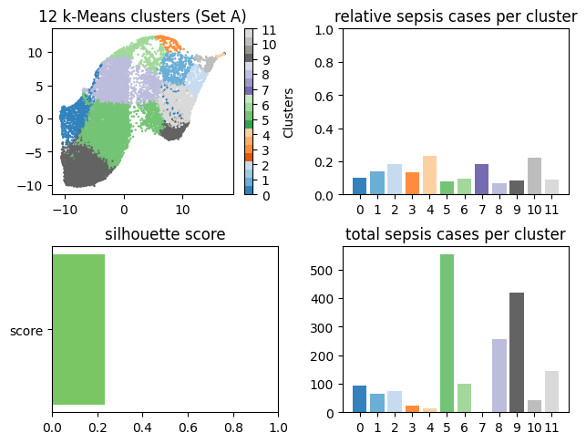
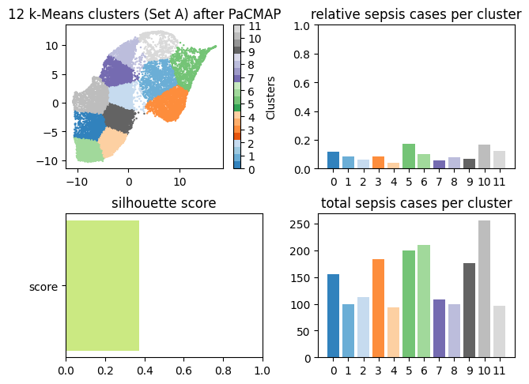
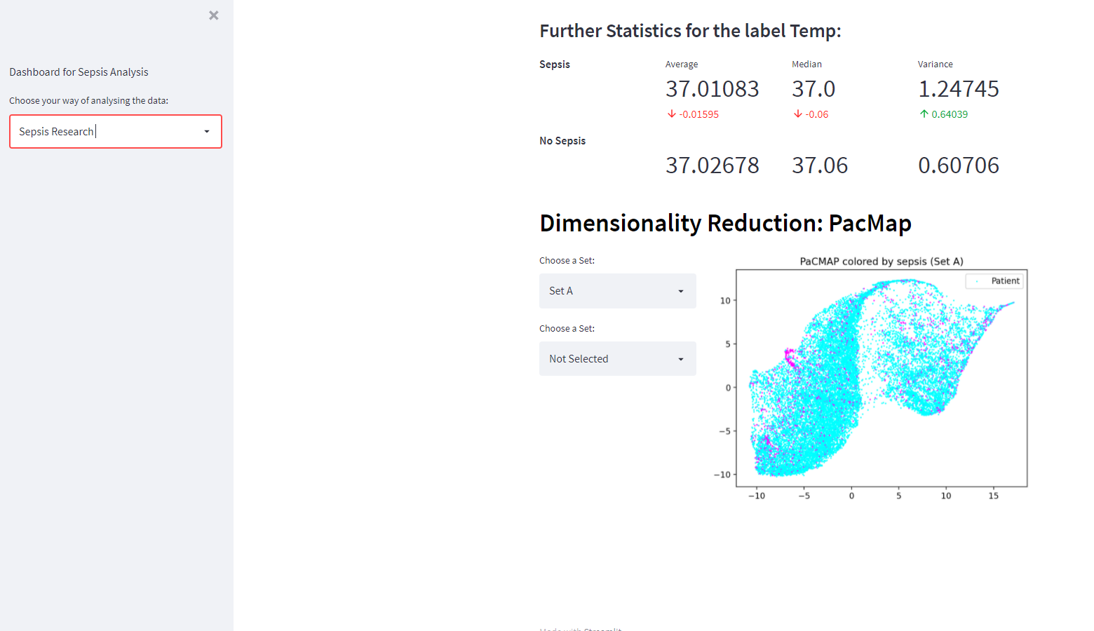
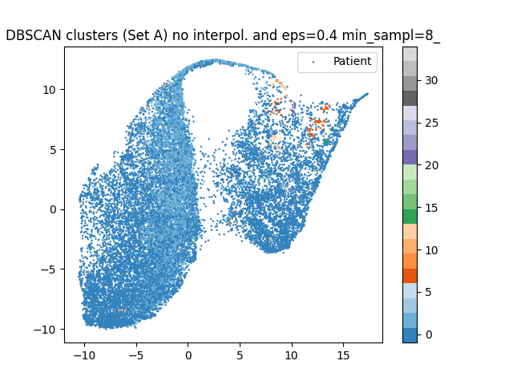
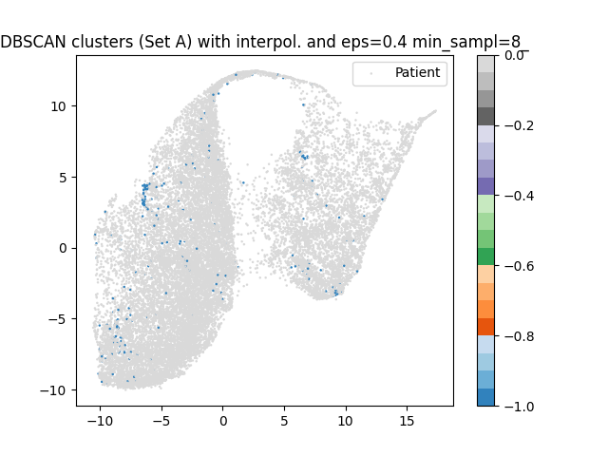
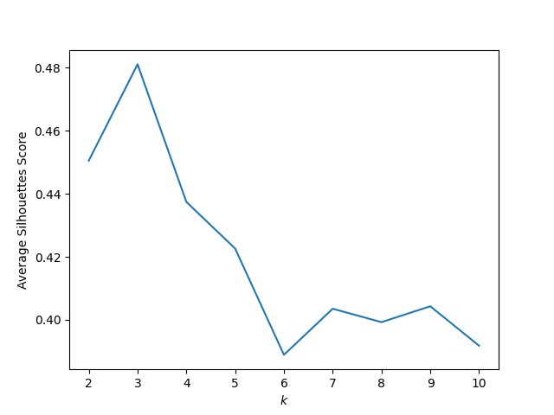
Recap of Last Presentation
New dashboard Tool (Dimensionality Reduction)
Conventional (Subspace) Clustering Methods (PaCMAP)
DBSCAN with and without Imputation (PaCMAP)
Quality Measures (Euclidean Silhouette Score)

Slide 3
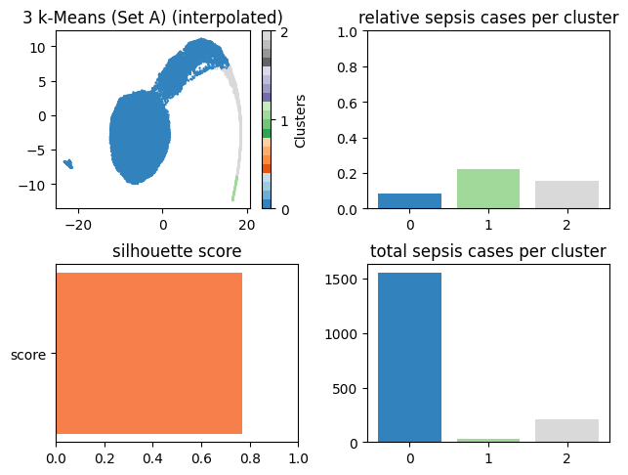
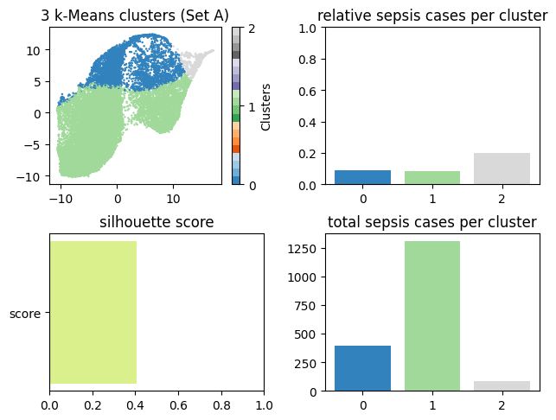
Recap of Last Presentation
K-means with k=3

Slide 4
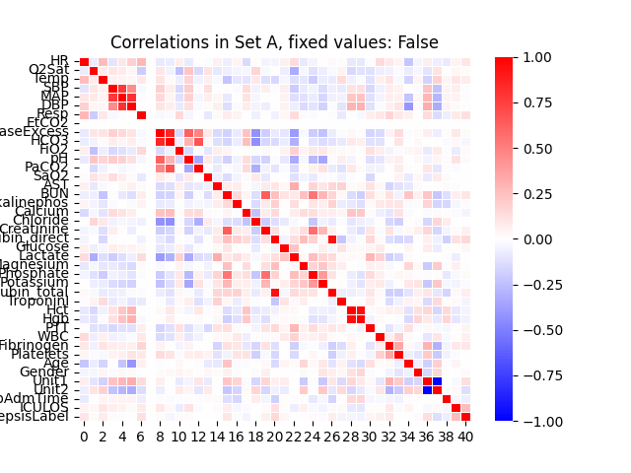
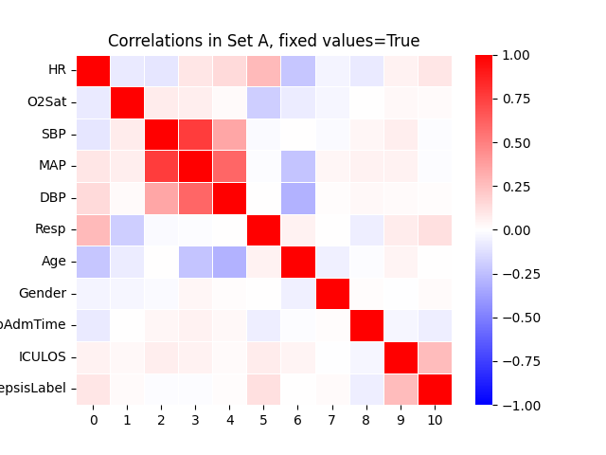
Recap of Last Presentation
Plotting of Correlations

Slide 5
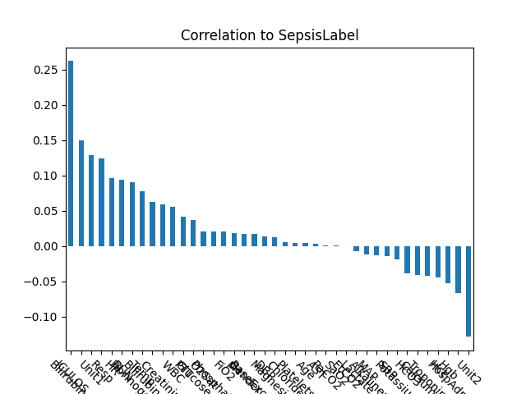
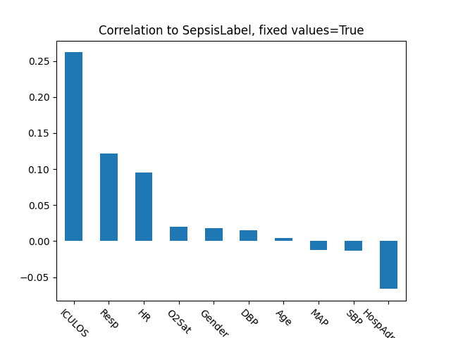
Recap of Last Presentation
Plotting of Correlations
→ ICULOS, Bilirubin, Resp and HR most important features for Sepsis

Slide 6
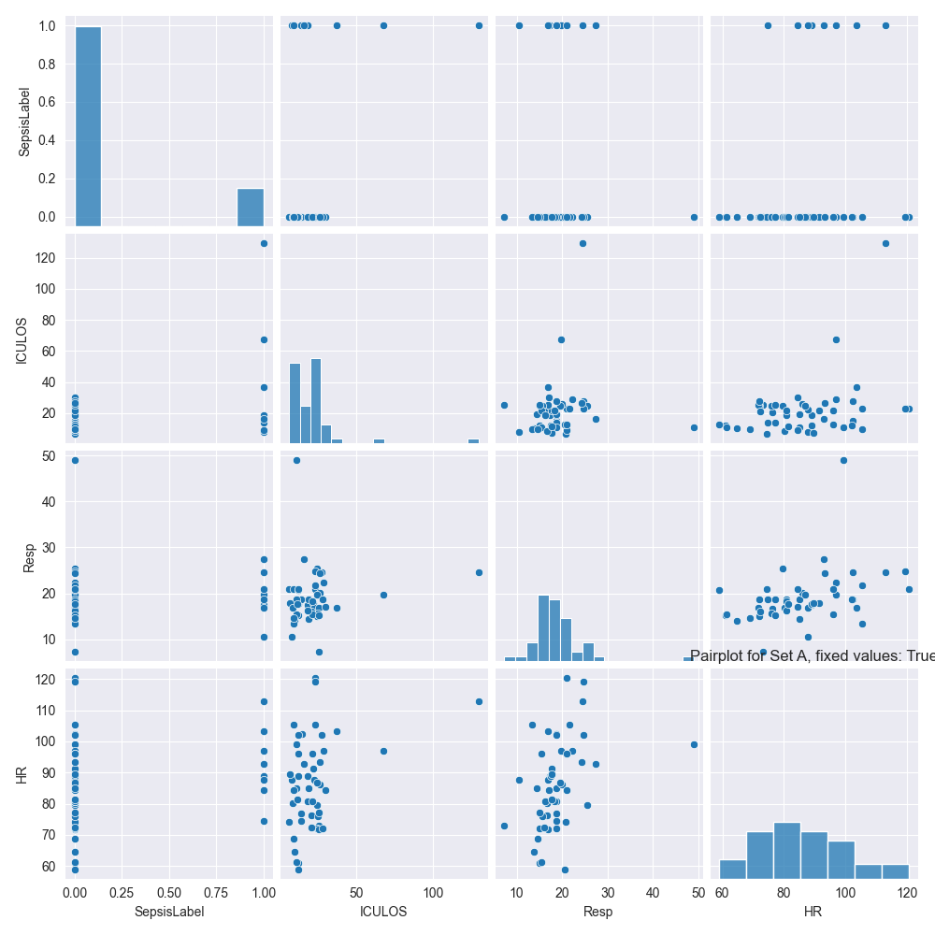
Recap of Last Presentation
Pairplots to compare selected labels

Slide 7
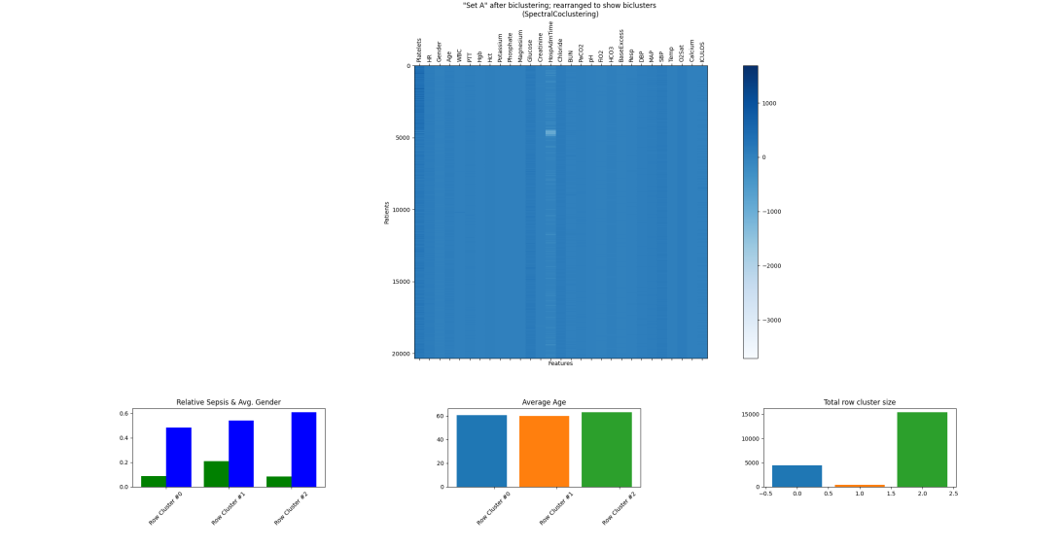
Task 4.1 – a) Spectral-Co-Clustering
Useful when structure of clusters is highly non-convex
Spectral-Co-Clustering:
biclustering with "coherent values"
biclusters by looking for "higher" values than those in the corresponding other rows/columns
uses k-means to cluster the values in a row/columns

Slide 8
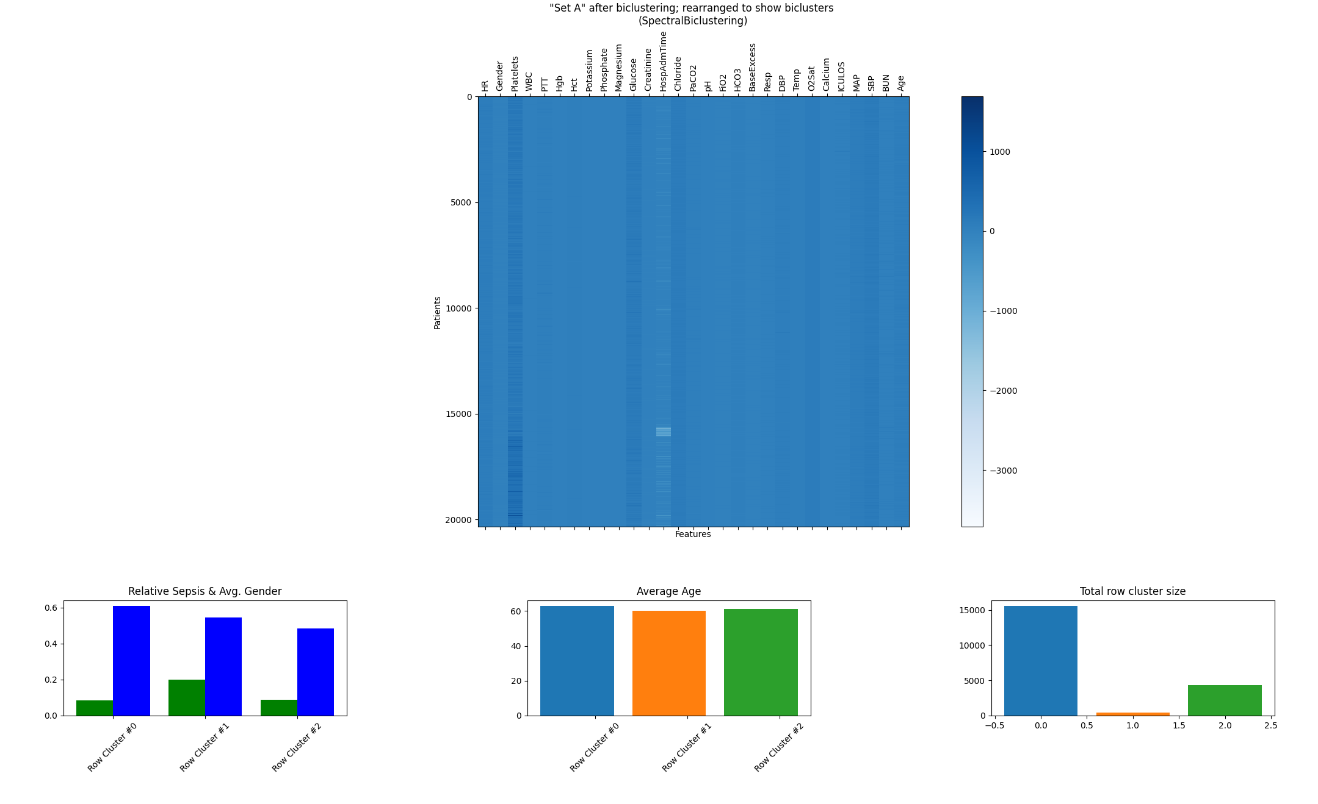
Task 4.1 – a) Spectral-Bi-Clustering
Spectral-Bi-Clustering
biclustering with expectation of approx. constant values in rows and columns
attempts to biclusters in a way to approximate a blockwise-constant checkerboard matrix

Slide 9
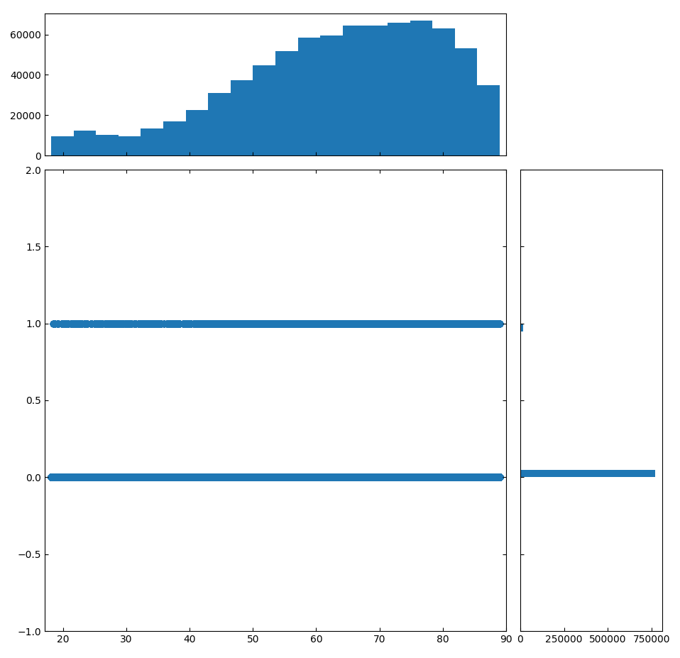
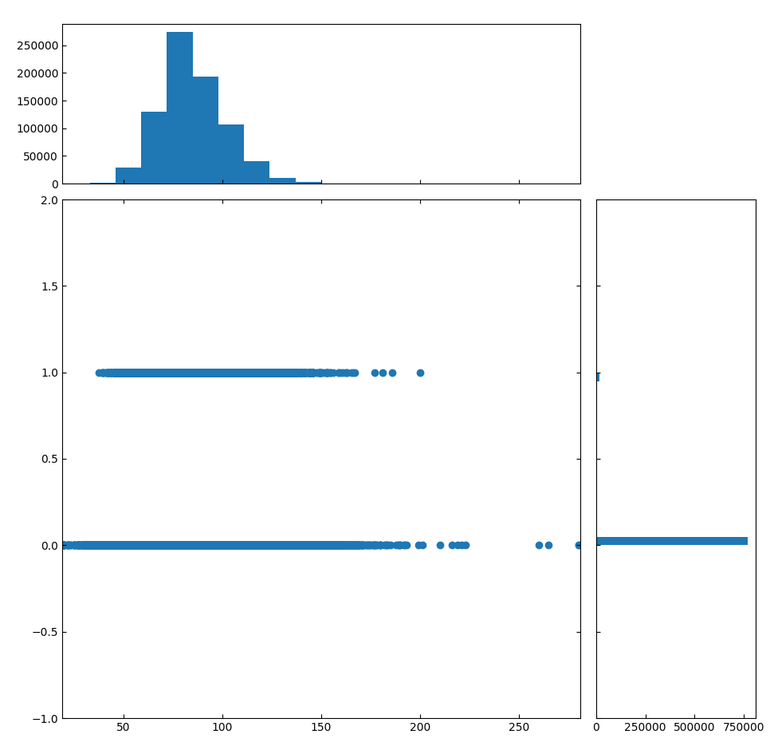
Task 4.1 – a) Subspace Clustering (Clique)
We devide the data space into grids, grids next to eachother are considerd clusters.
A threshhold, defines a grid to be compleat, by containing n amount of DP.
Sepsis bool
Age
HR

Slide 10
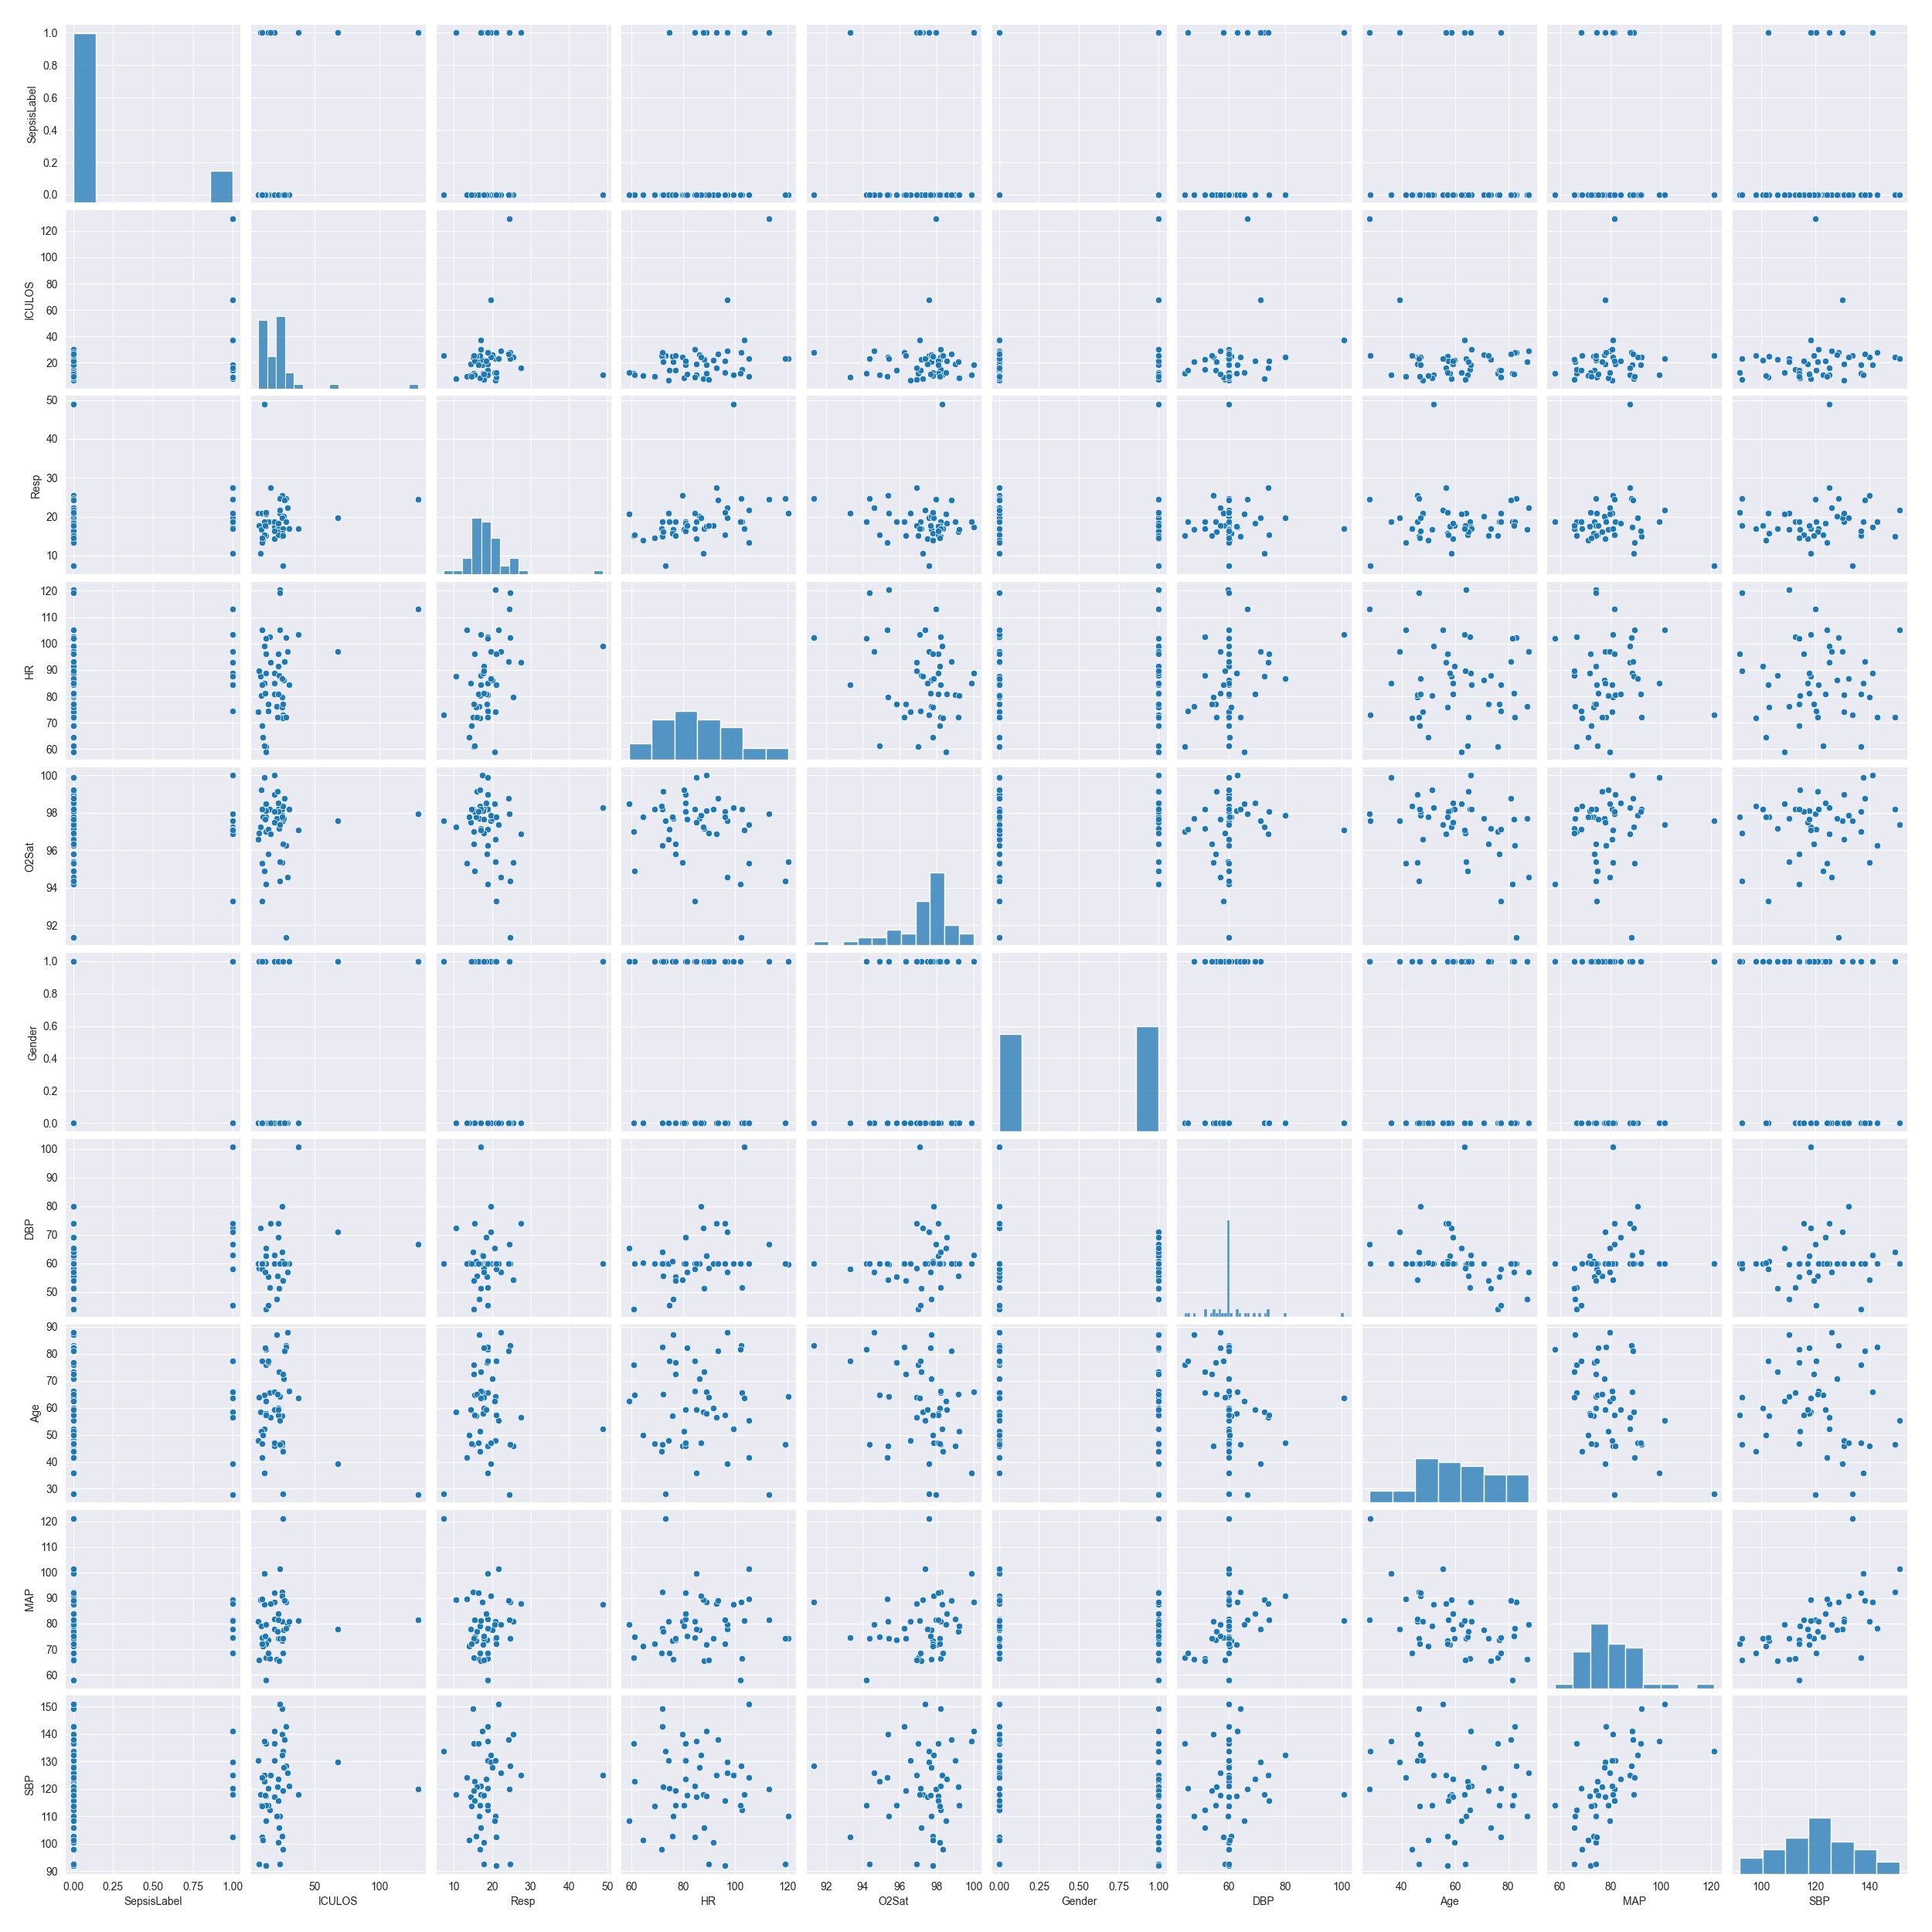
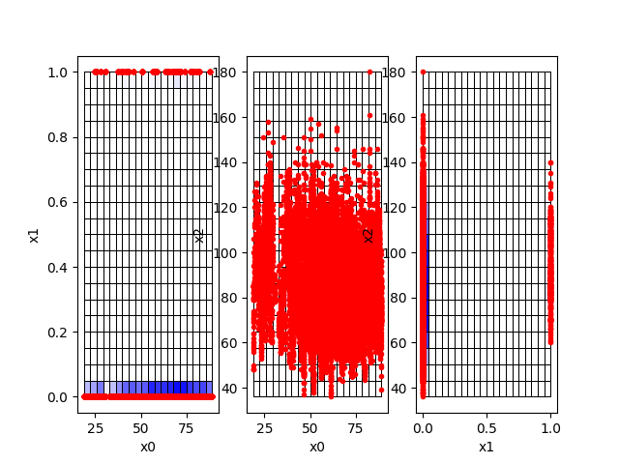
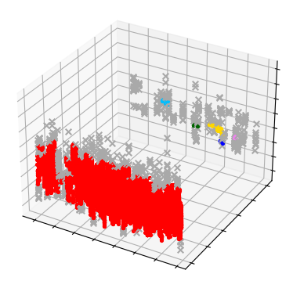
Task 4.1 – a) Subspace Clustering (Clique)
x0 := Age
x1 := Sepsis bool
x2 := HR
Threshold for grid Dropout:
Min. 10 DP
Amount of found clusters: 6

Slide 11
Task 4.1 – b) Evaluation Measures
Consensus Score
external measurement
expects a "true solution" to compare to
describes similarity of each pair of two sets of biclusters (in other words it judges how similar the biclustering is)
final score is mean of similarity divided by the whole set
ranges from 0 (dissimilar) to 1 (identical)

Slide 12
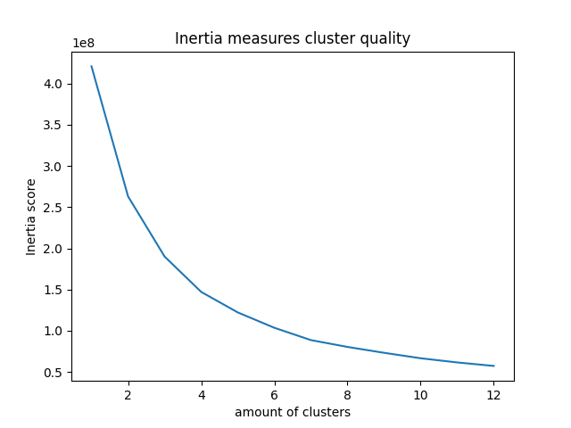
Task 4.1 – b) Evaluation measures
Inertia Score:
K-means proceeds to minimize the distance of each data point, to the cluster's centroid
The Inertia is a measurement for how spread out the data is
The score should be low, but we do not want to many clusters

Slide 13
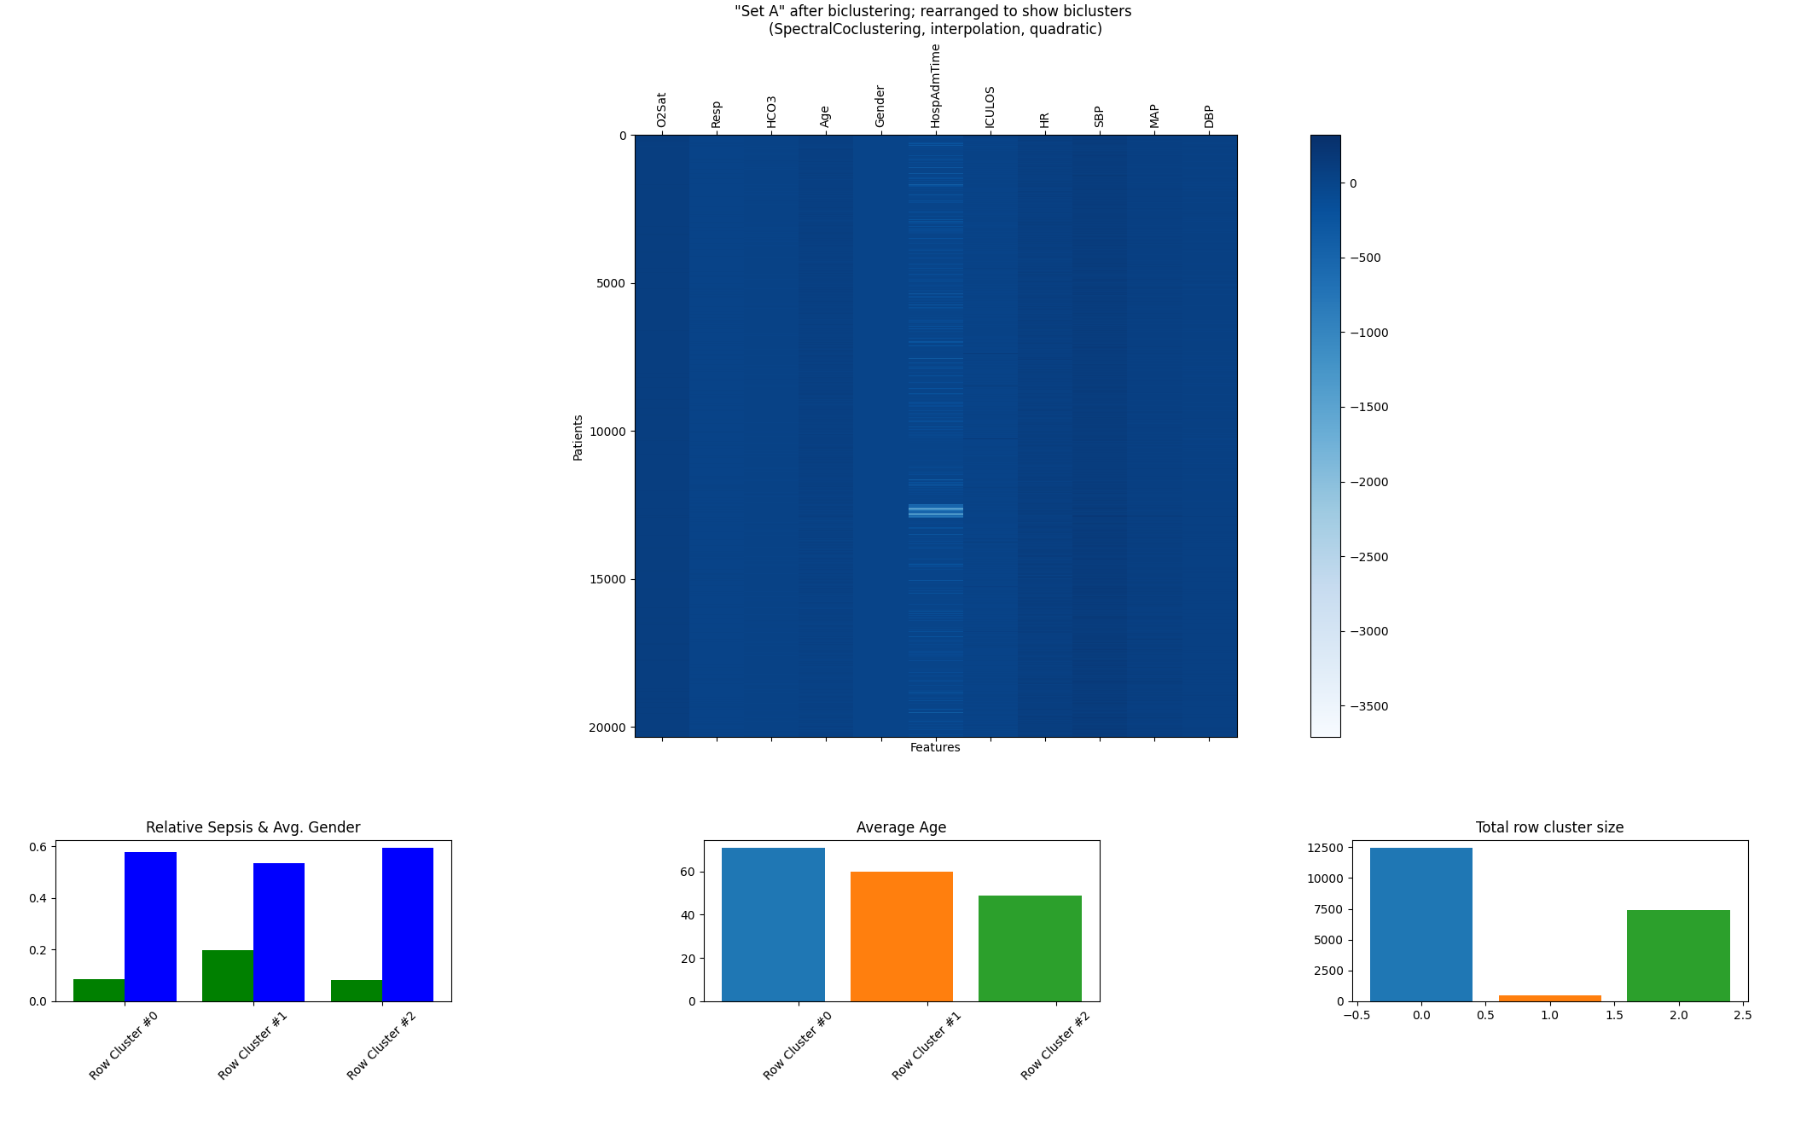
Task 4.2 – a) SpectralCoclustering

Slide 14
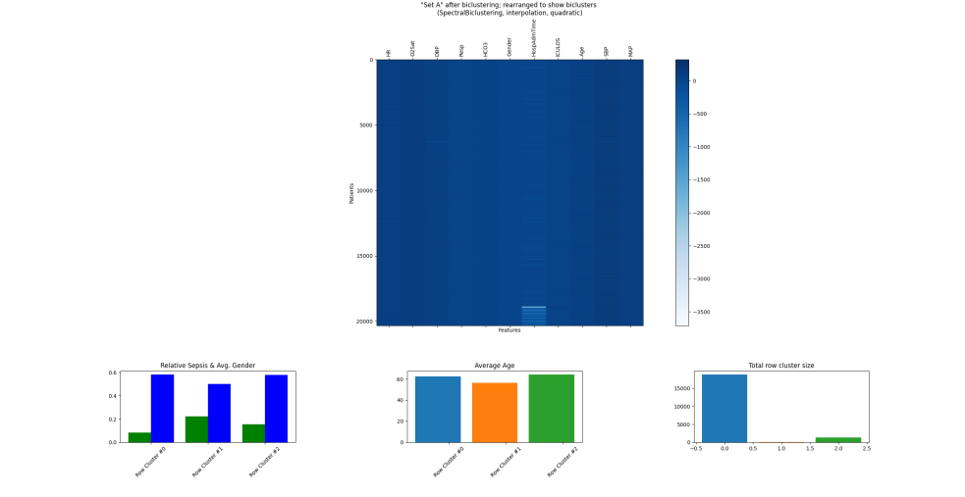
Task 4.2 – a) SpectralBiclustering

Slide 15
Next Possible Steps?
Configure subspace-clustering for better results
Rework Code and fix GitHub Issues
Add new team member?

Slide 16
Thank You!

