Slide 1

Data Challenges Task 2: Dashboard Implementation Group 8
Jakob Vanek 5879817 Philipp Wörner 6375519 Tobias Ettling 6753746 Xheni Hoxha 7267017

Slide 2
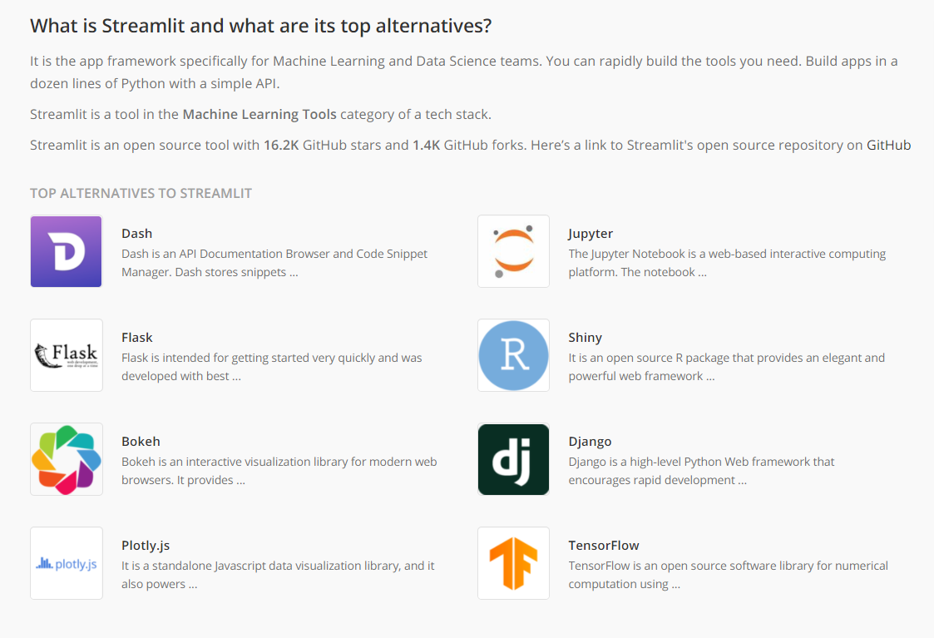
Conclusion of Last Presentation
Decision: Streamlit after comparing it to popular alternatives
Flask: Too unspecific
Plotly combined in a Webframe (JavaScript) Not efficient
Streamlit: Perfect solution, specified for Data Analysis and Visualization

Slide 3
Last Weeks Prozess
First implementation of the streamlit Dashboard
- Restructured data-objects
- Added .pickle caching to export analysis results
Restructurization of the dashboard
- Sidebar
- General Information to explain the project
- Landing Page to start fast data analysis
- Adding further Analysis Tools (mathematical analysis)

Slide 4
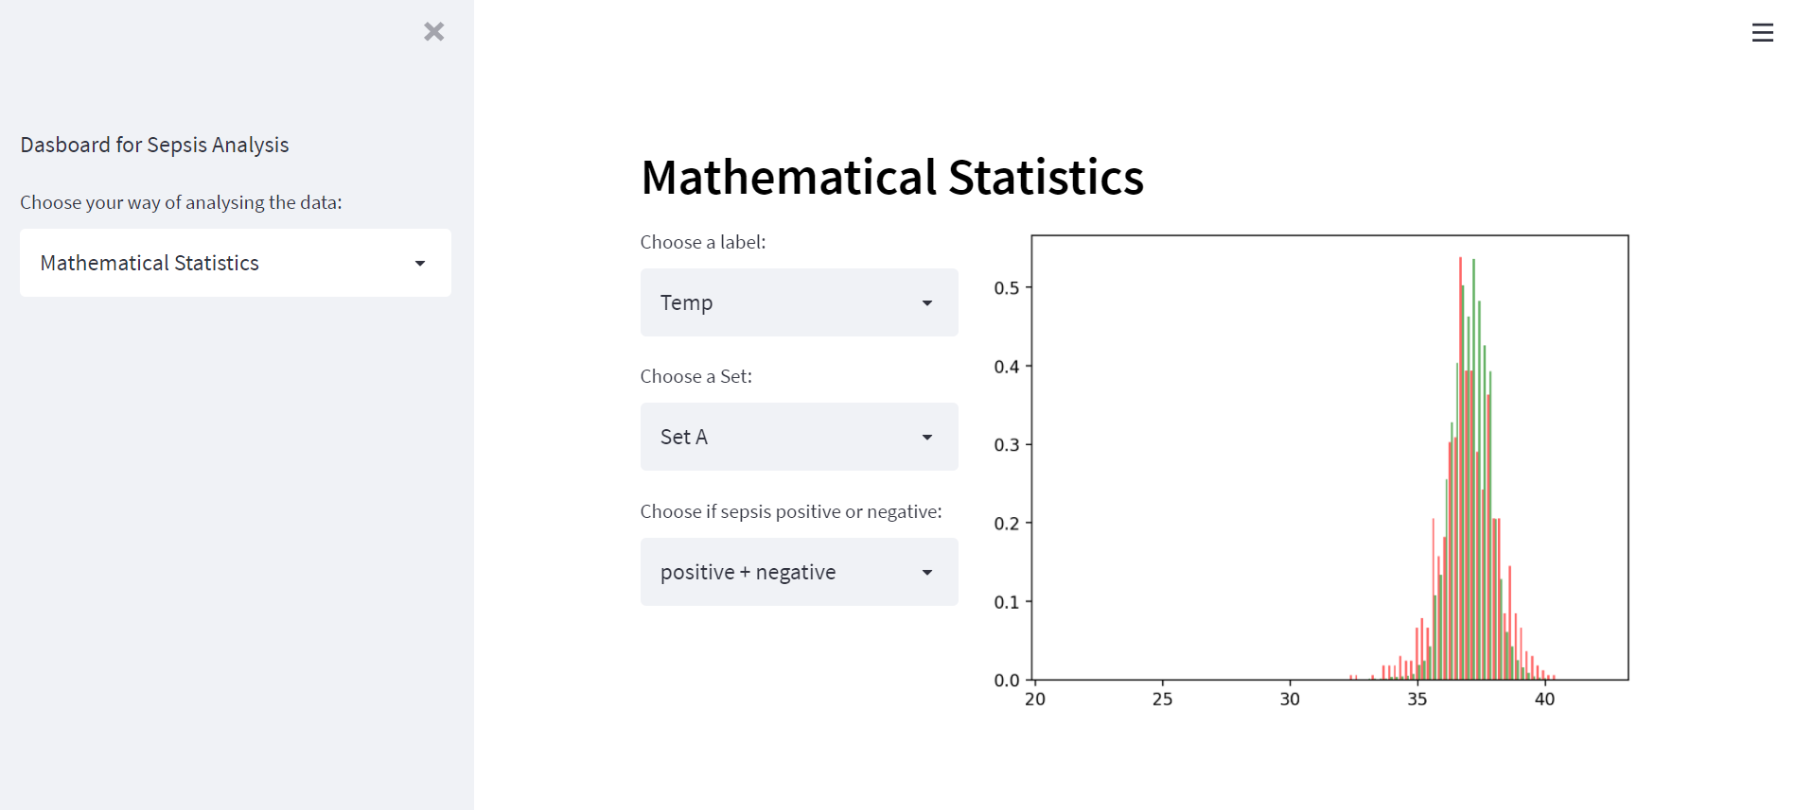
Final Look

Slide 5
Next Possible Steps?
Add further basic analysis features (correlation, variance, etc.)
Deploy Website via Streamlit Cloud
Conduct thorough Machine Learning Analysis

Slide 6
Thank you!

