Slide 1

Data Challenges Task 3: Clustering and Imputation Group 8
Jakob Vanek 5879817 Philipp Wörner 6375519 Tobias Ettling 6753746

Slide 2
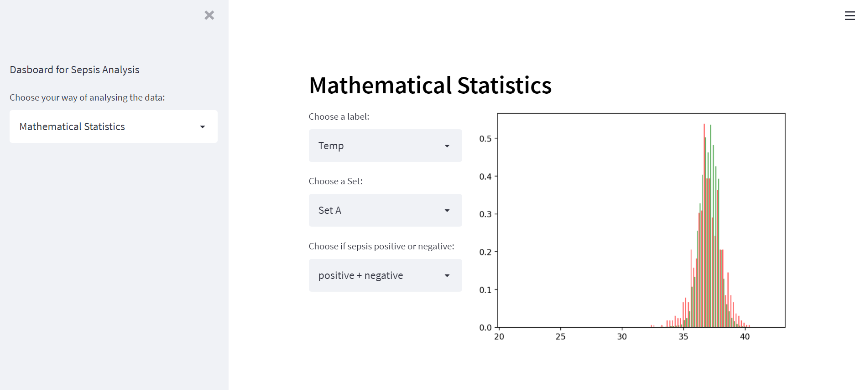
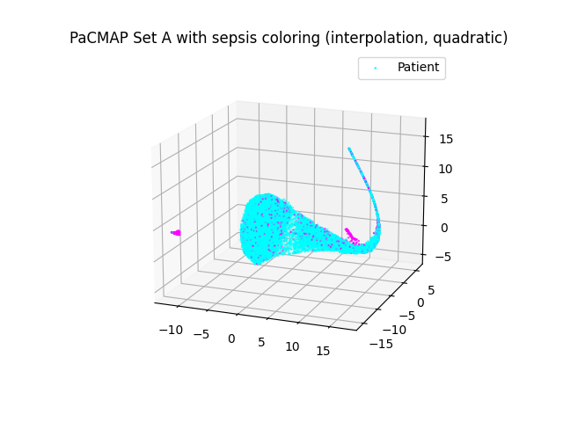
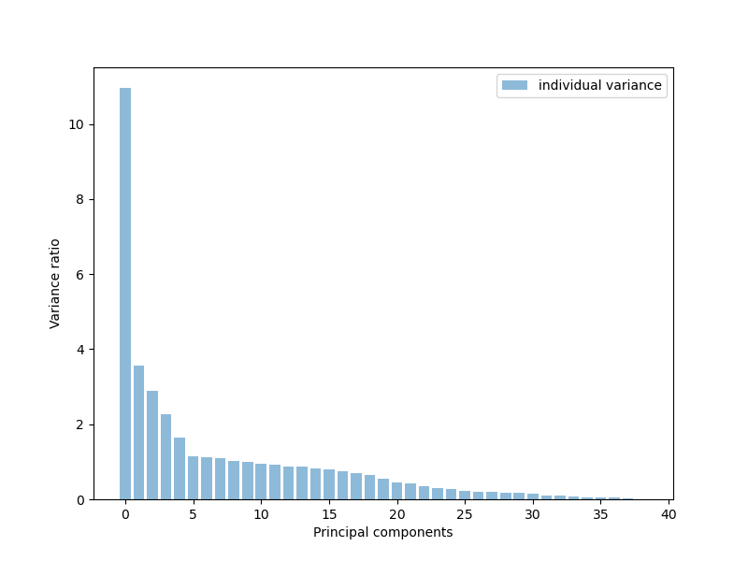
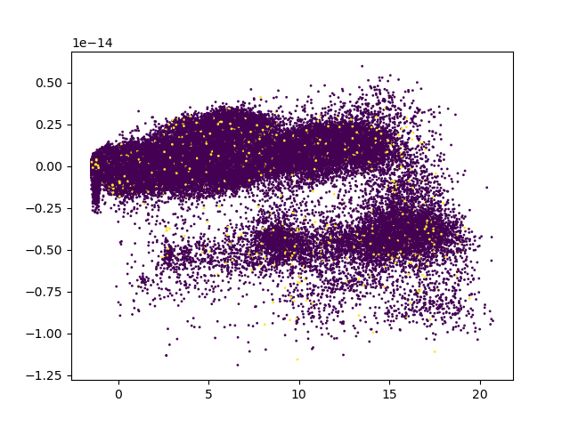
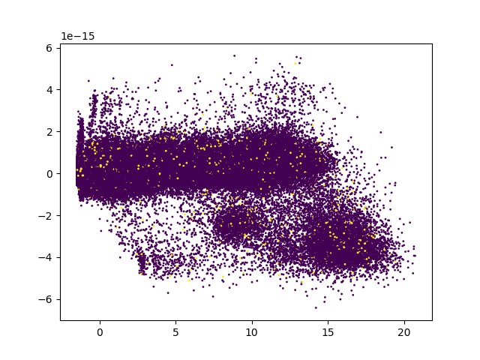
Recap of Last Presentation
PCA variance to label
Dropped out labels that are missing >50% Data
PCA on entire data set A

Slide 3
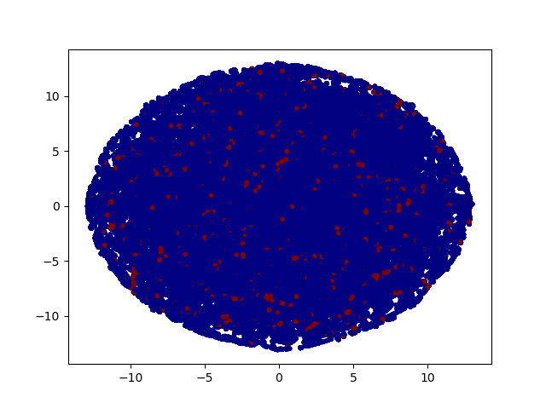
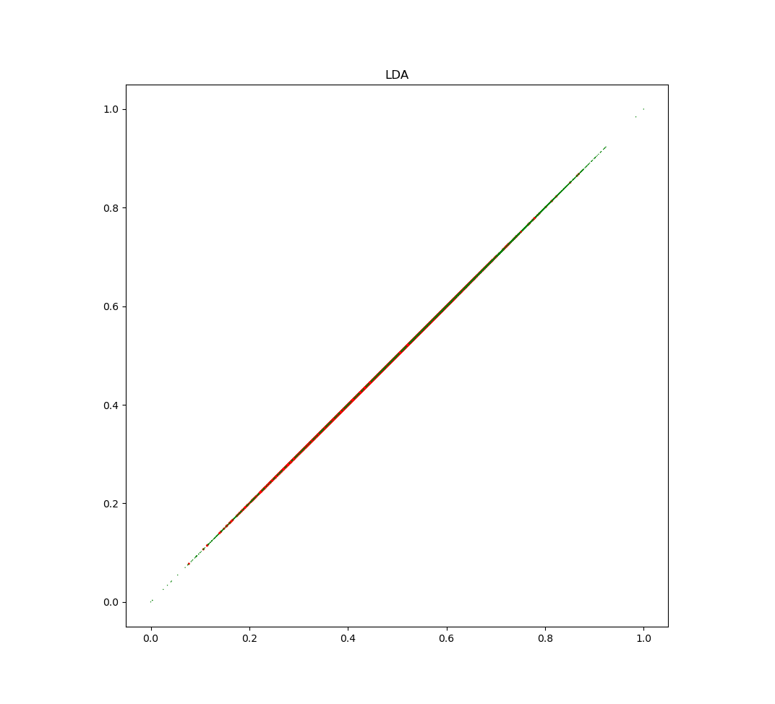
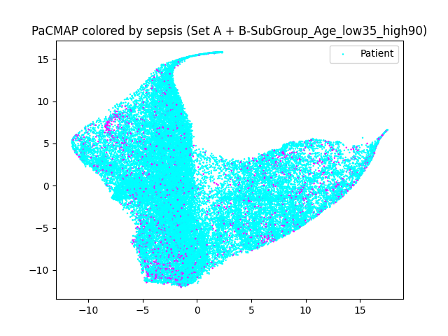
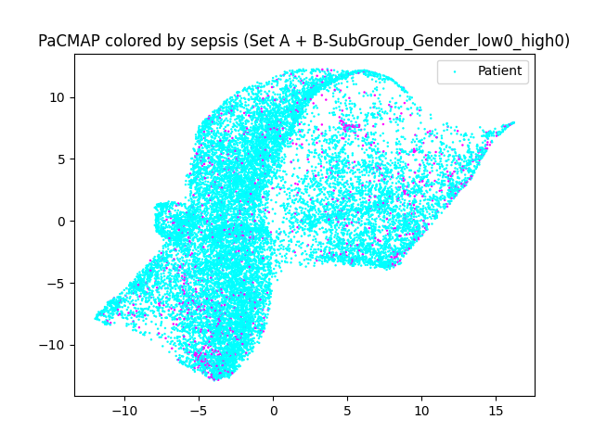
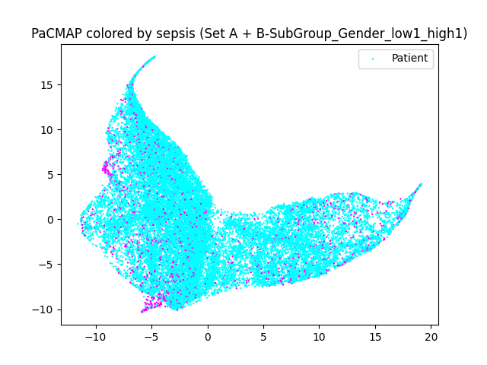
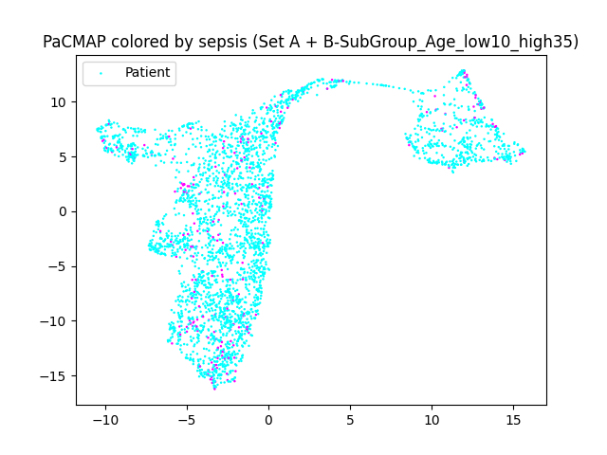
Recap of Last Presentation
TSNE on Set A
LDA on Set A
PacMap on subgroup age 35-90
PacMap on subgroup male
PacMap on subgroup female
PacMap on subgroup age 10-35

Slide 4
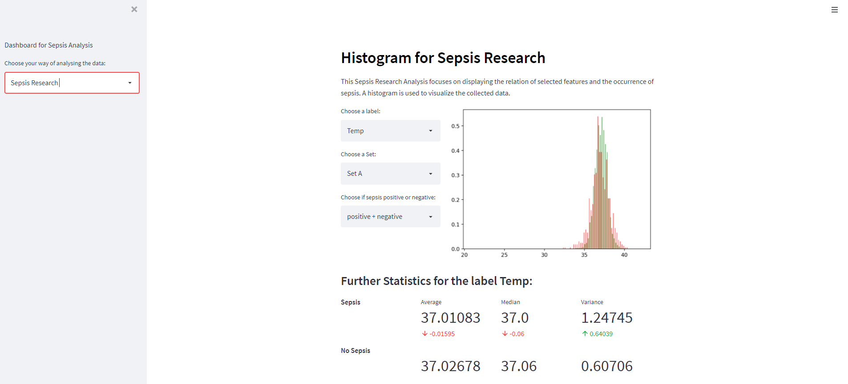
Recap of Last Presentation

Slide 5
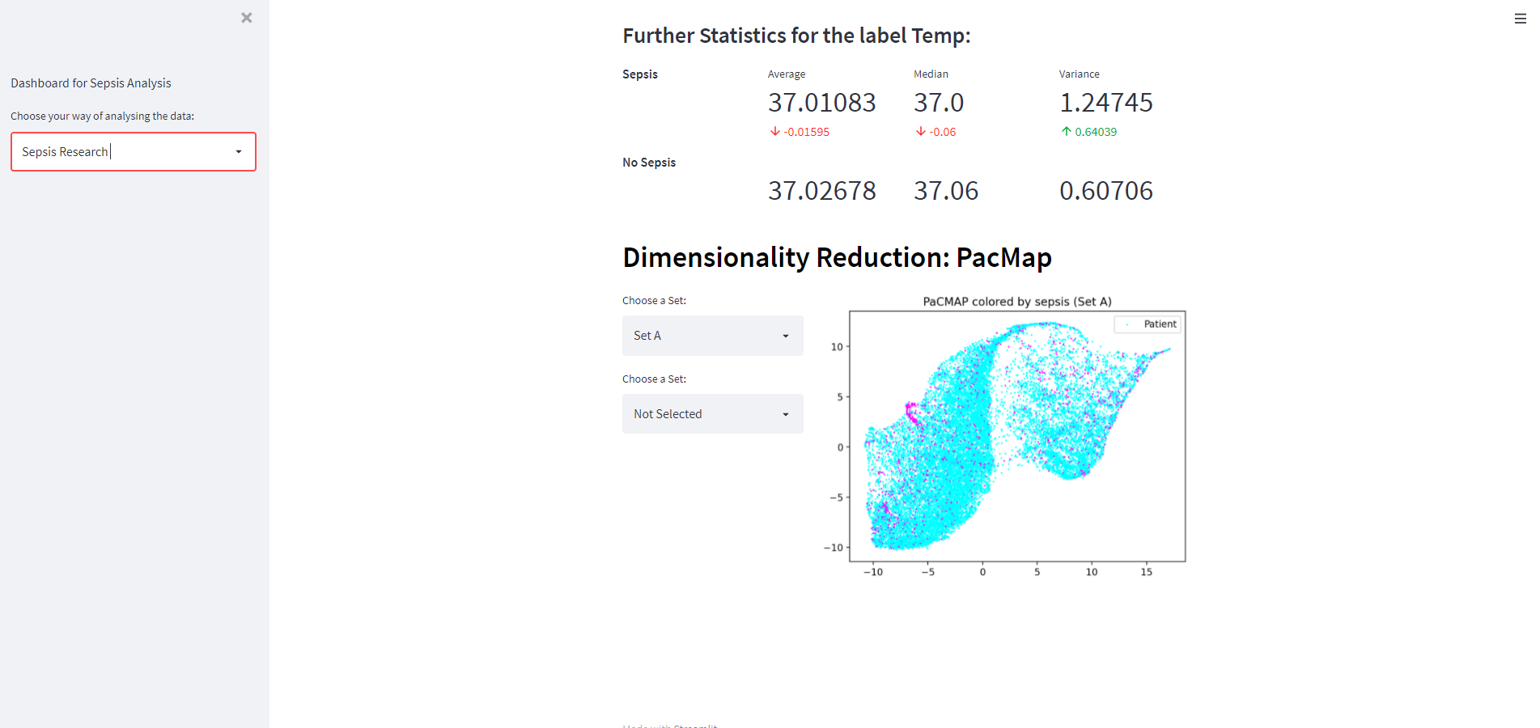
Recap of Last Presentation

Slide 6
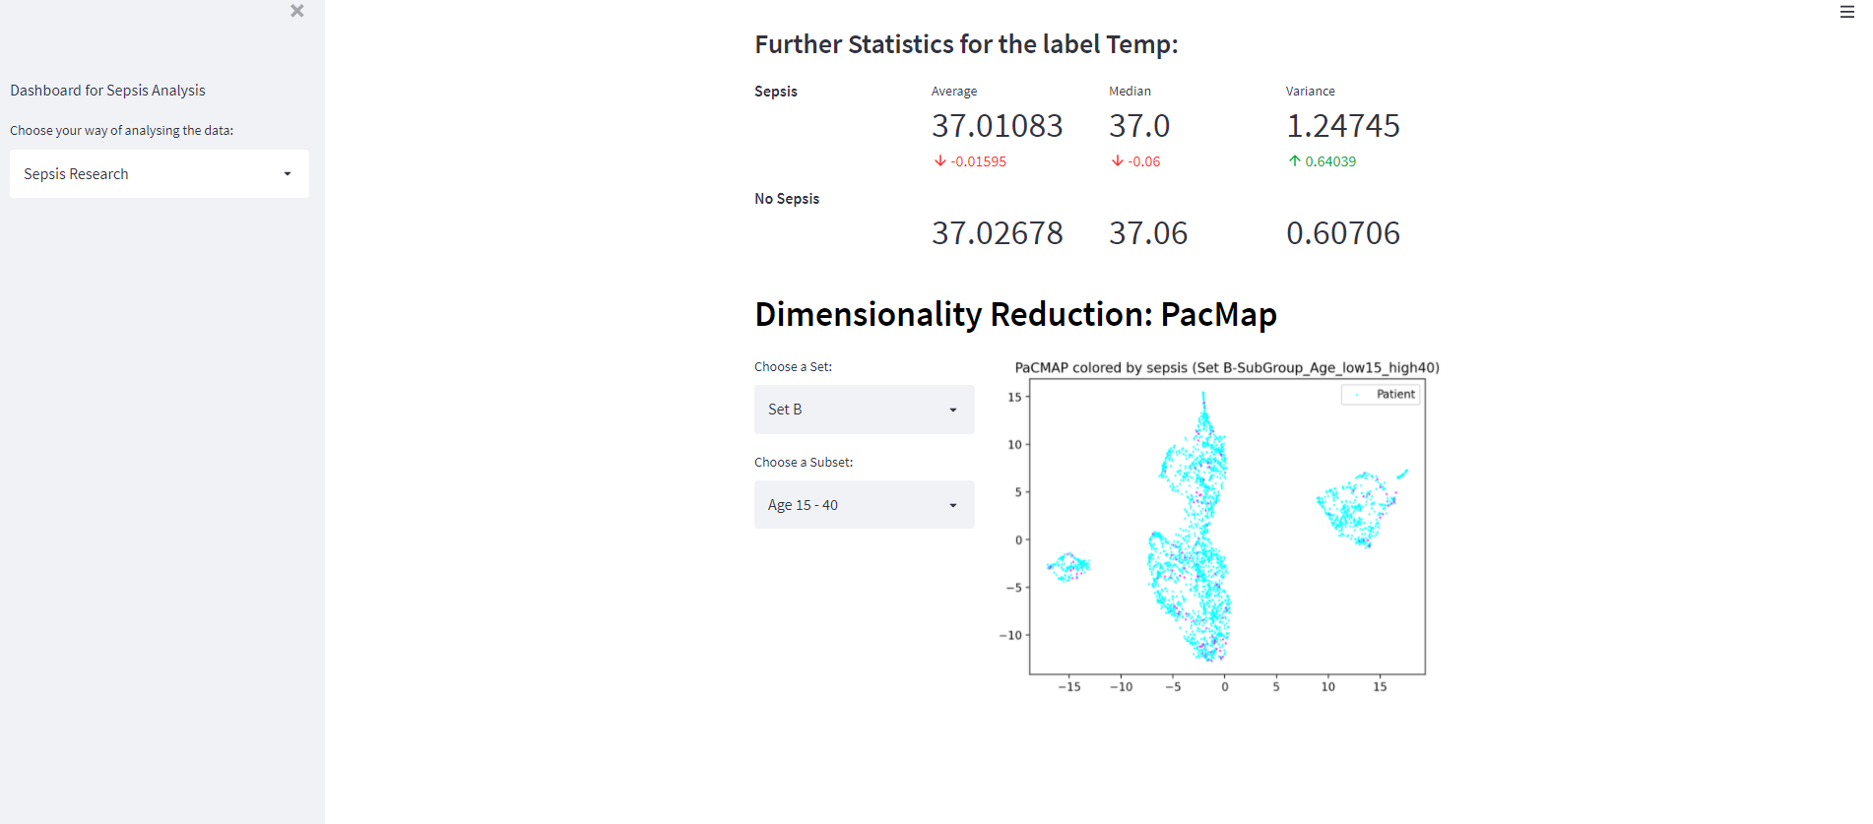
Recap of Last Presentation

Slide 7
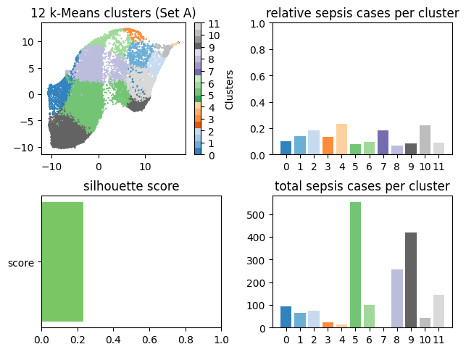
Task 3.1 – a) Conventional Clustering Methods
Some clusters are remarkable
Cluster #4 is rather dense while also having the highest sepsis chance
This is followed by Cluster #10 and #7 which are, according to PaCMAP, also located close to #4

Slide 8
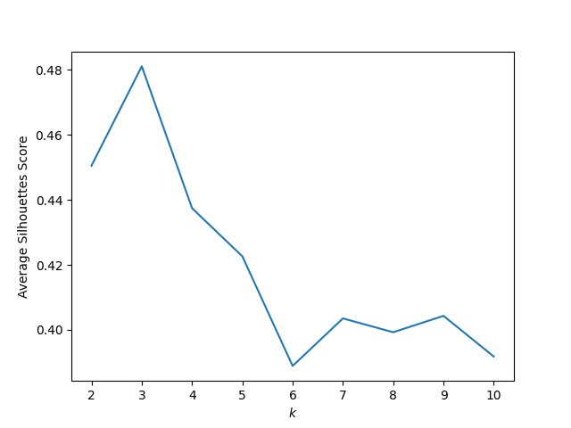
Task 3.1 – b) Quality Measures
Euclidean Silhouette Score for k-means (based on sklearn.metrics) to compare the distance of a data point and its assigned cluster center towards its distance to the other clusters
A high silhouette score speaks of a good cluster assignment (below 0.5 is relatively weak)
The advantage over Sum of Squared Errors is that it takes the heterogeneity between clusters into account (SSE only focusses on the homogenity inside the clusters)

Slide 9
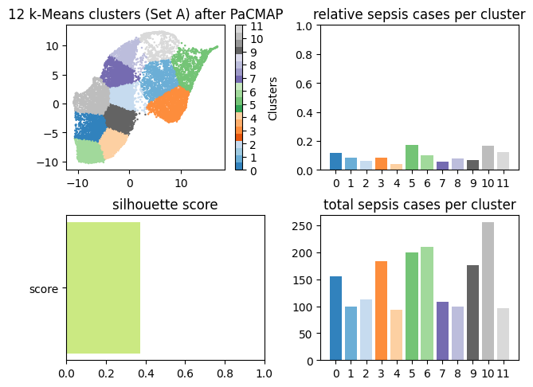
Task 3.1 – c) Clustering Subsets
Clustering of the PaCMAP data leads to vastly different results
The clusters are more uniformly sized
However, the spikes in the total sepsis cases has disappeared

Slide 10
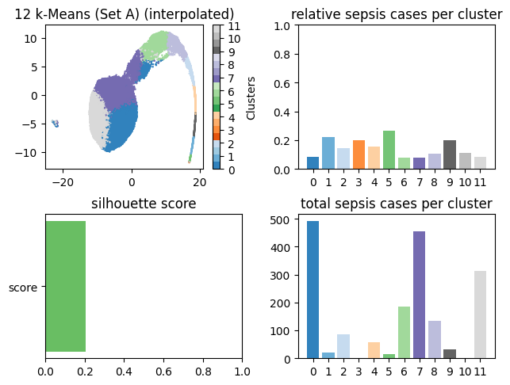
Task 3.2 – k-means with Imputation
PaCMAP has denser mapping which can be seen in the clustering.
Noteworthy clusters: #1 and #5 have a high relative value
cluster #1 (Sepsis: 20 Size: 89, relative: 22.4%)
cluster #5 (Sepsis: 14, Size: 53, relative: 26.4%)

Slide 11
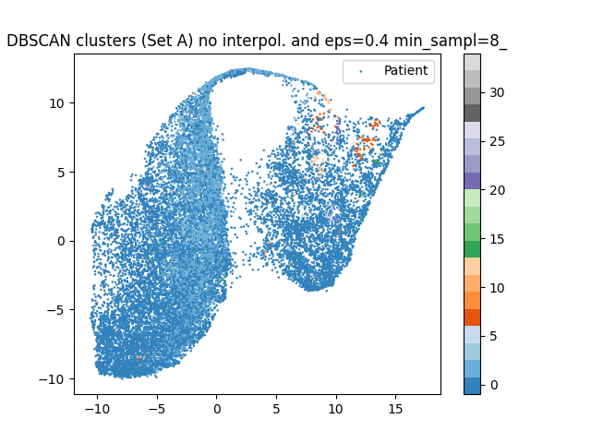
Task 3.2 – DBSCAN without Imputation
DBSCAN without interpolation and imputation (part of Task 3.1)
Also using z-values for standardization of features
Epsilon = 0.4
Min_samples = 8

Slide 12
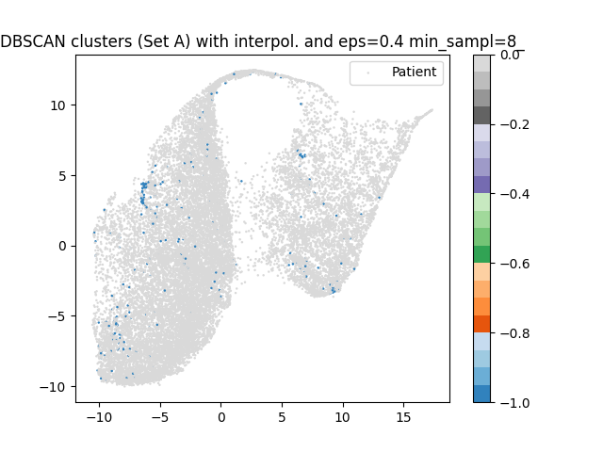
Task 3.2 – DBSCAN with Imputation
Epsilon value and minimum of neighboring samples must be further optimized (using silhouette score)
With these parameters there are no clusters found

Slide 13
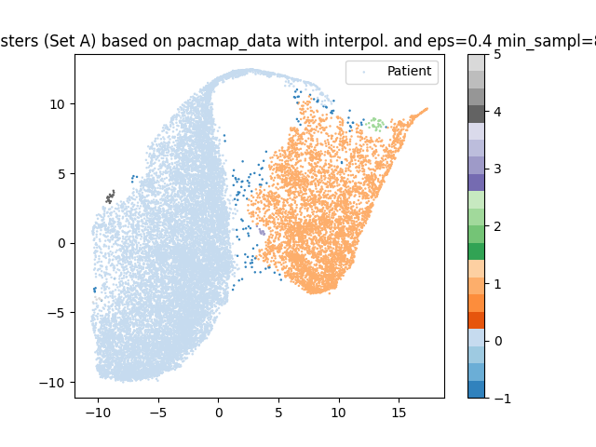
Task 3.2 – Clustering the PaCMAP-data
Clustering of the PaCMAP data leads to very precise clusters
While the interpretation of each cluster is unclear this is helpful to identify interesting subgroups

Slide 14
Next Possible Steps?
Apply subspace-clustering methods
Subspace Clustering and Imputation

Slide 15
Thank You!

