Slide 1

Data Challenges Task 3: Clustering and Imputation Group 8
Jakob Vanek 5879817 Philipp Wörner 6375519 Tobias Ettling 6753746 Xheni Hoxha 7267017

Slide 2
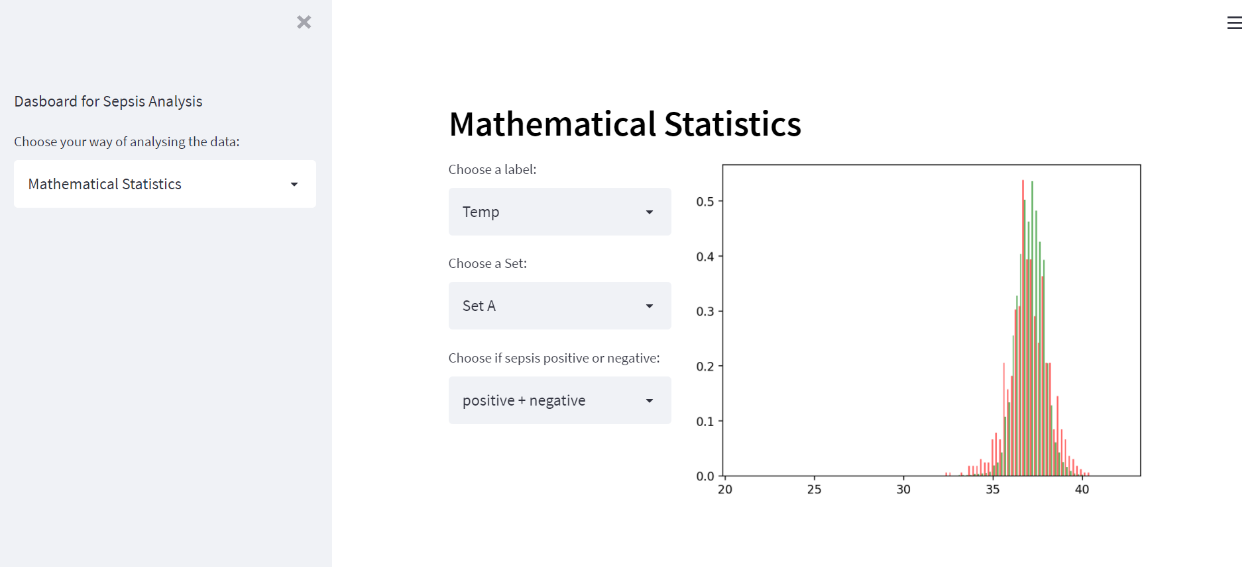
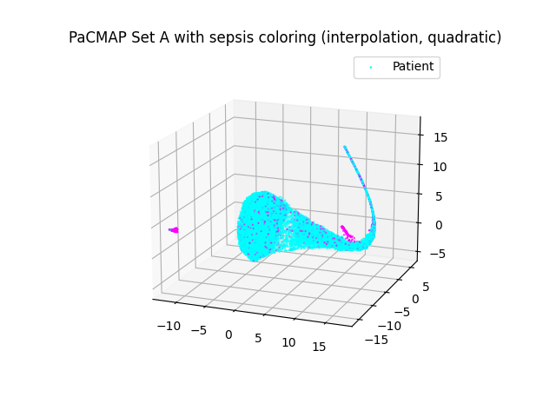
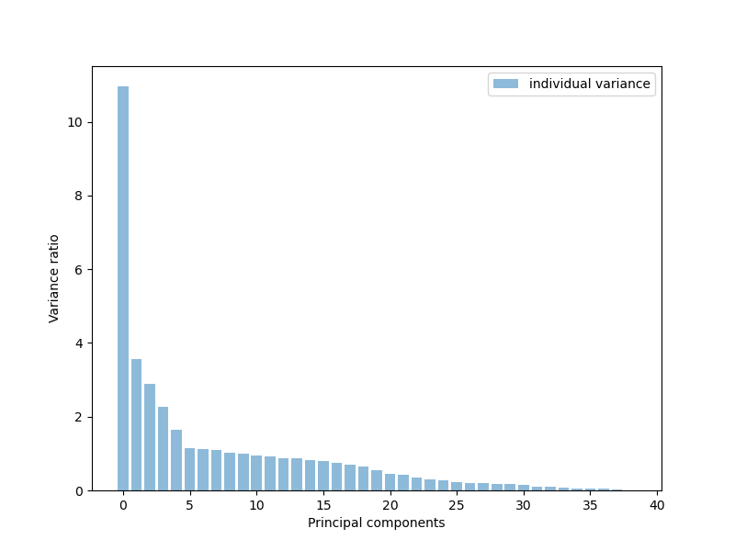
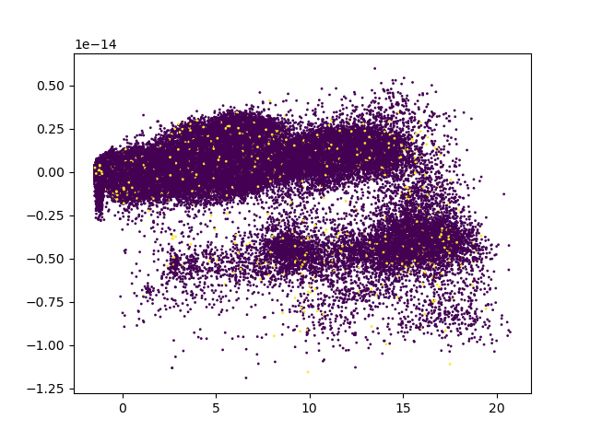
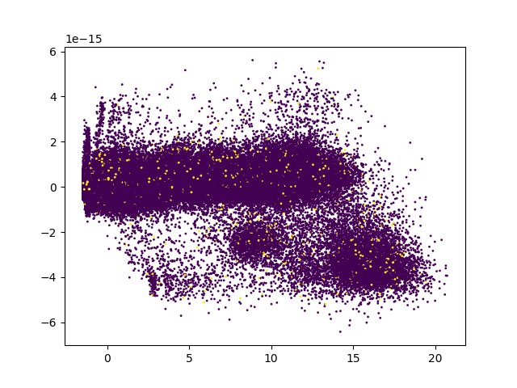
Recap of Last Presentation
PCA variance to label
Dropt ouut label that is missing
more than 50 % Data
PCA on enteire data set A

Slide 3
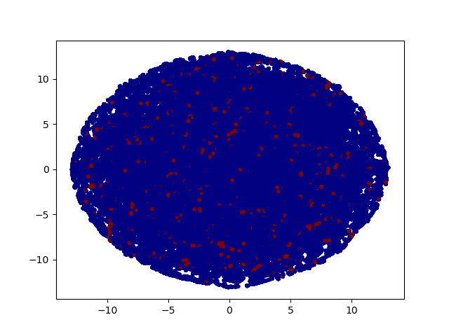
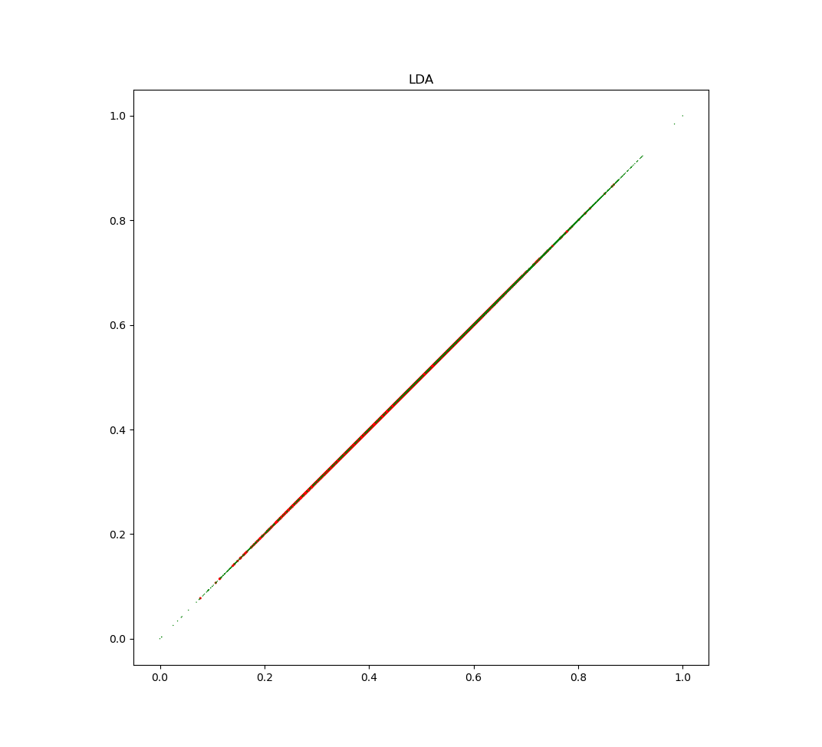
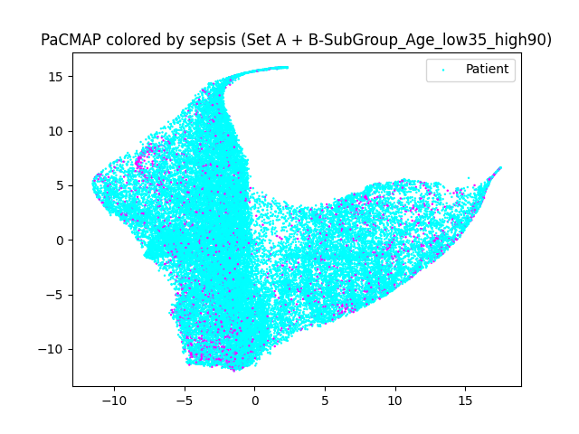
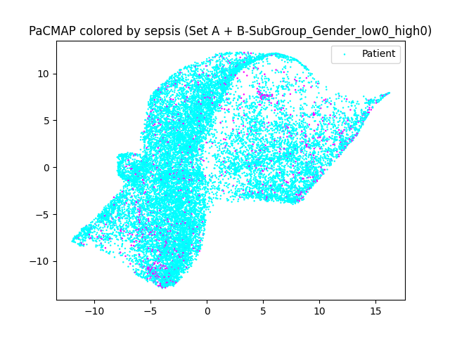
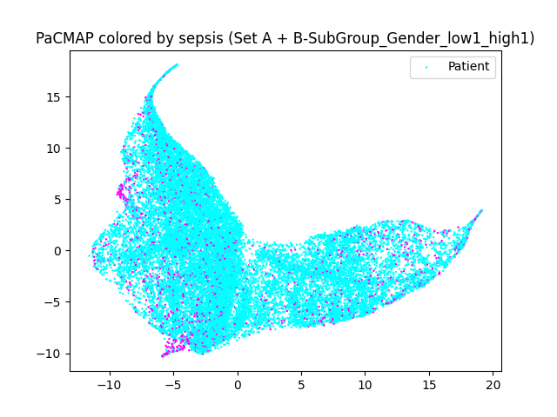
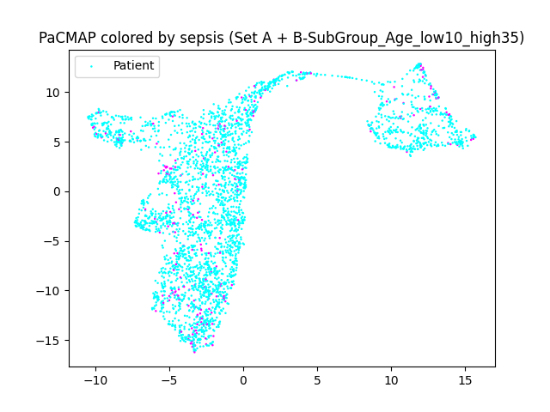
Recap of Last Presentation
TSNE on Set A
LDA on Set A
PacMap on subgroup age 35-90
PacMap on subgroup male
PacMap on subgroup female
PacMap on subgroup age 10-35

Slide 4
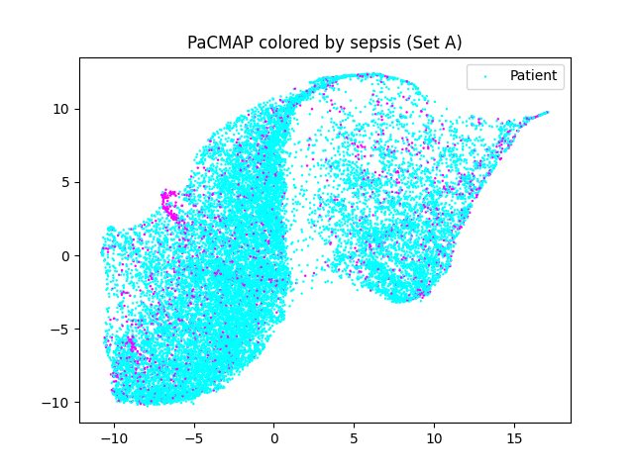
Task 3.1
Some clusters are remarkable. For example cluster #4 is rather dense while also having the highest sepsis chance. This is followed by Cluster #10 which is, according to PaCMAP, also located close to #4.

Slide 5
Task 3.1
Some clusters are remarkable. For example cluster #4 is rather dense while also having the highest sepsis chance. This is followed by Cluster #10 which is, according to PaCMAP, also located close to #4.
We've implemented the Silhouette Score which judges the whole clustering by comparing the distance of a data point and its assigned cluster center towards its distance to the other clusters. Therefore a low silhouette score speaks of a good cluster assignment.

Slide 6
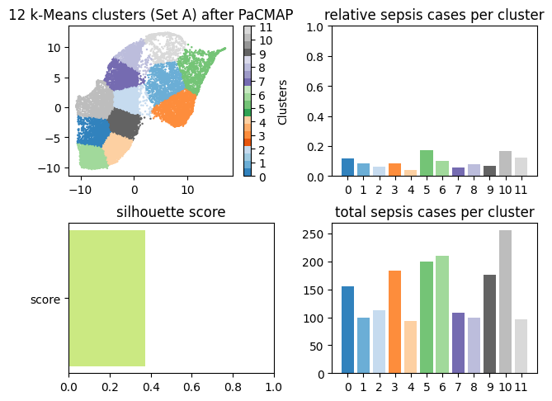
Task 3.1
Yes, the clustering is vastly different as it does not consider the original data point constellation anymore but the one given with PaCMAP instead. The clusters are more uniformly sized in the resulting graph and the spikes in the total sepsis cases has disappeared.

Slide 7
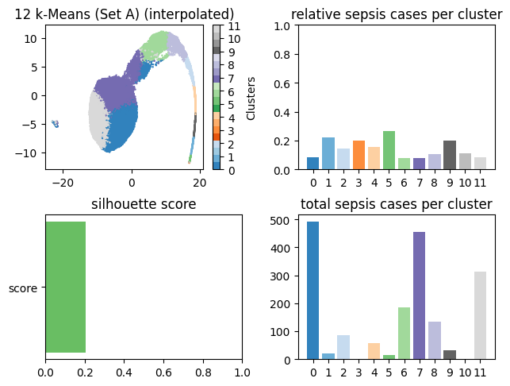
Task 3.2
Yes, as the PaCMAP already shows a radically different, more dense mapping it also shows in the clustering. A very noteworthy cluster here is cluster #3 which is tiny compared to the other clusters but still has a relatively high sepsis chance. The same goes for cluster #10

Slide 8
Next Possible Steps?
Apply subspace-clustering methods
Subspace Clustering and Imputation

Slide 9
Thank you!

