Slide 1

Data Challenges Task 3: Clustering and Imputation Group 8
Jakob Vanek 5879817 Philipp Wörner 6375519 Tobias Ettling 6753746

Slide 2
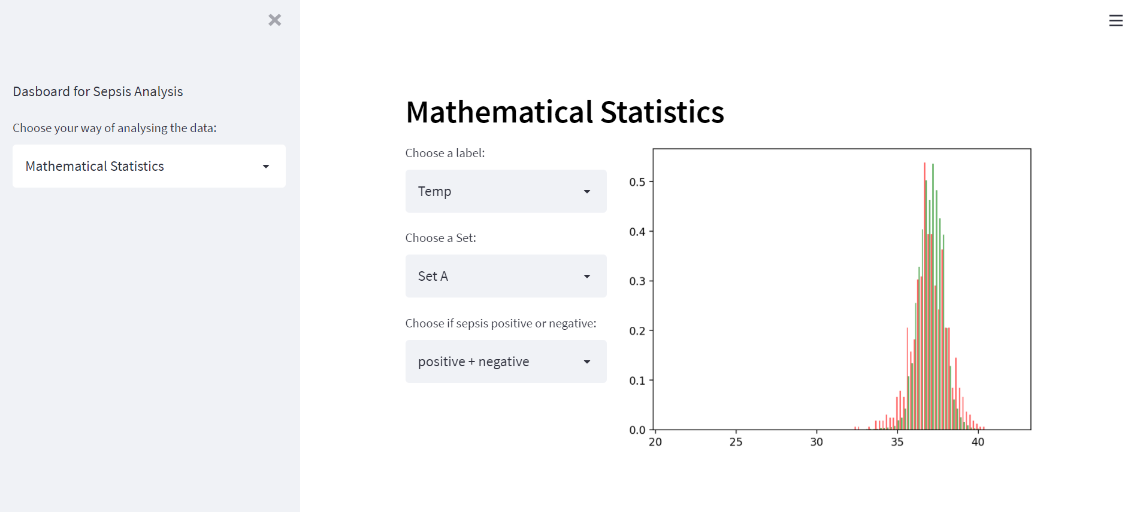
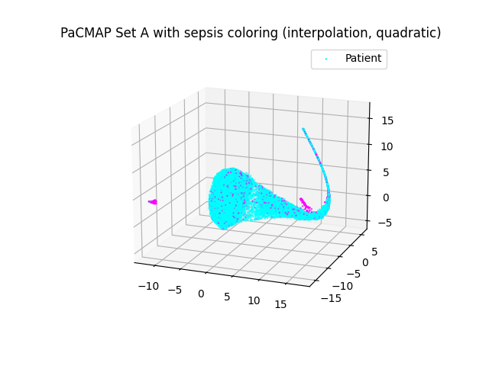
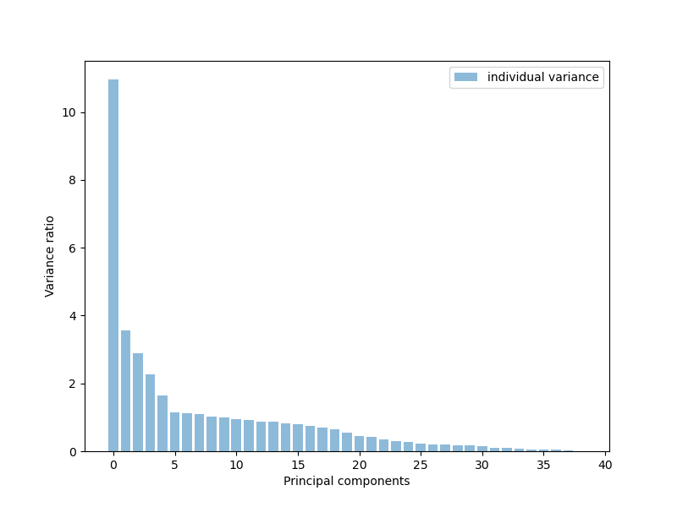
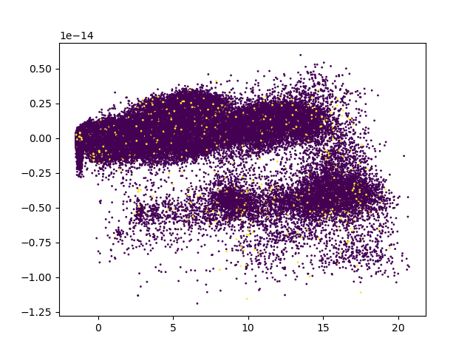
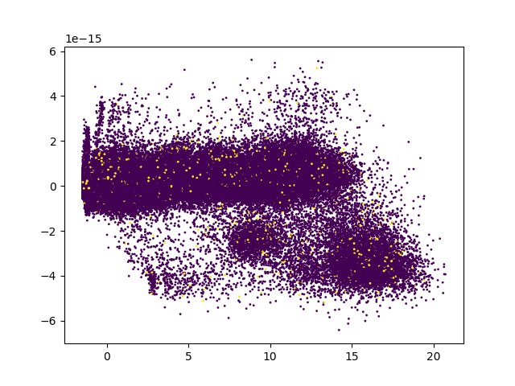
Recap of Last Presentation
PCA variance to label
Dropped out labels that are missing >46% Data
PCA on entire data set A

Slide 3
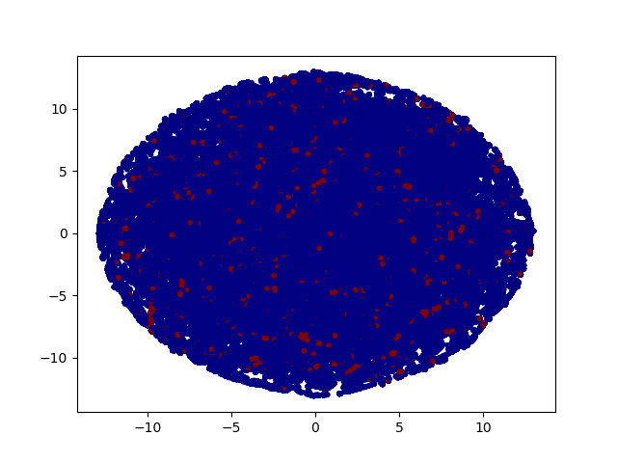
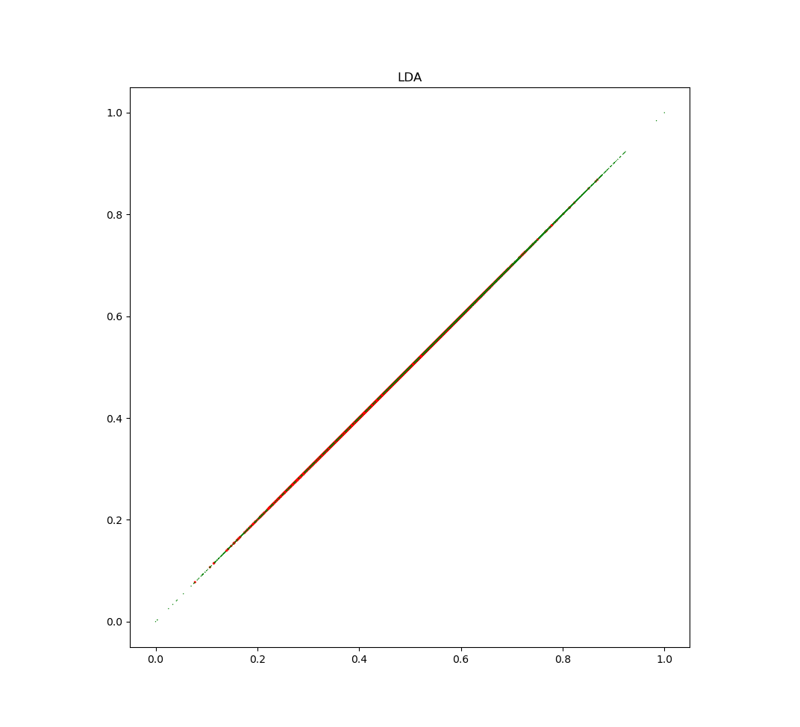
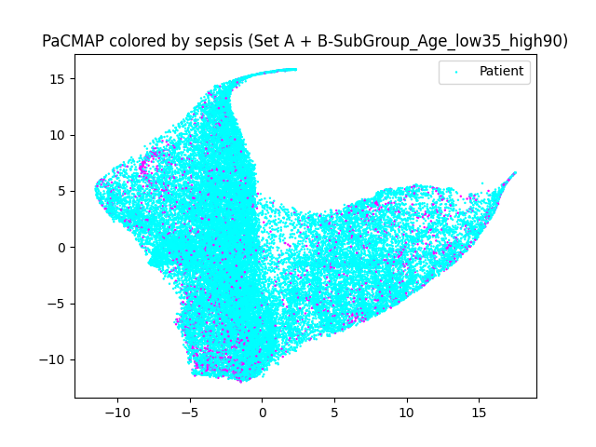
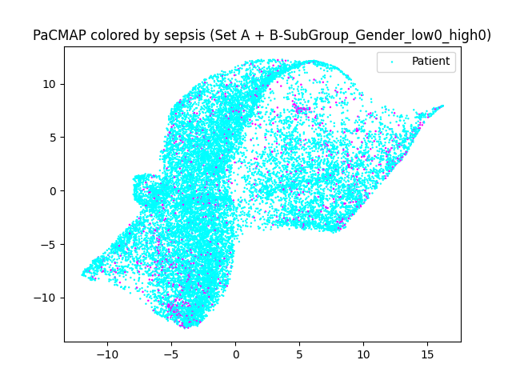
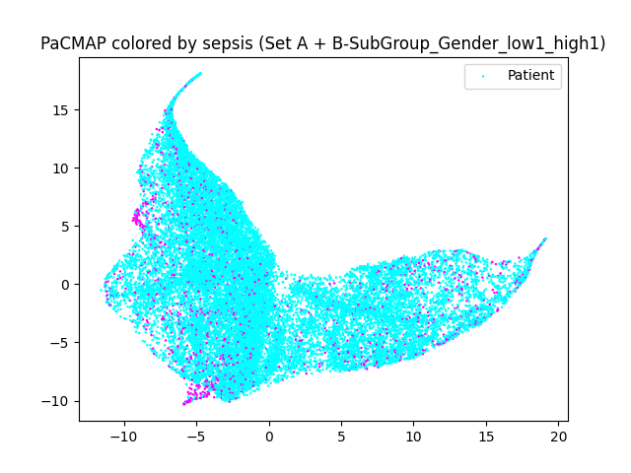
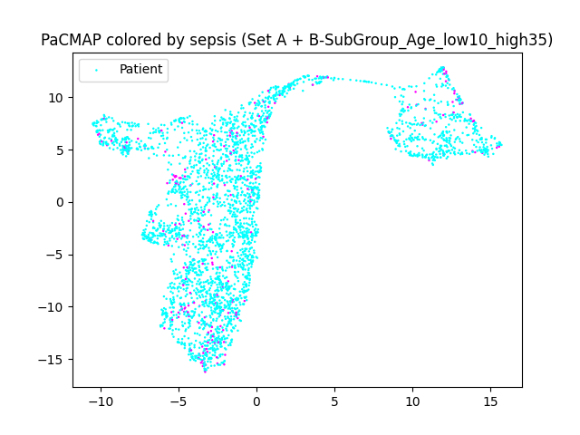
Recap of Last Presentation
TSNE on Set A
LDA on Set A
PacMap on subgroup age 35-90
PacMap on subgroup male
PacMap on subgroup female
PacMap on subgroup age 10-35

Slide 4
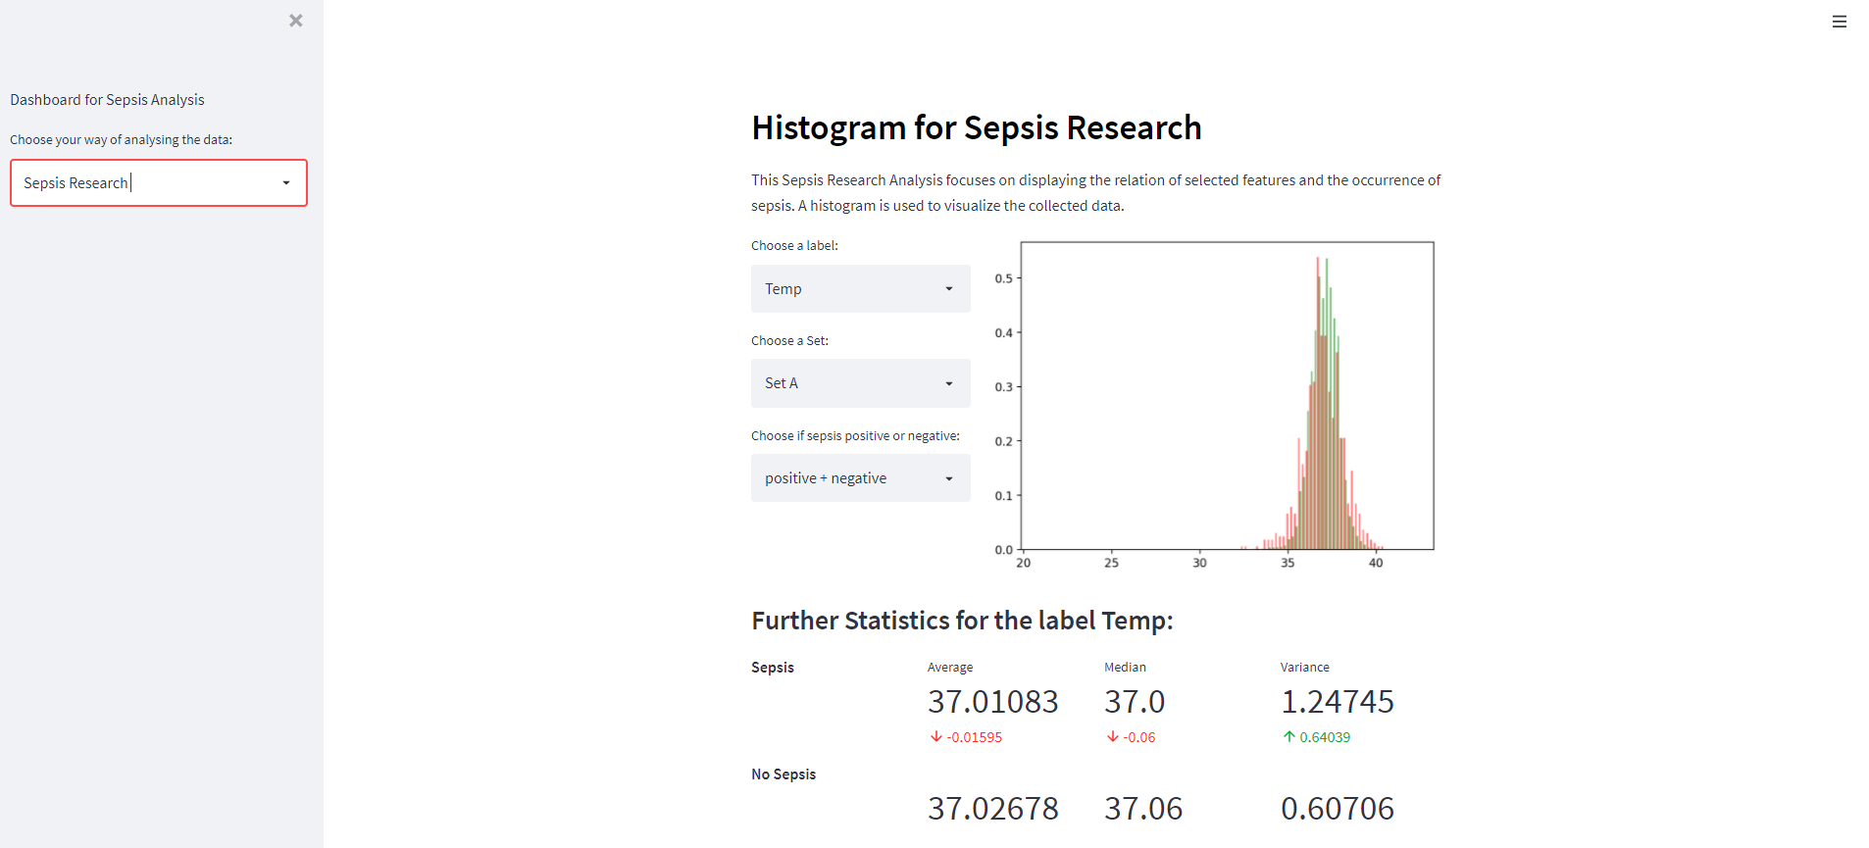
Recap of Last Presentation

Slide 5
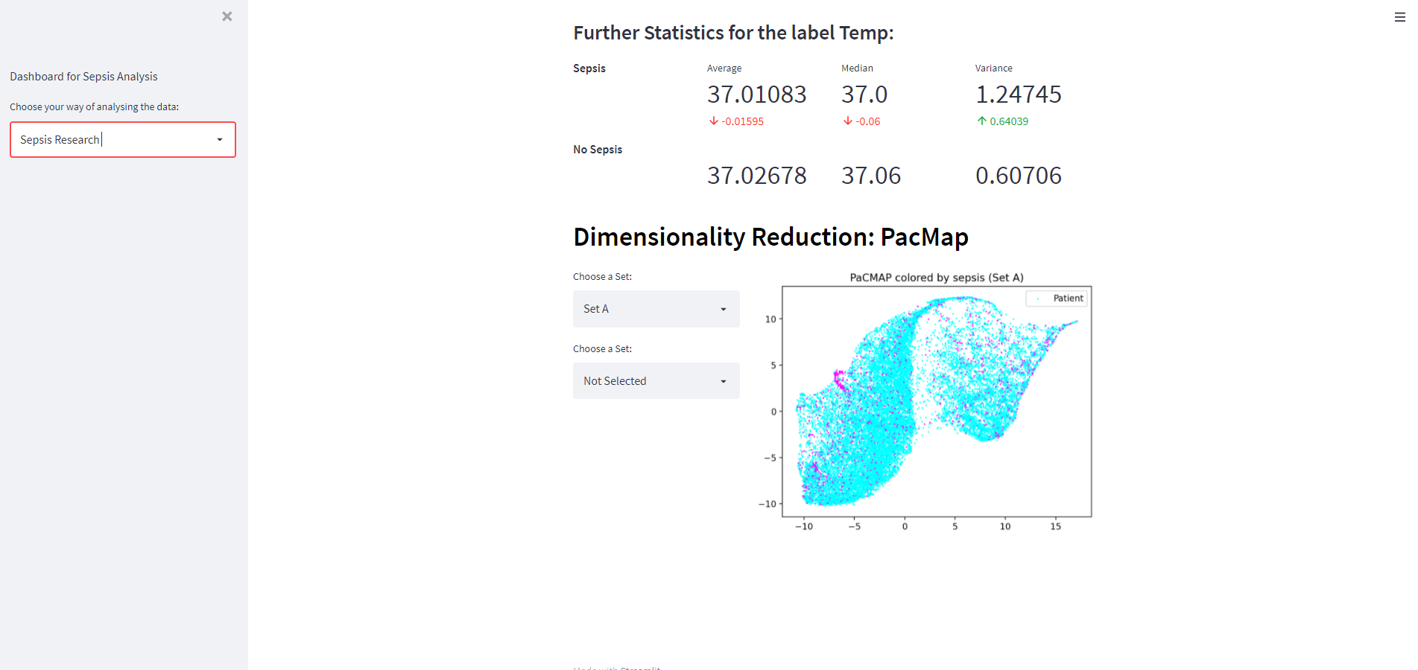
Recap of Last Presentation

Slide 6
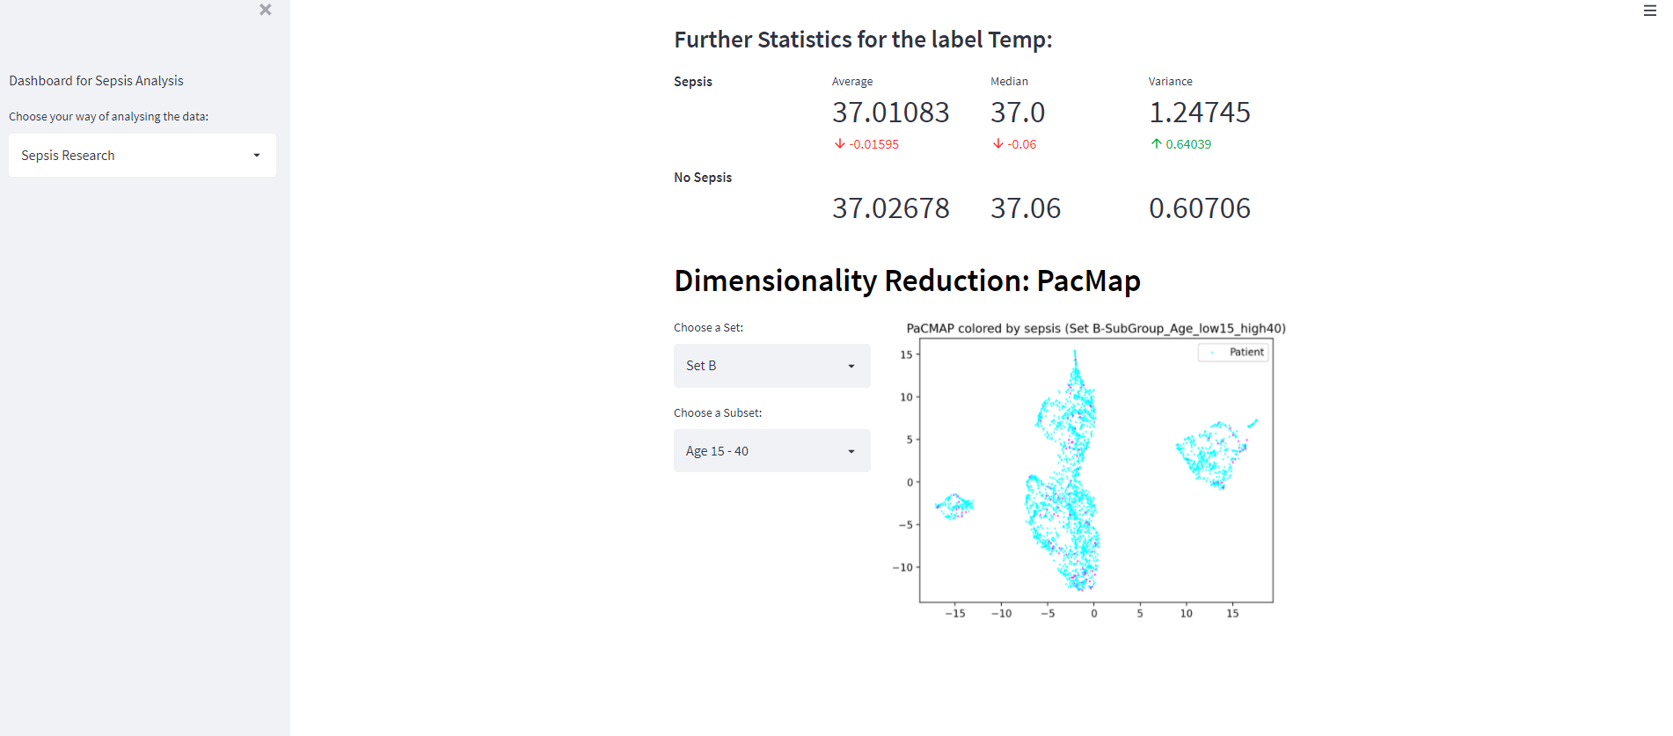
Recap of Last Presentation

Slide 7
Task 3.1 – a) Conventional Clustering Methods
Some clusters are remarkable. For example cluster #4 is rather dense while also having the highest sepsis chance. This is followed by Cluster #10 which is, according to PaCMAP, also located close to #4.
Bild fehlt

Slide 8
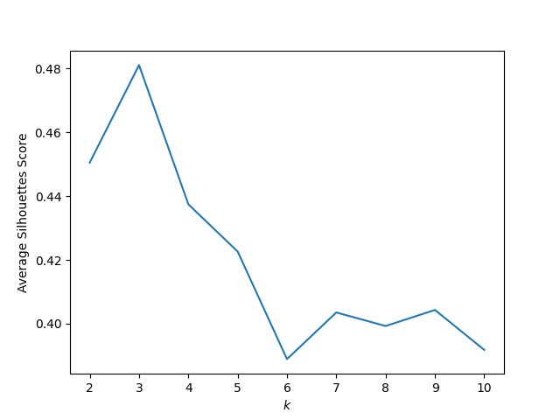
Task 3.1 – b) Quality Measures
We've implemented the Silhouette Score for k-means which judges the whole clustering by comparing the distance of a data point and its assigned cluster center towards its distance to the other clusters. Therefore a low silhouette score speaks of a good cluster assignment.
The advantage of the Silhoutte Score over the Sum of Squared Errors is that it also takes the heterogeneity between clusters into account. SSE only focusses on the homogenity inside the clusters.

Slide 9
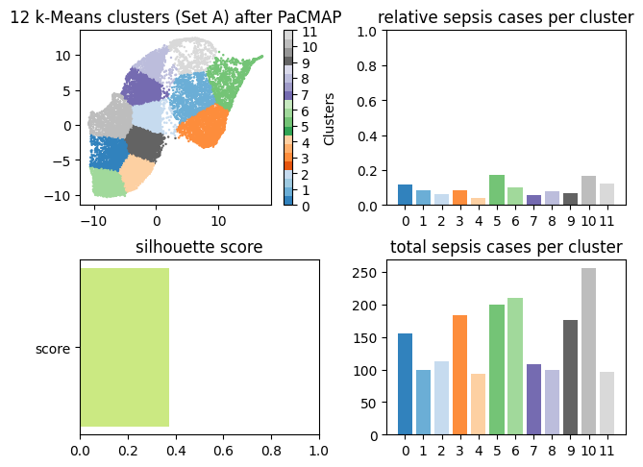
Task 3.1 – c) Clustering Subsets
The clustering is vastly different as it does not consider the original data point constellation anymore but the one given with PaCMAP instead. The clusters are more uniformly sized in the resulting graph and the spikes in the total sepsis cases has disappeared.
We were supposed to cluster subsets – not the pacmap set

Slide 10
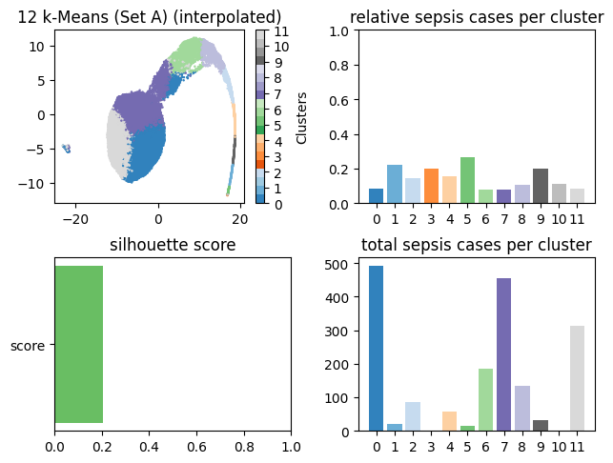
Task 3.2 – k-means with Imputation
PaCMAP has denser mapping which can be seen in the clustering.
A very noteworthy cluster here is cluster #3 which is tiny compared to the other clusters but still has a relatively high sepsis chance. The same goes for cluster #10 - that’s not correct

Slide 11
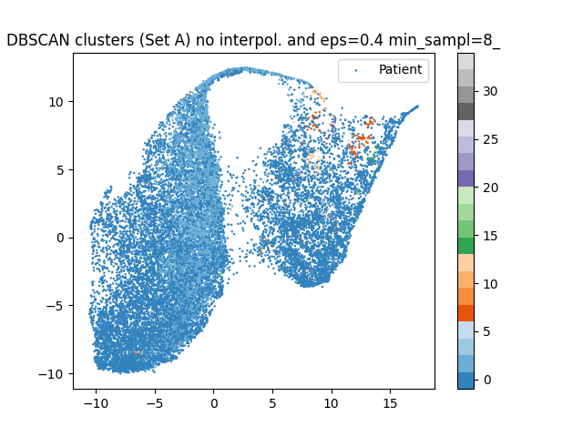
Task 3.2 – DBSCAN without Imputation
DBSCAN without interpolation & imputation
Also using z-values for standardization of features

Slide 12
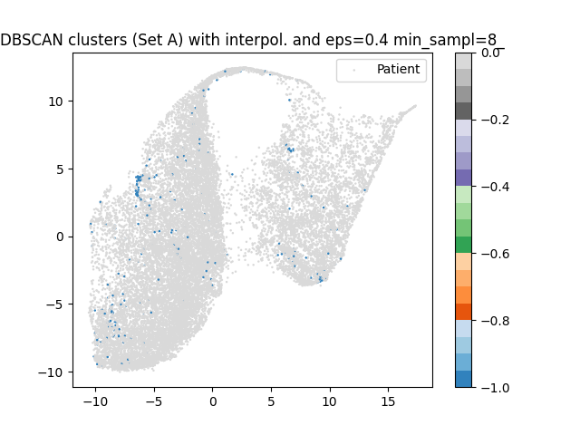
Task 3.2 – DBSCAN with Imputation
Epsilon value and minimum of neighboring samples must probably be optimized.
With these parameters there are no clusters found

Slide 13
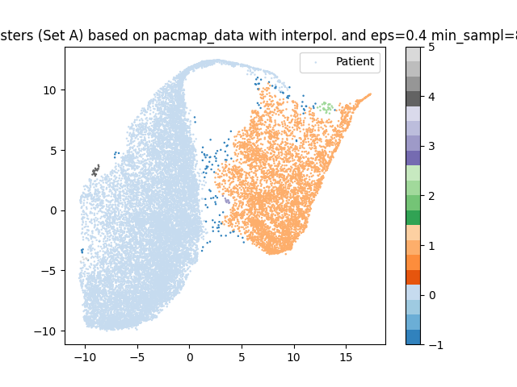
Task 3.2 – Clustering the PaCMAP-data
Clustering of the PaCMAP data leads to very precise clusters
While the interpretation of each cluster is unclear this is helpful to identify interesting subgroups

Slide 14
Next Possible Steps?
Apply subspace-clustering methods
Subspace Clustering and Imputation

Slide 15
Thank You!

