Slide 1
Data Challenges – Team DC8: Task 1
Team Presentation: Xheni, Philipp Wörner 6375519, Tobias Ettling 6753746 , Jakob Vanek 5879817

Slide 2
Overview
Access to the data set
Manual data exploration
Dimensionality reduction techniques
Web app development framework
Overview

Slide 3
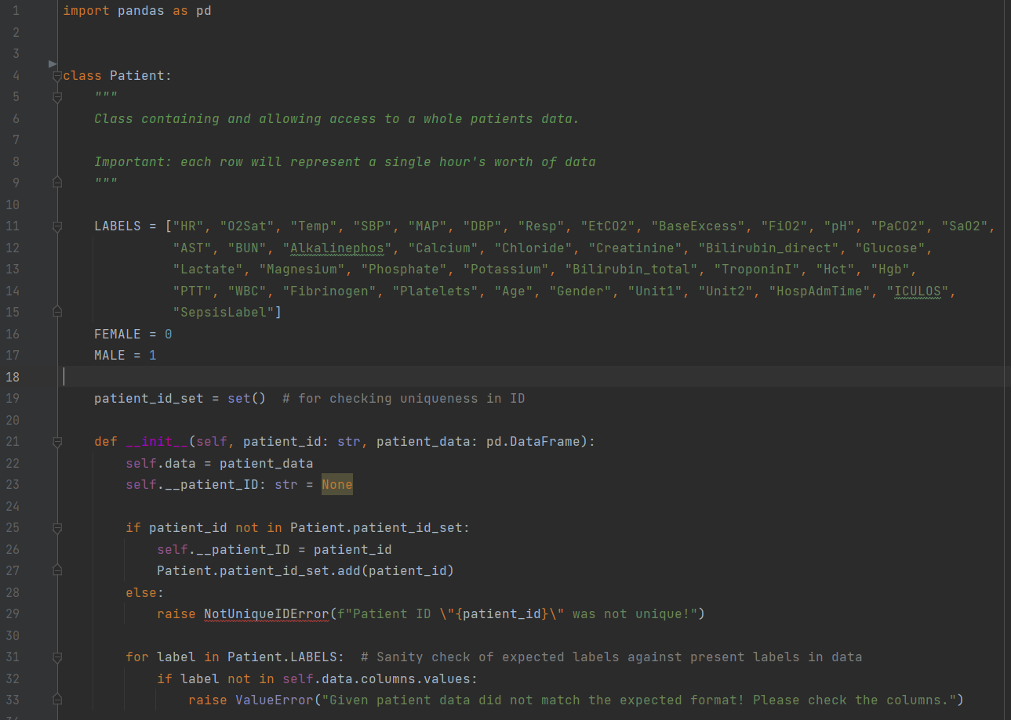
1. Access to the data set
We decided to use panda-dataframes in combination with object oriented classes for each patient
1. Access to the data set

Slide 4
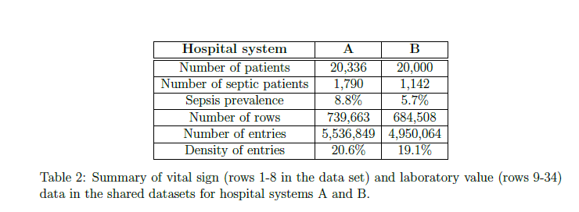
2a) Statistical Properties
Analysis from the original Paper[1] was verified
[1] https://physionet.org/content/challenge-2019/1.0.0/
2. Manual data exploration

Slide 5
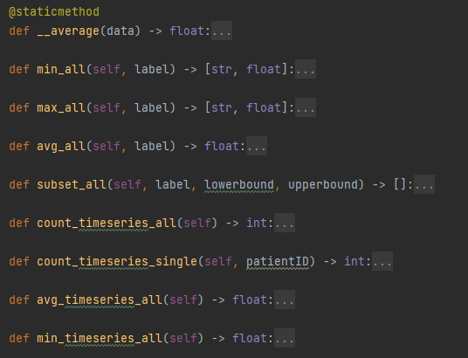
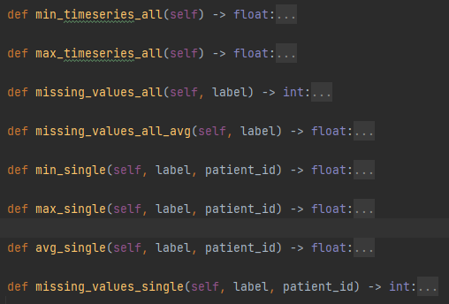
2a) Statistical Properties
We defined these methodes:
2. Manual data exploration

Slide 6
2a) Statistical Properties
Examplary Analysis of Features in Dataset A:
HR [Heart Rate]
Minimum Value in all HR colums: ['p004712', 20.0]
Maximum Value in all HR colums: ['p008574', 280.0]
Average Value in all HR colums: 84.98526444873023
Missing Values in all HR colums: 61189
O2Sat [O2 Saturation]
Minimum Value in all O2Sat colums: ['p014401', 20.0]
Maximum Value in all O2Sat colums: ['p000001', 100.0]
Average Value in all O2Sat colums: 97.26568772153938
Missing Values in all O2Sat colums: 95079
Temp [Temperature]
Minimum Value in all Temp colums: ['p002421', 20.9]
Maximum Value in all Temp colums: ['p015104', 42.22]
Average Value in all Temp colums: 37.02673699236573
Missing Values in all Temp colums: 523314
SBP [Systolic BP]
Minimum Value in all SBP colums: ['p014968', 22.0]
Maximum Value in all SBP colums: ['p005749', 281.0]
Average Value in all SBP colums: 120.96235945816058
Missing Values in all SBP colums: 120201
…
2. Manual data exploration

Slide 7
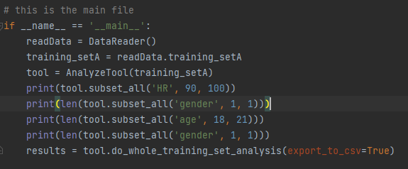


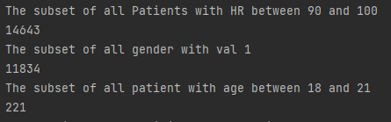
2b) Subgroups
Based on age:
Based on Gender:
Etc: Nan
Output
2. Manual data exploration

Slide 8
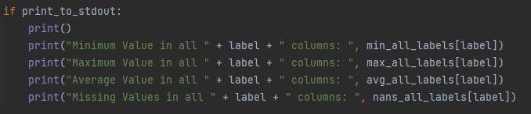
2c) Timeseries Data
Amount of Timeseries in the complete Dataset A:
Average amount of timeseries in all data: 38.857
Minimum amount of timeseries in all data: 8
Maximum amount of timeseries in all data: 336
Amount of timeseries in all data: 790215
2. Manual data exploration

Slide 9
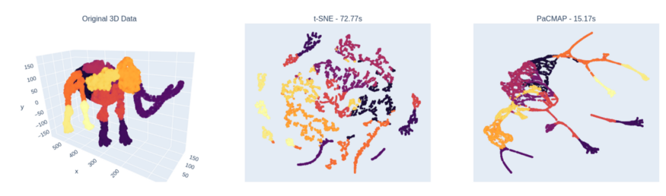
3. Dimensionality reduction techniques
Following the blogposts[2] conclusion:
PaCMAP is most suited for our dimensionality reduction
[2] https://towardsdatascience.com/why-you-should-not-rely-on-t-sne-umap-or-trimap-f8f5dc333e59
3. Dimensionality reduction techniques

Slide 10

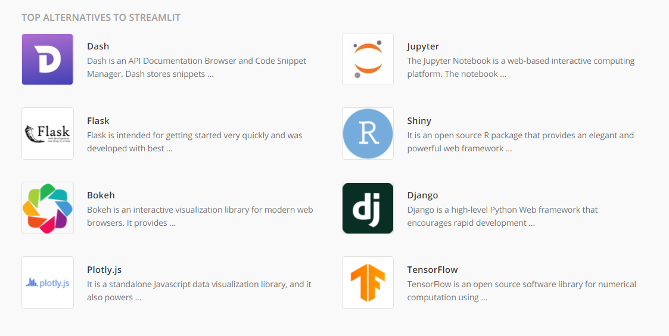
4. Web app development framework
We chose streamlit after comparing it to popular alternatives
Flask: Too unspecific
Plotly combined in a Webframe (JavaScript): Not efficient
Streamlit: Perfect solution, specified for data analysis and visualization
4. Web app development framework

Slide 11
4. Web app development framework
Examplatory screenshot of final result:
4. Web app development framework

Slide 12
Outlook
This dataset can now be analysed with different machine learning tools in python
Dimensionality reduction will be a helpful step to visualize the data
The final presentation of results will be enabled within a streamlit web app
Outlook

Slide 13
Data Challenges – Team DC8: Task 1
Team Presentation: Xheni, Philipp Wörner 6375519, Tobias, Jakob Vanek 5879817

