Slide 1

Data Challenges Task 1: PhysioNet Challenge Group 8
Jakob Vanek 5879817 Philipp Wörner 6375519 Tobias Ettling 6753746 Xheni Hoxha 7267017

Slide 2
Overview
1. Accessing the data set
2. Manual data exploration
a. Statistical properties of the data set
b. Identification of subgroups
c. Time series properties
3. Dimensionality reduction techniques
4. Web app development framework
Overview

Slide 3
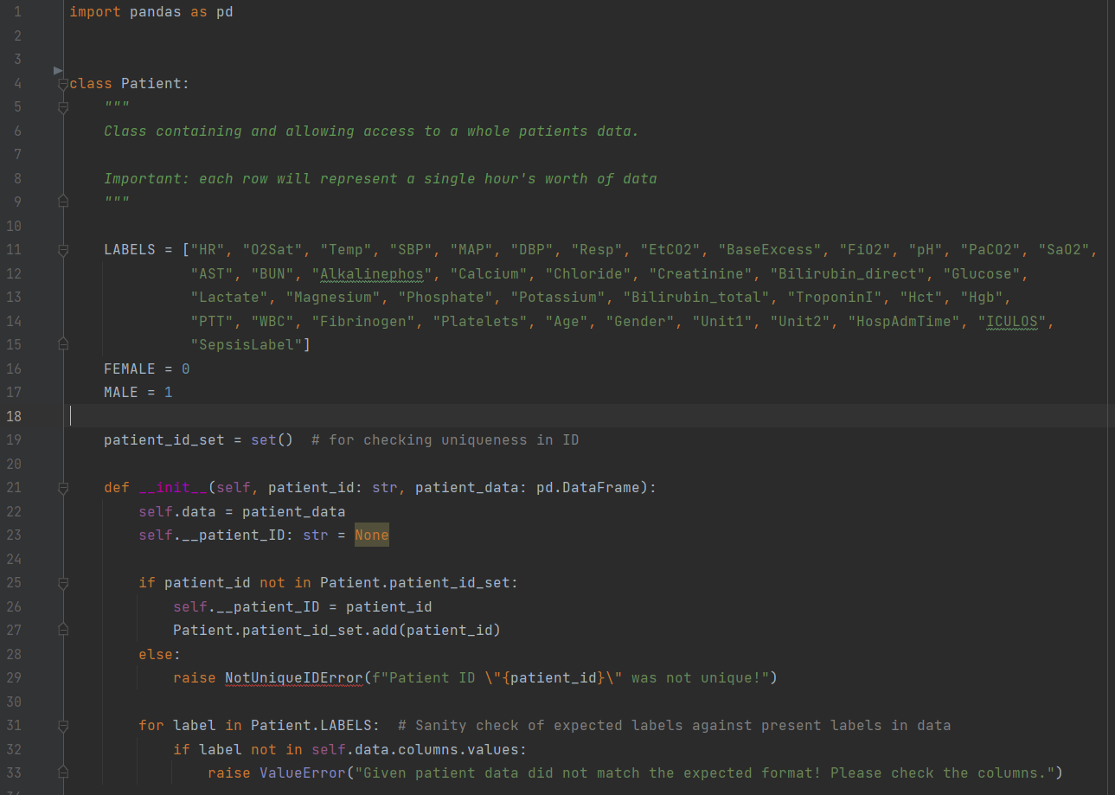
1. Accessing the data set
Using Panda-df in combination with Object-Oriented Classes for each patient
1. Accessing the data set

Slide 4
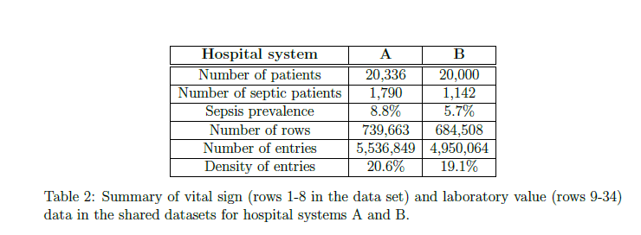
2. Manual data exploration
a) Statistical properties of the data set
Analysis from the original Paper[1] was verified
[1] https://physionet.org/content/challenge-2019/1.0.0/
2. Manual data exploration

Slide 5
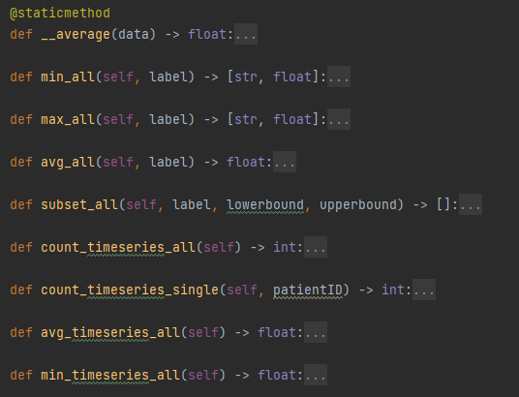
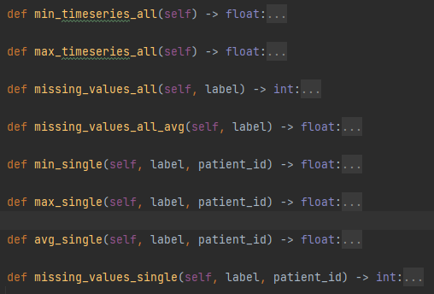
2. Manual data exploration
a) Statistical properties of the data set
Definition of used methods
2. Manual data exploration

Slide 6
2. Manual data exploration
a) Statistical properties of the data set
Examplary Analysis of Features in Dataset A:
HR [Heart Rate]
Minimum Value in all HR colums: ['p004712', 20.0]
Maximum Value in all HR colums: ['p008574', 280.0]
Average Value in all HR colums: 84.98526444873023
Missing Values in all HR colums: 61189
O2Sat [O2 Saturation]
Minimum Value in all O2Sat colums: ['p014401', 20.0]
Maximum Value in all O2Sat colums: ['p000001', 100.0]
Average Value in all O2Sat colums: 97.26568772153938
Missing Values in all O2Sat colums: 95079
Temp [Temperature]
Minimum Value in all Temp colums: ['p002421', 20.9]
Maximum Value in all Temp colums: ['p015104', 42.22]
Average Value in all Temp colums: 37.02673699236573
Missing Values in all Temp colums: 523314
SBP [Systolic BP]
Minimum Value in all SBP colums: ['p014968', 22.0]
Maximum Value in all SBP colums: ['p005749', 281.0]
Average Value in all SBP colums: 120.96235945816058
Missing Values in all SBP colums: 120201
…
2. Manual data exploration

Slide 7
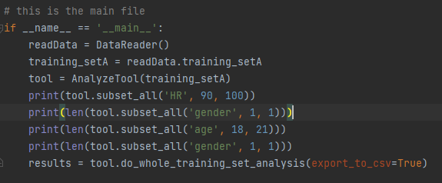


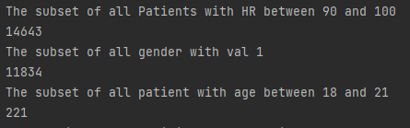
2. Manual data exploration
b) Identification of Subgroups
Based on Age
Based on Gender
Output
Etc: NaN
2. Manual data exploration

Slide 8
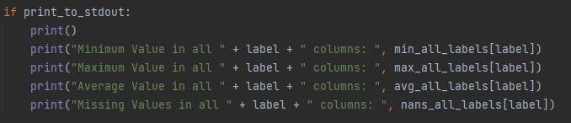
2. Manual data exploration
c) Time Series Properties
Amount of Timeseries in the complete Dataset A:
Average amount of timeseries in all data: 38.857
Minimum amount of timeseries in all data: 8
Maximum amount of timeseries in all data: 336
Amount of timeseries in all data: 790215
2. Manual data exploration

Slide 9
3. Dimensionality Reduction Techniques
Why is Dimmensionality Reduction needed?
Too many input features (41 dimensions) lead to
Challenges in visualizing projections
Challenges in making a predictive model
What are some Benefits?
Potentially increase understanding of underlying clusters in a dataset and the distribution of data
Retain „valid“ structure/ information
Helps in data compression, hence reduced storage space and computation time
3. Dimensionality reduction techniques

Slide 10
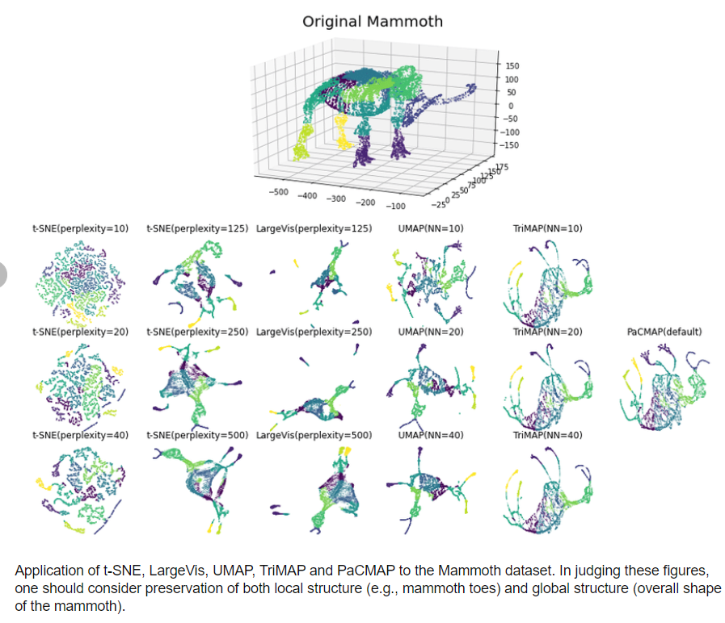
3. Dimensionality Reduction Techniques
Some good Techniques
Preserving Local structure
t-SNE: puts focus on nearest neighbors in the relative distance calculations.
UMAP: better preserves global structure, faster, but uses distances between nearest neighbors in the construction of the graph.
Preserving Global structure
PCA: the data -potentially correlated- is reframed into uncorrelated principal components captures the global structure of the data
TriMAP: triplets from nearest neighbors. Finding the next lower dimensional, which preserves reserving their distance ordering. Theoretically, both local and global structure.
[2] Wang, Yingfan & Huang, Haiyang & Rudin, Cynthia & Shaposhnik, Yaron. (2020). Understanding How Dimension Reduction Tools Work: An Empirical Approach to Deciphering t-SNE, UMAP, TriMAP, and PaCMAP for Data Visualization.
3. Dimensionality Reduction Techniques

Slide 11
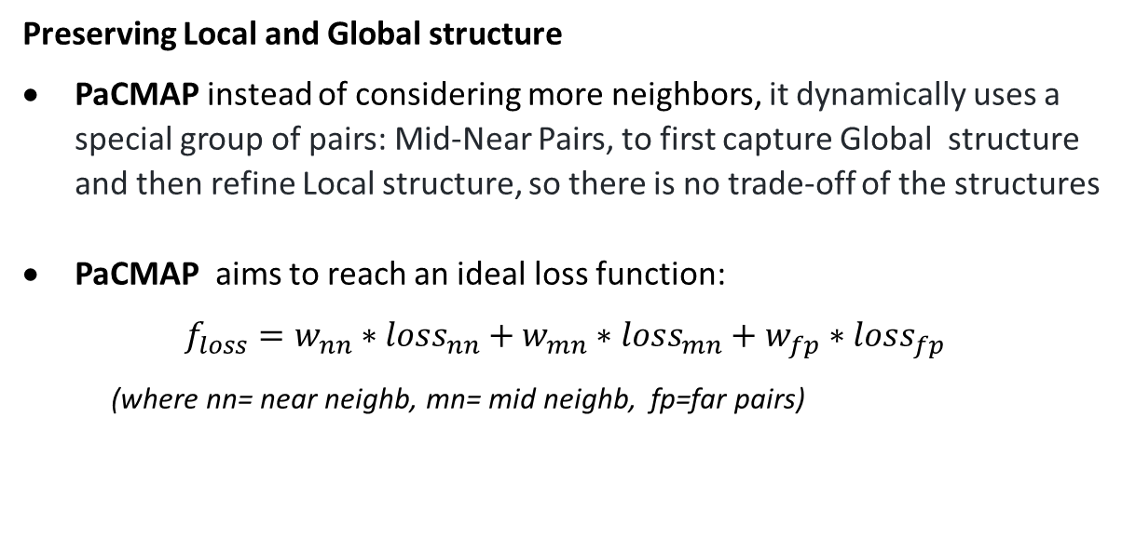
3. Dimensionality Reduction Techniques
Chosen Technique for the data set
Preserving Local and Global structure
PaCMAP instead of considering more neighbors, it dynamically uses a special group of pairs: Mid-Near Pairs, to first capture Global structure and then refine Local structure, so there is no trade-off of the structures
PaCMAP aims to reach an ideal loss function:
$$f_{loss}=w_{nn}∗{loss}_{nn}+w_{mn}∗{loss}_{mn}+w_{fp}∗{loss}_{fp}$$
(where nn= near neighb, mn= mid neighb, fp=far pairs)
[2] Wang, Yingfan & Huang, Haiyang & Rudin, Cynthia & Shaposhnik, Yaron. (2020). Understanding How Dimension Reduction Tools Work: An Empirical Approach to Deciphering t-SNE, UMAP, TriMAP, and PaCMAP for Data Visualization.
3. Dimensionality Reduction Techniques

Slide 12
4. Web app development framework
The front-end should be able to visualize every analyze method for each possible data specific parameter.
To avoid extensive loading time, the front-end solution has to access each value without loading the entire data every time.
A solution to this problem would be to first do every calculation and then save the output values to the disk memory (Python Pickle).
The user using the web app can then specify his desired output to the input elements given in the web app and does not have to deal with long interventions.
This takes a lot of weight and complexity from the front-end, which is why we chose Streamlit.
Streamlit is a nice way of presenting data, as the development is very simple and so the functionality.
Since the complexity is kept low by just loading the value in to the frame, simplicity is not a problem
4. Web app development framework

Slide 13

4. Web app development framework
Choosing streamlit after comparing it to popular alternatives
Flask: Too unspecific
Plotly combined in a Webframe (JavaScript)
Not efficient
Streamlit: Perfect solution, specified for Data Analysis and Visualization
4. Web app development framework

Slide 14
Outlook
This dataset can now be analyzed with different Machine Learning tools in Python
Dimensionality Reduction is a helpful step in data visualization
The final presentation of results is enabled within a Streamlit web app
Outlook

Slide 15
Thank you!

