Slide 1

Data Challenges Task 5: Imbalanced Learning Group 8
Aline Ochs 7549450
Jakob Vanek 5879817 Philipp Wörner 6375519 Tobias Ettling 6753746

Slide 2
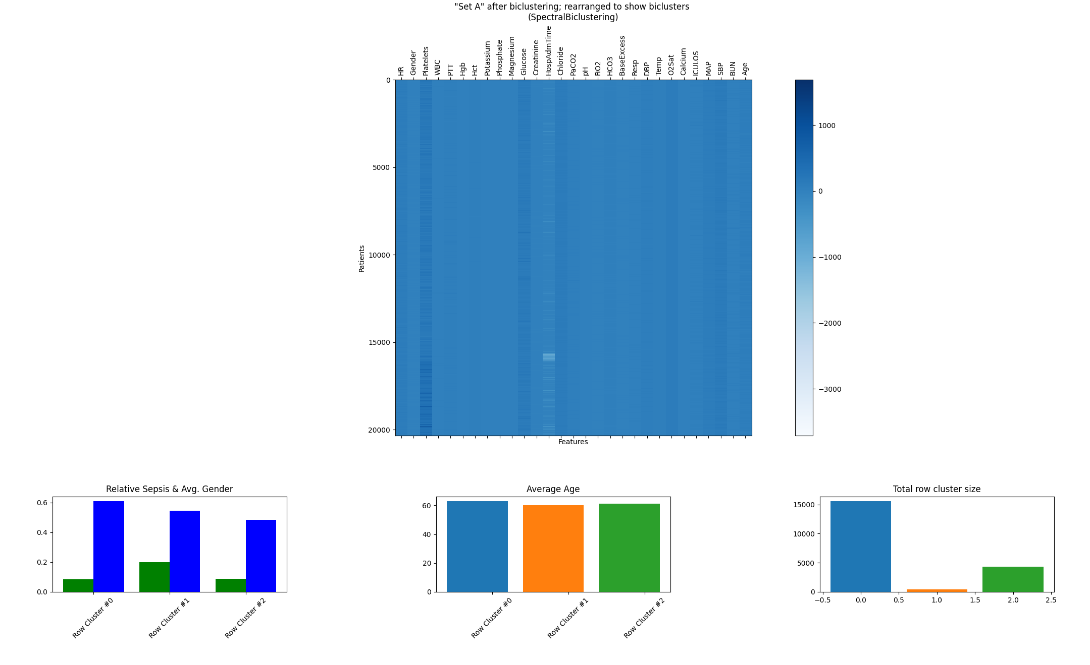
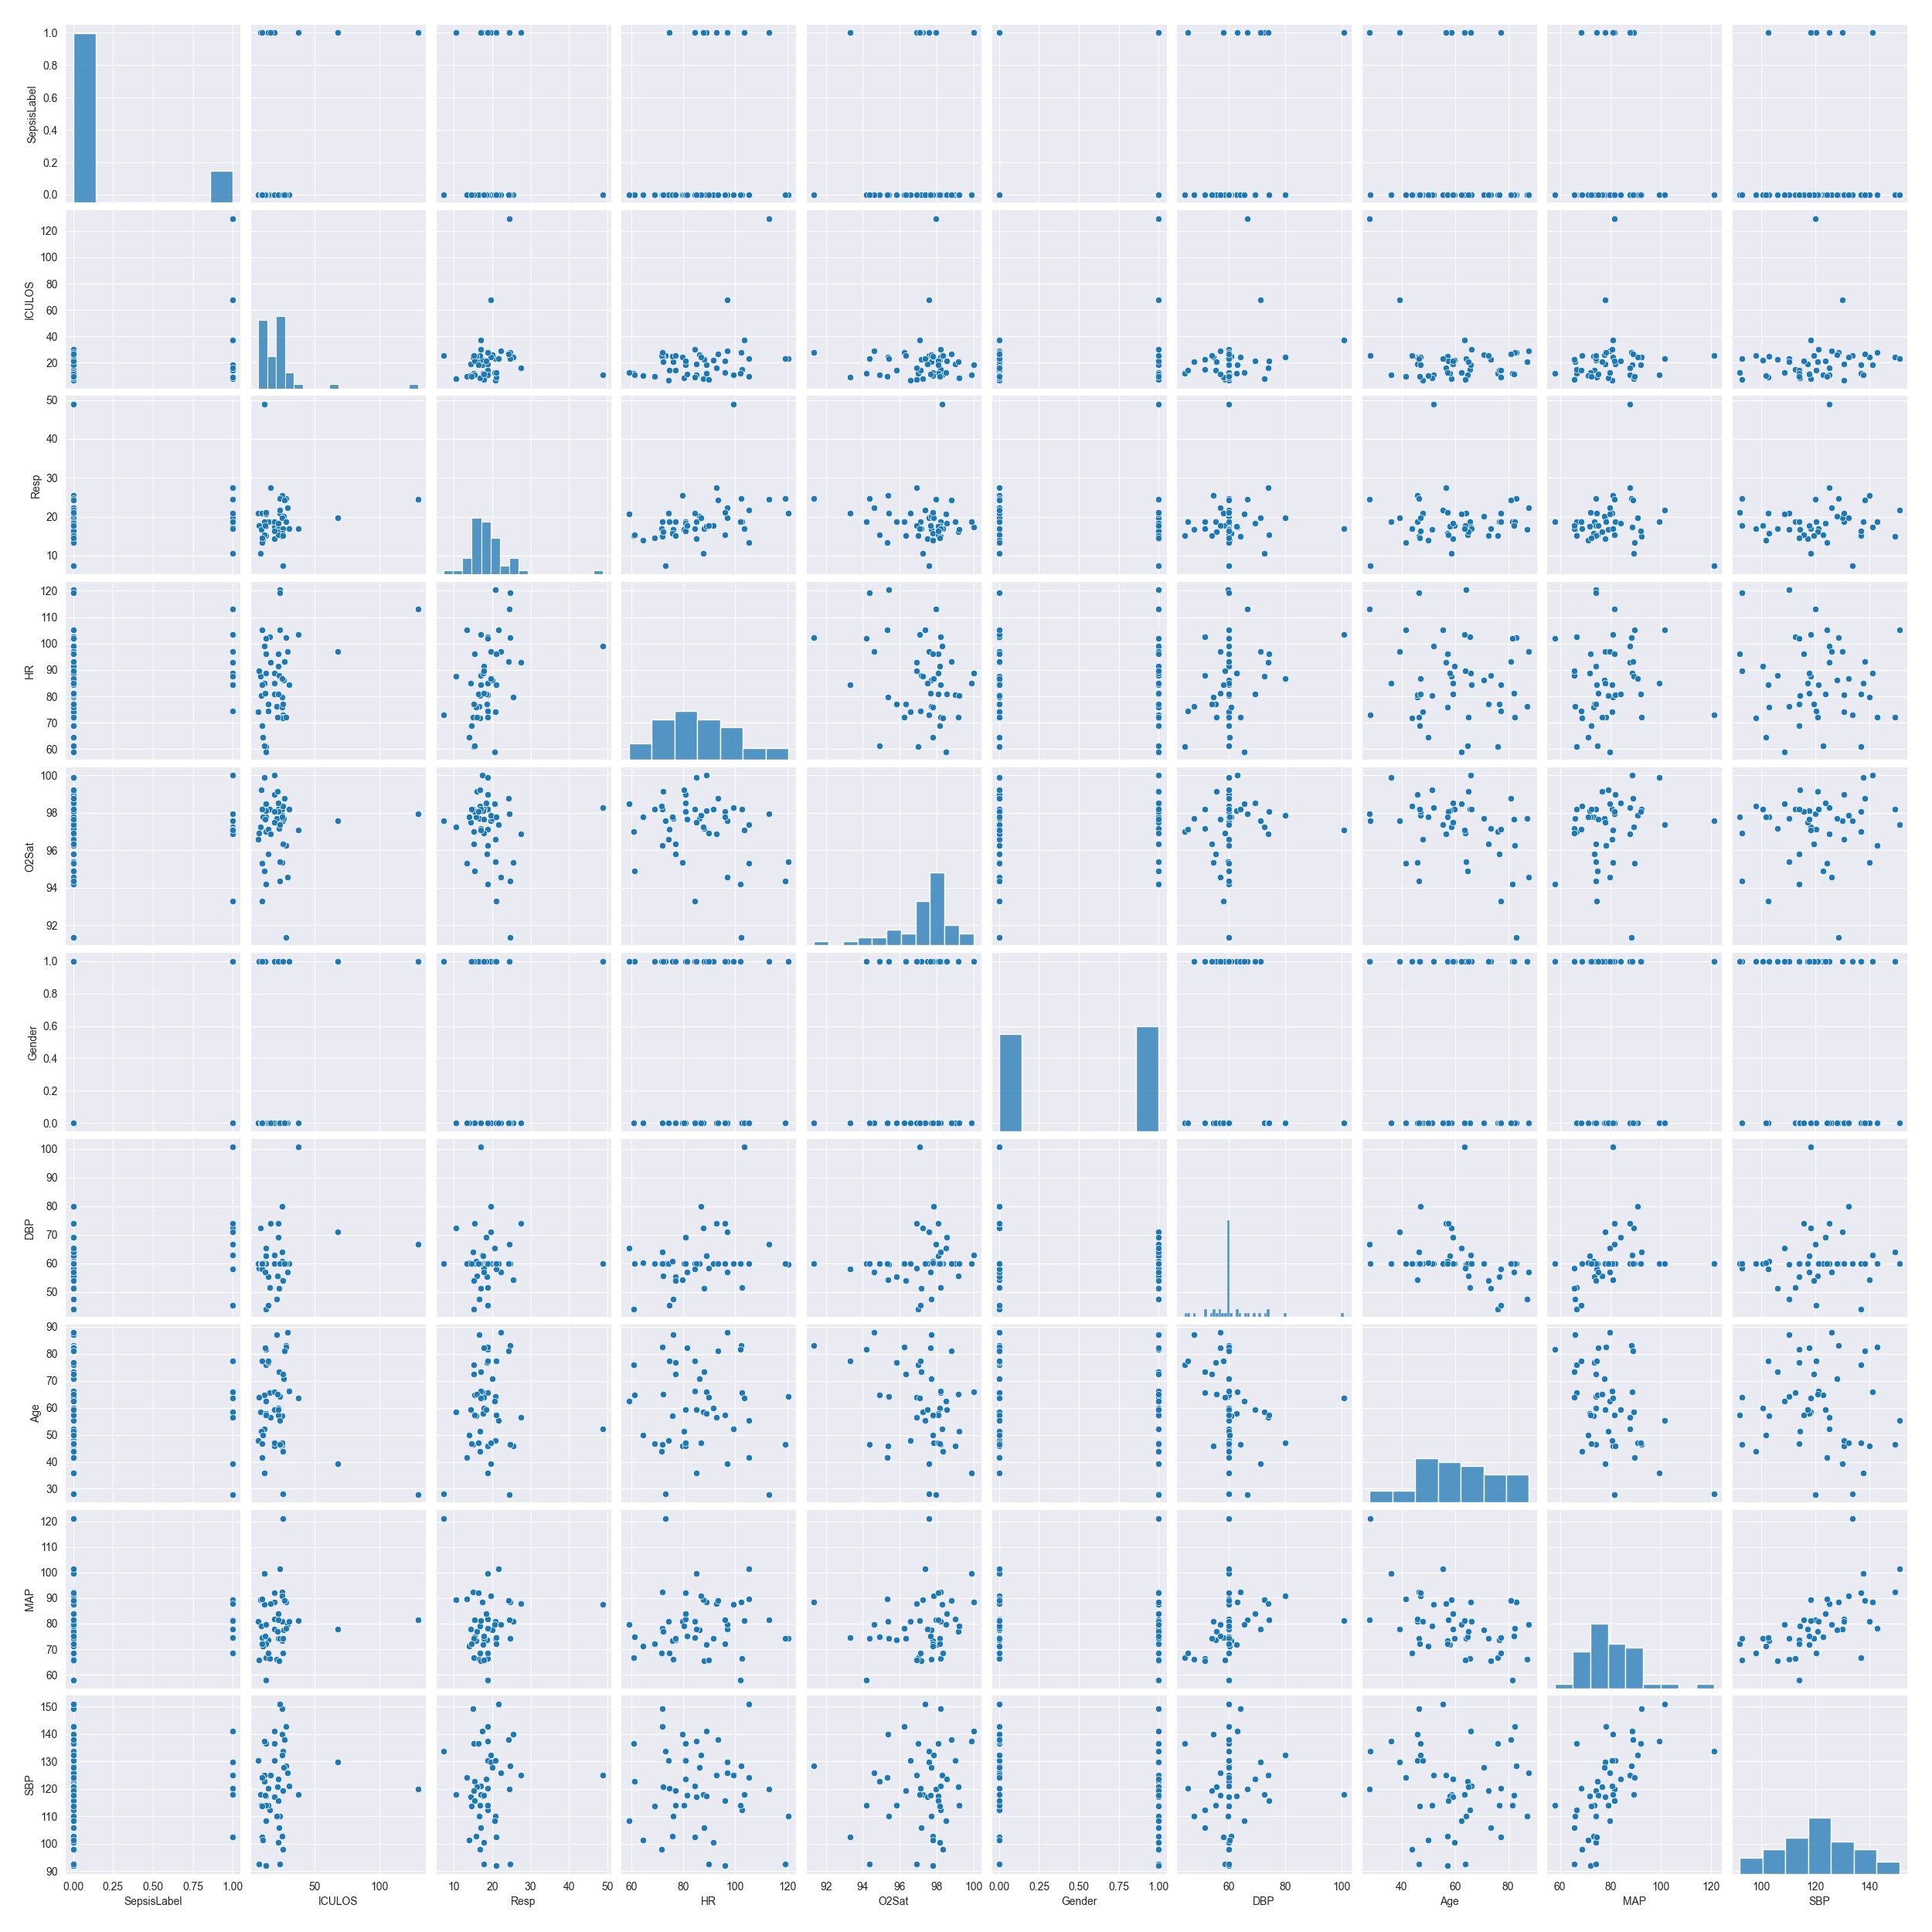
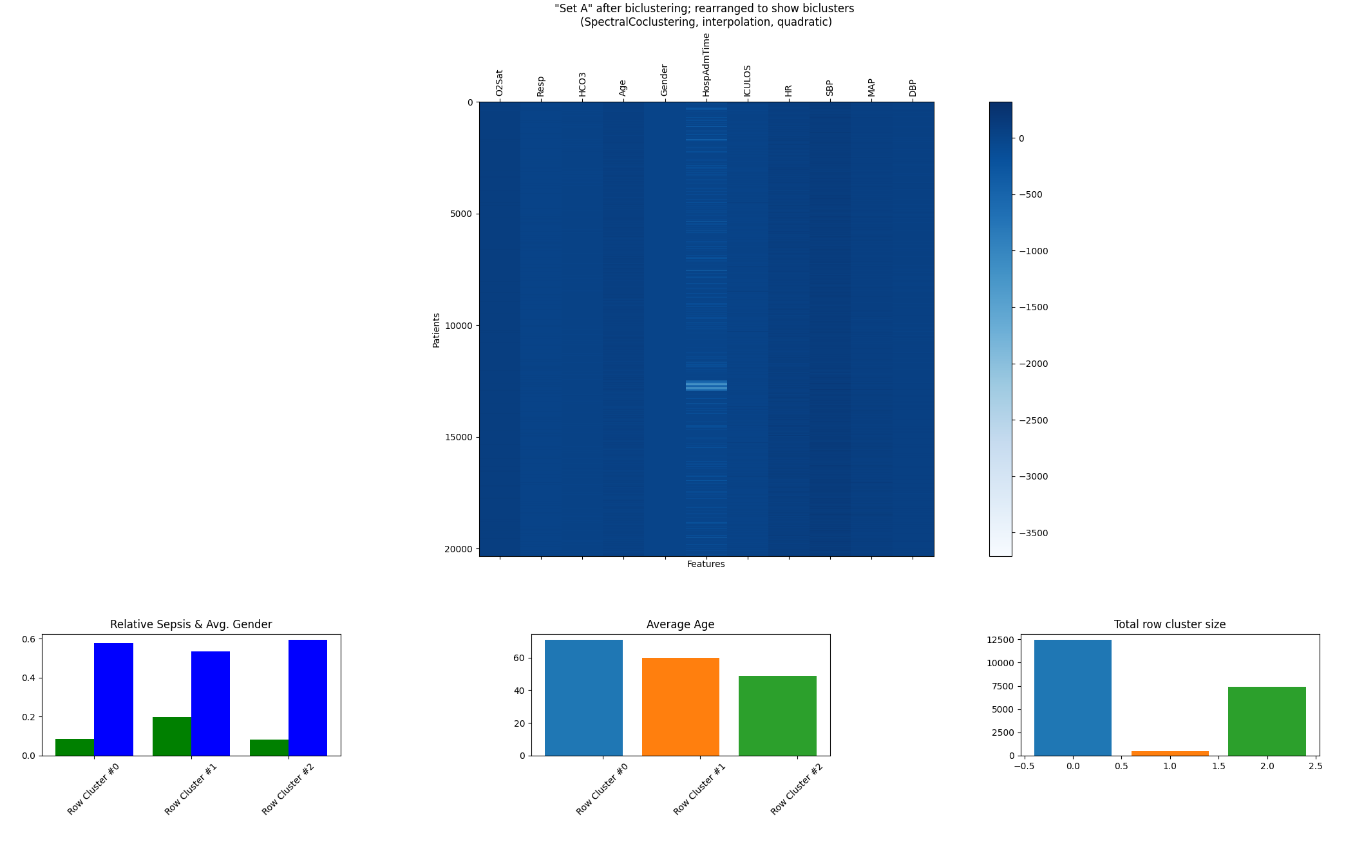
Recap of Last Presentation
Spectral-Bi & Co-Clustering
Subspace Clustering (Clique)
Das hier diesmal weglassen, weil sehr viel Inhalt beim Rest

Slide 3
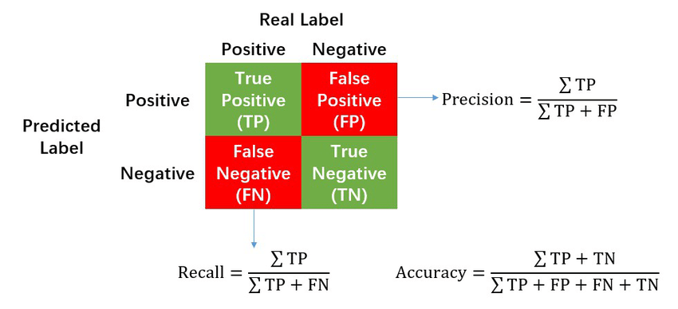
Task 5.1 – a) Accuracy Measures
Wie wird F1-Measure berechnet?
Ist die AUC-ROC Kurve hierfür sinnvoll?
In our case it is important to „catch“ every potential Sepsis case
→ Recall seems more important than the Precision
In the following discussion we will mainly focus on Accuracy ?
Source of image??

Slide 4
Task 5.1 – a) Classification with NeuralNetwork
Tobi hast du da was?

Slide 5
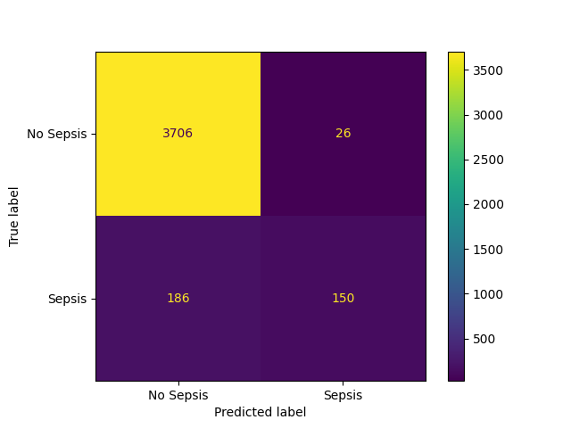
Task 5.1 – a) Classification with Decision Tree
Confusion Matrix:
Accuracy Measures (Classification Report)
Classification Report for complete (imbalanced) dataset:
precision recall f1-score support
0 0.95 0.99 0.97 3732
1 0.85 0.45 0.59 336
accuracy 0.95 4068
macro avg 0.90 0.72 0.78 4068
weighted avg 0.94 0.95 0.94 4068
→ Als Tabelle ☺
Implementation:
We used the standard Python Package sklearn
Total Accuracy seems ok, but very bad Recall (and Prediction) rate for Sepsis-Cases

Slide 6
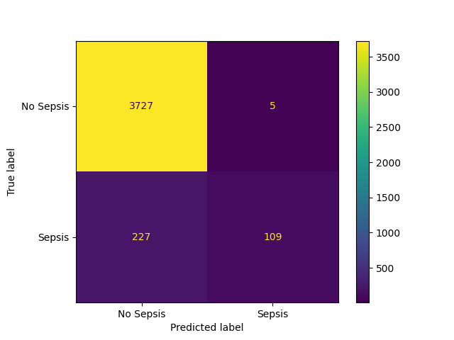
Task 5.1 – a) Classification with Random Forest
Confusion Matrix:
Accuracy Measures (Classification Report)
Classification Report for complete (imbalanced) dataset:
precision recall f1-score support
0 0.94 1.00 0.97 3732
1 0.96 0.32 0.48 336
accuracy 0.94 4068
macro avg 0.95 0.66 0.73 4068
weighted avg 0.94 0.94 0.93 4068
→ Als Tabelle ☺
Implementation:
- We used the standard Python Package sklearn
- Further aspects?

Slide 7
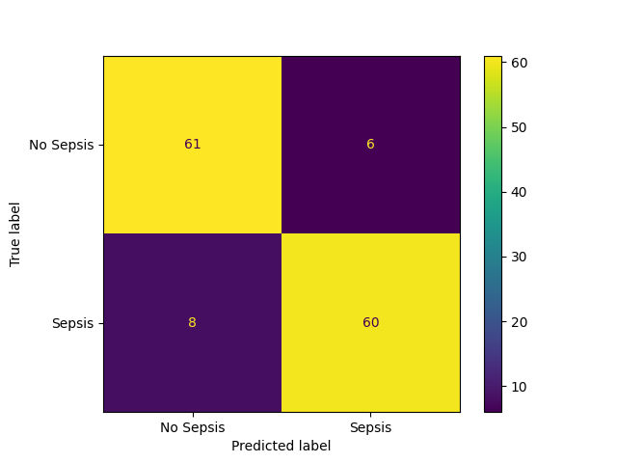
Task 5.1 – b) Undersampling with NearMiss (Decision Tree)
Confusion Matrix:
Accuracy Measures (Classification Report)
Classification Report for NearMiss Version: 2
precision recall f1-score support
0 0.88 0.91 0.90 67
1 0.91 0.88 0.90 68
accuracy 0.90 135
macro avg 0.90 0.90 0.90 135
weighted avg 0.90 0.90 0.90 135
→ Als Tabelle ☺
Implementation:
NearMiss offers 3 Versions from Python Package https://imbalanced-learn.org/stable/
Version 2 (distance to furtherest instance ?) had best results
accuracy is worse than total dataset, but recall is better for sepsis-cases
Very drastic reduction of dataset → Problem of overfitting
Jakob: Würde ich nicht nehmen

Slide 8
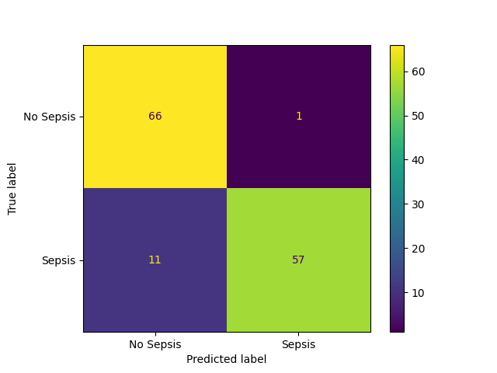
Task 5.1 – b) Undersampling with NearMiss (Random Forest)
Confusion Matrix:
Accuracy Measures (Classification Report)
Classification Report for NearMiss Version: 2
precision recall f1-score support
0 0.86 0.99 0.92 67
1 0.98 0.84 0.90 68
accuracy 0.91 135
macro avg 0.92 0.91 0.91 135
weighted avg 0.92 0.91 0.91 135
→ Als Tabelle ☺
Implementation:
…

Slide 9
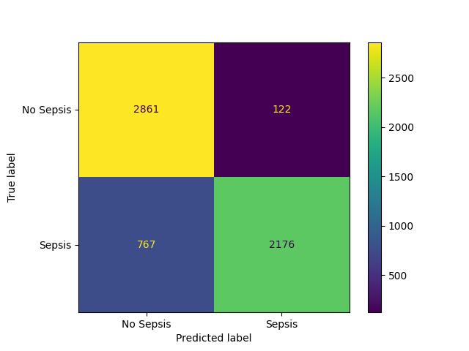
Task 5.1 – c) Oversampling with SMOTE (Decision Tree)
Confusion Matrix:
Accuracy Measures (Classification Report)
Classification Report for SMOTE oversampling
precision recall f1-score support
0 0.79 0.96 0.87 2983
1 0.95 0.74 0.83 2943
accuracy 0.85 5926
macro avg 0.87 0.85 0.85 5926
weighted avg 0.87 0.85 0.85 5926
→ Als Tabelle ☺
Implementation:
NearMiss offers 3 Versions
Version 2 (distance to furtherest instance ?) had best results
Very drastic reduction of dataset → Problem of overfitting
accuracy is worse than total dataset, recall is better for sepsis-cases, but not as good as Undersampling

Slide 10
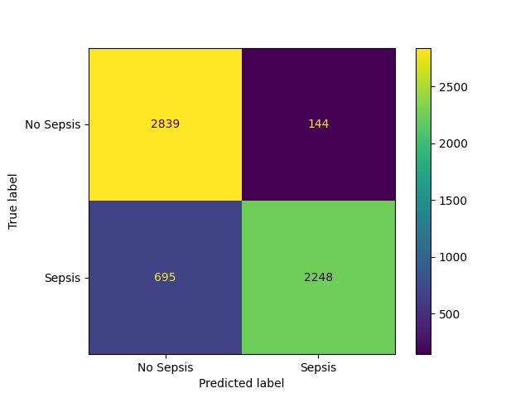
Task 5.1 – c) Oversampling with SMOTE (Random Forest)
Confusion Matrix:
Accuracy Measures (Classification Report)
Classification Report for SMOTE oversampling
precision recall f1-score support
0 0.80 0.95 0.87 2983
1 0.94 0.76 0.84 2943
accuracy 0.86 5926
macro avg 0.87 0.86 0.86 5926
weighted avg 0.87 0.86 0.86 5926
→ Als Tabelle ☺
Implementation:
…

Slide 11
Conclusion
Random Forest has better results than Decision Tree
Best result: RandomForest + Undersampling - But logically Oversampling seems better suited than Undersampling
In general imbalanced Methods are very helpful for this dataset

Slide 12
Next Possible Steps?
TimeSeries Classification
Preparation of final Presentation (Streamlit)
Starting with final report

Slide 13
Thank You!

