Slide 1

FLIGHT CANCELLATION ANALYSIS

Slide 2
Dataset
About Dataset
Context
The U.S. Department of Transportation's (DOT) Bureau of Transportation Statistics tracks the on-time performance of domestic flights operated by large air carriers. Summary information on the number of on-time, delayed, canceled, and diverted flights is published in DOT's monthly Air Travel Consumer Report and in this dataset of 2015 flight delays and cancellations. The data consisted on 3 csv files, flight.csv, airline.csv and airport.csv and used was the polars library for analysis of this data

Slide 3
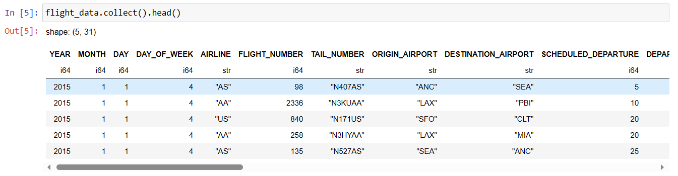
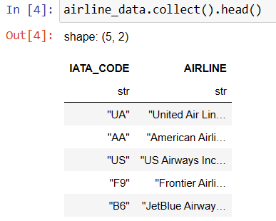
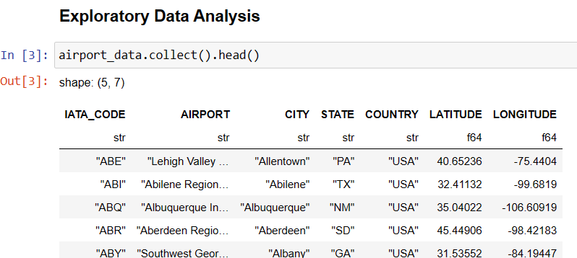
Flight consists of 31 columns and about 5million rows, airline consist of 2 columns and airport consist of 7 columns
Viewing Datasets

Slide 4
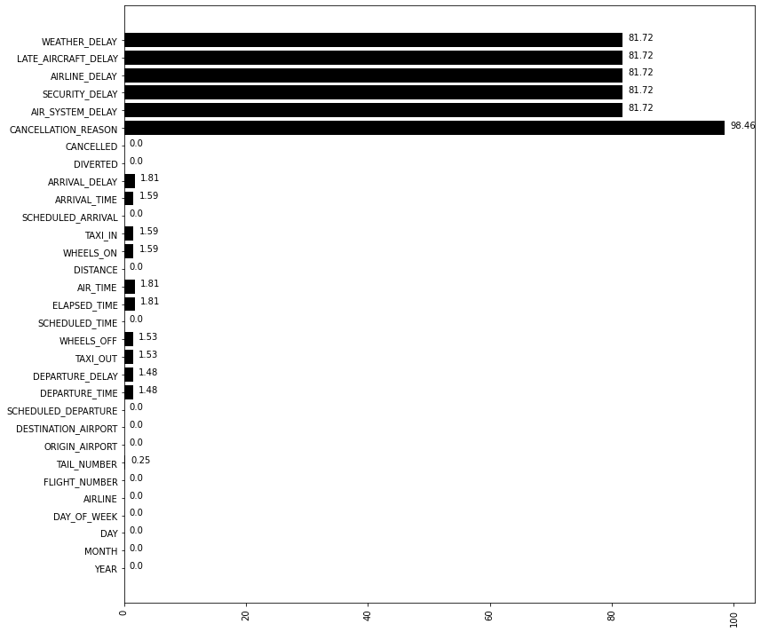
Missing Values in data
Missing values were not dropped as they were MAR and MNAR , missing values in columns like weather delay, late_aircraft delay, airline_delay, security_delay, air_system_delay were filled with 0.
Missing values in columns like Departure Time columns for example, were left as is cause it indicates the flight did not depart and was cancelled

Slide 5
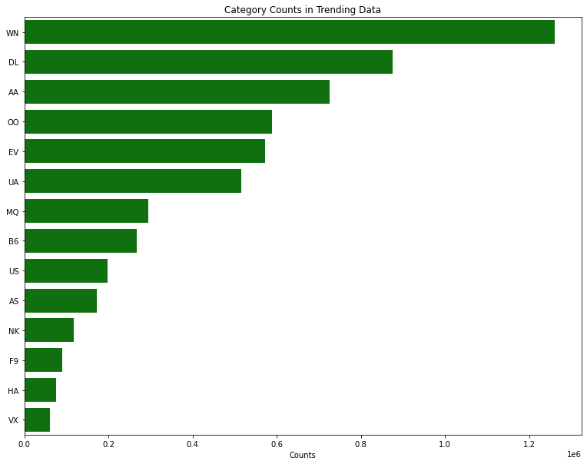
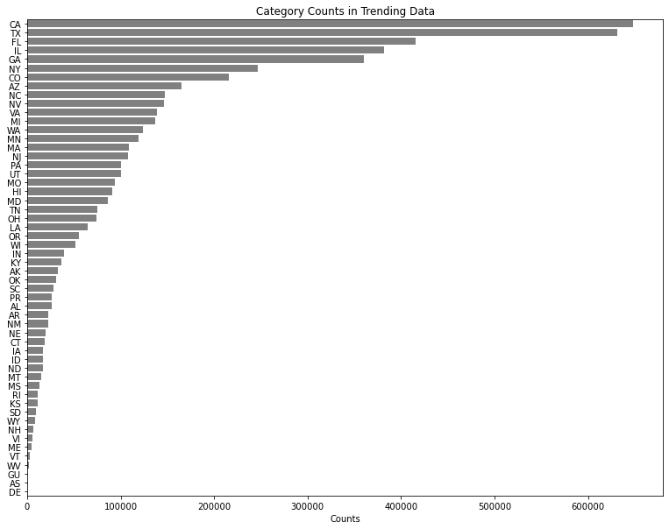
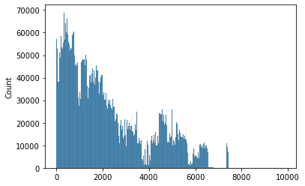
Univariate Analysis
Analysis such as statistical analysis by describe and other analysis by plots such as histogram plots were done on continuous columns and for categorical columns, countplots were done.

Slide 6
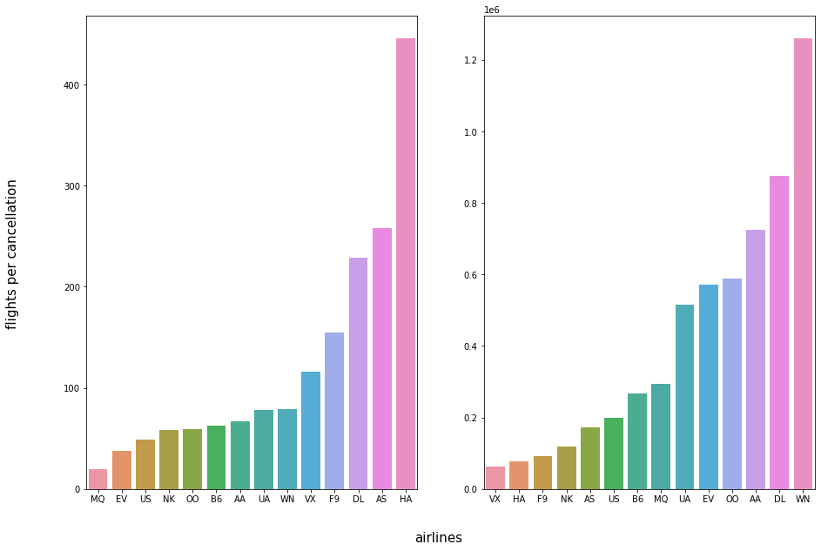
From analysis we can get insights that the Airline HA produces the best number of flights per cancellation, and we could advice people to board more HA airlines to avoid cancelled flights
Bivariate Analysis

Slide 7
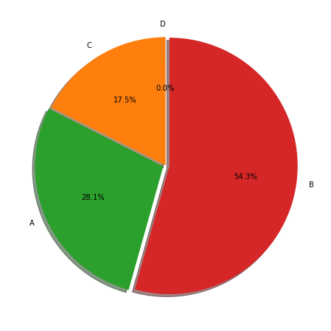
Reason B seems to be the most reason for cancelled flights, whatever the reason, it is important the airline operators work on it

Slide 8
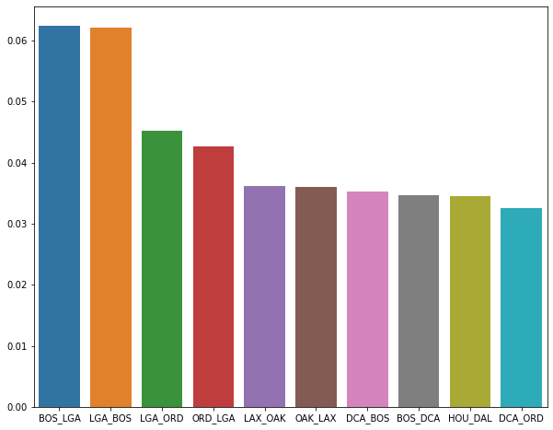
passengers who require flights in routes with high probability of cancellation might want to take flights going through other Routes

Slide 9
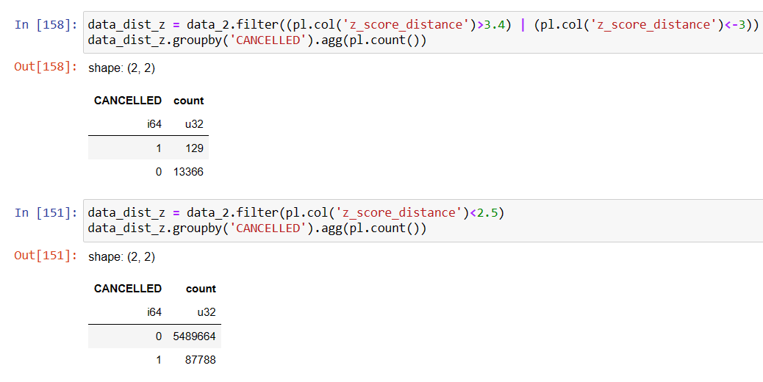
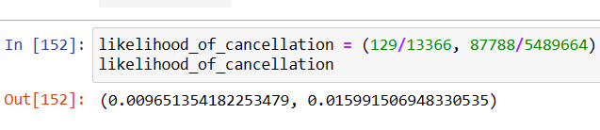
shorter trips have a greater probability of cancellation, this could be due to the fact they might not be generating enough revenue and greater traffic for shorter trips

Slide 10
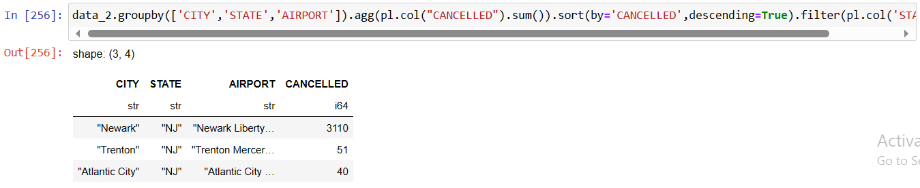
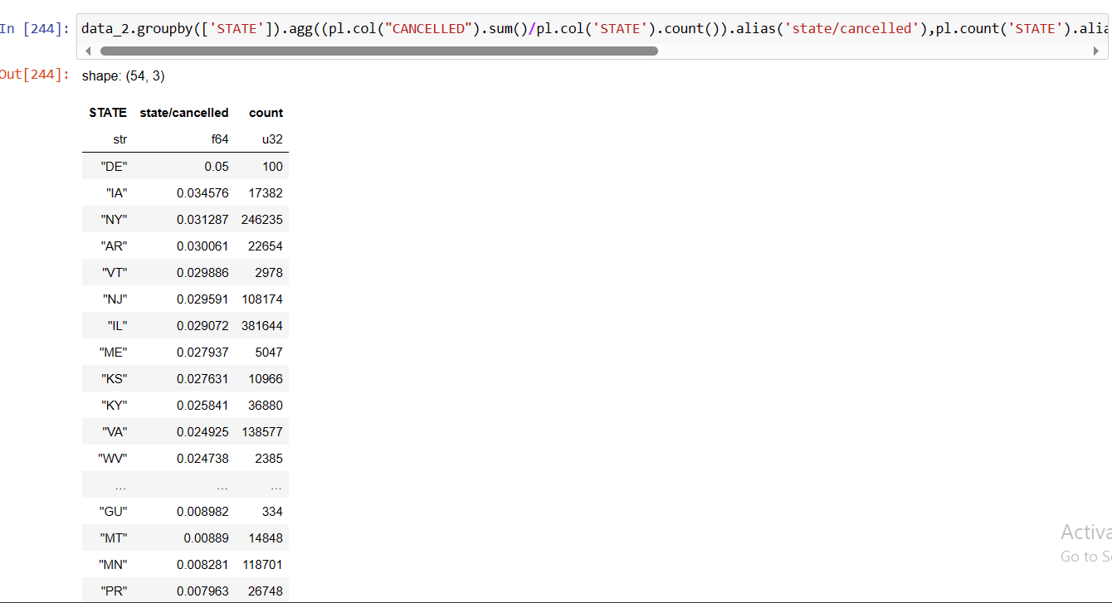
From analysis it was discovered certain states that had a higher probability of cancellation, had much traffic and not that much airports

Slide 11
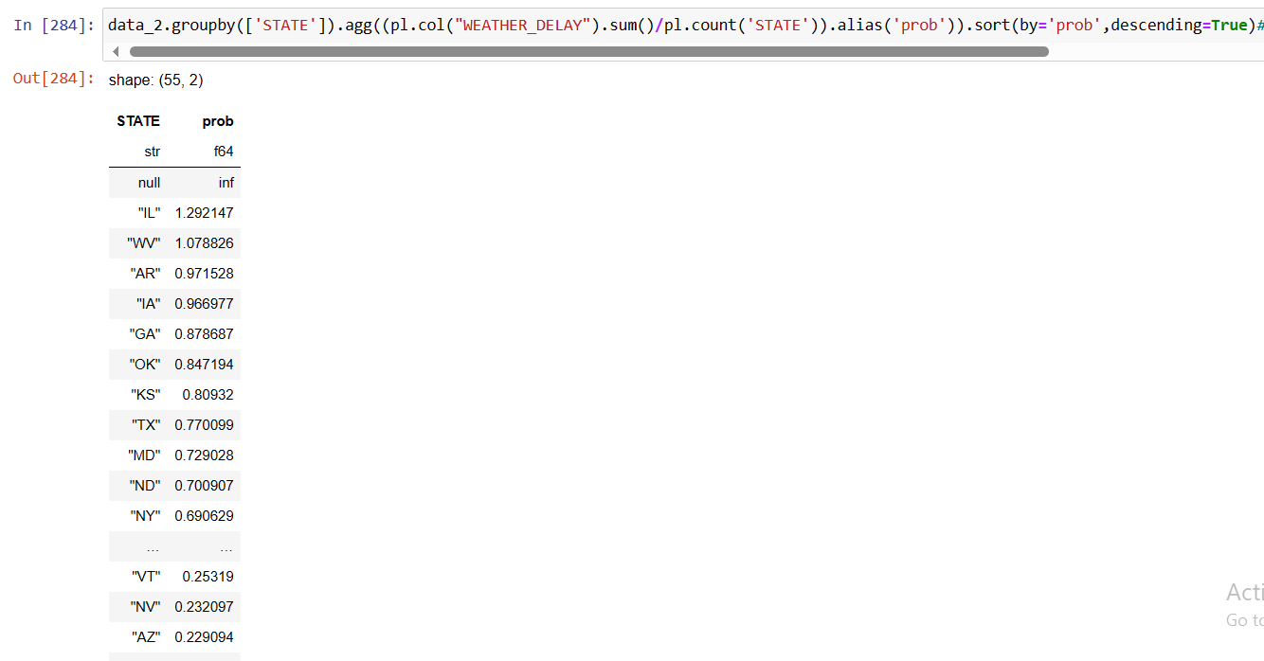
Weather delay was also found to be a causative factor in states with high prob of cancellation

Slide 12
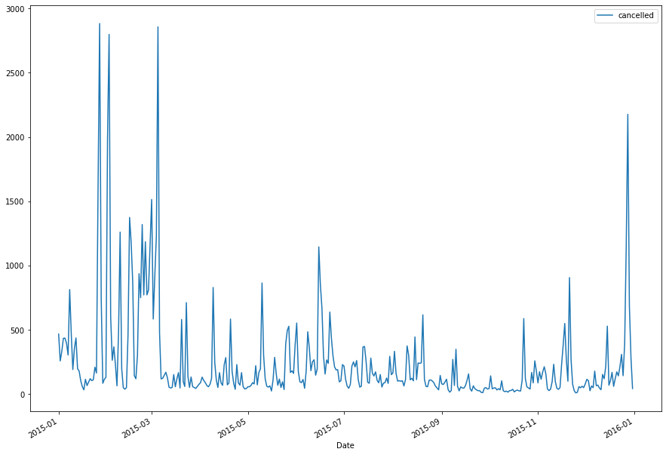
Cancellation occurrence's is shown to go up during the first quarter of the year, January to march, we can also link this to the fact that weather as found before was a factor in cancellation amongst other things
Time Series Analysis

Slide 13
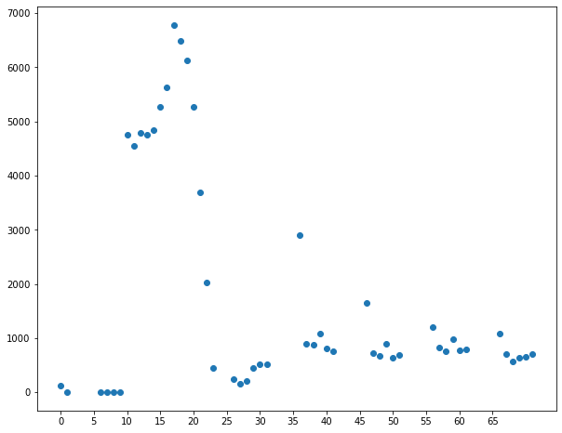
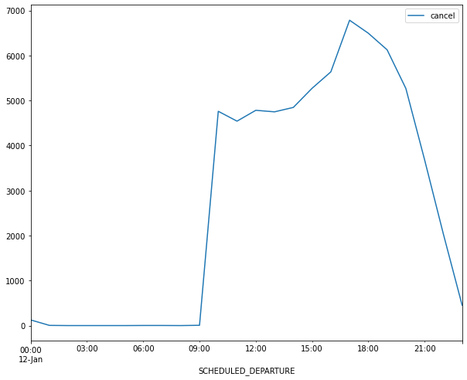
Number of cancelled flights is seen to go up at times when flights are scheduled from late afternoons to the evenings (3pm – 10pm), to reduce disappointments persons should avoid airlines that schedule flights regularly within these times

Slide 14
Feature Engineering
Features such as Routes, Speed, date, z_score etc were created

