Slide 1
Flights data
This presentation covers insights from the dataset

Slide 2
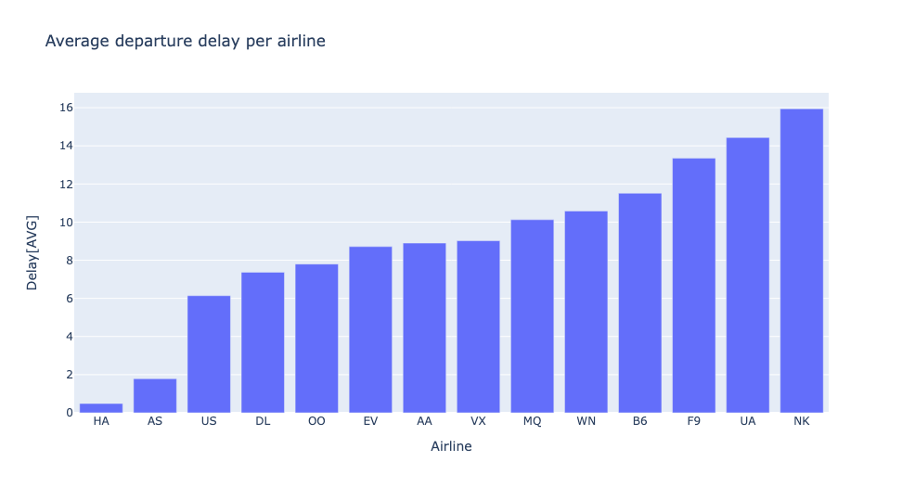
Airlines Delays
This aspect covers the average departure delay per airline in the United States of America. According to the graph we derive that the “NK” airline has an average of 16 minutes departure delay

Slide 3
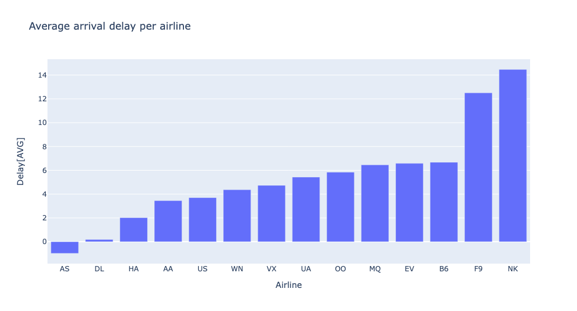
This aspect covers the average departure delay per airline in the United States of America. According to the graph we derive that the “NK” airline has an average of 14 minutes arrival delay

Slide 4
From the graphs above we can prove that about 82.85% of flights in the United States of America departs early with an average of 16 minutes delay on departure.
About 81.3% of the flights from the united States of America arrive early with an average of 14 minutes delay on estimated arrival time.

Slide 5
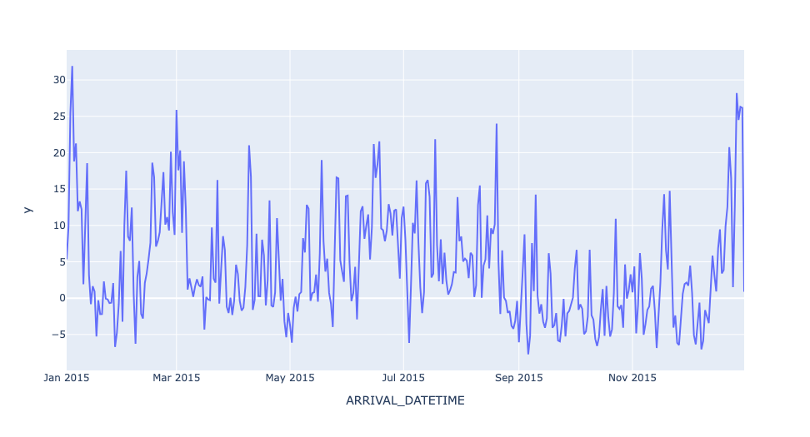
Average arrival delay overtime
This represents the average arrival delay of flights over the year 2015

Slide 6
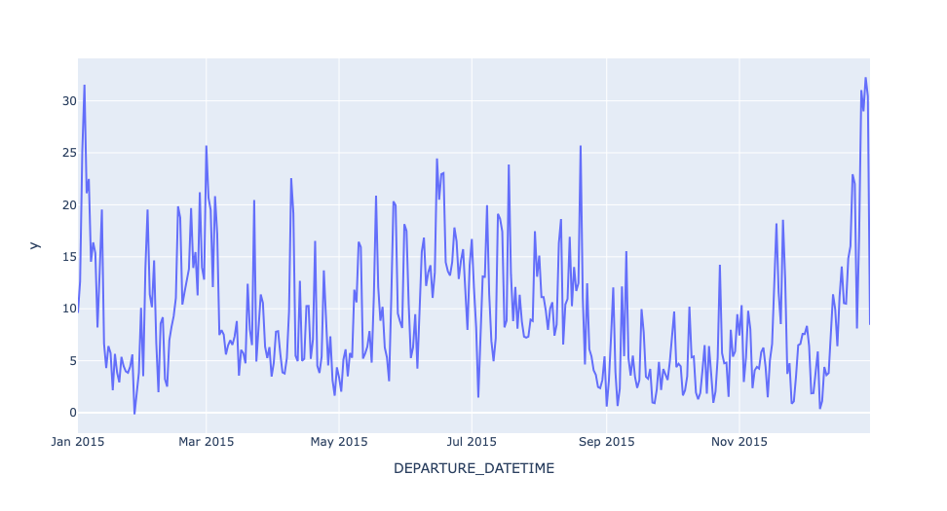
Average departure delay overtime
This represents the average departure delay experienced over the year 2015

Slide 7
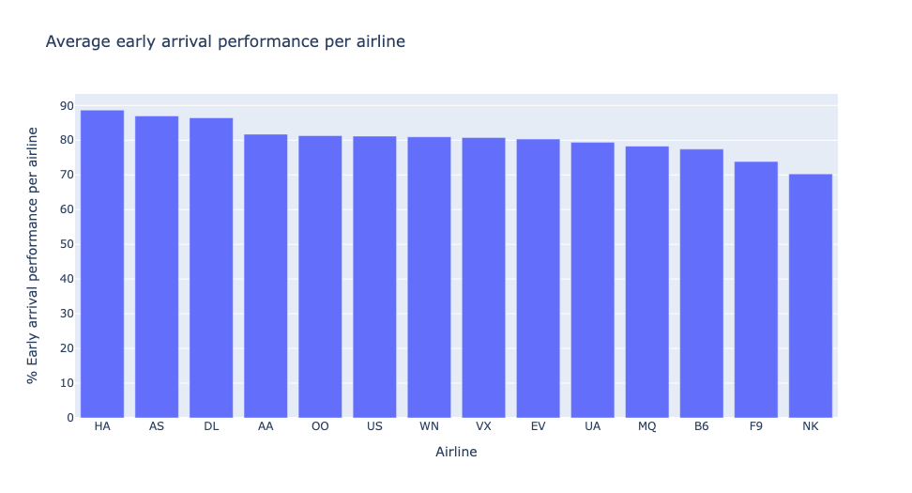
Airline performance
This graph represents the average performance of airlines in the United States of America based on the early arrival statistics represented in percentage

Slide 8
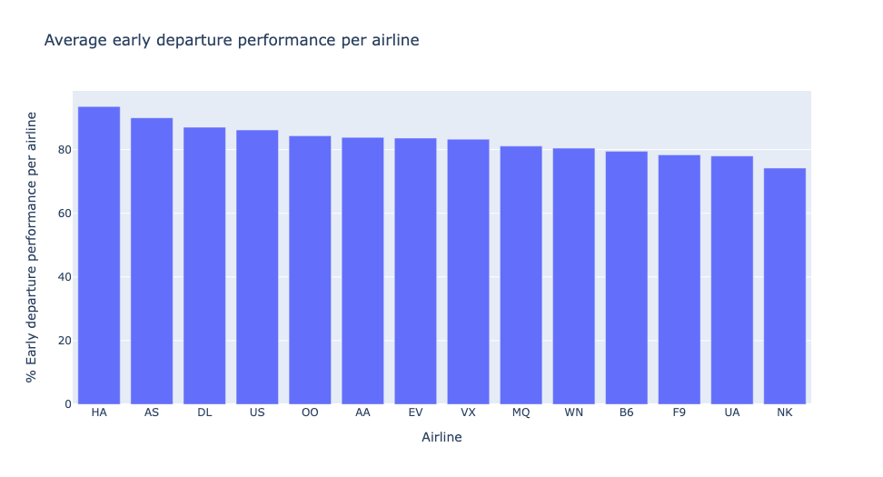
This graph represents the average performance of the airline in the United States of America based on the early departure statistics represented in percentages

Slide 9
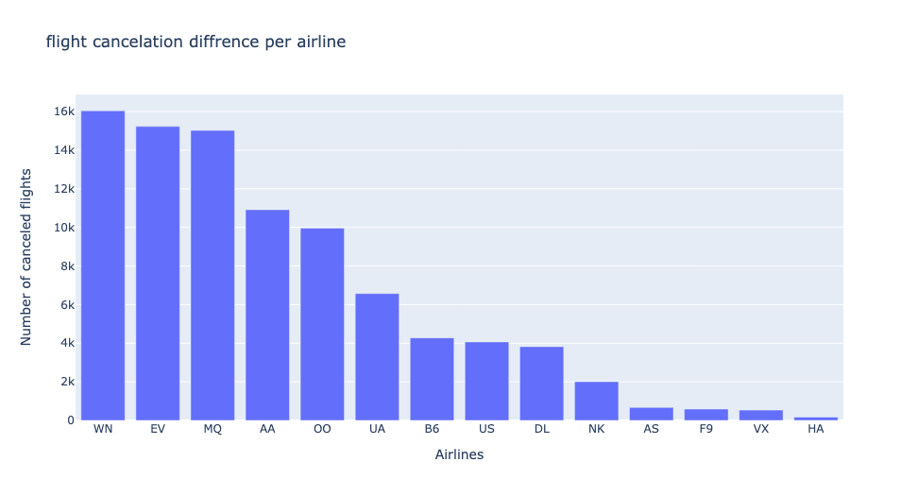
Flight cancelled
This represents the total number of flights cancelled by an airline in 2015 in the United States of America

Slide 10
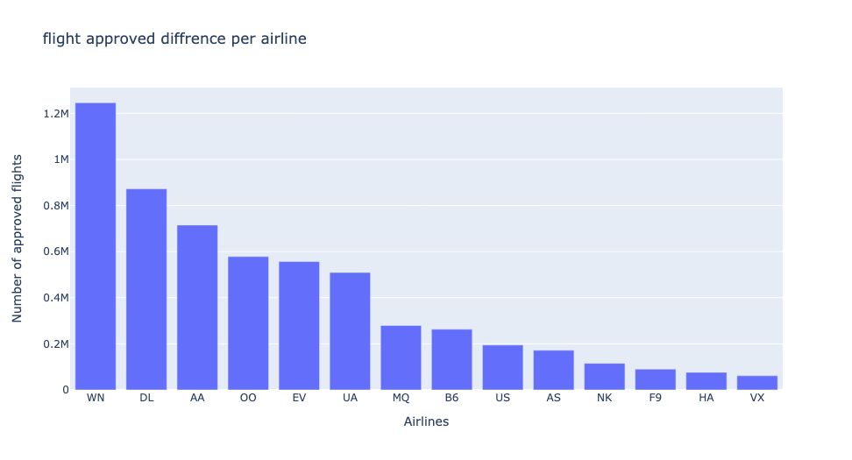
Flights approved
This graph represents the total number of flights approved in the United States of America in 2015

Slide 11
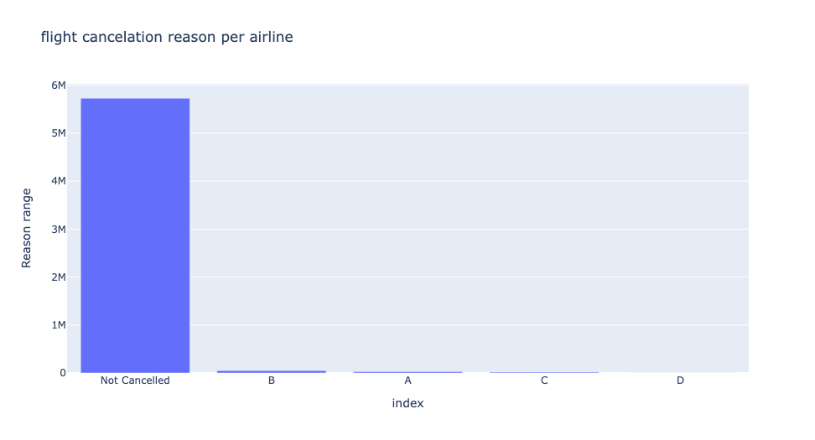
Flight cancellation reason
According to the representation below the major reason for most of the cancelled flights is due to the weather condition.

Slide 12
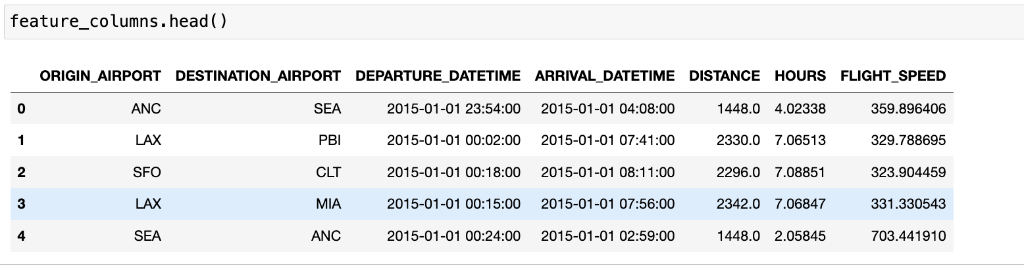
Feature Engineering
For this aspect of the dataset i created a new feature from the existing dataset which came about to form the flight speed column

