Slide 1
Sustainability Festival Survey
What 336 festival visitors told us, and what to do next
Two festivals (Campus A and Campus B) · 273 students · 63 faculty and staff
Notes:
Purpose: share the main findings from the two festival surveys and recommend three actions. Staff and students answered different questions, so findings are reported for each group separately.

Slide 2
Awareness is the gap, not interest
60%
7 in 10
76%
of staff have not heard of the Reuse Teams group (37 of 62)
students asking for bottle stations or clothing swaps already recognize them as existing programs
of students want at least one repair or sharing program that is not on today's list
Interest is high: 68% of students want to learn more. It does not depend on campus or on what they already know.
2
Notes:
Three headline numbers. (1) Staff: 37 of 62 not aware of the Reuse Teams group. (2) Students: of those wanting bottle filling stations, 72% already recognize them; for clothing swaps 67%. (3) Students: 204 of 270 chose at least one of fix-it clinics, sharing shelf, digital sharing platform (95% range 70-80%). Caveat: festival visitors chose to answer; students had a stamp-card incentive.

Slide 3
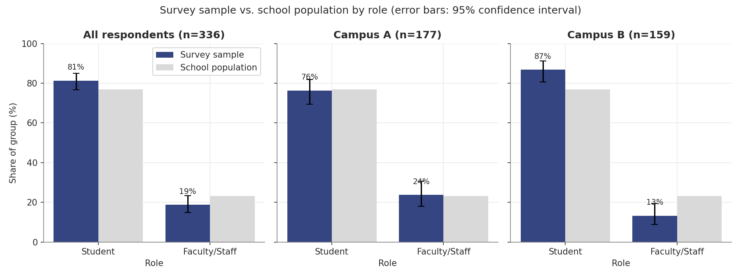
Who answered: mostly students
Staff are 19% of respondents but 23% of the school. The gap comes from Campus B: 21 staff, 13% of that sample.
Visitors chose to take part, and students earned a stamp toward a free water bottle. Results describe engaged festival-goers.
3
Notes:
Overall role mix: 273 students (81.2%) and 63 staff (18.8%) against a school split of 76.8% / 23.2% (borderline, p = 0.053). Campus A matches the school almost exactly; Campus B over-represents students (86.8%, p = 0.003). Source: outputs/03_representativeness.png

Slide 4
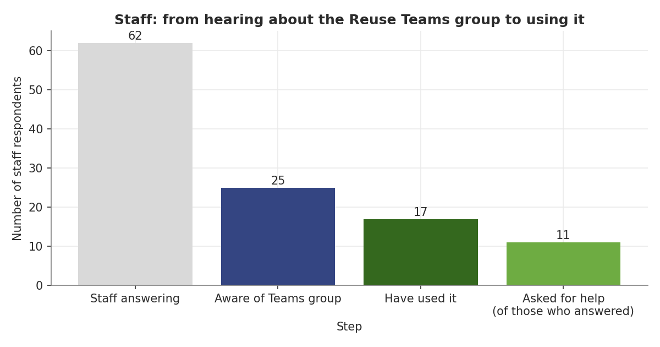
Staff don't know the Reuse Teams group
60%
have not heard of the group (37 of 62)
1 in 3
of those who know it have never used it (8 of 25)
6 of 11
staff who asked for help had never heard of the group
4
Notes:
The group exists to solve the barrier staff name most: 56% (34 of 61) say lack of awareness of reuse/sharing options; 36% (22) say it is hard to find items or who has them. 11 of the 21 who answered the help question asked for help or more information. Caveat: only 62 staff (21 at Campus B), margins of about +/-12 points; 'unsure' answers were common. Source: outputs/06_staff_funnel.png

Slide 5
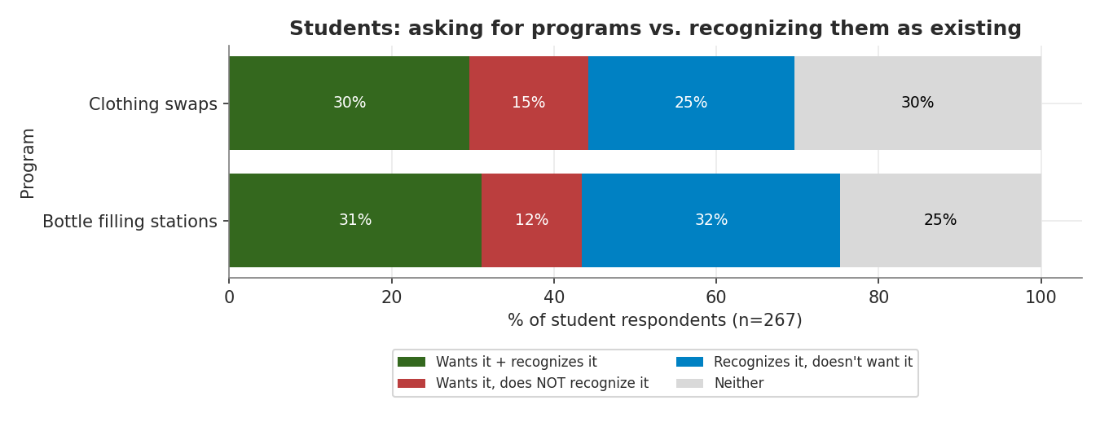
Students ask for what already exists
72% of students who want bottle stations and 67% who want clothing swaps already recognize them. The ask is likely for more locations or better visibility, not new programs.
5
Notes:
Paired test within the same students: wanting vs recognizing differs for bottle stations (p < 0.001) and clothing swaps (p = 0.007). The top request, reusable containers (58%), also overlaps: 83% of those asking recognize the reuse program, assuming that program covers containers (to confirm with the office). Caveat: the survey cannot separate 'wants more of it' from 'did not know it exists'. Source: outputs/06_student_want_vs_recognized.png

Slide 6
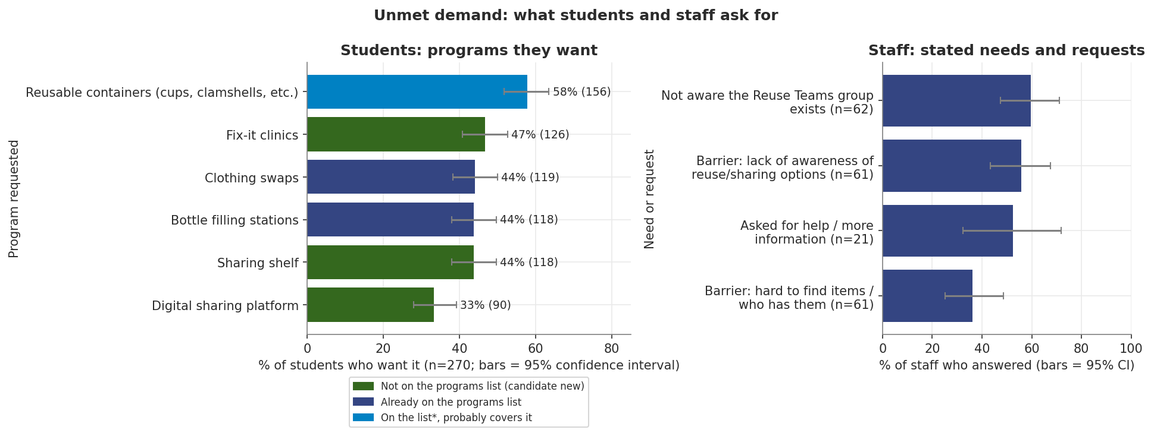
Three new ideas have real demand
76% of students (204 of 270) want at least one of fix-it clinics, a sharing shelf, or a digital sharing platform, which were not on the existing-programs list. Confirm none already exists before acting.
6
Notes:
34% of students want two or more of the three; 39 want all three. Same pattern at both campuses (72% at A, 79% at B; not significantly different). Staff say it is hard to find who has items (36%) and a third of students want a digital platform: a possible single tool for both groups (hypothesis). Caveat: ticking 'want' is cheap, so this is interest, not expected use. Source: outputs/09_unmet_demand.png

Slide 7
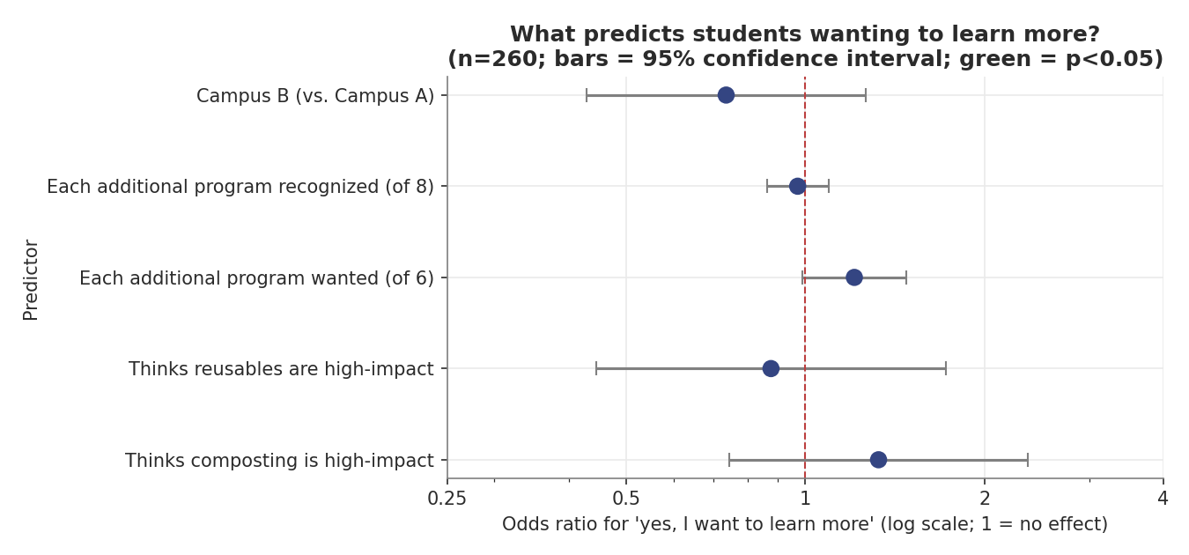
Interest is broad, not predictable
68%
of students want to learn more
No factor we tested predicts who says yes
Interested students know no more programs than others (4.1 vs 4.0 of 8)
The two festivals look alike: no campus difference held up after correction
7
Notes:
Logistic regression on 260 students (177 yes, 83 no) with five predictors. The model is no better than always guessing 'yes' (68% vs 68%; AUC 0.60). 23 campus comparisons were run; none survived correction for multiple testing. Implication: offer information to everyone instead of targeting a student type. Caveat: 'no effect found' can hide small effects. Source: outputs/07_logistic_odds_ratios.png, outputs/05_effect_sizes.png

Slide 8
Recommended next steps
1
2
3
Reach the staff who asked
Make existing programs visible
Pilot one new idea
Contact the 11 staff who asked for help. Promote the Reuse Teams group in department channels.
Add signs with locations and hours for bottle filling stations, clothing swaps and the reuse program.
Run a sharing shelf or one fix-it clinic day and count who shows up. Check first that neither already exists.
8
Notes:
Each action maps to a finding: (1) finding 1, staff awareness; (2) finding 3, visibility of existing programs; (3) finding 2, new-program demand. Track awareness and program use next year so the effect can be measured.

Slide 9
Limits and next year's survey
What to keep in mind
Next year
Visitors chose to answer, and students had a stamp-card incentive
Staff and students answered different questions, so they can't be compared
Only 62 staff, and 21 at Campus B
No questions on what people actually do, only on awareness and interest
Ask staff and students the same core questions
Add behavior questions, such as how often people use reusables
For each program ask: never heard of it, heard of it, or used it
Record the campus directly and collect emails in a separate form
9
Notes:
Full list of 14 limitations and the detailed suggestions are in outputs/11_limitations_and_next_year.md. Also: 28% of students ticked all four 'high-impact' options, so that question is a weak measure; text answers were mostly one word.

