Slide 1
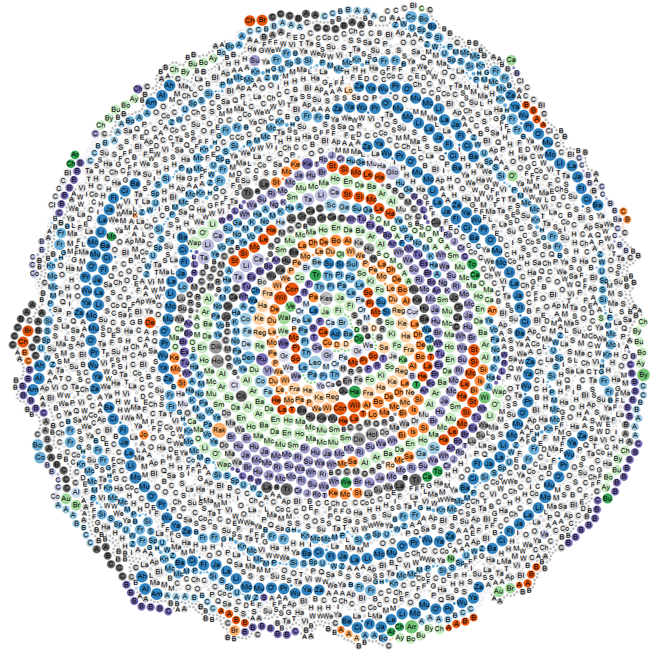
CS591 L1
Yihong Guo
Problems during the project:
1. Before this course, I was mostly on SQL database which very different form MongoDB. It takes me time to get rid of the idea of tables and SQL command.
2. Reading and reconstruct json file can be hard when there are too many fields for each item.
Learnings during the project:
1. Understand how MongoDB works and the differences between MongoDB and SQL.
2. Get used to D3 library and understand how JavaScript works with html.
Original structure:
"total_earnings" : "100381.19",
"zip" : "02132",
"detail" : "0.00",
"injured" : "0.00",
"title" : "Supvising Claims Agent (Asd)",
"other" : "1842.87",
"regular" : "98538.32",
"name" : "Adario,Anthony J",
"retro" : "0.00",
"department_name" : "ASD Human Resources",
"overtime" : "0.00",
"quinn" : "0.00"
Output structure: (Sample)
"name" : "job&earn2014",
"children" : [ {
"name" : "ASD Human Resources",
"children" : [ {
"name" : "Supvising Claims Agent (Asd)",
"children" : [ {
"name" : "Adario,Anthony J", "total_earnings" : "100381.19" } ] }
Datasets used: Employee Earnings Report 2012 Employee Earnings Report 2013 Employee Earnings Report 2014
Description:
In this project I'm focused on individual earning reports in three continuous years. By compare the total earnings each year and the number of person who has increasing total earnings in three years, we can find out the percentage of people who earns more and more each year and the tile and departments of these peoples.
To finish this, I go through three collections and looking for data that has same name. Than I merge all three collections and put total earnings of three years in a same collection.
For the second part, I go through all three collections and looks for people who have increasing total earning each year and only keep these data.
Then I calculate the percentage of people who have increasing earnings each year with the number of items of first script and the number of items of second script.
By running the script of combing datasets, I got result: “the percentage of people that have increasing earnings each year is 77.13%”
This was my original plan of operation on datasets. As I move into virtualization, virtualizing the statistics of percentage and people with continuous increasing earnings becomes not very interesting.
Then I come with an idea showing earnings of people in different department with each title.
In virtualization, circles of same color represent people of same title in each department and the size of circle represent the amount of earning of that person.
From the graph we can see department with most people are the gray circle which belong to “Boston City Council” and the tile is “Secretary”. However the size of gray circles are comparably small which means their earnings are not much.
The orange circles in the center which belong to “ASD Office of Budget Mangmnt” tends to have more earnings.

