Slide 1
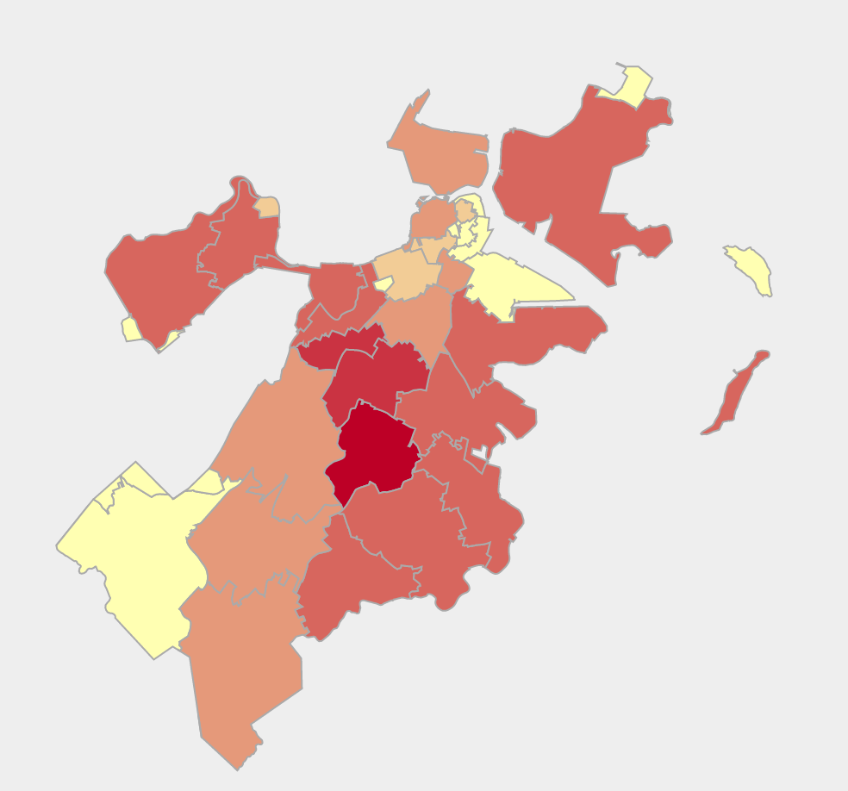
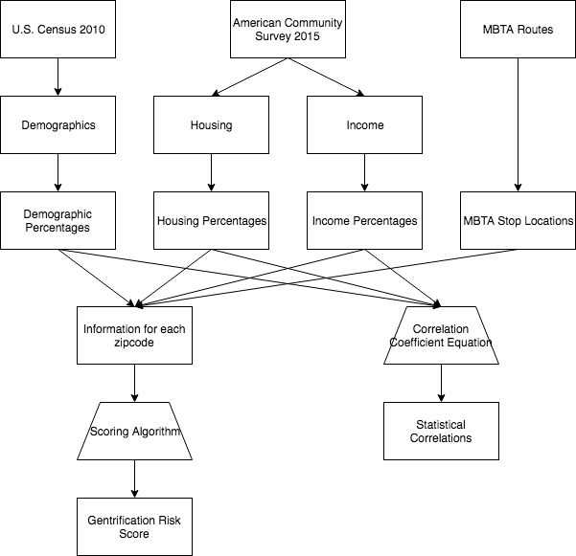


bu.edu/cs
Analyzing Risk of Gentrification in Boston
By Ben Gaudiosi, Ray Katz, and Ned Gleesin
Introduction
In urban areas, gentrification is one of the most significant problem affecting low income communities. New buildings are put up, rent increases, and all of a sudden residents can no longer afford to live in the place they once called home. Our project analyzes the risk of this phenomenon in Boston’s many neighborhoods by looking at various demographic, income, public transit, and housing statistics.
Analysis
Many studies have been done on finding the indicators of gentrification, and after some research, we came up with our own scoring method for analyzing this risk. We first normalized all of our variables. Then, for each neighborhood, we summed the distances from the means for each variables, multiplying by negative one if the variable is actually a negative indicator. This method is obviously not perfect, as some variables likely have more influence than others, but we believe this provides at least some insight into a very complex issue.
Datasets
2010 U.S. Census
2015 American Community Survey
City of Boston Data Portal
MBTA Routes and Stops
Conclusion
Our analysis shows that parts south Boston appear to be greatest risk of being gentrified. Community leaders should look to solutions so that residents of these neighborhoods aren’t displaced by rising rents. Looking ahead, it’s clear that more research needs to be done on how significantly each of the factors we used affects a neighborhoods gentrification risk.
Figure 1: Map of Boston showing which neighborhoods are most susceptible to gentrification. Red means that a neighborhood has a higher chance.
Median Income | Median Rent | 0.47
Median Income | Public Transit % | -0.65
Median Income | Old Homes % | -0.14
Median Income | Unemployment | -0.70
Median Rent | Married % | 0.01
Median Rent | Poverty Rate | -0.63
Median Rent | Unemployment | 0.42
References
Chapple, Karen. Mapping Susceptibility to Gentrification: The Early Warning Toolkit. UC Berkeley Center for Community Innovation, 2009.
Figure 2: Table showing correlation coefficients between several of the variables we used.
@BUCompSci

