Slide 1
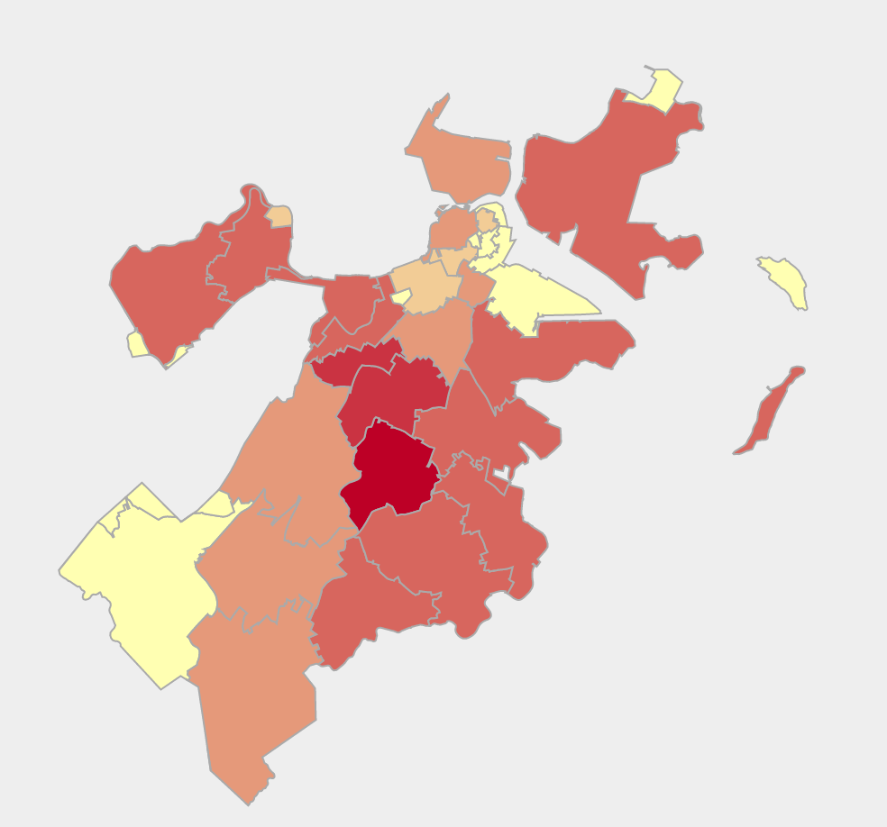


bu.edu/cs
Analyzing Risk of Gentrification in Boston
By Ben Gaudiosi, Ray Katz, and Ned Gleesin
Introduction
This is a paragaph, Insert words here, blah blah blah. This is a paragaph, Insert words here, blah blah blah. This is a paragaph, Insert words here, blah blah blah. This is a paragaph, Insert words here.
Correlation Coefficients
Median Income | Median Rent | 0.47
Median Income | Public Transit % | -0.65
Median Income | Old Homes % | -0.14
Median Income | Unemployment | -0.70
Median Rent | Married % | 0.01
Median Rent | Poverty Rate | -0.63
Median Rent | Unemployment | 0.42
Datasets
Boston
Sdfs
Sdf
Conclusion
This is a paragaph. Talk here about how we found some interesting correlations and some not so interesting. Also our analysis of gentrification yields important data for bostons future blah blah
Provenance
Analysis
Talk about how we developed our scoring method
References
No one cuz we’re baddassessdfdsfdsfds
Sdfsdfkljsdfkjlsdfkjlkdflskljfdkjlsdf
Hail satan
@BUCompSci

