Slide 1
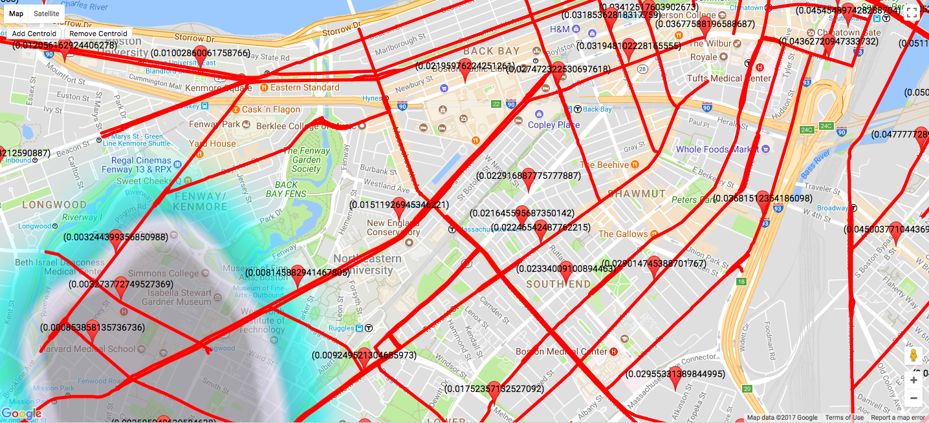
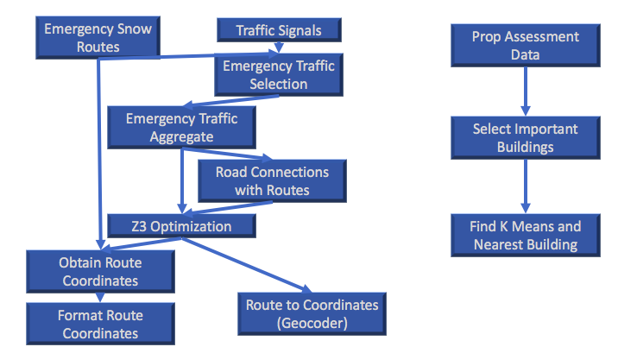


Handling Winter Storms in Boston
Motivation
Prioritizing Routes
Prioritizing Areas
The city of Boston is notorious for its extreme winter weather. With snow-
storms potentially causing problems ranging from minor inconveniences like
traffic backup, to more serious concerns like roads to hospitals being blocked,
it is important to clear snow from roads as effectively as possible.
Boston Open Data has a collection of “Snow Emergency Routes” - streets critical to the movement of police, ambulances, etc. during snow emergencies. Using z3-solver, we found a list of “high-priority” emergency routes by applying the constraint that all roads in the city must be connected to at least one route.
Using Analyze Boston’s “2017 Property Assessment” dataset, we selected high priority property types like hospitals, elderly homes, and schools. We then used the sklearn Python library to run k-means on a list of these properties’ coordinates. Returning k centroids, each denoted an area of importance as well as their nearest building of importance.
Datasets
Visualization
Provenance Model
Source: Analyze Boston
Property Assessment FY2017
Source: Boston Open Data
Snow Emergency Routes
Traffic Signals
We highlighted our high priority routes (defined above), and made a heatmap overlay with epicenters corresponding to the centroids we obtained by running k-means.
The flow of data to obtain the k-means result is relatively straightforward. We simply performed a selection on the property types deemed “important”. Finding each route is more involved:
Services / Libraries
Python Libraries
(ran with Python 3.6)
Flask
Numpy
Scipy
sklearn
z3-solver
Services:
Google Maps
(to create the visualization and perform geocoding used for street markers)
We also marked each highlighted route with its distance to its nearest centroid. The route with the smallest distance is the route of highest priority, followed by the route with the next smallest distance, and so on.
First, we select a list of traffic signals forming intersections on each route, and aggregate the list of intersecting streets. We flip this key-value pair, with each key being a road, and each value being a list of routes. We then run z3 on this result.
Steven Brzozowski, Chris Joe, Benjamin Kincaid, Keith Lovett
bu.edu/cs
@BUCompSci

