Slide 1
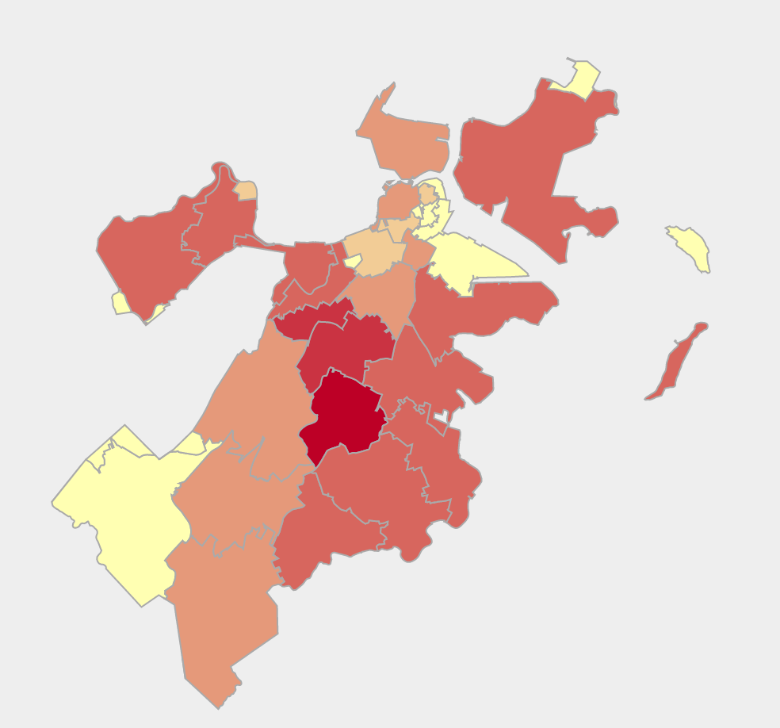
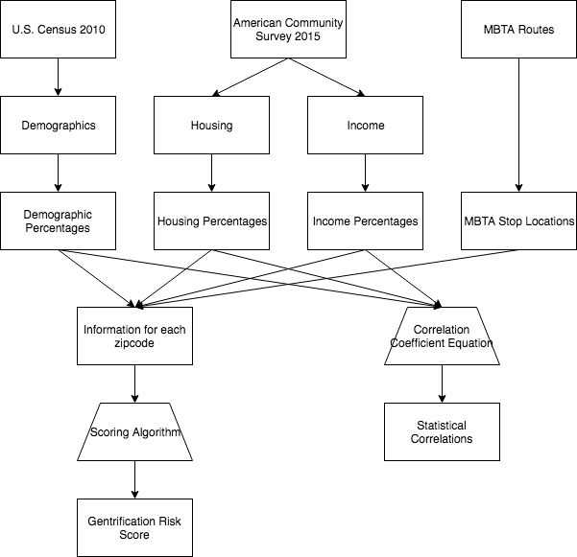


bu.edu/cs
Analyzing Risk of Gentrification in Boston
By Ben Gaudiosi, Ray Katz, and Ned Gleesin
Introduction
In urban areas, gentrification is one of the most significant problem affecting low income communities. New buildings are put up, rent increases, and all of a sudden residents can no longer afford to live in the place they once called home. Our project analyzes the risk of this phenomenon in Boston’s many neighborhoods by looking at various demographic, income, public transit, and housing statistics.
Analysis
Talk about how we developed our scoring method
Conclusion
This is a paragaph. Talk here about how we found some interesting correlations and some not so interesting. Also our analysis of gentrification yields important data for bostons future blah blah
Datasets
2010 U.S. Census
2015 American Community Survey
City of Boston Data Portal
MBTA Routes and Stops
Figure 1: Map of Boston showing which neighborhoods are most susceptible to gentrification. Red means that a neighborhood has a higher chance.
Median Income | Median Rent | 0.47
Median Income | Public Transit % | -0.65
Median Income | Old Homes % | -0.14
Median Income | Unemployment | -0.70
Median Rent | Married % | 0.01
Median Rent | Poverty Rate | -0.63
Median Rent | Unemployment | 0.42
References
No one cuz we’re baddassessdfdsfdsfds
Sdfsdfkljsdfkjlsdfkjlkdflskljfdkjlsdf
Hail satan
Figure 2: Table showing correlation coefficients between several of the variables we used.
@BUCompSci

