Slide 1
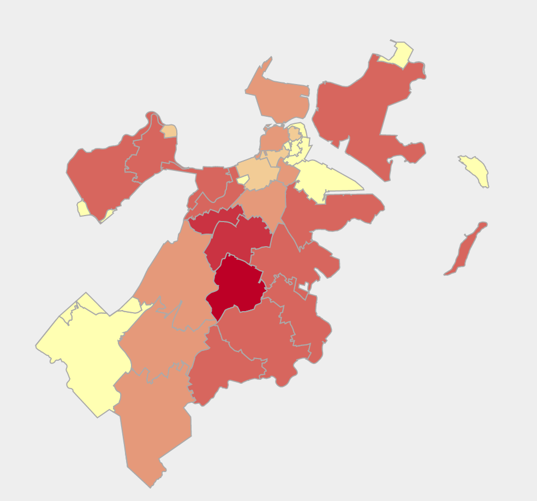
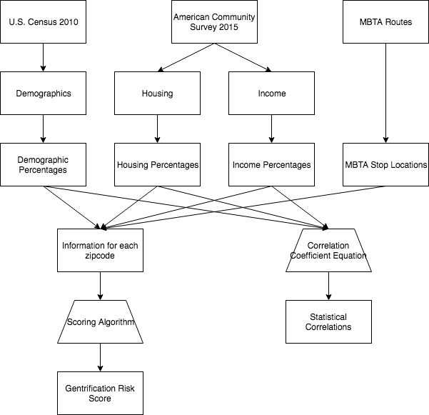


bu.edu/cs
Analyzing Risk of Gentrification in Boston
By Ben Gaudiosi, Ray Katz, and Ned Geeslin
Introduction
In urban areas, gentrification is one of the most significant problems affecting low income communities. New buildings are put up, rent increases, and all of a sudden, the residents can no longer afford to live in the place they once called home. Our project analyzes the risk of this phenomenon in many of Boston’s neighborhoods by investigating various demographic, income, public transit, and housing statistics.
Analysis
Many studies have examined the indicators of gentrification. After exhaustive research, we came up with a scoring method for analyzing the likelihood an area is being gentrified. We first normalized all of our variables. Then, for each neighborhood, we summed the distances from the means for each variables and gave the negative indicators a negative weight. This method is obviously not perfect as some variables likely have more influence than others, but we believe this provides at least some insight into a very complex issue.
Datasets
2010 U.S. Census
2015 American Community Survey
City of Boston Data Portal
MBTA Routes and Stops
Conclusion
Our analysis shows that parts of south Boston appear to have the greatest risk of being gentrified. Community leaders should look for solutions so residents are displaced by high rent. Looking ahead, it’s clear that more research needs to be done on how significantly each of the factors we used affects a neighborhoods gentrification risk. More research needs to be done in order to render an accurate scale.
Figure 1: Map of Boston showing which neighborhoods are most susceptible to gentrification. Red means that a neighborhood has a higher chance.
Median Income | Median Rent | 0.47
Median Income | Public Transit % | -0.65
Median Income | Old Homes % | -0.14
Median Income | Unemployment | -0.70
Median Rent | Married % | 0.01
Median Rent | Poverty Rate | -0.63
Median Rent | Unemployment | 0.42
References
Chapple, Karen. Mapping Susceptibility to Gentrification: The Early Warning Toolkit. UC Berkeley Center for Community Innovation, 2009.
Figure 2: Table showing correlation coefficients between several of the variables we used.
@BUCompSci

