Slide 1
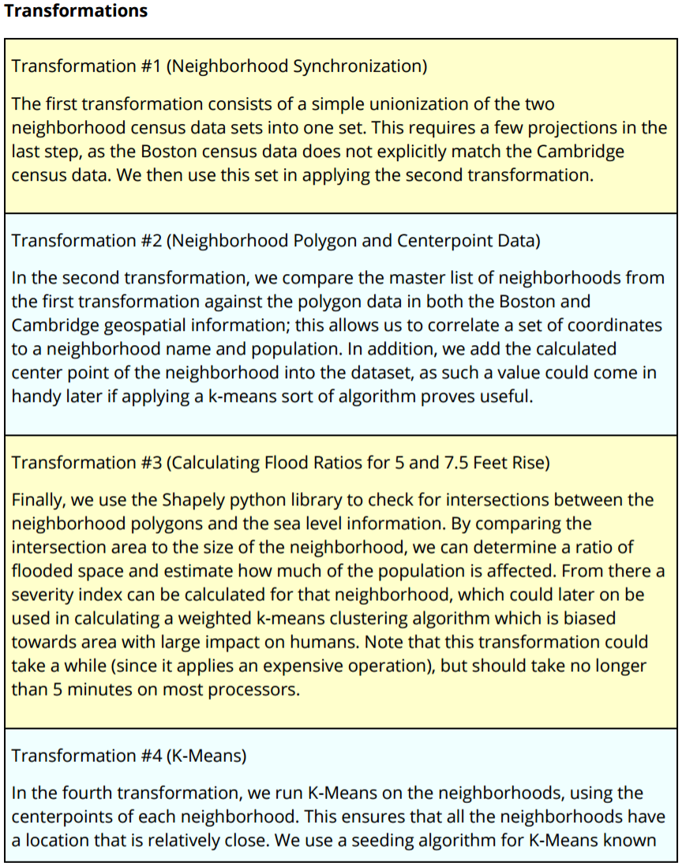
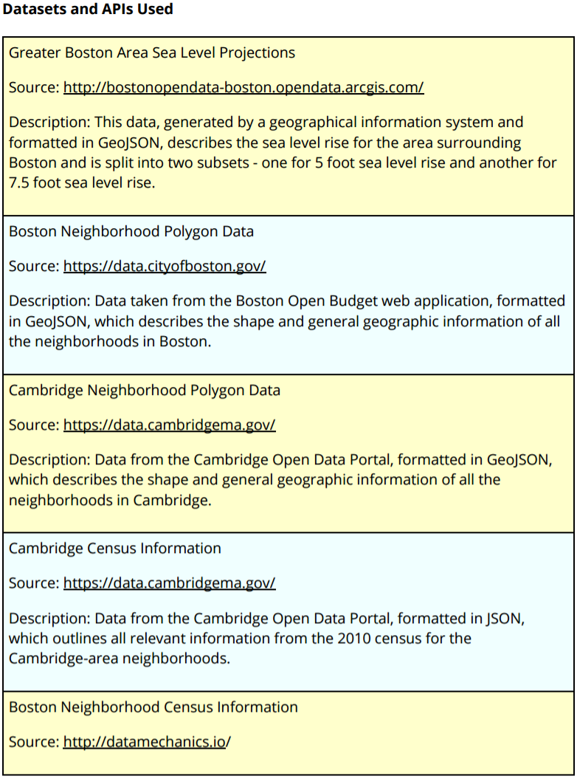
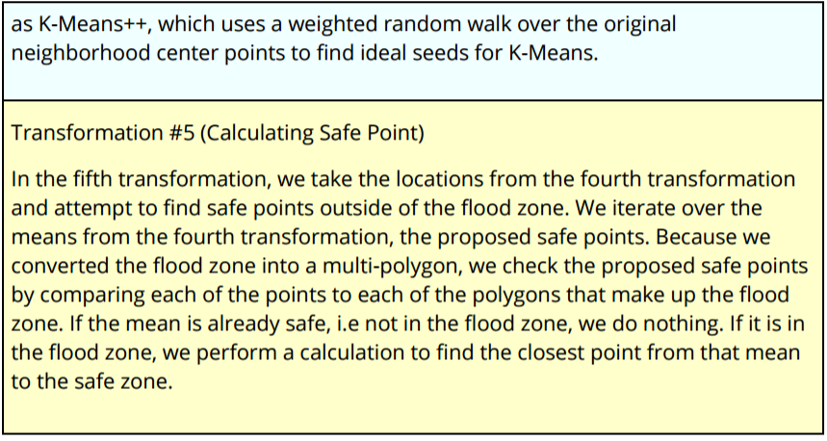
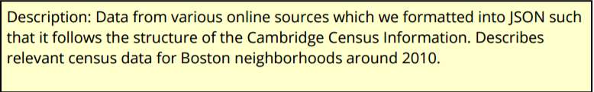


bu.edu/cs
Using Neighborhood and Sea Level Data to Determine Flood-Safe Zones in the Greater Boston Area
Introduction:
Climate change remains one of the defining issues of the 21st century. With sea levels rising around the world, coastal cities must be prepared to tackle new challenges.
Boston is no exception. In late 2016, Boston experienced what is known as a 'king tide' - the highest point that the natural tide gets to during the course of the year. The tide in that particular year was surprisingly high; water came over the wharf at almost two feet higher than the yearly average. As sea levels around the world continue to rise, it becomes increasingly important to understand where potential flooding can become a problem and act accordingly ahead of time. In this project, I collect neighborhood census data and pair it with neighborhood geospatial polygon data, then test where that intersects geo spatial data of estimated regions of coastal flooding at different sea levels. From this information, a severity index can be applied.
Our project aims to help city planners prepare for this scenario by identifying new locations outside the affected flood zone to build/move essential utilities such as electric stations or water pumps. We attempted to find locations that were close to large population centers so that they can service the greatest amount of people. By proactively and preemptively building in spots less affected by the increase in water levels, we can lessen the effect that climate change has on the city of Boston.
Conclusion:
The global warming problem is very real and must not be ignored. There are fundamentally two paths that must be explored to survive this issue: solving the cause of the problem, as well as finding workarounds while the problem continues to exist. Our project takes a relational data approach to finding safe locations as a temporary workaround. This project can be run on any other flood data geojson from other cities and locations. However, ultimately this is short term workaround to a long term problem.
@BUCompSci

