Slide 1
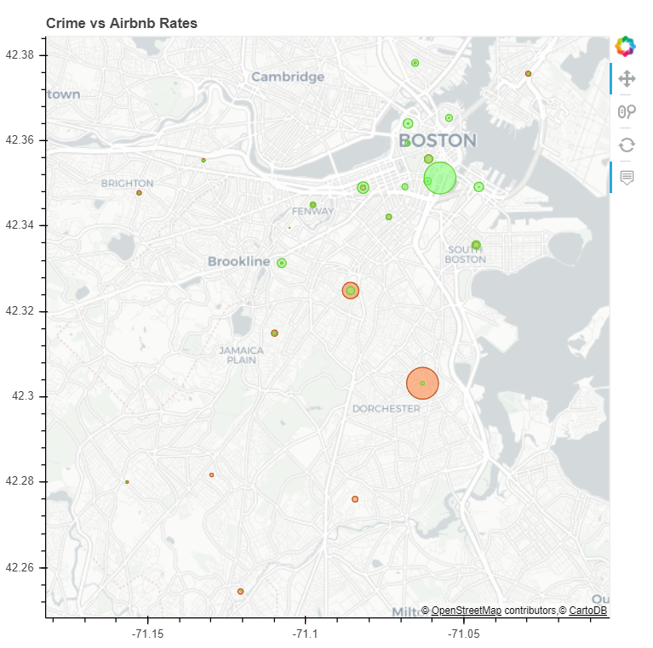
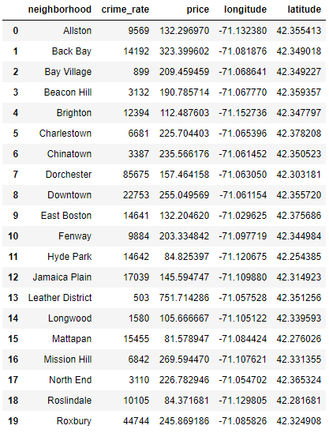


bu.edu/cs
SocioEconomic Effects on Airbnb Rates
Jinghang Yang, Bruce Zhang, and Xinyun Cao
Motivation
Results
Due to the high property value in the Boston area, we were curious about the factors that contribute to them. Specifically, we wanted to find out what causes Airbnb rates to be high or low in the Greater Boston Area so we compared the rates with various social and economic qualities of Boston neighborhoods.
Crime rate vs Average Airbnb prices per neighborhood
To our surprise, the correlation between price and crime rate was extremely low. Although we expected crime rate to have significant impact over a person’s decision to live/rent in a given neighborhood, it is likely that other positive factors outweigh the crime rate.
Method and Implementation
Crime rate vs Average Airbnb prices per neighborhood
Using the latitude/longitude boundaries of each neighborhood in Boston, we geometrically compared the coordinates of each crime report to get its associated neighborhood. Then we cleaned the data, merged it with the Airbnb data set, and generated some statistical results.
Algorithms
This is filler text, please update with some more information about the types of algorithms or techniques used to make results. This is filler text, please update with some more information about the types of algorithms or techniques used to make results. This is filler text, please update with some more information about the types of algorithms or techniques used to make results.
Algorithms
This is filler text, please update with some more information about the types of algorithms or techniques used to make results. This is filler text, please update with some more information about the types of algorithms or techniques used to make results. This is filler text, please update with some more information about the types of algorithms or techniques used to make results.
Datasets
Future Work
Boston crime rate since 2015
Airbnb rates
Boston community center
Swimming pools managed by Boston Center for Youth and Families
Boston Public Schools
Boston Police Stations
Sed a elit massa. Proin tristique justo ut magna luctus laoreet eu eu leo. In elit metus, tincidunt vel tincidunt ut, laoreet consectetur leo. Cras vitae dapibus sem. Donec sit amet pharetra nulla. Nunc aliquet mauris et justo condimentum rhoncus. Ut dolor tellus, sodales id elementum ac, fermentum blandit liberoSed a elit massa. Proin tristique justo ut magna luctus laoreet eu eu leo. In elit metus, tincidunt vel tincidunt ut, laoreet consectetur leo. Cras vitae dapibus sem. Donec sit amet pharetra nulla. Nunc aliquet mauris et justo condimentum rhoncus. Ut dolor tellus, sodales id elementum ac, fermentum blandit libero
@BUCompSci

