Slide 1
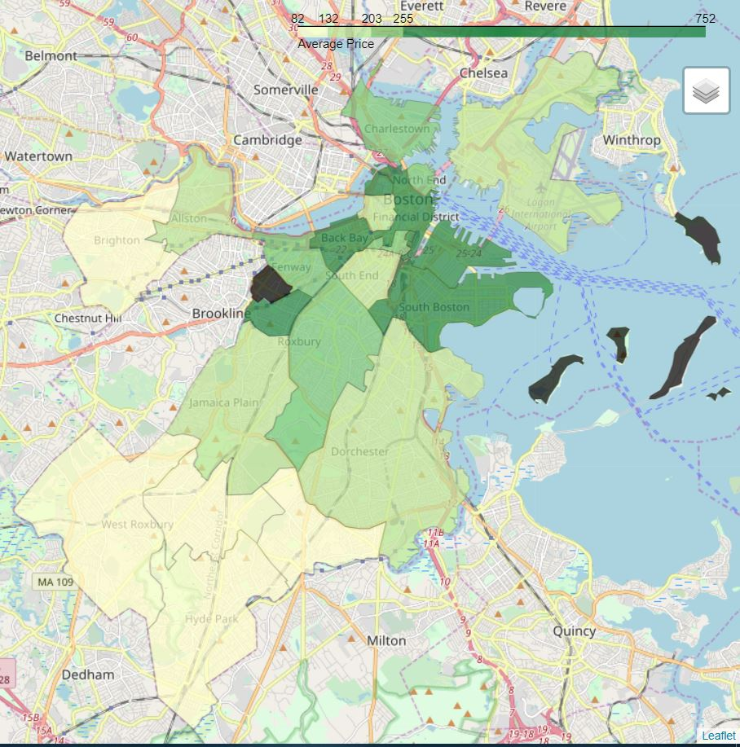
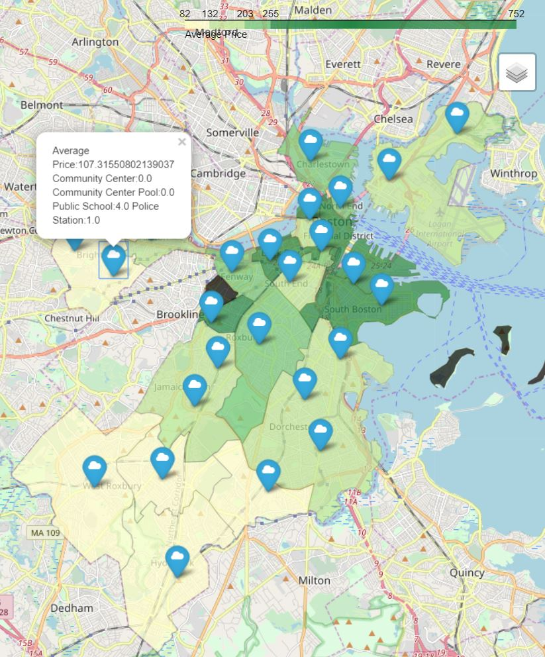
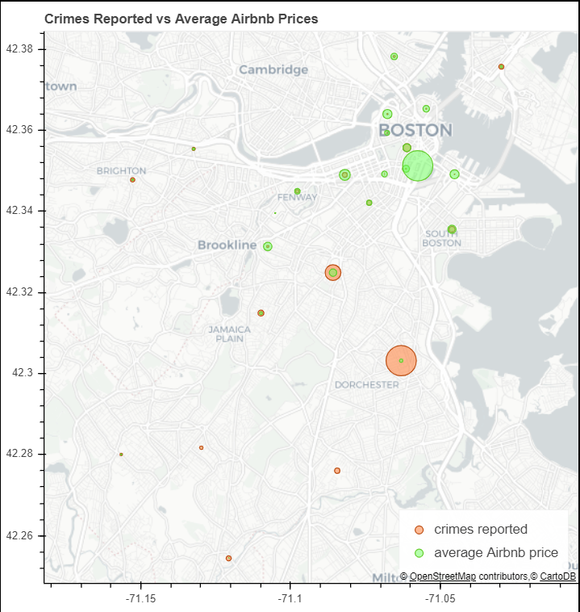
CS 504 Data Mechanics
SocioEconomic Effects on Airbnb Rates
Jinghang Yang, Yuan Zhang, and Xinyun Cao
Introduction
Factor one
Factor two
Due to the high property value in the Boston area, we were curious about the factors that contribute to them. Specifically, we wanted to find out what causes Airbnb rates to be high or low in the Greater Boston Area so we compared the rates with various social and economic qualities of Boston neighborhoods.
Crime vs Average Airbnb prices
Public Places vs Average Airbnb prices
Join
Sum
K-means
At first, we joined the Boston crime dataset and the Airbnb dataset based on neighborhood
For each neighborhood we summed up the numbers of crime occurred in that neighborhood
According to latitude and longitude, we used the k-means algorithm to cluster Airbnb houses, then we calculate the average Airbnb prices of each cluster. After that, we use the means we got to cluster public places in order to have a cluster of average Airbnb prices and total numbers of every public place.
Aggregation
For each neighborhood we calculate the average Airbnb price in that neighborhood
Correlation Coefficient
By using the clustered data, we calculated the correlation coefficient between the total number of public places and Airbnb average prices
Datasets
Crimes in Boston since 2015
Airbnb rates
Boston community center
Swimming pools managed by Boston Center
Boston Public Schools
Boston Police Stations
 | Correlation Coefficient
No. of center | -0.15939130465865842
No. of swimming pool | 0.019961379242068346
No. of public school | -0.33146333954281415
No. of police station | -0.122010212532738
Statistical Analysis
 | Correlation Coefficient
Crimes reported | -0.16378839031967327
Project Goals
Results
Future Work
Our project consider two factors that might influence the prices of Airbnb, the first is the number of Crime, and the second is the number of public places: community center, swimming pools, public schools and police stations. We aim to conclude whether these two factors really make a difference.
To our surprise, the correlation between price and crime rate was low. It is likely that other positive factors outweigh the crime rate. And the what disappointed too is that there were almost no relation between price and public places, the two factors we consider are not really playing important roles.
Unfortunately, we got the wrong direction. However, we will try other factors that have significant impact over a person’s decision to live/rent in a given neighborhood.
We will keep using the techniques such as data transformation, statistic analysis and visualizations based on real world datasets so that we could get a reasonable conclusion.

