Slide 1
Sealant-On-Rails: Revolutionizing Dental Health Data Management
Student Project Presentation
Presented By :
Manisha Panda
Apurva Mandalika
Jaydeep Radadiya
Sushant Shelar
Sarah Gullion
Jay Nehete

Slide 2
Motivation for the Project
Currently, our faculty and students visit elementary schools to conduct dental screenings and apply sealants to children. Data collected during these visits is recorded on paper forms, creating a cumbersome manual entry process for the program coordinator.
The envisioned web application will simplify this workflow and enhance data security.
Key Features:
User Friendly interface for data entry.
Auto Population of the data to save time and avoid manual errors.
Robust Analytical tools to evaluate program effectiveness.
Secure Data storage for protecting the sensitive data.

Slide 3
Project Goals
Purpose: Designed specifically for the Texas A&M School of Dentistry.
Function: Transforms the Sealants Outreach Program from paper-based to digital.
Client Goal 1: Replace manual forms with an efficient app for data entry and management.
Client Goal 2: Provides insightful statistics for program assessment, including progress and costs.

Slide 4
Project Development Overview
Technology: Ruby on Rails for development, Heroku for deployment, Google Cloud for user authentication.
External Gems Used:
OmniAuth for implementing Google auth.
BootStrap for styling
JQuery for Javascript
Database : SQLLite for development and PostgreSQL in Production
End Users: Faculty and students at Texas A&M School of Dentistry.
Project Location: https://github.com/Data-Mgmt-for-Sealants-Outreach-Program/Sealant-On-Rails-V2

Slide 5
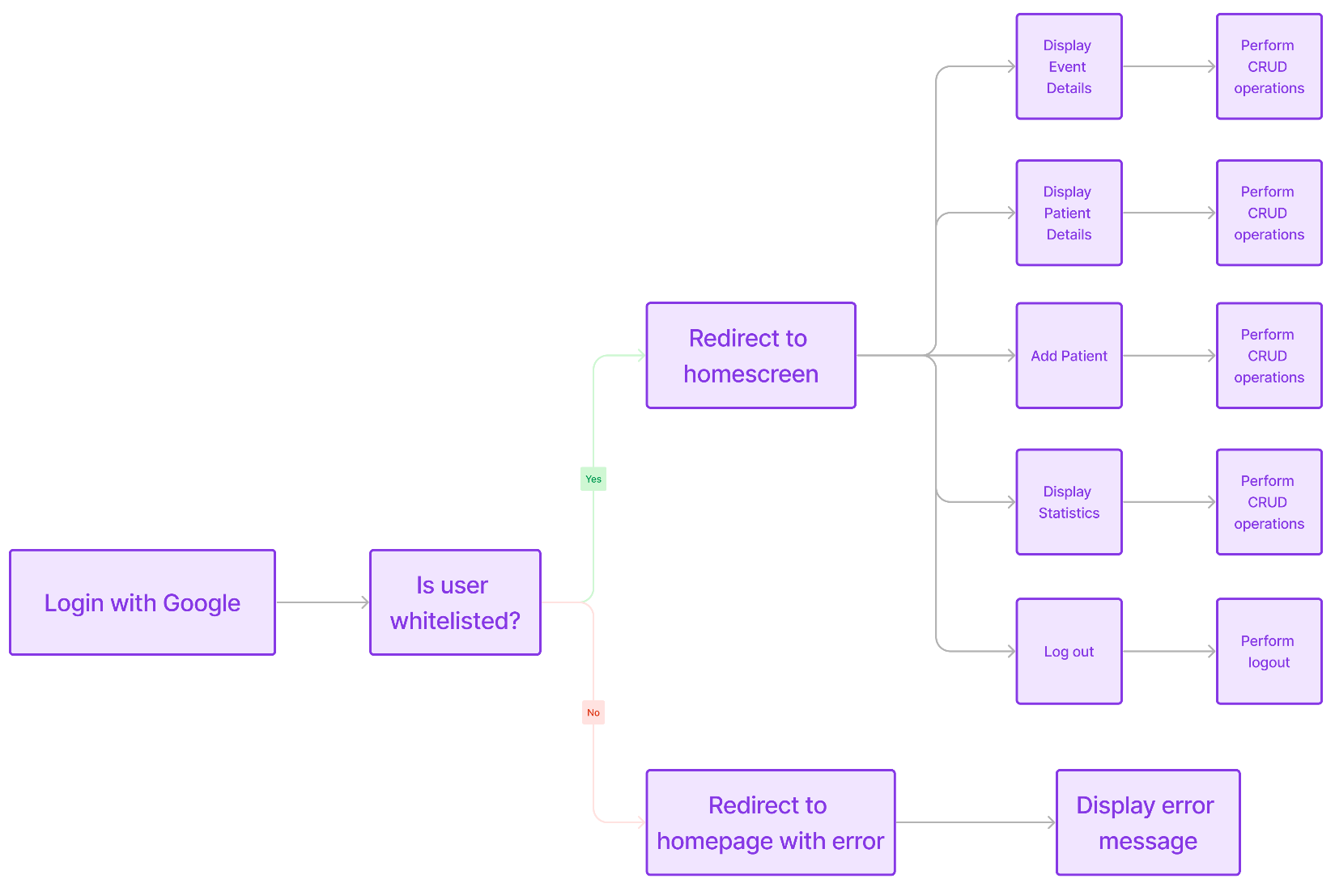
Project Flow

Slide 6
Project Validation
BDD Coverage (Cucumber Testing)
Google OAuth login with whitelisting.
Creating and Updating Events.
Creating Patient Profiles.
Updating Screening information on Patients Details.
Creating Statistics for Data Analysis
TDD Coverage (Rspec Testing)
Unit test cases for all the data model such as events, child details and events details.

Slide 7
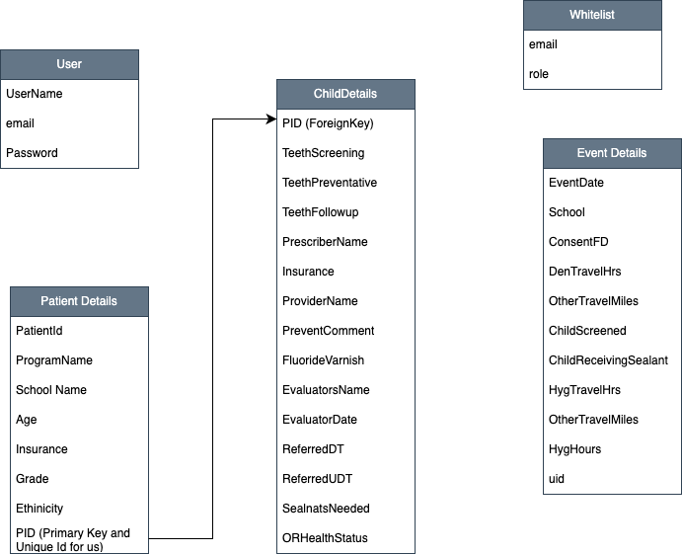
Project Database Design

Slide 8
Project Challenges
New to Ruby on Rails
Had to figure out the tech stack, class designs, ui designs, test case designs from scratch.
No team member had used ruby on rails in their past.
No team member had used heroku for hosting web application.
Development Issues
Google OAuth was a challenge to integrate as no straightforward guide exists.
Due to no experience in ruby on rails, we had to rebuild our project from scratch in the middle of the semester.
Our majority of the time went into refactoring the code so that it was in the “ruby-way”.
Non-technical client
Initially the conversation was very difficult as the requirements capturing and user stories development was difficult to build.

Slide 9
Project Lesson Learned
Team Collaboration:
Importance of regular team sync-ups for efficiency and reduced redundancy.
Client Communication:
Frequent, clear communication is key for understanding needs and expectations.
Agile Project Management:
Flexibility in planning is crucial to adapt to changes and challenges.
User-Centric Design:
Involving users early and regularly ensures the software meets their needs effectively.
Continuous Learning:
Keeping up-to-date with new technologies and methodologies is vital for successful implementation.

