Slide 1
Structural change and L2 sentence processing
Shaohua Fang
12/07/2021
Department of Linguistics

Slide 2
Background
Processing of garden-path sentences provides a window into how human parser integrates new information from language input into a previously computed analysis and how misanalysis if any can be resolved – ambiguity resolution.
(1) While the man hunted the deer ran into the woods. (Christianso et al., 2001)
……the man hunted the deer (object) ……ran……
……the deer (subject) ran into the woods……
Notes:
direct-object interpretation is subsequently ruled out by the subsequent verb – ‘ran’ which requires an explicit subject.

Slide 3
Previous studies
1) Verb bias used in ambiguity resolution
lexically specific frequency information about whether a verb is most likely to take a direct object (DO) or a sentential complement (SC) (Garnsey et al., 1997; Traxler, 2005).
E.g., (2) a. The professor forgot the theory revealed the underlying mechanism. (DO-bias)
b. The professor proved the theory revealed the underlying mechanism. (SC-bias)
2) Learners well used such information for ambiguity resolution (Dussias & Cramer-Scaltz, 2008; Qian et al., 2019).
Shorter RTs on revealed for (2b) than for (2a)
Notes:
The structural representations constructed by L2 learners are essentially shallower than those by native speakers

Slide 4
Research gap
Verb bias as a non-structural factor
How about manipulating the structural aspects of a verb while controlling for its non-structural properties such as verb bias in L2 sentence processing?
Structural change pertaining to verbs

Slide 5
Structural change
(1) The Australian woman saw the famous doctor has been drinking quite a lot. (Complement-clause)
See + NP/S
(2) Before the woman visited the famous doctor has been drinking quite a lot. (Adjunct-clause)
Visit + NP/Z (zero complement)
Which one is more difficult (1) or (2) ?
Notes:
Verbs can take either NP or Sentence as a complement.
See: Agent/Patient
Visit: Agent/Goal/Proposition
Complement-clause (Weak garden path)
Adjunct-clause (Strong garden path)

Slide 6
Principle-based parsing - Pritchett (1992)
Parsing is the local application of global syntactic principles.
Reanalysis is difficult when it results in a major rearrangement of thematic structure, but easy if it doesn’t.
NP/Z would be harder than NP/S as NP/Z requires a constituent to be moved out of its thematic domain.
Notes:
Principles include theta attachment, case assignment, binding etc.

Slide 7
Research question
1) Is processing difficulty at disambiguation greater in NP/Z ambiguity than in NP/S ambiguity for L1 and L2 learners?
2) Do L1 and L2 learners equally show sensitivity to verb-related structural properties during L2 sentence processing?
L2 learners arguably are less sensitive to structural information during processing.
3) Does proficiency modulate learners’ sensitivity to verb properties?

Slide 8
Methods
Participants
24 English native speakers; 65 Chinese learners of English
Design
2 (Complement type: NP/S vs. NP/Z) *2 (Ambiguous vs. Unambiguous)
Martials
32 sets of items in 4 conditions (Adapted from Strut et al., 1999)
Tasks:
Self-paced reading (SPR) – RT (Ibex Farm)
The Australian woman / saw the famous doctor / had been drinking / quite a lot.
CQ: Is the woman an Australian?
Acceptability judgment task (AJT) to ensure material plausibility – 1-7 Likert Scale (Qualtrics)
E.g., The Australian woman saw the famous doctor.
Condition | Example sentence
Ambiguous-NP/S | (1). The Australian woman / saw the famous doctor / had been drinking / quite a lot.
Ambiguous-NP/Z | (2). Before the woman / visited the famous doctor / had been drinking / quite a lot.
Unambiguous-NP/S | (3). The Australian woman saw that the famous doctor had been drinking quite a lot.
Unambiguous-NP/Z | (4). Before the woman visited, the famous doctor had been drinking quite a lot.
Notes:
To ensure the plausibility of the misanalysis part

Slide 9
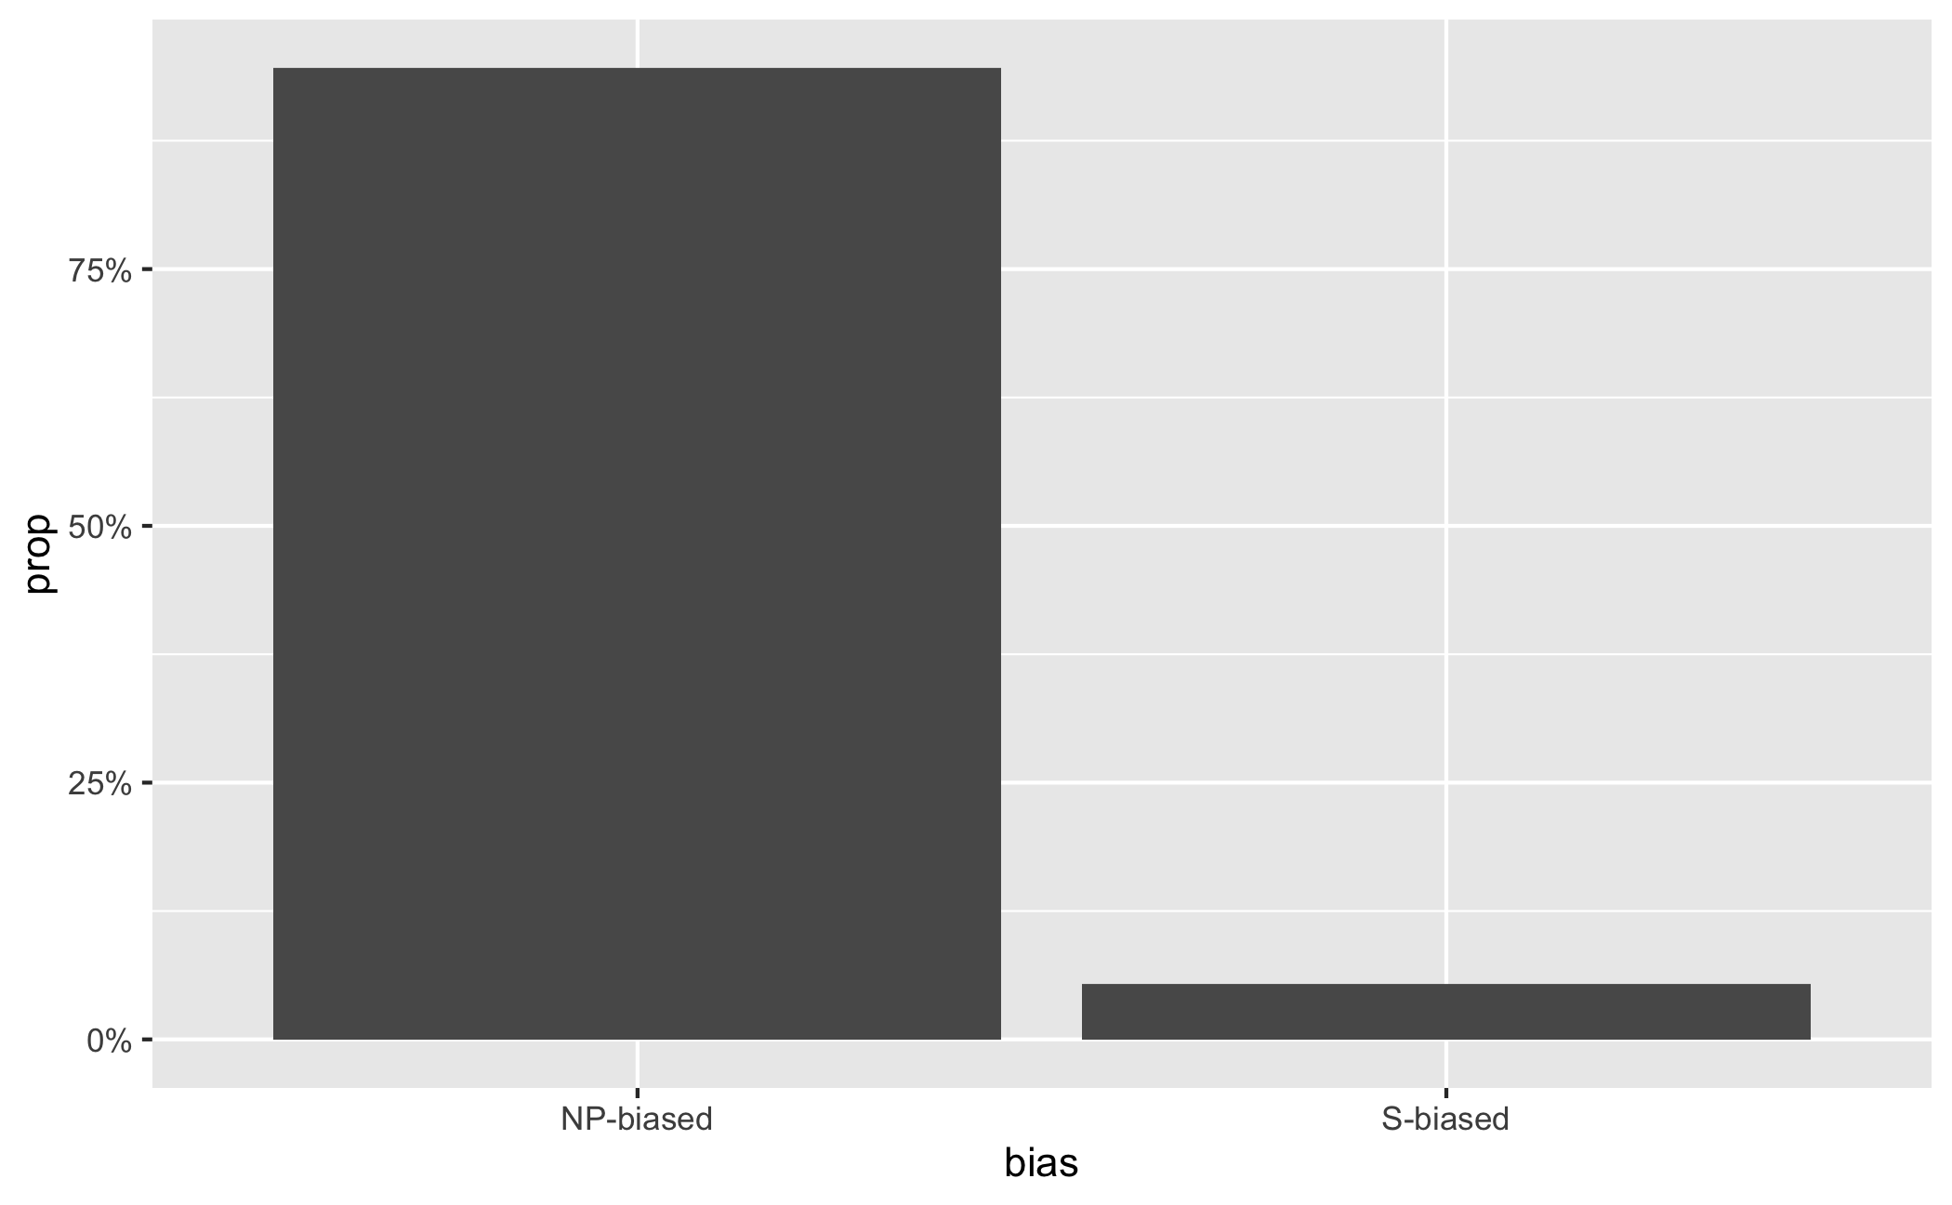
COCA
To ensure the verbs are statistically biased toward the NP reading
E.g., if ‘accepted’ + that / NN+VBN -> S-biased, otherwise -> NP-biased

Slide 10
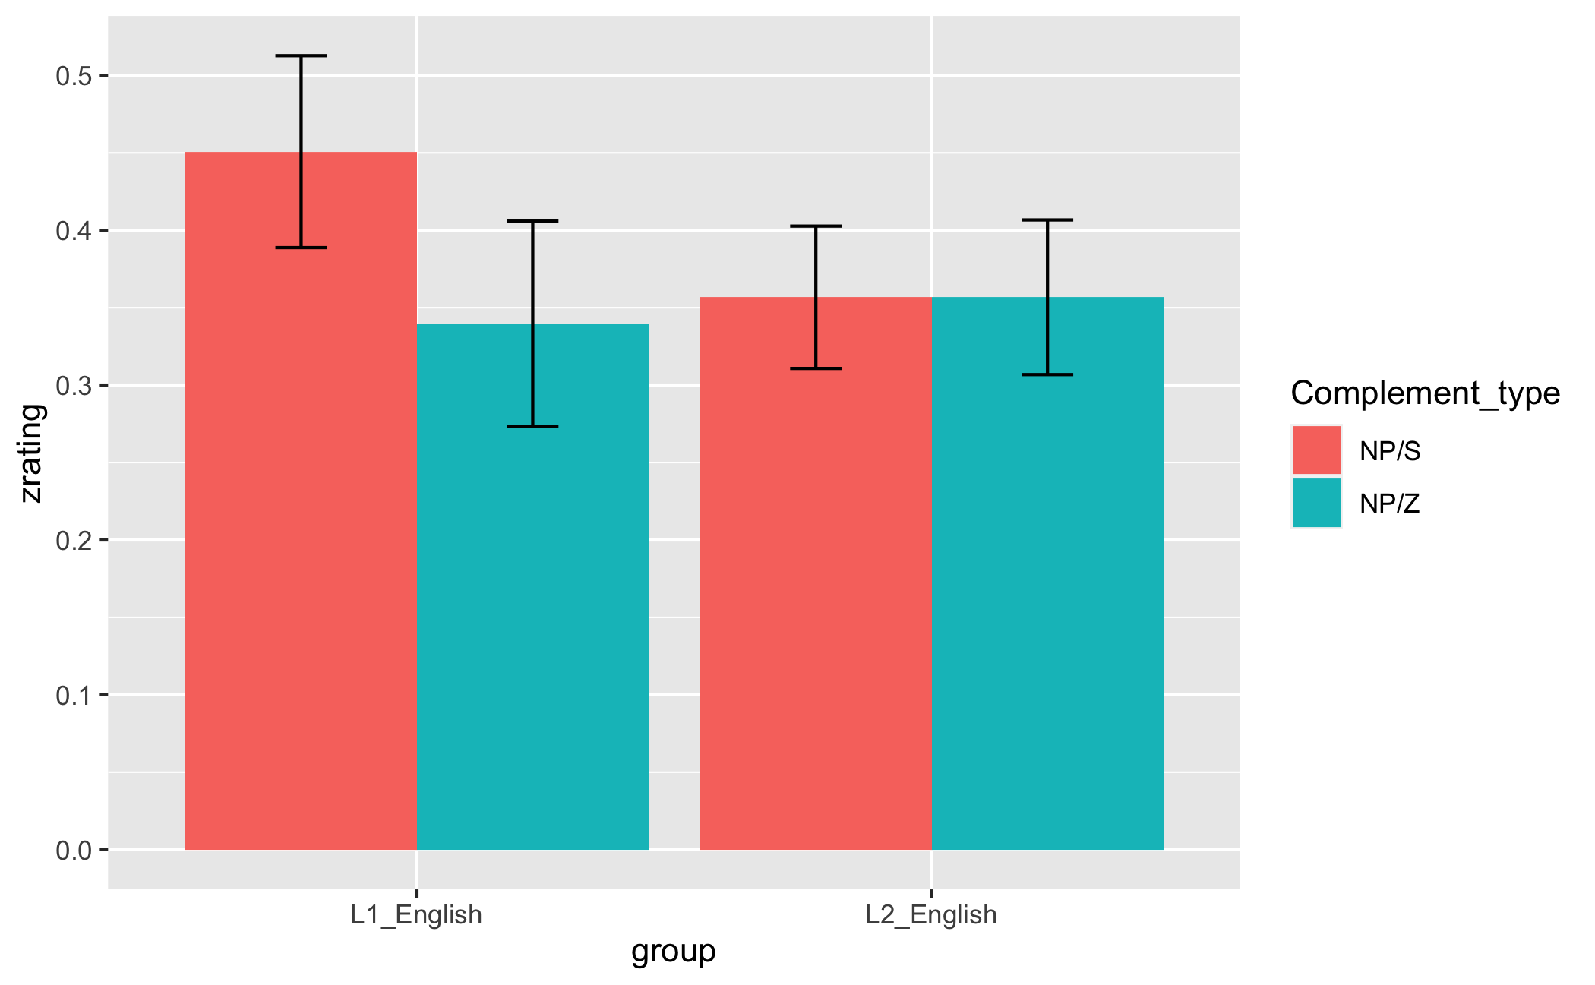
AJT
AJs z-scored by participant and language to mitigate scale bias.
Linear mixed-effects models (LMEM) showed that ratings did not significantly differ by condition (β=-0.05, SE=0.09, p=.554) and language group (β=-0.04, SE=0.06, p=.543), thus ruling out plausibility as a potential confound.
Notes:
We z-scored ratings by participant and language tested. Z-scoring by-participant helps to control for biases in how individual participants used the 7-point scale

Slide 11
SPR
Data trimming:
Participants whose accuracy on CQs lower than 80% excluded
1 L1 speakers excluded, remaining for 94.3 %
6 L2 learners excluded, remains for 90.3 %
LMEM indicated a reliable higher accuracy for L1 than for L2 speakers (β=-0.11, SE=0.002, p=.014)
RTs beyond 2.5 SDs from the mean removed
2.6 % affected for L1
2.5 % affected for L2
Notes:
For residualization:
accurate_trimmed1$word_length <- nchar(as.character(accurate_trimmed1$word))
accurate_trimmed1$word_length<- as.numeric(accurate_trimmed1$word_length)
mixed_model <- lmer(log_RT ~ scale(word_length) + (1+scale(word_length)|Subject), accurate_trimmed1)
accurate_trimmed1$corrected_log_rt <- residuals(mixed_model)

Slide 12
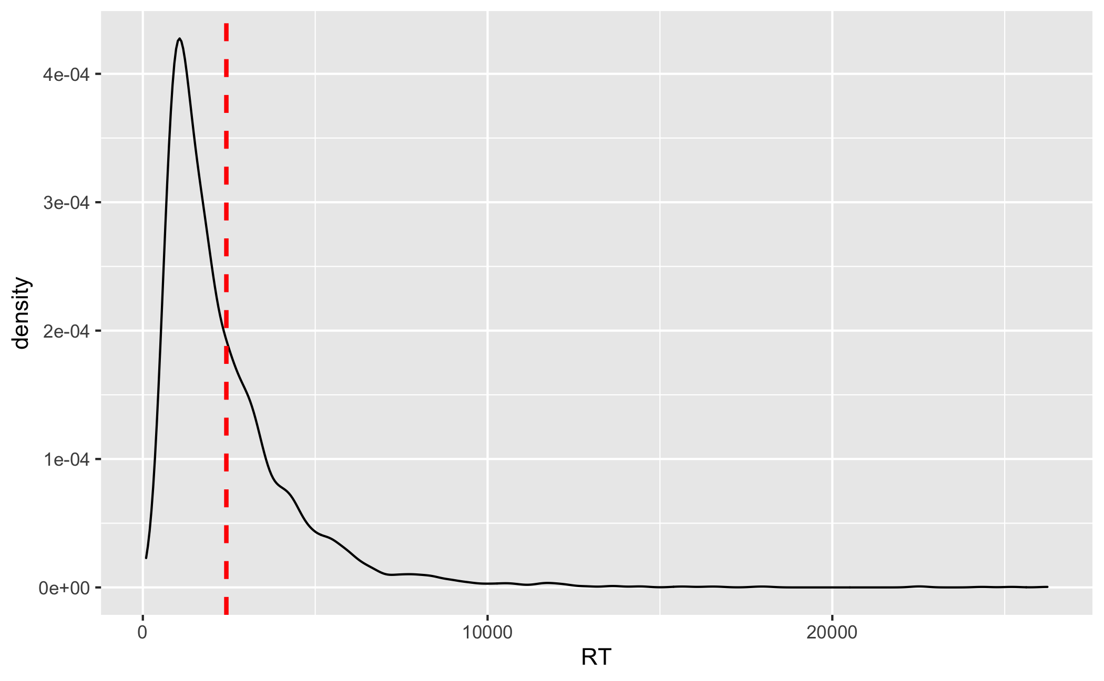
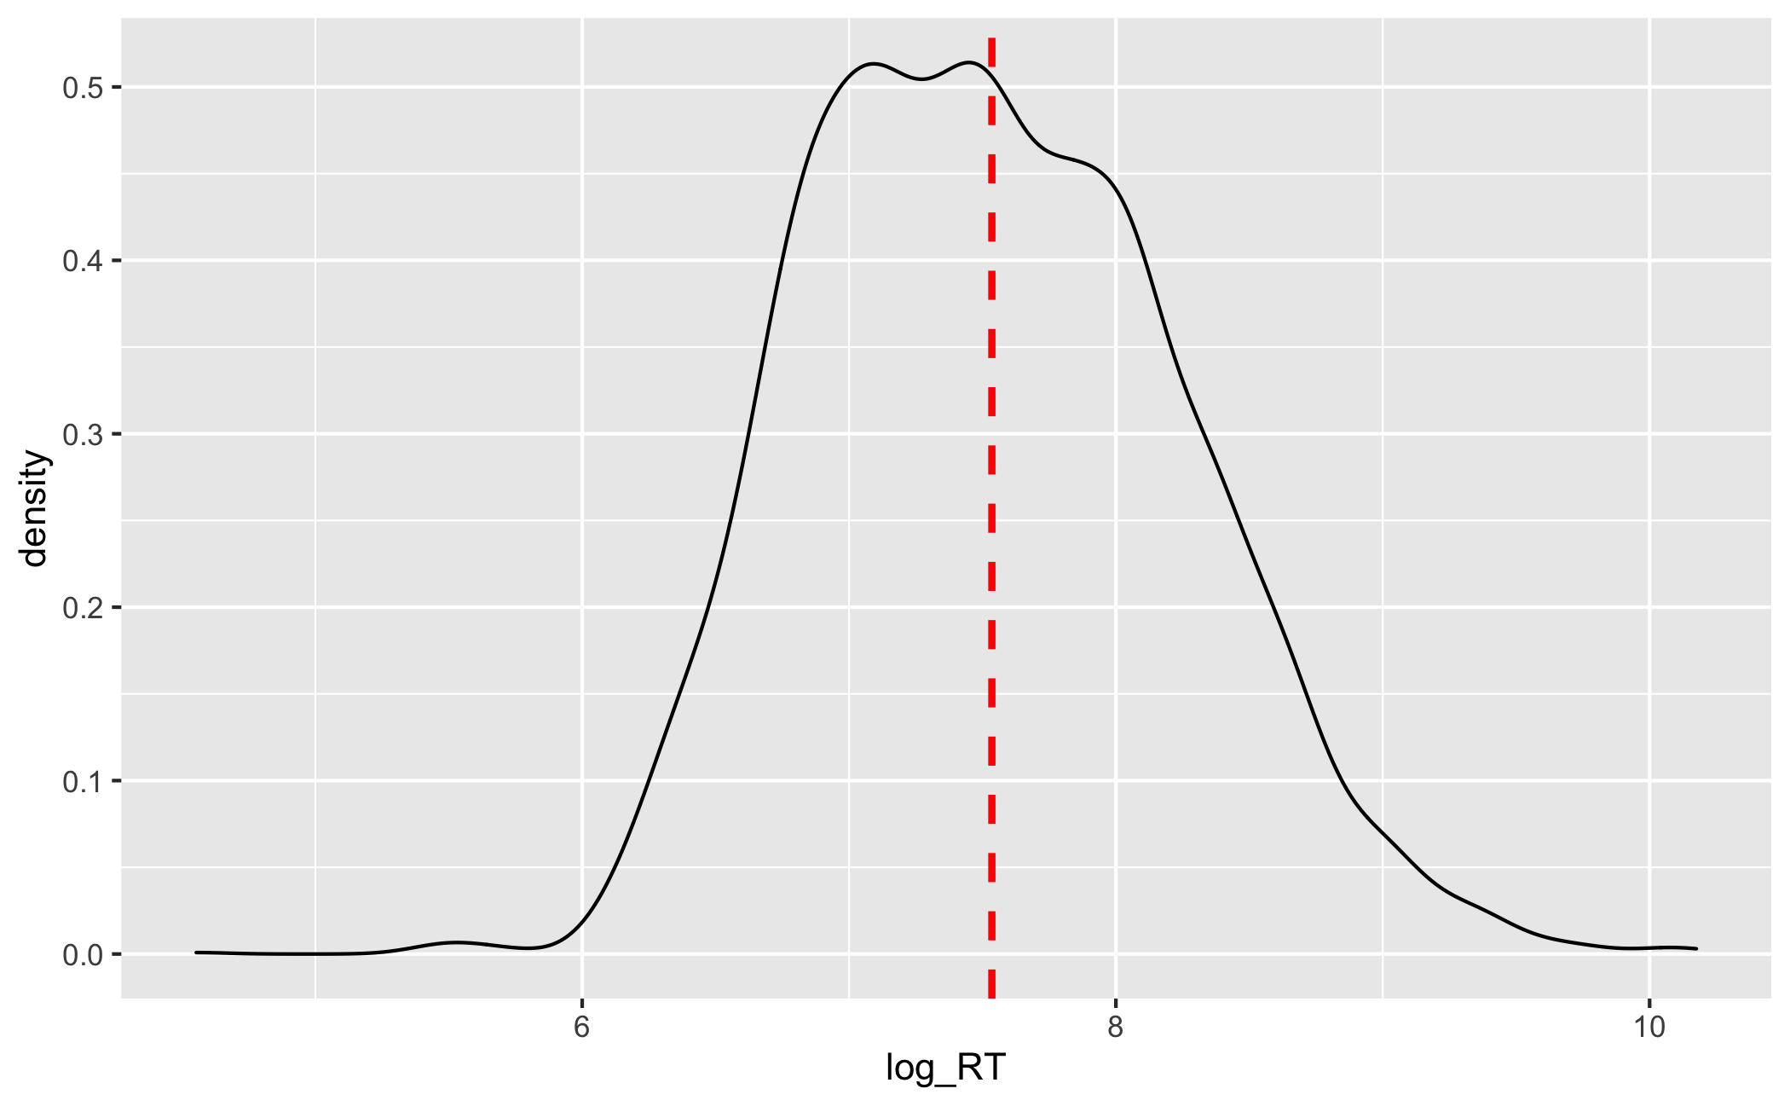
Data trimming cont’d
RTs were then log transformed to approach normal distribution
Residualized the log-transformed RTs to adjust for the variability in word length and individual reading speed
Notes:
For residualization:
accurate_trimmed1$word_length <- nchar(as.character(accurate_trimmed1$word))
accurate_trimmed1$word_length<- as.numeric(accurate_trimmed1$word_length)
mixed_model <- lmer(log_RT ~ scale(word_length) + (1+scale(word_length)|Subject), accurate_trimmed1)
accurate_trimmed1$corrected_log_rt <- residuals(mixed_model)

Slide 13
Modeling procedures
Only R3 was analyzed, as it’s the critical region for the effects to be shown
For L1 speakers
Random effect structure kept maximal
by-item, by-subject intercept
by-subject random slope for Ambiguity*Complement type
Random effect structures simplified only when models converge
Fixed effects for complement type and ambiguity sum coded
For L2 speakers
Identical as above, except that by-item random slope for Language Proficiency was additionally added in the random effect structure

Slide 14
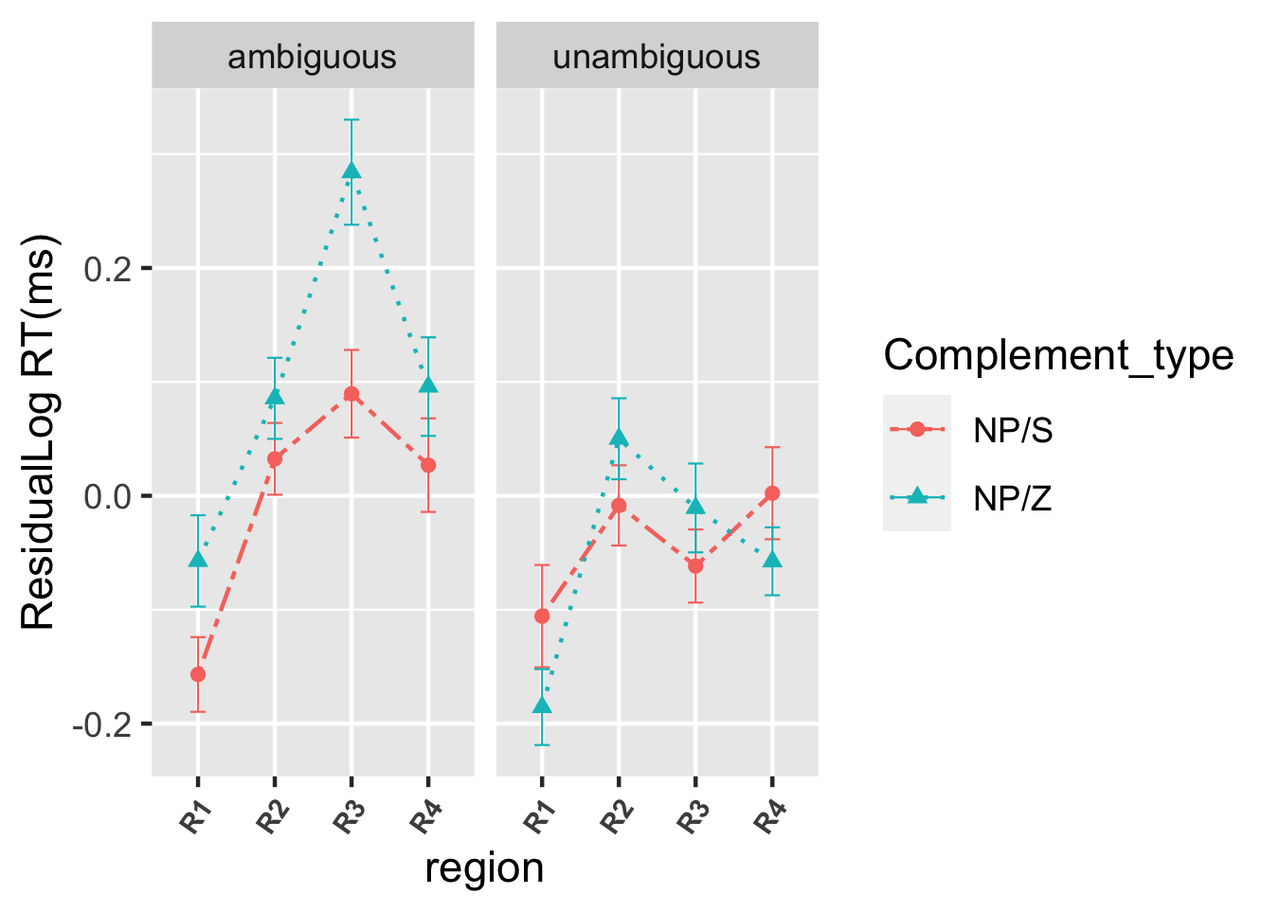
L1 results
Results:
Main effects of ambiguity and complement type
Unambiguous sentences were read faster their ambiguous counterparts (β=0.224, SE=0.039, p<.0001). NP/S sentences were read more quickly than NP/Z sentences (β=-0.124, SE=0.039, p=.0016)
Interaction between complement type and ambiguity
NP/S sentences were read faster than NP/Z sentences only in the ambiguous condition (β=-0.194, SE=0.055, p=.0005)
Notes:
Sum coding:
Compares the mean of the dependent variable for a given level to the overall mean of the dependent variable.

Slide 15
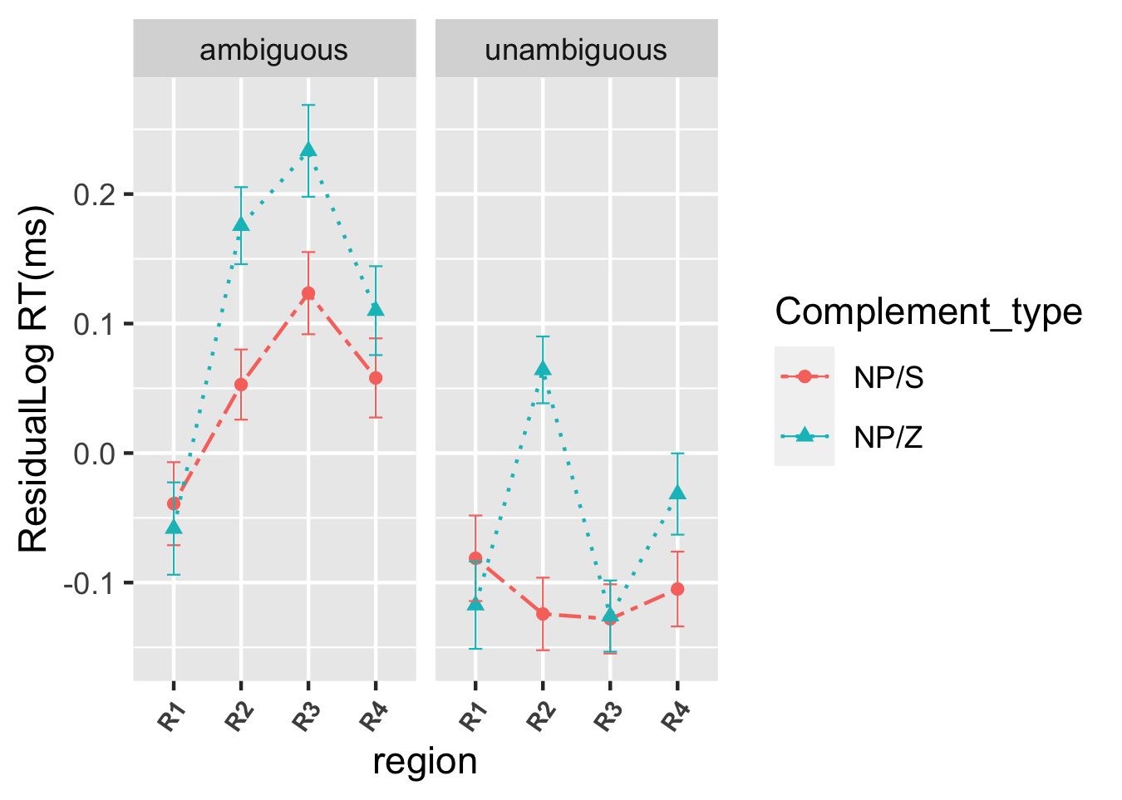
L2 results
Results:
Main effects of ambiguity and complement type
Unambiguous sentences were read faster their ambiguous counterparts (β=0.31, SE=0.029, p<.0001). NP/S sentences were read more quickly than NP/Z sentences (β=-0.059, SE=0.030, p=.0445)
Interaction between complement type and ambiguity
NP/S sentences were read faster than NP/Z sentences only in the ambiguous condition (β=-0.117, SE=0.042, p=.0054)
Proficiency modulated only the overall RTs but not the extent to which learners were sensitive to structural properties (β=0.044, SE=0.018, p=.0137)

Slide 16
Conclusion
1) Is processing difficulty at disambiguation greater in NP/Z ambiguity than in NP/S ambiguity for L1 and L2 learners?
YES
2) Do L1 and L2 learners equally show sensitivity to verb-related structural properties during L2 sentence processing?
L2 learners arguably are less sensitive to structural information during processing.
YES
3) Does proficiency modulate learners’ sensitivity to verb properties?
NO

Slide 17
Future research
Eye-tracking with overt measures (e.g., regressive eye movements) for reanalysis.
Comprehension questions following test sentences added to explicitly capture reanalysis.
Statistical distribution of verb complement examined in learner corpora.

Slide 18
Thank you

Slide 19
All the verbs are biased toward the NP reading, only when can it be ensured that sentences will be initially misanalysed, because reanalysis is assumed to occur after misanalysis.
Reanalysis is the research focus

