Slide 1


Effective Note-taking and Citation Management with Obsidian
Kontakt
Name
E-mail address
DD.MM.YYYY ▪ Introduction to Obsidian

Slide 2

Welcome
LOGO
Introduction Round
… name
… academic background (discipline)
… current research tpoic in one sentence
Icons by Microsoft Power Point

Slide 3
Welcome
LOGO
[insert tool for poll ‘1.2 Poll - Expectations of participants’, see didactic table]

Slide 4

Welcome
LOGO
Welcome
Training Objectives
Part 1: Personal Knowledge Management
What is Obsidian?
Reflect on your current system and explore how Obsidian can support your research workflow.
Understand effective note-taking and self-organization techniques.
Part 2: Obsidian Basics
Learn how to create, manage, and link notes using Markdown syntax.
Explore features like graph view, tags, and metadata.
Customize your workspace with plugins and themes.
Created by Wena Vega, sketchify
(canva.com)
Notes:
[Sprechnotizen einfügen]
Add: Dont want to convince you using obsidian! There might be tools which are more suitable for your workflow. In the end of this traning you will at least have an idea what this tool should offer (if it is not obsidian). AND We can not go deeper in self organization techniques, which can be mendatory for enhancing your workflow. But I can provide you a quick overview about sources. I just offer you a tool. And I have a contradiction for you: On the one hand a tool is useless without a propper method or self organization technique. BUT on the other hand I will encourage you to just begin with your knowledge collection, as if the structure will create itself.
Difference between selforganization system and knowledge management system:

Slide 5

Welcome
LOGO
Agenda
Icons by Microsoft Power Point
Notes:
[Sprechnotizen einfügen]
Add: Dont want to convince you using obsidian! There might be tools which are more suitable for your workflow. In the end of this traning you will at least have an idea what this tool should offer (if it is not obsidian). AND We can not go deeper in self organization techniques, which can be mendatory for enhancing your workflow. But I can provide you a quick overview about sources. I just offer you a tool. And I have a contradiction for you: On the one hand a tool is useless without a propper method or self organization technique. BUT on the other hand I will encourage you to just begin with your knowledge collection, as if the structure will create itself.
Difference between selforganization system and knowledge management system:

Slide 6

Welcome
LOGO
Welcome
Obsidian Teaching Philosophy
Trainer is your guide, not your guru.
Empowerment instead of convincing.
Simple tools, deep work.
Minimalism in style and plugins.
Picture: icons by Microsoft Power Point
Notes:
[Sprechnotizen einfügen]
Add: Dont want to convince you using obsidian! There might be tools which are more suitable for your workflow. In the end of this traning you will at least have an idea what this tool should offer (if it is not obsidian). AND We can not go deeper in self organization techniques, which can be mendatory for enhancing your workflow. But I can provide you a quick overview about sources. I just offer you a tool. And I have a contradiction for you: On the one hand a tool is useless without a propper method or self organization technique. BUT on the other hand I will encourage you to just begin with your knowledge collection, as if the structure will create itself.
Difference between selforganization system and knowledge management system:

Slide 7


LOGO
Questions
Icons by Microsoft Power Point

Slide 8
What is Obsidian?
LOGO
[insert tool for poll ‘2.2 Poll - Experiences with note taking’, see didactic table]

Slide 9
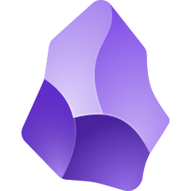
LOGO
What is Obsidian?
LOGO
What is Obsidian?
Highly customisable (Community plugins)
Free of charge (except Sync, Publish and commercial use)
Cross-Platform (Windows, Mac, Android, iOS, Linux)
Interoperable
Easily import notes from other apps (Obsidian Importer)
Obsidian Logo
Note on Logo Usage: The use of the Obsidian logo in this presentation is considered fair use. Please be aware that the author is not affiliated with nor representatives of Dynalist Inc., the company that develops Obsidian.
Notes:
Obsidian was developed in 2020 during COVID-19 pandemic.
Note-taking and knowledge management application

Slide 10
What is Obsidian?
LOGO
What is Obsidian?
[insert short YouTube Video about Obsidian here, e.g. A Better Computer (2021) This is Obsidian, https://www.youtube.com/watch?v=d2FNqEDGc8g ]
Notes:
Not sponsored video on YouTube by „A Better Computer“

Slide 11

What is Obsidian?
LOGO
What is Obsidian?
All Obsidian files...
... are stored locally in a folder.
… are .md files (Markdown).
... can be opened with other Markdown readers.
.md
Created by pixabay, modified by Nele Fuchs. Content License - Pixabay
Note on Logo Usage: The use of the Obsidian logo in this presentation is considered fair use. Please be aware that the author is not affiliated with nor representatives of Dynalist Inc., the company that develops Obsidian.
Notes:
Not sponsored video on YouTube by „A Better Computer“

Slide 12
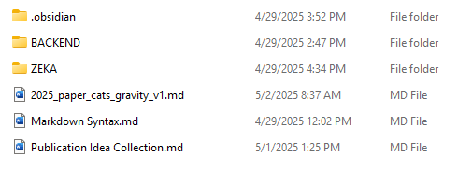
What is Obsidian?
LOGO
.md
=
Created by pixabay, modified by Nele Fuchs. Content License - Pixabay
Notes:
Not sponsored video on YouTube by „A Better Computer“

Slide 13


Synchronization Across Devices
LOGO
Chargeable, easy to set up, no maintenance = Obsidian Sync
Free of charge, complicated setup, maintenance required = e.g. LiveSync
Icons by Microsoft Power Point
Note on Logo Usage: The use of the Obsidian logo in this presentation is considered fair use. Please be aware that the author is not affiliated with nor representatives of Dynalist Inc., the company that develops Obsidian.
Notes:
X

Slide 14

What is Obsidian?
LOGO
Disadvantages of Obsidian
Does not support real-time collaboration.
Data is stored locally, no integrated cloud storage.
Mobile version often lacks functionality.
Customization overload.
Not completely Open Source.
Icons by Microsoft Power Point

Slide 15








Why Obsidian for Research?
LOGO
What is Obsidian?
Storage
Notebook (paper)
Slips of paper
Post-It note
Word document
.txt file
Note function Smartphone
Literature management program
Calendar
E-mail program
“in the back of your mind”…
Input
Output
Research
Icons by Microsoft Power Point
Meme “stressed mouse” by Luke Statzer, text by Nele Fuchs, created with imgflip.com

Slide 16
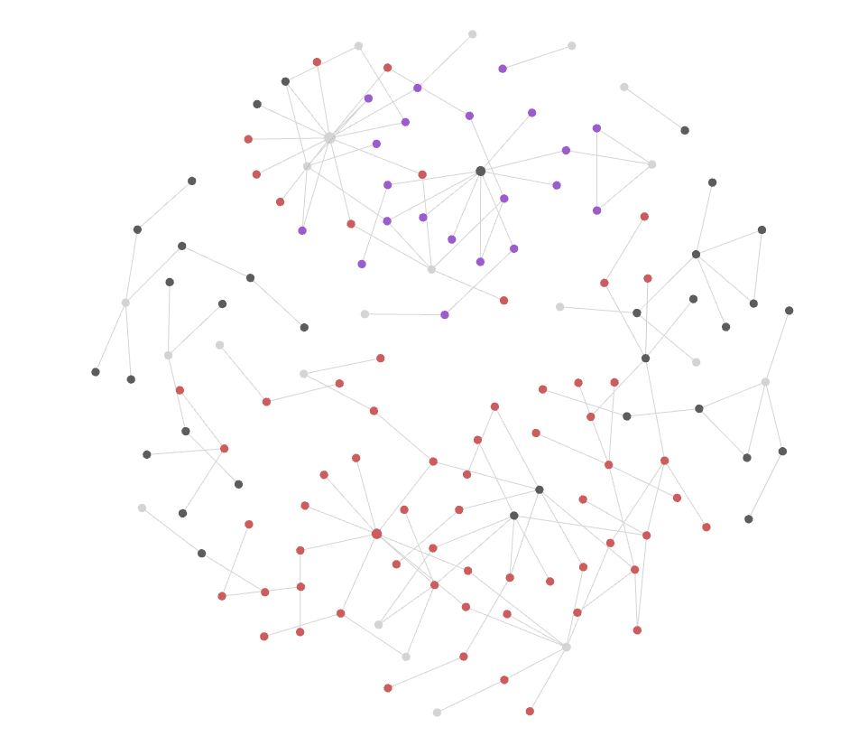

Why Obsidian for Research?
LOGO
First Brain
Second Brain
Graph view by Nele Fuchs CC0
Icon by Microsoft Power Point
Note on Logo Usage: The use of the Obsidian logo in this presentation is considered fair use. Please be aware that the author is not affiliated with nor representatives of Dynalist Inc., the company that develops Obsidian.
Notes:
Obsidian like a second brain. Help us to think and organize our ideas better.
First brain can feel a bit caotic because of the large amout of knowledge.
Addressing Research Challenges
• Managing large volumes of information and knowledge
• Connecting ideas across different sources
• Flexible organization for evolving projects
• Supporting non-linear thinking
• Enhanced literature review process
• Improved idea generation and connection
• Flexible project management
• Support for writing and structuring papers

Slide 17
Why Obsidian for Research?
LOGO
Storage
Input
Output
Research
Icons by Microsoft Power Point
Note on Logo Usage: The use of the Obsidian logo in this presentation is considered fair use. Please be aware that the author is not affiliated with nor representatives of Dynalist Inc., the company that develops Obsidian.

Slide 18
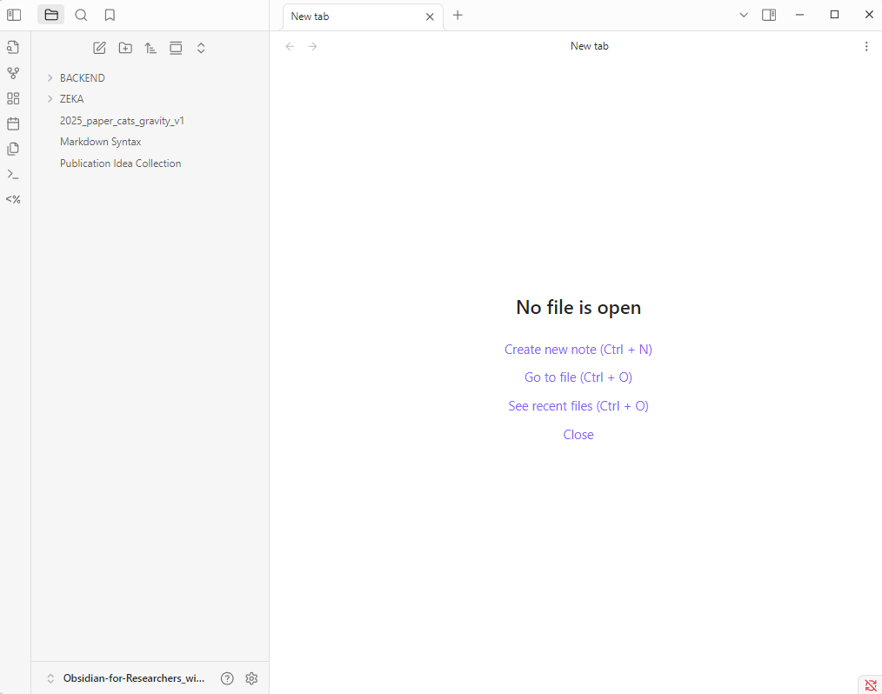
Use Case I - Obsidian for Researchers
LOGO
Screenshot by Nele Fuchs CC0

Slide 19
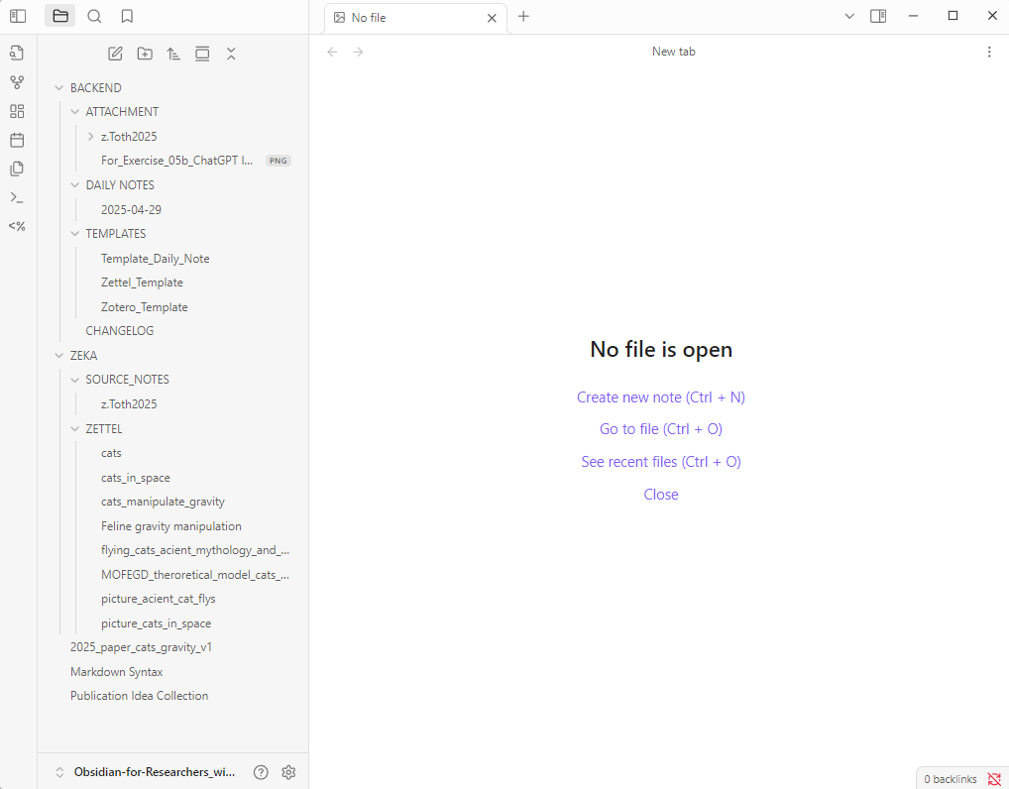
Use Case I - Obsidian for Researchers
LOGO
Screenshot by Nele Fuchs CC0

Slide 20
LOGO
Use Case II - Dusk Obsidian Vault
[Show an example with a Vault that has implemented many features. Participants get an impression of what is possible with Obsidian. E.g. https://github.com/DuskWasHere/dusk-obsidian-vault ]

Slide 21
LOGO
Questions
Icon by Microsoft Power Point

Slide 22


LOGO
Personal Reflection Space
Reflection Task: How Do You Take Notes?
Step 1: Individual Reflection (5 min)
Where, when, and what do you usually note down?
Quickly jot down your thoughts.
Step 2: Discussion (5 min)
Talk with your neighbor:
  For which project could Obsidian support you?
  How might you use it in your workflow?
Icons by Microsoft Power Point
Notes:
Now, let’s move into our 'Personal Reflection Space.' This is a great opportunity for you to take a moment to think about your own workflow. As part of this training, we will engage in a reflective exercise aimed at identifying both effective and ineffective aspects of your current self-organization practices. Here’s what you need to do:
Take a moment to think about your daily tasks and responsibilities as a researcher. Consider how you currently organize your work, manage your time, and keep track of your projects and which tools you are using. Answer the question: What brought you to Obsidian?
Take about two minutes for this exercise. Don’t worry about making it perfect; just write down your thoughts as they come to you. This reflection will help you identify your strengths and areas where tools like Obsidian can support you. After this you have some minutes to tell your neigbour what you wrote down. Ready? Any questions? Let’s get started!

Slide 23

LOGO
Note Taking Systems
“Obsidian for Researcher” set up is inspired by the Bullet Journal method (Carroll 2018).
Main difference: For good reasons, Carroll recommends using a paper notebook:
  Less distraction
  Writing by hand has an effect on our learning process
  Limitation of space
  No copy-paste laziness possible
The main aim is not to increase productivity, but to be mindful with our time and capacities.
Icons by Microsoft Power Point
Ryder Carroll (2018): The Bullet Journal Method: Track the Past, Order the Present, Design the Future. Penguin Publishing Group: New York.
Notes:
Now, let’s move into our 'Personal Reflection Space.' This is a great opportunity for you to take a moment to think about your own workflow. As part of this training, we will engage in a reflective exercise aimed at identifying both effective and ineffective aspects of your current self-organization practices. Here’s what you need to do:
Take a moment to think about your daily tasks and responsibilities as a researcher. Consider how you currently organize your work, manage your time, and keep track of your projects and which tools you are using. Answer the question: What brought you to Obsidian?
Take about two minutes for this exercise. Don’t worry about making it perfect; just write down your thoughts as they come to you. This reflection will help you identify your strengths and areas where tools like Obsidian can support you. After this you have some minutes to tell your neigbour what you wrote down. Ready? Any questions? Let’s get started!

Slide 24
LOGO
Note Taking Systems
Adaptation of the bullet journal method in Obsidian
1. The Daily Log (Carroll 2018, 103)
2. Rapid Logging (Carroll 2018, 77)
3. How to take notes? (Carroll 2018, 93)
Icons by Microsoft Power Point
Ryder Carroll (2018): The Bullet Journal Method: Track the Past, Order the Present, Design the Future. Penguin Publishing Group: New York.
Note on Logo Usage: The use of the Obsidian logo in this presentation is considered fair use. Please be aware that the author is not affiliated with nor representatives of Dynalist Inc., the company that develops Obsidian.
Notes:
Now, let’s move into our 'Personal Reflection Space.' This is a great opportunity for you to take a moment to think about your own workflow. As part of this training, we will engage in a reflective exercise aimed at identifying both effective and ineffective aspects of your current self-organization practices. Here’s what you need to do:
Take a moment to think about your daily tasks and responsibilities as a researcher. Consider how you currently organize your work, manage your time, and keep track of your projects and which tools you are using. Answer the question: What brought you to Obsidian?
Take about two minutes for this exercise. Don’t worry about making it perfect; just write down your thoughts as they come to you. This reflection will help you identify your strengths and areas where tools like Obsidian can support you. After this you have some minutes to tell your neigbour what you wrote down. Ready? Any questions? Let’s get started!

Slide 25

LOGO
Note Taking Systems
Adaptation of the Bullet Journal Method in Obsidian
The Daily Log (Carroll 2018, 103)
  Container for logging tasks and notes.
  Place for:
    daily thoughts
    reflection = learning (92)
    set your agenda for the day (78)
  Not a place for endless to-do lists, but a place to reflect, sort to-dos and (importantly!) sort them out
Aim: to clear the mind.
Screenshot by Nele Fuchs CC0
Ryder Carroll (2018): The Bullet Journal Method: Track the Past, Order the Present, Design the Future. Penguin Publishing Group: New York.
Note on Logo Usage: The use of the Obsidian logo in this presentation is considered fair use. Please be aware that the author is not affiliated with nor representatives of Dynalist Inc., the company that develops Obsidian.
Notes:
Now, let’s move into our 'Personal Reflection Space.' This is a great opportunity for you to take a moment to think about your own workflow. As part of this training, we will engage in a reflective exercise aimed at identifying both effective and ineffective aspects of your current self-organization practices. Here’s what you need to do:
Take a moment to think about your daily tasks and responsibilities as a researcher. Consider how you currently organize your work, manage your time, and keep track of your projects and which tools you are using. Answer the question: What brought you to Obsidian?
Take about two minutes for this exercise. Don’t worry about making it perfect; just write down your thoughts as they come to you. This reflection will help you identify your strengths and areas where tools like Obsidian can support you. After this you have some minutes to tell your neigbour what you wrote down. Ready? Any questions? Let’s get started!

Slide 26
LOGO
Note Taking Systems
Adaptation of the Bullet Journal Method in Obsidian
Rapid Logging (Carroll 2018, 77)
  Write down to-dos and notes briefly but clearly.
Example:
  ❌ Call Keith back about where we want to go for dinner this weekend.
  ✅ Keith: call about restaurant Sat
Not a system that helps you create lists that grow endlessly.
Sort out to-dos regularly.
Just because it could be done doesn't mean it has to be done.
Screenshot by Nele Fuchs CC0
Ryder Carroll (2018): The Bullet Journal Method: Track the Past, Order the Present, Design the Future. Penguin Publishing Group: New York.
Note on Logo Usage: The use of the Obsidian logo in this presentation is considered fair use. Please be aware that the author is not affiliated with nor representatives of Dynalist Inc., the company that develops Obsidian.
Notes:
Now, let’s move into our 'Personal Reflection Space.' This is a great opportunity for you to take a moment to think about your own workflow. As part of this training, we will engage in a reflective exercise aimed at identifying both effective and ineffective aspects of your current self-organization practices. Here’s what you need to do:
Take a moment to think about your daily tasks and responsibilities as a researcher. Consider how you currently organize your work, manage your time, and keep track of your projects and which tools you are using. Answer the question: What brought you to Obsidian?
Take about two minutes for this exercise. Don’t worry about making it perfect; just write down your thoughts as they come to you. This reflection will help you identify your strengths and areas where tools like Obsidian can support you. After this you have some minutes to tell your neigbour what you wrote down. Ready? Any questions? Let’s get started!

Slide 27
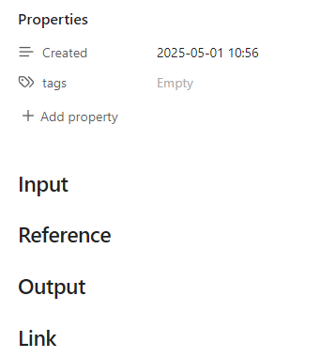
LOGO
Note Taking Systems
Adaptation of the Bullet Journal Method in Obsidian
How to take notes? (Carroll 2018, 93)
  Don't just write down the wording, but the meaning of it.
Example:
"The feline capacity for spatial memory and object permanence rivals that of some primates, suggesting advanced cognitive mapping in domestic cats."
— Dr. Jane Whiskers, Journal of Comparative Cognition, 2022 (source: ChatGPT made it up)
  ❌ Cats are smart and can remember things.
  ✅ Summary: Cats show spatial memory and object permanence comparable to primates (Whiskers, 2022). This suggests they build internal maps of their environment, which may explain their navigation skills in familiar territories.
  Possible implication: Reconsider the cognitive abilities of cats in behavioral studies. Could be relevant for designing enrichment in animal shelters.
Screenshot by Nele Fuchs CC0
Ryder Carroll (2018): The Bullet Journal Method: Track the Past, Order the Present, Design the Future. Penguin Publishing Group: New York.
Note on Logo Usage: The use of the Obsidian logo in this presentation is considered fair use. Please be aware that the author is not affiliated with nor representatives of Dynalist Inc., the company that develops Obsidian.
Notes:
Now, let’s move into our 'Personal Reflection Space.' This is a great opportunity for you to take a moment to think about your own workflow. As part of this training, we will engage in a reflective exercise aimed at identifying both effective and ineffective aspects of your current self-organization practices. Here’s what you need to do:
Take a moment to think about your daily tasks and responsibilities as a researcher. Consider how you currently organize your work, manage your time, and keep track of your projects and which tools you are using. Answer the question: What brought you to Obsidian?
Take about two minutes for this exercise. Don’t worry about making it perfect; just write down your thoughts as they come to you. This reflection will help you identify your strengths and areas where tools like Obsidian can support you. After this you have some minutes to tell your neigbour what you wrote down. Ready? Any questions? Let’s get started!

Slide 28
[15min break]

Slide 29
LOGO
Quick Poll
[insert tool for poll ‘5.1 Poll - activation’, see didactic table]
Notes:
Now, let’s move into our 'Personal Reflection Space.' This is a great opportunity for you to take a moment to think about your own workflow. As part of this training, we will engage in a reflective exercise aimed at identifying both effective and ineffective aspects of your current self-organization practices. Here’s what you need to do:
Take a moment to think about your daily tasks and responsibilities as a researcher. Consider how you currently organize your work, manage your time, and keep track of your projects and which tools you are using. Answer the question: What brought you to Obsidian?
Take about two minutes for this exercise. Don’t worry about making it perfect; just write down your thoughts as they come to you. This reflection will help you identify your strengths and areas where tools like Obsidian can support you. After this you have some minutes to tell your neigbour what you wrote down. Ready? Any questions? Let’s get started!

Slide 30

LOGO
Hands-On Exercise
Learn the Basics of Obsidian
A step-by-step guide that introduces some of the fundamental features of Obsidian.
You’ll learn how to:
Set up your personal Vault
Use templates to streamline your daily workflow
Organize and track tasks efficiently
The resource is available in two formats:
Step-by-step instructions – ideal for beginners who want to build understanding while creating their Vault
A finished example Vault – recommended for advanced users who want to dive in and explore the setup right away
Icon by Microsoft Power Point
Notes:
Alright, let's do a deep dive into Obsidian. You know, the cool thing about Obsidian is that there are literally thousands of ways to set up and organize your vault. It's like a digital playground for your thoughts!
Now, in today's session, we're going to do some hands-on exercises. These aren't just for fun – though I hope you'll enjoy them! We've got two main goals here:
First, we want to dive into some of the more advanced features of Obsidian. There's a lot of power under the hood, and we're going to unpack some of that together.
Second, and this is important, I'm going to show you a workflow that I've found really useful. Now, it might not be perfect for everyone – we all think and work differently, right? But my hope is that you'll see some techniques that you can adapt to fit your own style.
So, are you ready to get your hands dirty with some Obsidian magic? Let's jump in!

Slide 31

LOGO
Hands-On Exercise
[create shortened link]
https://doi.org/10.5281/zenodo.17978344

Slide 32

LOGO
Personal Reflection Space
Think about everything you heard and saw so far and have a look on your notes from the last personal reflection space:
For which project do you want to try using a digital note-taking-app like Obsidian?
Which part of your daily routine should be supported?
What are the parts which already went well in your organization method?
Icon by Microsoft Power Point
Notes:
Now, let’s move into our 'Personal Reflection Space.' This is a great opportunity for you to take a moment to think about your own workflow. As part of this training, we will engage in a reflective exercise aimed at identifying both effective and ineffective aspects of your current self-organization practices. Here’s what you need to do:
Take a moment to think about your daily tasks and responsibilities as a researcher. Consider how you currently organize your work, manage your time, and keep track of your projects and which tools you are using. Answer the question: What brought you to Obsidian?
Take about two minutes for this exercise. Don’t worry about making it perfect; just write down your thoughts as they come to you. This reflection will help you identify your strengths and areas where tools like Obsidian can support you. After this you have some minutes to tell your neigbour what you wrote down. Ready? Any questions? Let’s get started!

Slide 33
LOGO
Questions
Icon by Microsoft Power Point

Slide 34
LOGO
Imprint and Information
The paper “Your Digital Research Assistant: An Open Educational Resource for Teaching the Basics of Obsidian” (Fuchs 2025) contains more detailed information.
The slides can be used and adapted for your own purposes in research and teaching.
University of Bremen
Data Science Center (DSC)
Bibliothekstraße 5
D-28359 Bremen
https://www.dsc-ub.de/index.php
Status: August 2025
The OER was product within the third party funded project ‘Data Nord’ by the BMFTR (Bundesministerium für Forschung, Technologie und Raumfahrt).
This publication is licensed under the Creative Commons License (CC BY 4.0): https://creativecommons.org/licenses/by/4.0/
Some parts, figures and other third-party material, if otherwise identified, and the Obsidian Logo is not included under the above licence.
Please be aware that the author is not affiliated with nor representatives of Dynalist Inc., the company that develops Obsidian.

